Slide 1
AI Agent for Autonomous Carrier Rerouting using LangGraph
Submitted By: Suhana Kumari
Assignment: AI Agent Research & Development

Slide 2
Problem Statement
Problem
Shipments can be delayed due to traffic, weather, or vehicle issues.
Choosing another carrier manually takes time.
Companies need a faster and smarter solution
Goal
Build an AI agent system that:
Detects shipment issues.
Finds alternative carriers.
Selects the best carrier.
Sends the final notification.

Slide 3
Solution
Telemetry Alert
Triage Agent
Route Agent
Decision Agent
Notification
End
Benefits
Faster decisions
Less manual work
Easy to extend

Slide 4
AI Agents
Triage Agent
Checks shipment delay
Finds severity
Route Agent
Retrieves available carrier options
Decision Agent
Chooses best carrier
Notification Agent
Generates the final notification

Slide 5
Technologies Used
Python
LangGraph
LangChain
Groq API
Llama 3.3 70B
Pydantic
dotenv

Slide 6
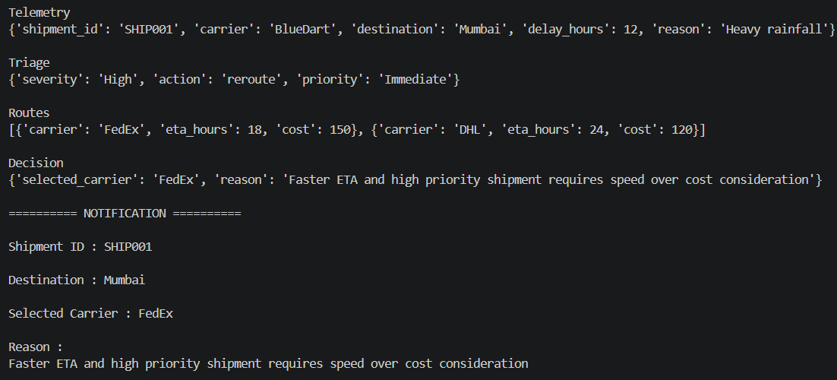
Output
Example output of the AI workflow

Slide 7
Results
Four-node LangGraph workflow implemented.
Conditional routing added.
AI agents shared information using shared state.
Successfully selected the optimal carrierr.
Generated final notification.

Slide 8
Challenges & Model Comparison
Successfully implemented the workflow using Llama 3.3 (Groq).
Designed the project to support multiple LLMs using a common llm_factory.
Attempted to integrate Google Gemini for comparison.
Gemini integration was attempted, but compatibility issues between the integration library and the available Gemini model prevented execution within the project timeline.

Slide 9
Future Work
Complete comparison between Llama 3.3 and Gemini using the existing architecture.
Add live logistics APIs.
Deploy using FastAPI

Slide 10
Conclusion
Built a multi-agent AI workflow using LangGraph.
Automated shipment rerouting.
Used shared state and conditional routing.
The project can easily support additional LLMs in the future.
THANK YOU!

