Slide 1





Personal Finance Chatbot 💰
A sophisticated AI-powered financial assistant that helps users manage their finances, make investment decisions, and plan their savings
Profile Management
Investment Advice
Savings Planning
Credit Score Analysis
Built with Python and Gradio
+

Slide 2






Table of Contents
1.
Introduction
7.
Investment Advice
2.
Market Context
8.
Savings Planning
3.
Project Overview
9.
Credit Score Analysis
4.
Key Features
10.
Technical Architecture
5.
User Profile Management
11.
Competitive Advantages
6.
Financial Data Management
12.
Roadmap & Next Steps
Navigate through our AI-powered financial assistant solution

Slide 3


Introduction
Revolutionizing Personal Finance
Our AI-powered chatbot transforms how users interact with their finances, offering personalized guidance through natural conversation.
User
How much should I save for retirement?
Real-time analysis of financial data and market trends
Smart planning tailored to individual goals and risk profiles
Finance Bot 💰
Based on your age (34) and income ($75K), I recommend saving 15% annually. Let's create a personalized plan...
Actionable insights delivered through intuitive conversations
"Bringing professional financial advice to everyone, regardless of wealth status"
AI-powered conversation
Making complex financial decisions simple through conversation

Slide 4
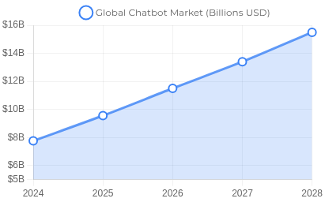


Market Context
Growing Demand for AI Financial Solutions
Chatbot Market Growth 2024-2028
The chatbot market is experiencing explosive growth, with financial applications leading the way in adoption and innovation.
Market Size
Adoption
$15.5B
Expected global chatbot market by 2028
40%
US consumers using chatbots regularly
88% of users engaged with at least one chatbot conversation in 2022
70% of banking and finance chatbot users engage multiple times
AI-powered financial advisors can provide more equitable and accessible services than traditional financial advisors, reaching underserved populations.
23.3% CAGR for AI-driven financial services from 2023-2028
The perfect time to enter the growing market for AI-powered financial assistance
Made with Genspark

Slide 5
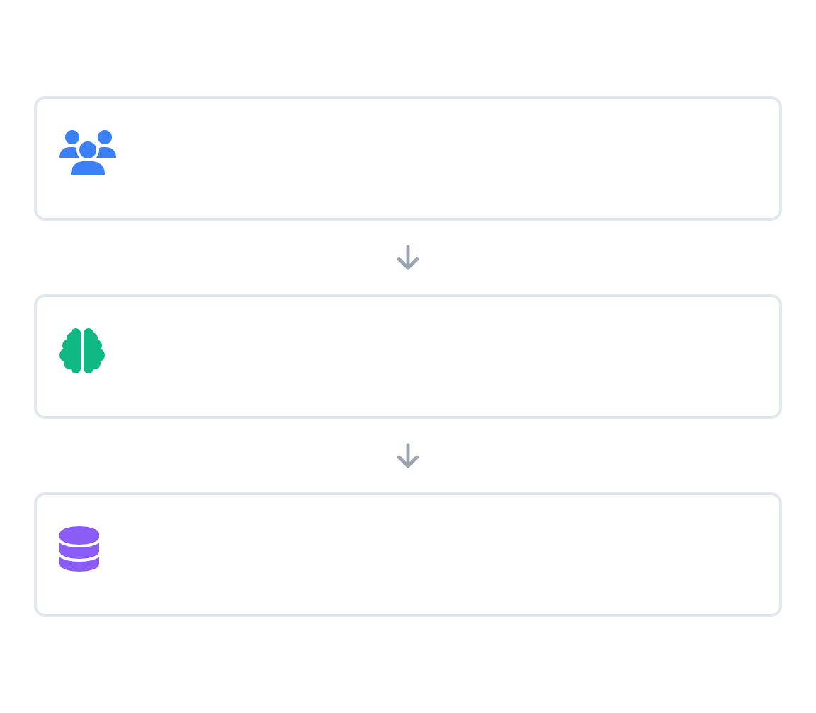



Project Overview
Personal Finance Chatbot
Technical Architecture
A sophisticated AI-powered financial assistant built with Python
and Gradio, designed to help users manage finances, make investment decisions, and plan savings through natural language interaction.
User Interface Layer
Interactive chat interface built with Gradio
Python Core
Gradio UI
AI Analytics
Logic Layer
Core chatbot logic & financial calculations
Local Data Storage
Personalized management tailored to individual user profiles
Investment recommendations based on risk tolerance and goals
Data Layer
Local data storage & API integrations
Real-time market data integration for informed decisions
Intuitive chat interface with natural language processing
Secure, scalable architecture with end-to-end encryption
Core Components:
app.py
Entry Point
chatbot.py
Core Logic
ui.py
Interface
api_handler.py
Integrations
credit_calculator.py
Credit Score
Made with Genspark

Slide 6



Key Features
The Personal Finance Chatbot offers six powerful features designed to transform how users manage their financial lives through intelligent conversation:
Profile Management
Financial Data Management
Investment Advice
Personalized financial profile setup
Personalized portfolio allocation
Income tracking
Risk tolerance assessment
Expense monitoring
Age-based investment strategies
Income and family size considerations
Savings management & bulk data entry
Real-time market data analysis
Savings Planning
Credit Score Analysis
Interactive Chat Interface
Emergency fund calculations
Credit score simulation
Natural language interaction
Goal-based savings recommendations
Personalized improvement tips
Context-aware responses
Financial education & guidance
Retirement & insurance planning
Debt management advice
One comprehensive solution for all your financial management needs
Made with Genspark

Slide 7
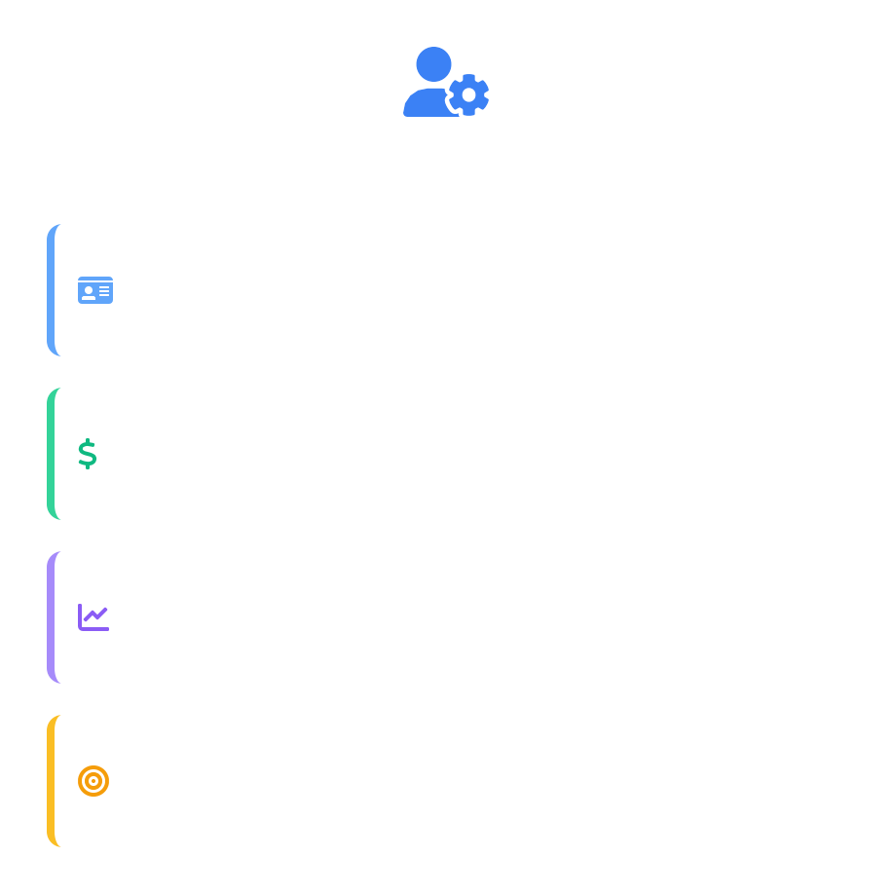

User Profile Management
Creating Personalized Financial Journeys
Our chatbot builds comprehensive user profiles to deliver tailored financial advice that evolves with users' changing needs and circumstances.
Profile Elements
Demographics
Age, location, family size
Personalized Setup - Captures age, location, income, family size, and financial goals
Financial Status
Income, assets, debt load
Risk Tolerance Assessment - Sophisticated questionnaire evaluates comfort with market volatility
Risk Profile
Conservative to aggressive scale
Adaptive Recommendations - Evolving advice based on changing life circumstances and market conditions
Financial Goals
Retirement, education, home
Profiles are securely stored locally and never transmitted to third parties
Personalized financial advice that adapts as your life evolves

Slide 8
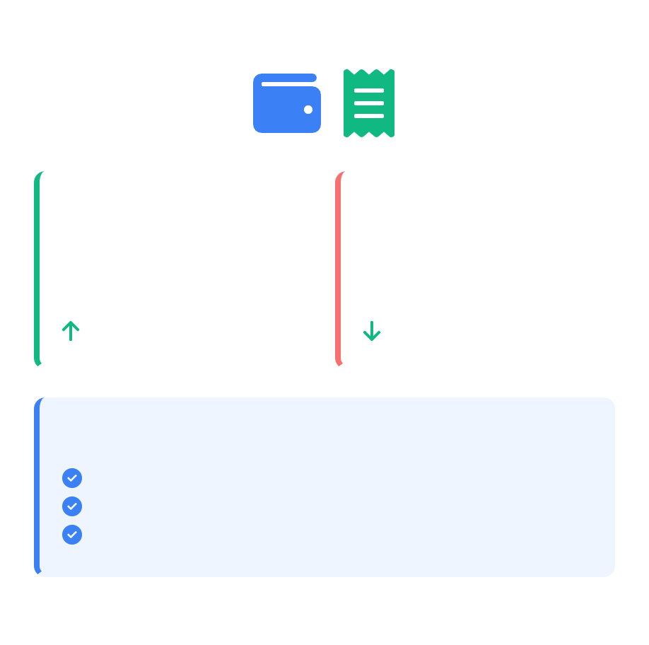
Financial Data Management
Comprehensive Financial Tracking
Track, analyze, and optimize your complete financial picture through our intuitive data management system.
Income
Expenses
Multiple Income Sources - Track salary, investments, side hustles, and more
$4,250 this
month
$2,875 this
month
Expense Monitoring - Categorize and analyze daily/monthly spending patterns
+5% from last month
-3% from last month
Savings Management - Monitor growth and progress toward financial goals
Analysis Insights
Bulk Data Entry - Import transactions from CSV or connect to financial institutions
Largest expense category: Housing (35%) Dining out reduced by 15% this month Savings rate: 17% (Target: 20%)
Smart categorization automatically sorts transactions using AI pattern recognition
Comprehensive analysis brings clarity to your spending and saving habits

Slide 9
Investment Advice & Savings Planning
AI-Driven Financial Insights
Our chatbot leverages advanced algorithms to provide personalized investment and savings recommendations based on user profiles, market trends, and financial goals.
Smart Portfolio Allocation
Conservative Portfolio (Low Risk)
Portfolio Allocation - Age and risk-based investment suggestions
Moderate Portfolio (Medium Risk)
Tax Optimization - Strategic tax-saving investment recommendations
Market Analysis - Real-time data integration for informed decisions
Goal Planning - Custom savings strategies for specific objectives
Aggressive Portfolio (High Risk)
Sample Savings Goal Calculation
The chatbot calculates optimal emergency fund amounts based on income, expenses, and family size.
Home Down Payment: | $60,000
Monthly Contribution: | $850
Interest Rate: | 4.5%
Time to Goal: | 5.2 years
Personalized financial strategies adapted to your changing life circumstances
Made with Genspark

Slide 10
Credit Score Analysis
Simulate & Improve Your Credit Profile
Our chatbot analyzes your financial behaviors and credit profile to provide actionable recommendations that improve your credit score and financial health.
User
Real-time simulations show how financial decisions impact your credit score
How would paying off my credit card affect my score?
Personalized improvement plan with prioritized actionable steps
Debt management strategies customized to your financial situation
Finance Bot 💰
Reducing your credit utilization from 80% to 30% could increase your score by approximately 40 points within 60 days.
A 50-point credit score increase can save thousands on mortgage interest
Poor
Fair
Good
Excellent
Transform your credit health with personalized AI-driven recommendations
Made with Genspark

Slide 11
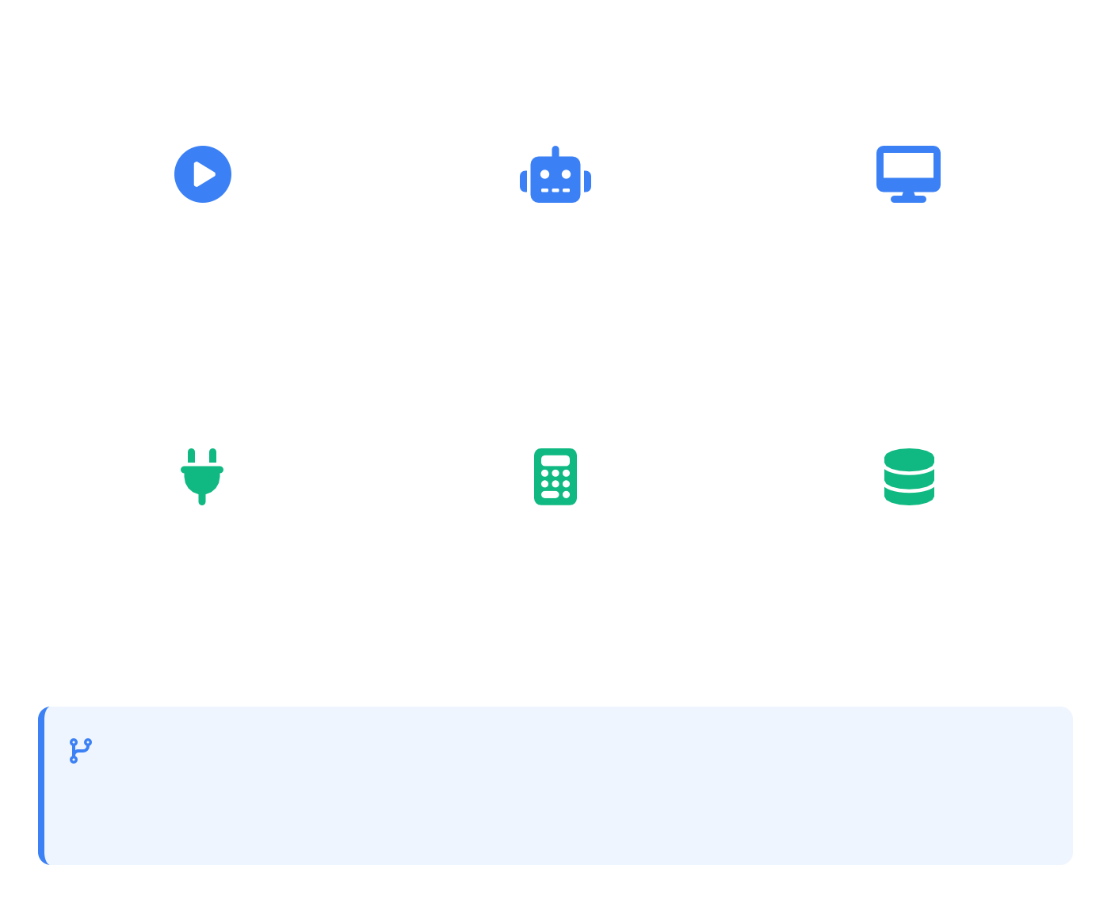

Technical Architecture
Built with Python & Gradio
Component Structure
Our solution leverages modern technologies to deliver a responsive, intelligent financial assistant with clean architecture.
app.py
chatbot.py
ui.py
Python backend for robust financial calculations and AI logic
Main application entry point and initialization logic
Core chatbot logic and financial calculations
Gradio interface components and layouts
Gradio framework for rapid UI development and interactive elements
API integrations for real-time financial data and market analysis
api_handler.py
credit_calculator.py
data_storage.py
External API integrations for financial data
Credit score simulation logic
Secure local data persistence layer
Security Features
Environment-variable-based API key protection
Modular Architecture
Components are designed with separation of concerns, enabling easy maintenance and future extensibility
Secure local data storage of personal information
User authentication and data encryption
Simple deployment: pip install -r requirements.txt then python app.py
Made with Genspark

Slide 12




Competitive Advantages & Roadmap
Our Unique Advantages
Development Roadmap
Real-time Advice
Full Integration
Q4 2025
Cloud integration for seamless multi-device synchronization
Instantaneous financial guidance based on market conditions and user activity, unlike static robo-advisors.
Comprehensive solution combining investment, savings, credit scoring, and budgeting in one conversational interface.
Q1 2026
Advanced analytics dashboard with predictive financial modeling
Privacy-Focused
Adaptive Learning
Local data storage with encrypted APIs for maximum security and user privacy protection.
Continuously improves recommendations based on user interactions and financial outcomes.
Q2 2026
Multi-language support and international market expansion
Market Positioning
Our chatbot fills the gap between expensive human financial advisors and limited automated tools, providing personalized advice at scale with the accessibility of modern conversational AI.
Q3 2026
Banking & investment account integration with major institutions
Building the financial assistant of tomorrow, today
Made with Genspark

