Slide 1
Guardian
Rules G0–G15 and how they work
Locked facts, traceable copy and checked approval
IntentLocked café campaign project
01
Notes:
Guardian protects owner-approved campaign truth. G0 is a teaching label for the prerequisite gate, not a persisted rule ID. The actual policy enumerates G01–G15.
Sources inspected 10 October 2026. Repository: D:/HR2-AI-FB38B877-main
D:/HR2-AI-FB38B877-main/backend/guardian/policy.py
D:/HR2-AI-FB38B877-main/backend/guardian/rules.py

Slide 2
Guardian in the campaign workflow
01
Owner locks facts
Canonical values and reviewed language forms
02
AI drafts a template
Creative language uses approved slot grammar
03
Code fills and checks
Parser, provenance and G01–G15 report
04
Reader and owner review
Bound audit evidence and current artifact hashes
05
Authorized export
Server repeats checks before releasing exact bytes
02
Notes:
The generation prompt receives slot grammar and nonfactual context. Code renders approved forms and derives slots_used. Deterministic checks run before semantic audit. Repairs are bounded and failures remain visible. Approval/export recheck persisted evidence and exact bytes.
Sources inspected 10 October 2026. Repository: D:/HR2-AI-FB38B877-main
D:/HR2-AI-FB38B877-main/backend/generation_service.py
D:/HR2-AI-FB38B877-main/backend/guardian/slots.py
D:/HR2-AI-FB38B877-main/backend/guardian/rules.py
D:/HR2-AI-FB38B877-main/backend/approval_service.py

Slide 3
G0 Prerequisite gate
The server loads the current locked campaign
The request must match its campaign ID and revision. The selected language and channel must belong to that campaign.
Direct calls face the same checks
Client flags and constructed Python objects cannot supply their own approval, facts or policy overrides.
Draft facts or a stale revision: request rejected
G0 is a presentation label. Stored reports start at G01.
03
Notes:
G0 is explanatory shorthand only. rules.py first revalidates both request and authoritative campaign, verifies campaign ID/revision, requires locked status, and checks language/channel selections. Rejected inputs receive a domain error before a rule report.
Sources inspected 10 October 2026. Repository: D:/HR2-AI-FB38B877-main
D:/HR2-AI-FB38B877-main/backend/guardian/rules.py
D:/HR2-AI-FB38B877-main/backend/guardian/report.py

Slide 4
G01 Numbers bind to amount, unit and role
A number needs the right fact provenance
A date containing 25 cannot authorize a 25% discount. A matching 20% literal still fails outside an approved OFFER slot.
{{OFFER}}: PASS fragment 20% off / 25% off: BLOCKED
Different spellings still need the same authority
25% ೨೫% ಇಪ್ಪತ್ತೈದು ಶೇಕಡಾ
ippattaidu shekada २५% ٢٥% half price 1/2 off
04
Notes:
The hypothetical test fixture locks 20% off. Exact numeric agreement alone does not authorize a literal outside a slot. G01 validates approved OFFER surfaces against canonical amount/unit/discount role and catches numeric claims outside provenance. Date numbers do not grant discount authority. Kannada/Kanglish lexicons remain conservative and require native validation.
Sources inspected 10 October 2026. Repository: D:/HR2-AI-FB38B877-main
D:/HR2-AI-FB38B877-main/backend/guardian/claims.py
D:/HR2-AI-FB38B877-main/backend/guardian/rules.py
D:/HR2-AI-FB38B877-main/backend/tests/test_guardian.py

Slide 5
G02 and G03 Dates and money
G02 Dates and weekdays
Dates, days and relative timing must come from approved DATES or DAYS provenance.
Monday / ಸೋಮವಾರ / Somavara / tomorrow
G03 Currency and amounts
Currency claims need their own supported amount and fact role. A percentage offer does not authorize a cash discount.
Flat Rs 50 off or $20 off: BLOCK when unsupported
05
Notes:
G02 covers weekdays, months, dates and relative date expressions. DAYS and DATES must use their own slots. G03 currency claims bind amount and fact role. Samples are adversarial examples, not offers approved for a real café.
Sources inspected 10 October 2026. Repository: D:/HR2-AI-FB38B877-main
D:/HR2-AI-FB38B877-main/backend/guardian/rules.py
D:/HR2-AI-FB38B877-main/backend/guardian/lexicon_en.py
D:/HR2-AI-FB38B877-main/backend/guardian/lexicon_kn.py
D:/HR2-AI-FB38B877-main/backend/guardian/claims.py

Slide 6
G04 and G05 Timing and completeness
G04 Time windows
Time claims use approved TIME_WINDOW provenance. An unspecified window cannot become “9 PM” or “all day”.
G05 Complete channel assets
Final assets visibly include café, location, offer, product, dates, days and every specified condition. Required channel fields must be present.
A short valid fragment skips completeness. It cannot approve an asset.
06
Notes:
G04 flags unauthorized times and all-day/till/after expressions. G05 applies only in asset mode. Visible headline/body/CTA must include CAFE LOCATION OFFER PRODUCT DATES DAYS and every specified condition. Channel-required fields also must be nonempty. Hashtags/alt_text cannot discharge visible disclosure.
Sources inspected 10 October 2026. Repository: D:/HR2-AI-FB38B877-main
D:/HR2-AI-FB38B877-main/backend/guardian/policy.py
D:/HR2-AI-FB38B877-main/backend/guardian/rules.py

Slide 7
G06 Approved forms and exact provenance
Template
{{OFFER}}
Approved display in this hypothetical fixture
20% off
Stored evidence
OFFER / version 1 / en / nom / owner-1 / span [0, 7)
Tampered display or an unapproved affix blocks G06.
07
Notes:
Parser accepts {{KEY}} or {{KEY|nom/dat/gen/loc}}. Lookup requires locked canonical data plus approved_at/approval_id and approved surface forms. Renderer chooses the first approved form deterministically. Provenance uses half-open Unicode code-point offsets. Actual fixture output for {{OFFER}}: {"fields":{"headline":"","body":"20% off","cta":"","alt_text":""},"spans":[{"field":"body","start":0,"end":7,"template_start":0,"template_end":9,"key":"OFFER","version":1,"language":"en","case":"nom","approved_form":"20% off","approval_id":"owner-1"}],"slots_used":["OFFER"]}
Sources inspected 10 October 2026. Repository: D:/HR2-AI-FB38B877-main
D:/HR2-AI-FB38B877-main/backend/guardian/slots.py
D:/HR2-AI-FB38B877-main/backend/guardian/rules.py
D:/HR2-AI-FB38B877-main/backend/tests/test_guardian.py

Slide 8
G07 and G08 Facts and promises
G07 Factual literals outside slots
The template must express facts through authoritative slots. Hidden hashtags, CTA and alt text also receive checks.
20% off outside {{OFFER}}: G01 + G07
G08 Unsupported claims and hostile wrappers
Free cake, best coffee, altered products or locations, and instructions to ignore rules cannot create new approved promises.
not {{OFFER}}: G07 + G08
08
Notes:
G07 rejects fact-like literals in prefill fields even if equal to approved values. G08 detects known unsupported promises/superlatives, product/location constructions, prompt injection, incompatible slot connectors and hostile negation/wrappers. Broad novel semantics need G14. Tested substring boundaries avoid confusing coffee/carefree with free.
Sources inspected 10 October 2026. Repository: D:/HR2-AI-FB38B877-main
D:/HR2-AI-FB38B877-main/backend/guardian/rules.py
D:/HR2-AI-FB38B877-main/backend/guardian/lexicon_en.py
D:/HR2-AI-FB38B877-main/backend/guardian/lexicon_kn.py
D:/HR2-AI-FB38B877-main/backend/tests/test_guardian.py

Slide 9
G09 and G10 Conditions and brand
G09 Every condition needs authority
“No ID needed” invents an ID policy. Approved “students only” may appear inside ELIGIBILITY after form approval.
Unspecified does not mean unrestricted.
G10 Required and forbidden brand wording
Rendered copy respects must_not_say. Complete assets include required brand wording in visible copy.
Brand rules cannot waive factual contradictions.
09
Notes:
G09 checks restriction/condition phrases outside their approved condition slots. Approved students only inside ELIGIBILITY is legitimate, while a bare literal creates an unauthorized restriction. G10 applies brand must_not_say to rendered text and must_say to visible asset text. Brand wording cannot override factual rules.
Sources inspected 10 October 2026. Repository: D:/HR2-AI-FB38B877-main
D:/HR2-AI-FB38B877-main/backend/guardian/rules.py
D:/HR2-AI-FB38B877-main/backend/guardian/policy.py
D:/HR2-AI-FB38B877-main/backend/tests/test_guardian.py

Slide 10
G11 and G12 Script and readable output
G11 Language and script fit
Kannada expects mostly Kannada letters. English and Kanglish expect Latin letters. A warning cannot replace native reading.
G12 Length and actual poster bounds
WhatsApp 1,500 Instagram 2,200
Facebook 3,000 Poster 600 code points
Social length: WARN. Poster length or clipped text: BLOCK.
Poster pixel checks remain incomplete until measured.
10
Notes:
G11 is a WARN based on script heuristic: Kannada letter share at least one half; en/kn-Latn letters Latin. This is not semantic or native validation. G12 social overlength warns, poster overlength blocks. Poster pixel measurement begins incomplete and renderer/approval only completes it from persisted validated canvas bounds. Product limits sum all supplied fields and are not social API maxima.
Sources inspected 10 October 2026. Repository: D:/HR2-AI-FB38B877-main
D:/HR2-AI-FB38B877-main/backend/guardian/rules.py
D:/HR2-AI-FB38B877-main/backend/guardian/policy.py
D:/HR2-AI-FB38B877-main/backend/art_service.py
D:/HR2-AI-FB38B877-main/backend/approval_service.py
D:/HR2-AI-FB38B877-main/docs/KANNADA_NATIVE_REVIEW.md

Slide 11
G13 Template syntax and placeholders
Accepted grammar
{{KEY}} {{KEY|nom}} {{KEY|dat}}
{{KEY|gen}} {{KEY|loc}}
Malformed or unresolved
{{OFFER {{UNKNOWN}} {{PRODUCT|abl}}
[offer] XX% <N>%
Hashtags and CTA receive the same checks as the body.
11
Notes:
The parser scans delimiters, validates key and case and bounds token count. Normalized unresolved delimiters, square bracket placeholders and percent placeholders are rejected too. It scans all customer-facing fields. Fullwidth delimiters cannot bypass the boundary.
Sources inspected 10 October 2026. Repository: D:/HR2-AI-FB38B877-main
D:/HR2-AI-FB38B877-main/backend/guardian/slots.py
D:/HR2-AI-FB38B877-main/backend/guardian/rules.py
D:/HR2-AI-FB38B877-main/backend/tests/test_guardian.py

Slide 12
G14 Blinded customer expectation audit
The reader sees final customer-facing text
R7 extracts what a customer would believe, with exact quoted evidence. It does not receive the locked facts or scores.
Code compares the extraction with locked truth
Factual mismatches block. Other promises require review. Persisted evidence must bind current content and dependencies.
Absent reader result: INCOMPLETE. No approval.
An AI semantic result cannot clear a deterministic block.
12
Notes:
Current B5 code implements the R7 reader and code comparison. Old B2 documents describe it as pending implementation and are historical. Base diagnostic assets still start with G14 incomplete. R7 sees final rendered fields/language/channel and exact span candidates, never locked facts or scores. It covers twelve keys and quotes exact evidence. Code compares canonical expectations to facts/provenance. Other promises warn and require review. Missing/malformed/unavailable/stale evidence cannot pass. No authenticated G14 call or native signoff is performed by building this deck.
Sources inspected 10 October 2026. Repository: D:/HR2-AI-FB38B877-main
D:/HR2-AI-FB38B877-main/backend/semantic_audit.py
D:/HR2-AI-FB38B877-main/backend/optimization_service.py
D:/HR2-AI-FB38B877-main/backend/approval_service.py
D:/HR2-AI-FB38B877-main/docs/DELIVERY_BOUNDARY.md

Slide 13
G15 Target audience and eligibility
Student-only offer + families
Eligibility conflict. Targeting cannot widen the offer.
Open-to-all offer + families
Compatible targeting. Locked offer values stay the same.
Unknown or custom eligibility needs owner clarification.
13
Notes:
G15 checks both campaign audiences and requested audience. Student-restricted offers allow only recognized student labels. Unknown eligibility plus targeting blocks; custom eligibility needs resolution. Open-to-all permits audience changes without inventing a new discount or restriction. The exact current fact-change service requires proposal/confirmation/reviewed forms/publication.
Sources inspected 10 October 2026. Repository: D:/HR2-AI-FB38B877-main
D:/HR2-AI-FB38B877-main/backend/guardian/rules.py
D:/HR2-AI-FB38B877-main/backend/audience_policy.py
D:/HR2-AI-FB38B877-main/backend/approval_service.py
D:/HR2-AI-FB38B877-main/docs/DELIVERY_BOUNDARY.md

Slide 14
Shadow normalization preserves displayed text
Original text contains an invisible separator
೨​೫% ರಿಯಾಯಿತಿ
The checker reads 25% in normalized shadow text
Original finding range: [0, 4) Unicode code points
Normalization handles decimal digits, case, compatibility forms
and invisible controls. The displayed Kannada stays unchanged.
14
Notes:
Actual normalization example: {"original":"೨​೫% ರಿಯಾಯಿತಿ","shadow":"25% ರಿಯಾಯಿತಿ","first_claim_original_span":[0,4]}. Each normalized character maps back to an original base/mark cluster. Offset ranges are Python code points, not UTF-8 bytes or JavaScript UTF-16 units. UI highlights use Array.from(text).slice. The original display is never reconstructed from normalized shadow text.
Sources inspected 10 October 2026. Repository: D:/HR2-AI-FB38B877-main
D:/HR2-AI-FB38B877-main/backend/guardian/normalize.py
D:/HR2-AI-FB38B877-main/backend/guardian/rules.py
D:/HR2-AI-FB38B877-main/backend/tests/test_guardian.py

Slide 15
Examples checked by the actual Guardian code
{{OFFER}}
PASS
20% off
BLOCKED
G01, G07
not {{OFFER}}
BLOCKED
G07, G08
no ID needed
BLOCKED
G07, G09
Complete asset, no reader
INCOMPLETE
G14
Hypothetical fixture: 20% off. These are diagnostic results.
15
Notes:
Examples executed locally 10 October 2026 using the explicitly hypothetical locked 20% fixture. No AI provider calls. Full results stored privately during deck build. All cited outcomes derive from the code, not hand-labeled judgments. Complete WhatsApp asset has required slots and Visit CTA, but no persisted reader so missing G14.
Sources inspected 10 October 2026. Repository: D:/HR2-AI-FB38B877-main
D:/HR2-AI-FB38B877-main/backend/tests/test_guardian.py
D:/HR2-AI-FB38B877-main/backend/guardian/rules.py

Slide 16
Guardian reports and status
PASS
Applicable diagnostic checks completed without a block
BLOCKED
A BLOCK-severity check failed, even if another check is missing
INCOMPLETE
A mandatory check has no completed result
Reports include rule findings, original spans, versions and hashes.
Missing checks keep integrity null. A report cannot grant approval.
16
Notes:
Current schema guardian-report-2.1 and guardian-policy-2.1. Each G01–G15 result has applicability, completion, nullable pass state, severity and exact findings. BLOCKED takes precedence over INCOMPLETE. Missing required checks produce null integrity. Standalone diagnostics keep approval_ready false and native_review PENDING. The B6 approval record is separate from the diagnostic report.
Sources inspected 10 October 2026. Repository: D:/HR2-AI-FB38B877-main
D:/HR2-AI-FB38B877-main/backend/guardian/report.py
D:/HR2-AI-FB38B877-main/backend/guardian/policy.py

Slide 17
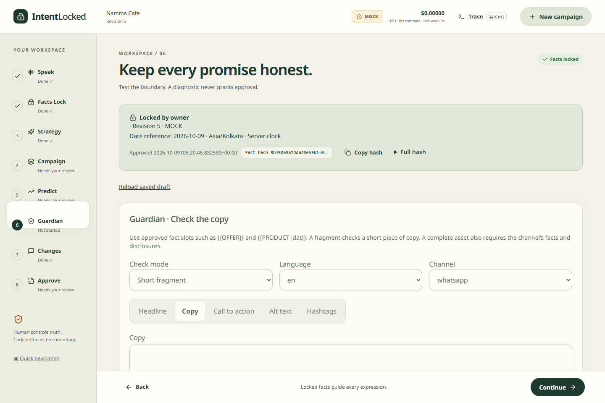
Guardian in the project interface
Saved MOCK
browser evidence
Select the mode,
language and channel.
Check the copy.
Review exact findings.
A diagnostic report never grants approval.
17
Notes:
Existing saved browser screenshot from the repository. It visibly shows MOCK and a locked sample campaign, not a new live production run. The UI selects fragment/asset, language and channel. Individual supplied fields receive checks.
Sources inspected 10 October 2026. Repository: D:/HR2-AI-FB38B877-main
D:/HR2-AI-FB38B877-main/docs/evidence/redesign-stage-guardian-1440.png
D:/HR2-AI-FB38B877-main/frontend/components/GuardianPanel.tsx

Slide 18
Approval and export recheck current evidence
Current item
Stored content, dependency versions and source payload match
Complete audit
No blocking result and no missing mandatory check
Owner review
Exact preview hashes, warning acknowledgments, native review
Exact export
Artifact bytes, fonts, layout and approval still match
18
Notes:
Standalone CheckRequest reports have approval_ready false. B6 uses server-owned persisted delivery items, not a client report. It repeats source/dependency/byte hashes, recomputes Guardian, binds persisted reader, requires all mandatory checks, warning acknowledgment and exact observed preview hashes. Non-English items require owner native-review confirmation. Export verifies readiness/approval and exact bytes again. No actual human attestation or live release occurs in this deck.
Sources inspected 10 October 2026. Repository: D:/HR2-AI-FB38B877-main
D:/HR2-AI-FB38B877-main/backend/approval_service.py
D:/HR2-AI-FB38B877-main/backend/ledger.py
D:/HR2-AI-FB38B877-main/docs/DELIVERY_BOUNDARY.md

Slide 19
Current limits and release status
Implemented and testable
Token parsing, approved rendering, span mapping, deterministic rules, semantic comparison and persisted approval/export checks.
Pending evidence stays visible
Native Kannada review and the current asset’s required live/semantic evidence must finish before claiming a release gate passes.
Mock examples demonstrate behavior. They do not prove live or human approval.
19
Notes:
The slideshow explains implemented mechanics but does not certify a deployment. Recent full backend 597 and website browser two test outcomes are broader than Guardian only, so no invented Guardian-only count appears. B5/B6 mock flows exist, live providers vary in availability and text-only models cannot authorize image vision. Missing G14 remains incomplete. Real native Kannada signoff remains pending.
Sources inspected 10 October 2026. Repository: D:/HR2-AI-FB38B877-main
D:/HR2-AI-FB38B877-main/docs/KANNADA_NATIVE_REVIEW.md
D:/HR2-AI-FB38B877-main/docs/SECURITY_AND_RELEASE.md
D:/HR2-AI-FB38B877-main/docs/WEBSITE_OPENROUTER.md
D:/HR2-AI-FB38B877-main/backend/guardian/report.py

