Slide 1






DATA GOVERANCE AND SECURITY

Slide 2
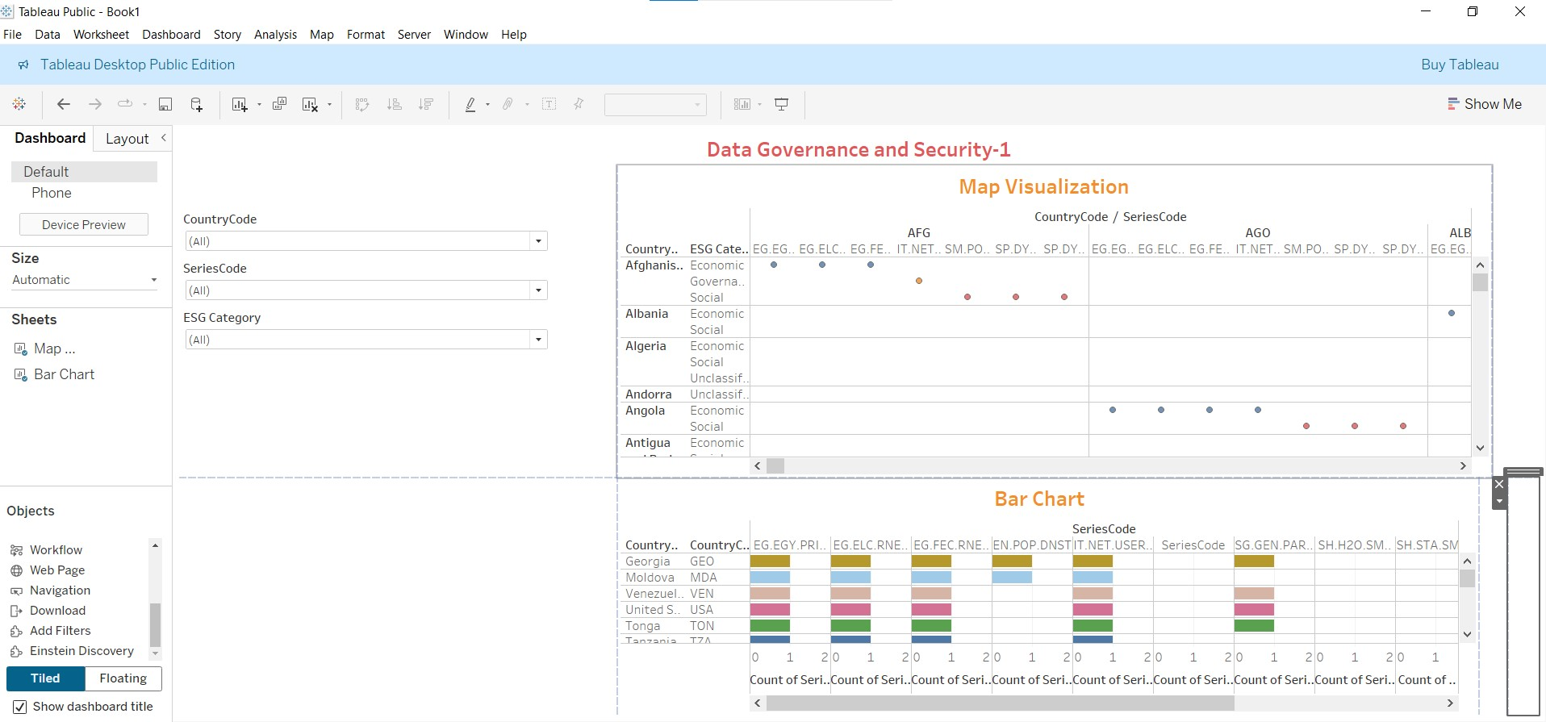
Task:Create an Interactive Dashboard for ESG Data by Country

Slide 3
1. Dashboard Overview Insight
The dashboard focuses on Data Governance and Security indicators.
Data is analysed across:
Countries
ESG Categories (Economic, Social, Governance)
Series Codes (World Bank–style indicators like energy, internet, population, sanitation, etc.)
Two main visual components:
Map Visualization (top)
Bar Chart (bottom)
🎛 Filters Used
CountryCode
SeriesCode
ESG Category

Slide 4
2. Filter-Based Insights
👉 Insight
Users can dynamically drill down to specific countries, indicators, or ESG dimensions.
This enables comparative analysis between countries or ESG pillars.

Slide 5
3. Map Visualization Insights
🌍 What the Map Shows:
Countries (AFG, AGO, ALB, etc.) plotted against multiple Series Codes
Color-coded points represent ESG Categories
📌 Key Insights:
Some countries (e.g., Afghanistan, Angola) show data presence across multiple ESG indicators, while others have sparse or missing values.
Economic indicators appear more frequently populated than Social or Governance ones.
Governance-related indicators are less consistently available, highlighting data gaps.
👉 Interpretation:
This suggests uneven data governance maturity across countries.
Countries with fewer plotted points may have limited reporting, weaker governance frameworks, or missing data.

Slide 6
4. Bar Chart Insights
📊 What the Bar Chart Shows:
Count of Series Codes by country
Comparison across different ESG-related indicators
🔍 Key Insights:
Countries like USA, Georgia, Moldova show higher indicator coverage.
Some countries consistently appear across multiple indicators → stronger data availability & reporting
Others show very low counts → data accessibility or governance challenges
👉 Interpretation:
Higher bar counts imply:
Better data infrastructure
Stronger governance and transparency
Lower counts may signal:
Poor data collection
Inconsistent ESG reporting

Slide 7
5. ESG-Specific Insights
Economic ESG indicators dominate the dataset
Social indicators (water, sanitation, population access) are moderately available
Governance indicators are least represented
👉 Insight:
Globally, economic data is prioritized, while governance metrics lag behind
This highlights a risk area for ESG compliance and policy-making

Slide 8
6. Overall Business / Policy Insight
✔ Helps identify:
Countries with strong vs weak data governance
ESG dimensions with data gaps
Priority areas for policy intervention or investment
✔ Useful for:
ESG risk assessment
Sustainability reporting
Data governance strategy
International benchmarking

Slide 9
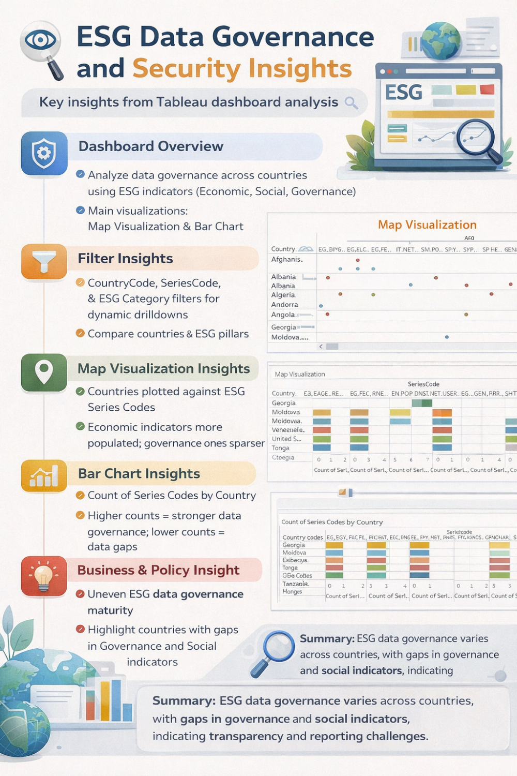
7. One-Line Summary (Very Useful)
“The dashboard reveals uneven ESG data governance across countries, with strong economic data availability but significant gaps in governance and social indicators, highlighting transparency and reporting challenges.”

Slide 11
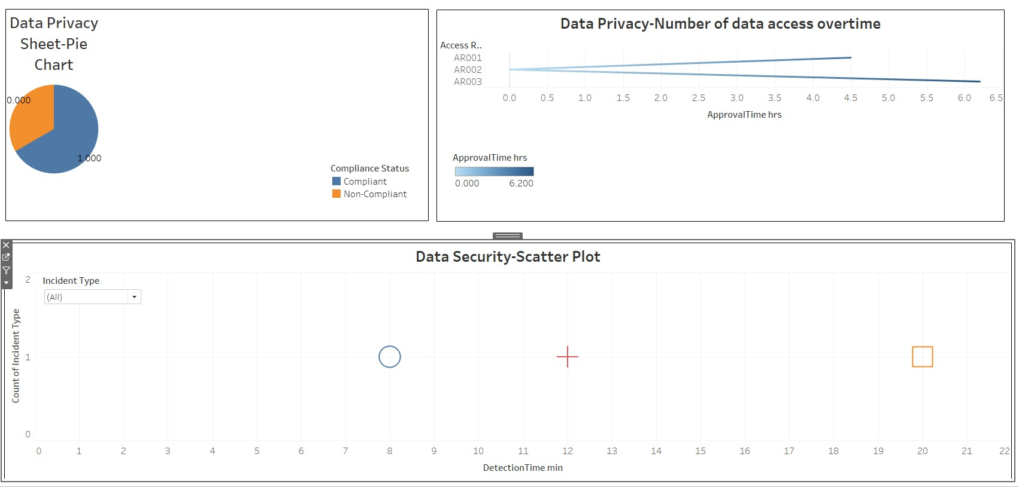
DATA PRIVACY AND SECURITY SHEET

Slide 12
INSIGHT FROM DATA PRIVACY
🔐 Data Privacy (Pie Chart)
Majority of access requests are compliant, indicating strong adherence to data privacy policies.
A small portion is non-compliant, highlighting areas where policy enforcement or user awareness can improve.
⏱️ Data Privacy – Access Over Time
Approval time ranges up to ~6.2 hours.
Some access requests take longer to approve, which may delay business operations.
Indicates a need to optimize approval workflows while maintaining privacy controls.

Slide 13
INSIGHT FROM DATA SECURITY SHEET
🛡️ Data Security – Incident Scatter Plot
Very low number of security incidents overall (mostly single occurrences).
Detection times vary (≈8 to 20 minutes).
Faster detection exists, but some incidents take longer to identify, suggesting scope to improve monitoring and alerting systems.
✅ Overall Insight
👉 Data privacy compliance is strong and security incidents are minimal, but reducing approval delays and improving incident detection speed will further strengthen governance and operational efficiency.
I

Slide 14
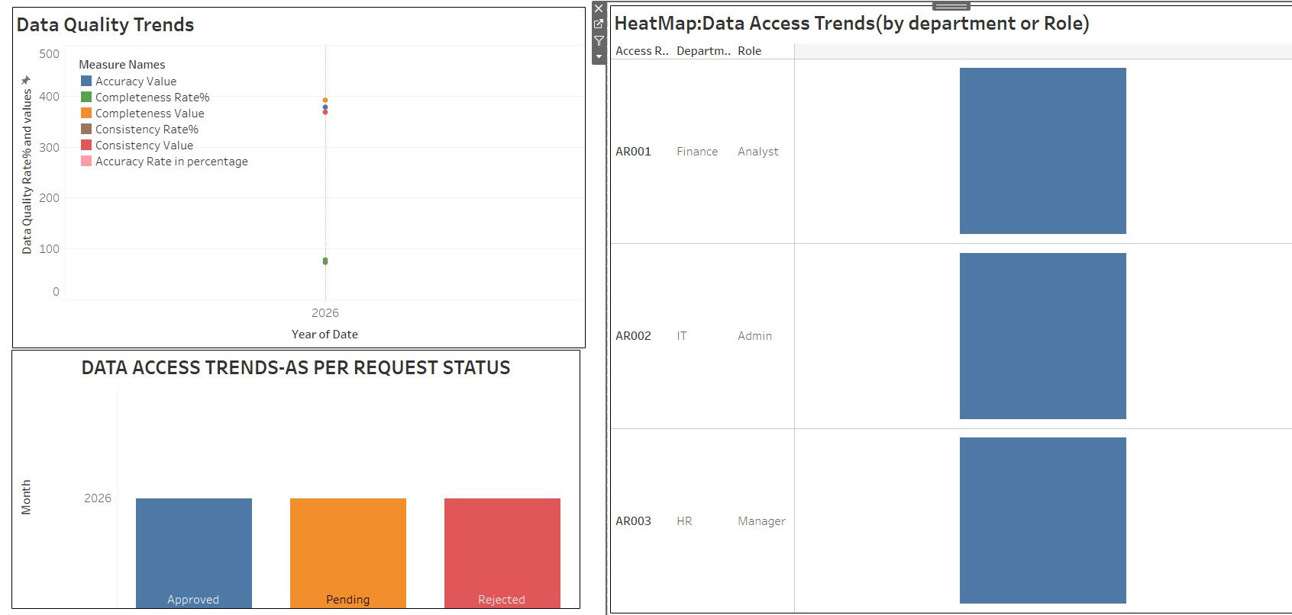
Data Quality And Access Sheet

Slide 15
Data Quality And Access Sheet Trends
**1 Data Quality Trends (2026)**
* **Accuracy, Completeness, and Consistency** are all relatively high, indicating **overall good data quality**.
* **Completeness Rate (~70–75%)** is lower than accuracy and consistency → **data gaps still exist**.
* Accuracy and consistency values are strong, suggesting **reliable and standardized data**.
**2 Data Access Trends (Request Status)**
* **Approved, Pending, and Rejected requests are almost evenly distributed**.
* This indicates a **balanced access control process**, but also scope to **reduce pending requests** for faster access.
**3️⃣ Data Access Heatmap (By Department & Role)**

Slide 16
Data Quality and Access Insights
* **HR Managers** and **IT Admins** show **higher access activity** compared to Finance Analysts.
* Indicates **role-based access concentration**, especially in **administrative and managerial roles**.
* Finance access appears more controlled/restricted.
**Overall Insight**
👉 Data quality is strong, access governance is structured, but **improving data completeness and reducing pending access requests** can further enhance efficiency.

Slide 17
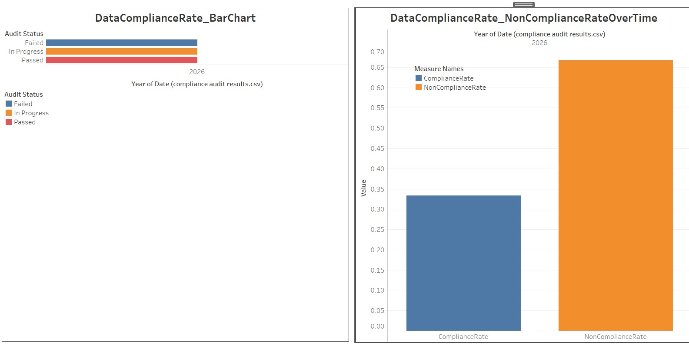
Data Compliance Sheet

Slide 18
Data Compliance Insights
📊 Audit Status Overview (2026)
Passed, In-Progress, and Failed audits are almost evenly distributed.
Indicates that while some controls are effective, a significant portion still needs remediation or follow-up.
High “In Progress” count suggests ongoing compliance efforts rather than completed resolution.
⚠️ Compliance vs Non-Compliance Rate
Non-Compliance Rate (~67%) is significantly higher than the Compliance Rate (~33%).
This highlights elevated compliance risk and potential exposure to regulatory or audit issues.
Suggests policies are defined but not consistently implemented.
🔎 Key Takeaway
👉 Compliance maturity is still developing—organizations should prioritize closing failed audits, accelerating in-progress audits, and strengthening control enforcement to improve overall compliance rates.

Slide 19
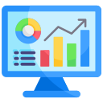

DATA GOVERANCE AND SECURITY
You can see this Analysis using this link
https://public.tableau.com/app/profile/jaya.suhane/viz/Dataqualitytreands/AnalysisresultsofDataSecurityandGoverenanceDataSet?publish=yes
Ms. Jaya Suhane
suhane79jaya@gmail.com

