Slide 1
CS133-Project Neural network implementation
Group Member:
Su Hang
Ji Yangbiao
Qiao Wenhui

Slide 2
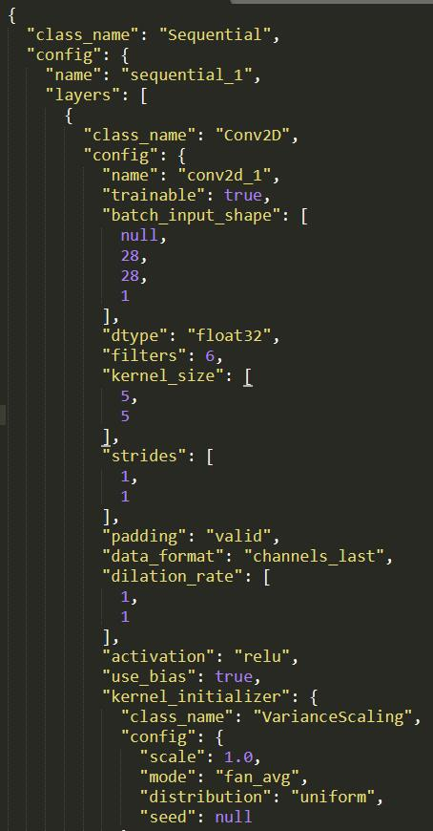
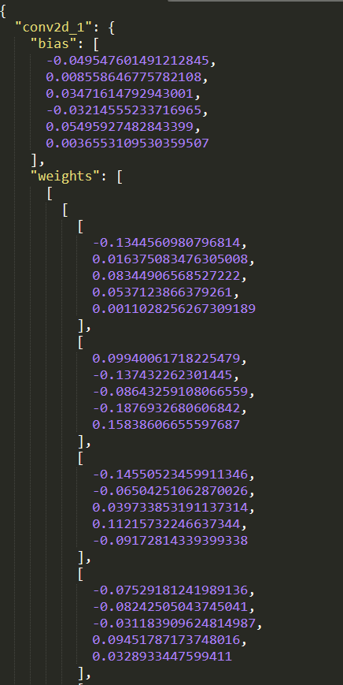
Load the pre-trained definition file
Two json file as the input.
Model.json
Weight.json

Slide 3
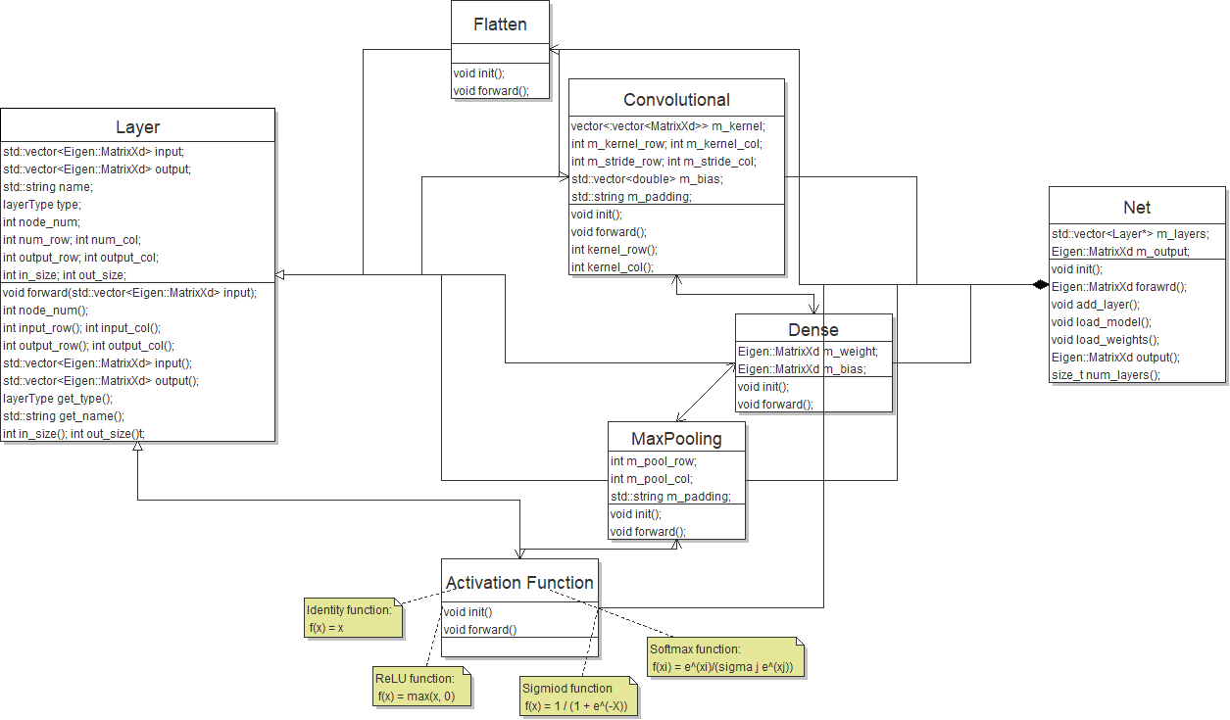
Class diagram

Slide 4
Abstract Class: Layer base
Inherited by other layer
Type of layers:
enum layerType {
Conv, Pooling, Dense, Flatten,
Identity, ReLU, Sigmoid, Softmax
};
Attribute:
Node_num in_size out_size (Include rows and columns)
Std::tring name; layerType type.

Slide 5
Child Class of Layer
Convolutional layer
Dense layer
Flatten layer
Max pooling layer

Slide 6

Activation Function
Work as an independent layer
Four functions implemented
Identity
$f\left(x\right)=x$
Softmax
$f\left(x_{i}\right)= \frac{e^{x_{i}^{}}}{\sum_{j=0}^{j=n}{e^{x_{j}}}}$
Sigmoid
$f\left(x\right)= \frac{1}{1+ e^{−x}}$
ReLU
$f\left(x\right)=max⁡(0, x)$

