Slide 1
CAPSTONE PROJECT — LOGISTICS · ML · OPTIMIZATION
shortest path
Data-Driven
Last-Mile Routing
actual driver path
A hybrid machine-learning + optimization system that plans delivery routes the way real drivers actually drive — not just the shortest path on paper.
last stop
2021 Amazon Last-Mile Routing Research Challenge
depot
Google OR-Tools
XGBoost
Streamlit
Suhani Chauhan
github.com/suhani-chauhan/Data-Driven-Last-Mile-Routing
01/15

Slide 2
02 / 15 THE PROBLEM
The shortest path isn't the real path
Delivery drivers routinely deviate from the mathematically shortest route. Real streets, parking limits, one-way turns, and shortcut alleyways matter more than straight-line distance — and classic routing math has no way to know that.
THIS PROJECT'S PREMISE
Learn from thousands of real Amazon drivers' historical routes, and bend the optimizer's math toward how people actually deliver — instead of how a ruler would.
● Classic solvers optimize geometry — a Traveling Salesperson Problem over travel-time, nothing else.
● Real drivers optimize experience — where you actually can't park, which lot exit saves two minutes, which stop order avoids backtracking.
● The gap between the two is wasted driver time, missed delivery windows, and route plans nobody on the ground trusts.
02/15

Slide 3
03 / 15 WHY IT MATTERS
Routing math that ignores human behavior is routing math nobody follows
RESEARCH PEDIGREE
This problem class is not hypothetical — it's the same one Amazon and the MIT Center for Transportation & Logistics posed to the logistics-research community in the 2021 Last-Mile Routing Research Challenge, scored against real drivers' actual stop sequences.
● Tacit knowledge doesn't show up in a distance matrix. Parking availability, walkability, personal habit — drivers carry context no travel-time table encodes.
● “Optimal on paper” often means “ignored in practice.” A route plan drivers don't trust gets silently reordered anyway — the optimization was wasted.
● Every mile of mismatch is a real cost — fuel, driver time, missed time-windows, at the scale of a national delivery network.
03/15

Slide 4
04 / 15 DATASET
2021 Amazon Last-Mile Routing Research Challenge
Hosted on the AWS Open Data Registry, co-organized with the MIT Center for Transportation & Logistics. Real historical routes with the ground-truth stop order each driver actually followed.
9,164
total historical routes
6,112
training routes
3,052
evaluation routes
5
U.S. metro areas
● route_data.json — date, departure time, vehicle dimensions, depot station.
● package_data.json — dimensions, weight, delivery time windows, lat/lng per stop.
● travel_times.json — precomputed, asymmetric point-to-point transit matrix per route.
● actual_sequences.json — the ground-truth order the human driver actually drove.
FETCH IT
aws s3 sync --no-sign-request \ s3://amazon-last-mile-challenges/almrrc2021/ ./data/
04/15

Slide 5
05 / 15 SYSTEM ARCHITECTURE
What happens when a route gets solved (1/2)
Two things are learned once, offline. Everything after that runs fresh, every time a route is solved.
PREPARED ONCE — OFFLINE
PREP A
Clean & join
Raw nested JSON → tidy Parquet tables: one route, one stop, one package per row.
data_pipeline.py
PREP B
Learn zone habits
Every training route's real stop sequence → an empirical zone-to-zone transition table.
zone_penalty.py
EVERY TIME A ROUTE IS SOLVED
1
Request comes in A route ID and an α weight arrive — from the Streamlit “Solve” button, or --route-id on the CLI. [pages/home.py · model_apply.py]
2
Load that one route load_route() pulls just this route's rows from the pre-built Parquet tables: depot, stops, real T_ij matrix, service times, time windows. [routes/stops/travel_times.parquet]
3
Look up zone habits Each stop's zone is resolved and matched against the offline table to get P_ij — how rarely drivers make that exact hop. [zone_of() · build_pij_table()]
4
Build the hybrid cost matrix For every stop pair: C_ij = T_ij + α · scale · P_ij, where scale is this route's own mean T_ij.
05/15

Slide 6
06 / 15 SYSTEM ARCHITECTURE
What happens when a route gets solved (2/2)
5
Construct the OR-Tools model
A RoutingIndexManager + RoutingModel; C_ij becomes the arc-cost objective. A Time dimension separately enforces service time and hard time-windows, untouched by α.
6
Solve
PARALLEL_CHEAPEST_INSERTION finds a first feasible route; GUIDED_LOCAL_SEARCH then improves it for up to the time budget — 60s for the headline results.
7
Return the stop order
The solved sequence streams back — drawn live on the Streamlit map, or written out to the CLI caller.
8
Score (evaluation only)
Not part of a live request — for benchmarking, the returned sequence is compared against the driver's real actual_sequences.json order via the ERP-based metric. [model_score.py]
pandas · pyarrow · Dask · ijson • Google OR-Tools (ATSP) • Streamlit · folium · geopy
06/15

Slide 7
07 / 15 THE CORE IDEA
The hybrid cost function
C_ij = T_ij + α · scale · P_ij
T_ij — Real pairwise travel time between stop i and stop j, from the route's own precomputed matrix.
P_ij — 1 − P(zone(j) | zone(i)) — the empirical penalty: how rarely real drivers make this exact zone-to-zone hop.
α — Tunable weight balancing raw travel time against learned driver habit. Default 1.0.
scale — Each route's own mean T_ij, so the penalty stays comparable across routes of any size.
Only the solver's arc-cost objective changes. Hard constraints — service time, time windows — stay on the real T_ij, untouched.
In plain terms: two zones that drivers hop between constantly get treated as “cheap,” even if a slightly shorter hop exists elsewhere that almost nobody actually takes.
Zone B
common · low P_ij
Zone A
rare · high P_ij
Zone C
07/15

Slide 8
08 / 15 TECH STACK
Built on production logistics tooling
DATA PIPELINE
● pandas & PyArrow — tabular cleaning, Parquet I/O
● Dask — out-of-core batching, 8GB-RAM safe
● ijson — streaming the largest JSON files
OPTIMIZATION & ML
● Google OR-Tools — ATSP solve, Guided Local Search
● scikit-learn — empirical zone-penalty modeling
● XGBoost — per-stop difficulty model (documented, unused — see slide 11)
DASHBOARD
● Streamlit — multi-page interactive app
● streamlit-folium + folium — live map rendering
● geopy — address ↔ coordinate geocoding
08/15

Slide 9
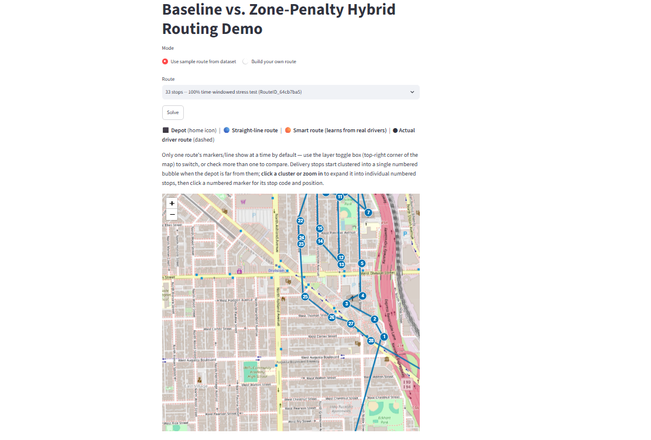
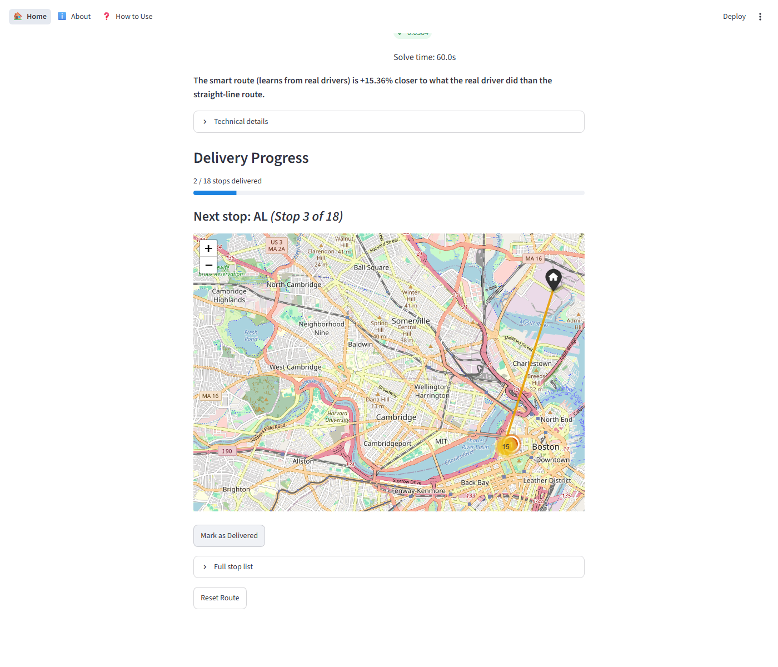
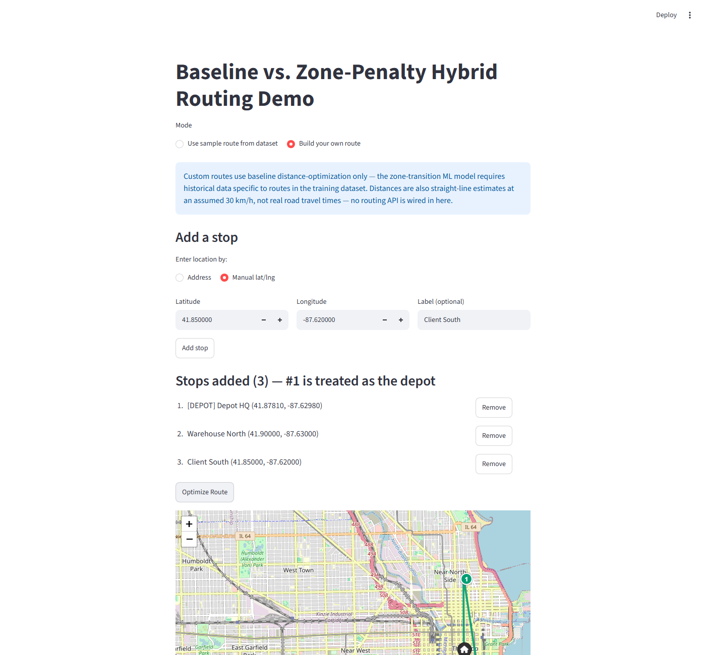
09 / 15 TRY IT YOURSELF
An interactive dashboard, not just a notebook
Baseline vs. hybrid comparison
Overlays the straight-line baseline, the zone-penalty hybrid route, and the driver's actual path.
Delivery progress tracking
“Mark as Delivered” walks the stop order one at a time; delivered stops drop off the map.
Build-your-own-route mode
Enter a depot and stops by address or lat/lng and get an optimized order for a route outside the dataset.
09/15

Slide 10
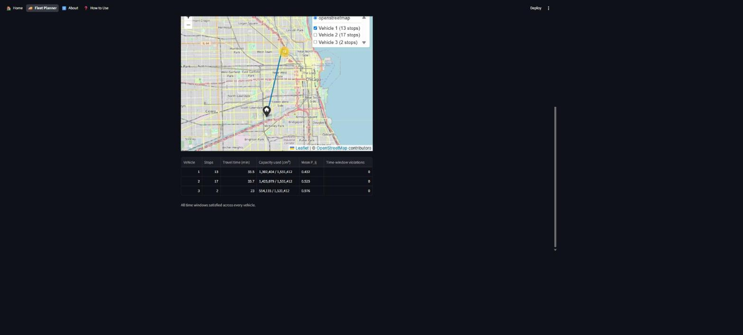
10 / 15 EXTENDING THE SYSTEM
One driver becomes a fleet
A second solver mode: split the same route across multiple vehicles — a Capacitated Vehicle Routing Problem with Time Windows (CVRPTW) — using the exact same learned cost function as the single-driver demo.
● Same cost function, more vehicles. The hybrid arc-cost and time-window logic were factored out of the single-vehicle solver into shared functions — nothing about C_ij is duplicated between modes.
● Capacity = package volume. The dataset has no weight field, so each stop's demand is its total package volume (cm³) — the one physical quantity a real van's cargo space is limited by.
● Route-aware default capacity. An even split of the route's total volume plus 40% slack — not a fixed constant, since routes vary well over 10× in total package volume.
HONEST SCOPE NOTE
No official Amazon score applies to a multi-vehicle split — the dataset's ground truth is one driver's single sequence per route. This mode reports total travel time and capacity/time-window feasibility per vehicle instead.
Fleet Planner — 33-stop route, 3 vehicles
13 / 17 / 2 stops per vehicle, solved in 30.2s, every vehicle within capacity, zero time-window violations.
10/15

Slide 11
11 / 15 RESULTS
31.7% closer to how real drivers actually deliver
31.7%
average improvement in official sequence-deviation score, hybrid vs. baseline, on 15 randomly sampled routes (paired, same-route comparison).
0.0728
0.0498
15 / 15
60s
baseline avg. score (lower is better)
hybrid avg. score
feasible solves, both conditions
solve budget per route
Scoring metric: ERP-based sequence-deviation (Merchan et al., 2021) — a byte-verified, line-for-line port of the official MIT-CAVE/rc-cli scorer.
11/15

Slide 12
12 / 15 DEPLOYMENT
Container-ready, not just laptop-ready
A Dockerfile packages the dashboard so it runs anywhere with one command — no local Python setup required.
RUN THE DASHBOARD
docker build -t last-mile-routing . docker run -p 8501:8501 last-mile-routing # open http://localhost:8501
RUN THE CLI PIPELINE
docker run -v "$(pwd)/data:/app/data" \ last-mile-routing python src/model_apply.py \ --route-id ROUTE_ID
● Runs standalone out of the box. The image bundles the same small, git-committed data/deploy/ subset the live Streamlit Cloud demo uses — no 568MB dataset download needed to see it work.
● Full dataset via bind mount. The CLI pipeline commands need the full processed dataset, which isn't baked into the image — it's mounted in at run time instead.
● python:3.11-slim, not the brief’s literal "Ubuntu 20.04." A documented, deliberate deviation — every dependency here has a prebuilt Linux wheel, so a slim Python base needs no manual toolchain setup.
● Verified end-to-end, not just written. A real docker build + docker run, confirming the dashboard serves and solves correctly inside the container.
12/15

Slide 13
13 / 15 ENGINEERING RIGOR
Built to be believed, not just demoed
Every number above comes with its own honest asterisk — documented in the repo, not hidden from it.
SOLVER
Feasibility is ~90%, not 100%, at a 15-second solve budget — 3/30 sampled routes came back infeasible almost instantly. Not yet root-caused. At the 60-second budget used for the headline number, feasibility was 15/15.
ML MODEL
An XGBoost per-stop difficulty model was tried and dropped — it never reached a usable validation R² (best: −0.0424). Kept in the repo as documented, unused exploration; a lightweight empirical zone-transition penalty is used instead.
TIMING
Results are time-budget sensitive — the same route can score meaningfully differently at 20s vs. 60s. Expected behavior for the Guided Local Search metaheuristic under a fixed wall-clock limit, not a bug.
CUSTOM ROUTES
The “build your own route” mode currently gets baseline treatment only — the zone-penalty model needs historical data tied to dataset zones, which arbitrary addresses don't have.
13/15

Slide 14
14 / 15 WHAT'S NEXT
Where this goes from here
● Score the full evaluation set — 3,052 routes, beyond the current 15-route sample.
● Root-cause the ~10% solver infeasibility at short solve budgets.
● Investigate the scoring-time outlier — one 194-stop route took 1,408s to score vs. 15–18s typical.
● Design a real benchmark for fleet mode — there's no official score for a multi-vehicle split today.
● Extend zone penalties to custom routes, beyond the dataset's own zones.
● Stretch goal: a PPM Markov sequence model, scoped out of this MVP.
14/15

Slide 15
Thank You
15/15

