Slide 1
Sales Performance Dashboard
Interactive Dashboard for Business Stakeholders
Created by: Suhani Pancholi Tool Used: Power BI Date: 11 April 2025

Slide 2
Objective
Goal: To analyze and visualize key sales and profit metrics to support data-driven decisions by business stakeholders.
Key Questions Answered:
How are sales performing over time?
What are the top-performing categories and products?
What are the trends based on sale type and payment mode?

Slide 3
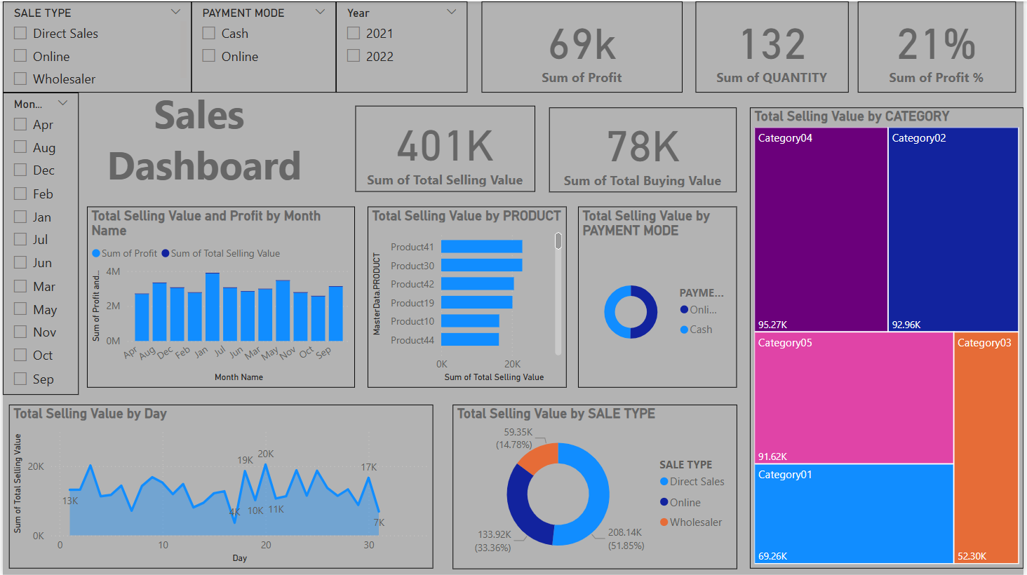
Sales Trends & KPIs at a Glance

Slide 4
KPIs Tracked
KPI | Value
Total Profit | 69k
Total Quantity Sold | 132
Profit Percentage | 21%
Total Selling Value | 401k
Total Buying Value | 78k

Slide 5
Visualizations Used
Bar Chart – Monthly Sales & Profit
Line Chart – Daily Sales Trend
Donut Charts – Sales by Sale Type & Payment Mode
Tree Map – Sales by Category
Bar Chart – Top Products by Sales
Cards – KPIs Summary

Slide 6
Interactivity Features
Slicers for Filtering:
Sale Type
Payment Mode
Year
Month
Drill-through Enabled
Consistent Color Scheme
Dynamic Title & Layout

Slide 7
Key Insights
Online Sales contribute the largest share (51.85%) of total sales.
Category04 is the top-performing category with the highest sales.
Product41 is one of the highest-selling products.
Sales trend peaked around mid-month (Day 15–20).
Cash payments are significantly lower compared to online mode.

Slide 8
Recommendations
Focus on promoting top-selling categories and products.
Leverage the growth in online sales with targeted campaigns.
Evaluate underperforming sale types or categories for improvement.
Consider expanding to new product lines based on category success.

