Slide 1


NEXT GEN EMPLOYABILITY PROGRAM
CREATING A FUTURE-READY WORKFORCE
Student Name :
Suhani Jitendra Ghuge.
Student ID :
College Name :
STU67820732d49a31736574770
Trinity Academy of Engineering, Pune

Slide 2
CAPSTONE PROJECT SHOWCASE
A Service for Delivering Food(Zomato Clone) with MERN Technology

Slide 3
Abstract
This project is a food delivery service built using the MERN (MongoDB, Express.js, React.js, Node.js) stack, similar to Zomato. The platform allows users to browse restaurants, view menus, and place orders online. Users can sign up, log in, and manage their profiles securely. Restaurants can list their menus, update prices, and manage orders. The backend uses MongoDB Atlas for storing user and restaurant data, while Express.js and Node.js handle API requests. The frontend, built with React.js and Tailwind CSS, provides a smooth user experience. JWT-based authentication ensures secure logins. Redux manages the application state efficiently. Axios is used for API communication. The platform aims to provide a seamless and user-friendly food ordering experience.

Slide 4


Problem Statement
Convenience Demand- People prefer online food ordering over traditional dining due to time constraints and ease of access.
High Platform Fees – Existing food delivery services often charge high commissions, affecting restaurant profits.
Limited Restaurant Options – Many platforms have a restricted selection, limiting customer choices.
Order Management Issues-Restaurants struggle with handling orders efficiently and updating menu listings.

Slide 5

Project Overview
This project is a comprehensive food delivery application built using the MERN stack, designed to deliver a seamless experience for both users and administrators.On the backend, the system leverages Node.js and Express.js along with MongoDB Atlas for secure data storage and efficient management of user information. An admin panel created with React.js enables administrators to display and update food listings and monitor user orders in real-time. Additionally, the project incorporates essential functionalities such as shopping cart management, order placement, and Stripe payment integration to ensure secure and hassle-free transactions. This food delivery service streamlines the process of online ordering.

Slide 6
Proposed Solution
To address the challenges of online food ordering and restaurant management, this project proposes a MERN-based food delivery platform with an intuitive user interface and efficient backend functionalities. The solution includes a fully responsive frontend using React.js and Tailwind CSS, allowing users to browse restaurants, add food items to their cart, and place orders seamlessly. Secure user authentication (JWT-based login and registration) ensures data protection and access control.
The solution also includes an order tracking system for users to view their past and current orders, while admins can update order statuses to enhance transparency. By integrating all these functionalities, the platform aims to provide a smooth, secure, and efficient food ordering experience for customers while helping restaurants manage their operations with ease.

Slide 7
Technology used
This project utilizes the MERN (MongoDB, Express.js, React.js, Node.js) stack along with other modern tools and libraries to enhance performance, security, and user experience.
Frontend:
React.js – For building a responsive and dynamic user interface.
Tailwind CSS – For styling and ensuring a mobile-friendly design.
Redux – For state management across components.
Axios – For handling API requests and data fetching.
Backend:
Node.js – For handling server-side logic.
Express.js – For building RESTful APIs.
MongoDB Atlas – A cloud-based NoSQL database for storing users, restaurants, and orders.
Mongoose – For MongoDB object modeling and schema validation.

Slide 8
Authentication & Security:
JWT (JSON Web Token) – For secure user authentication.
Bcrypt.js – For password hashing and security.
Dotenv – For managing environment variables securely.
Payment & Order Management:
Stripe API – For secure online payment processing.
Local Storage / Session Storage – For temporarily storing user cart data.
Admin Panel & Additional Tools:
React.js (Admin Panel) – For managing restaurant menus and orders.
Cloudinary / Firebase (Optional) – For image storage and optimization.
Postman – For API testing and debugging

Slide 9
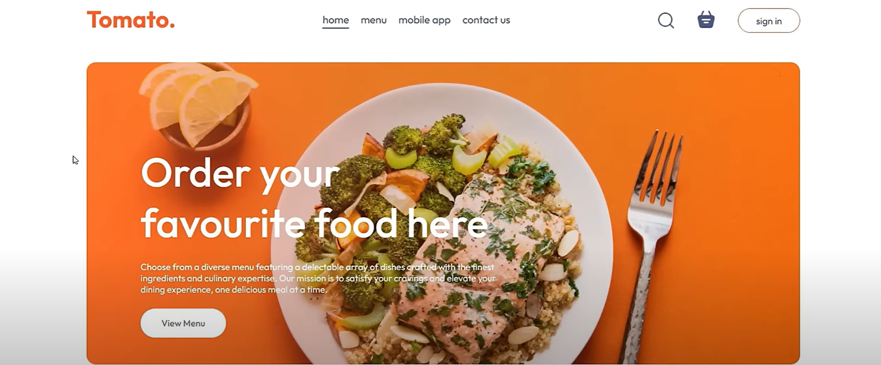
Modelling & Result- Home Page

Slide 10
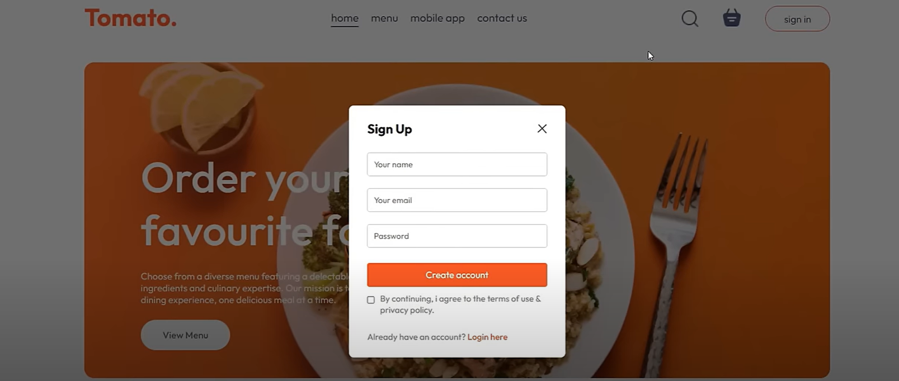
Modelling & Result – Sign Up

Slide 11
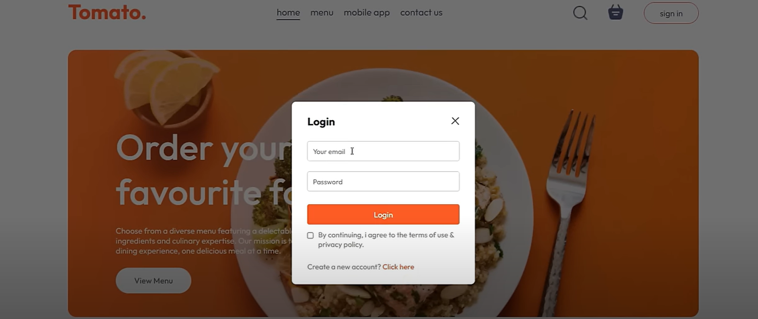
Modelling & Result – Login Page

Slide 12

Conclusion
This MERN-based food delivery platform integrates a responsive frontend, secure backend, and scalable database to provide a seamless food ordering experience. JWT authentication ensures user security, while Redux and Axios enhance state management. Key features include signup/login, cart functionality, order placement, and an admin panel for restaurant management. Stripe integration enables secure payments, and users can track their orders efficiently. The system bridges the gap between customers and restaurants, with future potential for real-time tracking and AI-based recommendations to enhance the experience further.

Slide 13


Notes:
Thank You !!

