Slide 1
EcoGuard Gujarat
Agentic AI for Industrial Pollution Intelligence IBM Granite + IBM Bob

Slide 2


Project Title – EcoGuard Gujarat: AI-Powered Industrial Pollution Intelligence Platform
Domain of Project – Environmental Sustainability
Student Name | Recent Passport Photo | Email ID | Mobile number [WhatsApp]
SUHANI CHOKHRA |  | maheshwarisuhani110@gmail.com | +91-7733078151
MITALI JOSHI |  | joshimitali2005@gmail.com | +91-9461290932

Slide 3
Problem Statement – Smart Industrial Pollution Monitoring
The Challenge Industrial zones along Gujarat’s Golden Corridor (Vapi–Ankleshwar–Vatva) face significant air and water pollution from chemical and manufacturing activity. Pollution data can be fragmented, while abnormal readings and compliance violations may be difficult to prioritize. The Objective Build an agentic pollution-intelligence platform that continuously monitors industrial pollution, detects anomalies and violations, assesses risk, and supports timely regulatory action. Key Requirements • Multi-pollutant monitoring: air, water, industrial emissions, noise and waste. • District/factory/hotspot visibility through an interactive Gujarat Map. • Automatic anomaly and violation prioritization. • Actionable alerts, risk scoring and explainable AI insights.

Slide 4
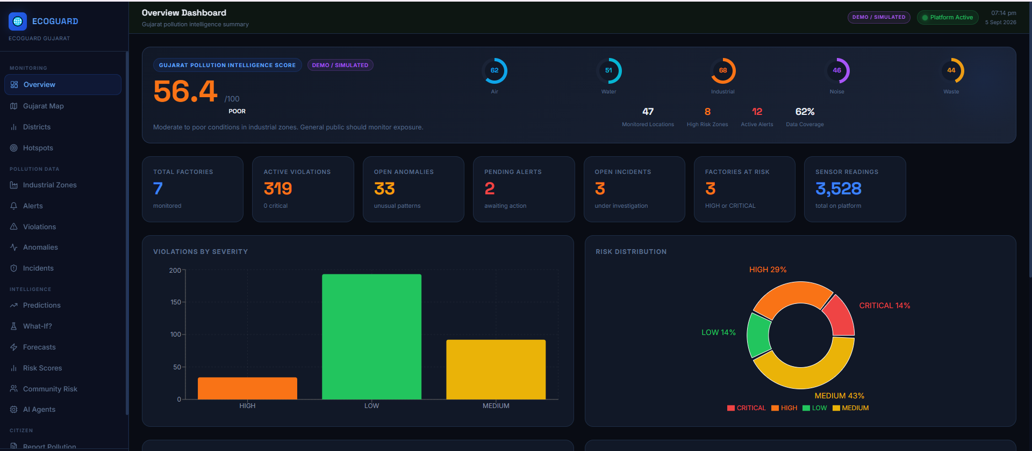
Proposed Solution – EcoGuard Gujarat
EcoGuard Gujarat is a web-based multi-agent pollution intelligence platform that converts pollution readings into decisions and actions. Core Solution • Unified dashboard for pollution score, factories, violations, anomalies, alerts and incidents. • Interactive Gujarat Map for district, factory and hotspot-level intelligence. • Specialized AI agents analyze readings, detect unusual patterns, classify compliance risk and generate recommendations. • Role-based monitoring for administrators, regulators, officers and citizen-facing views. • Demo-ready architecture that can later connect to live sensor and government data streams.

Slide 5
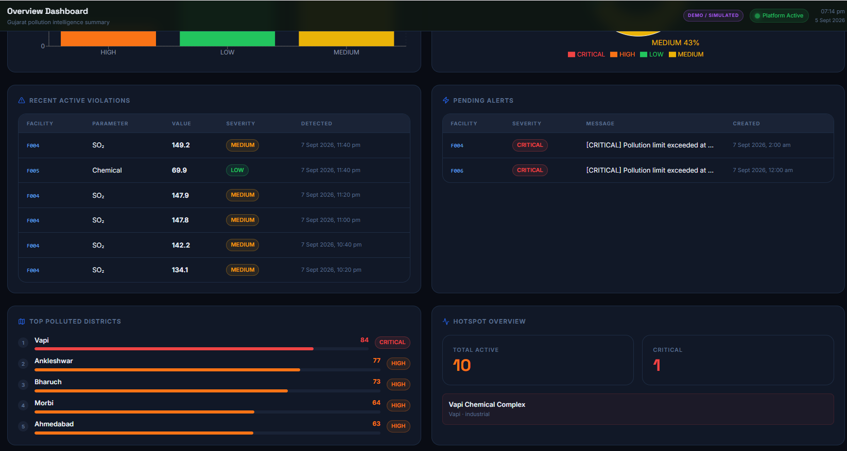

Slide 6
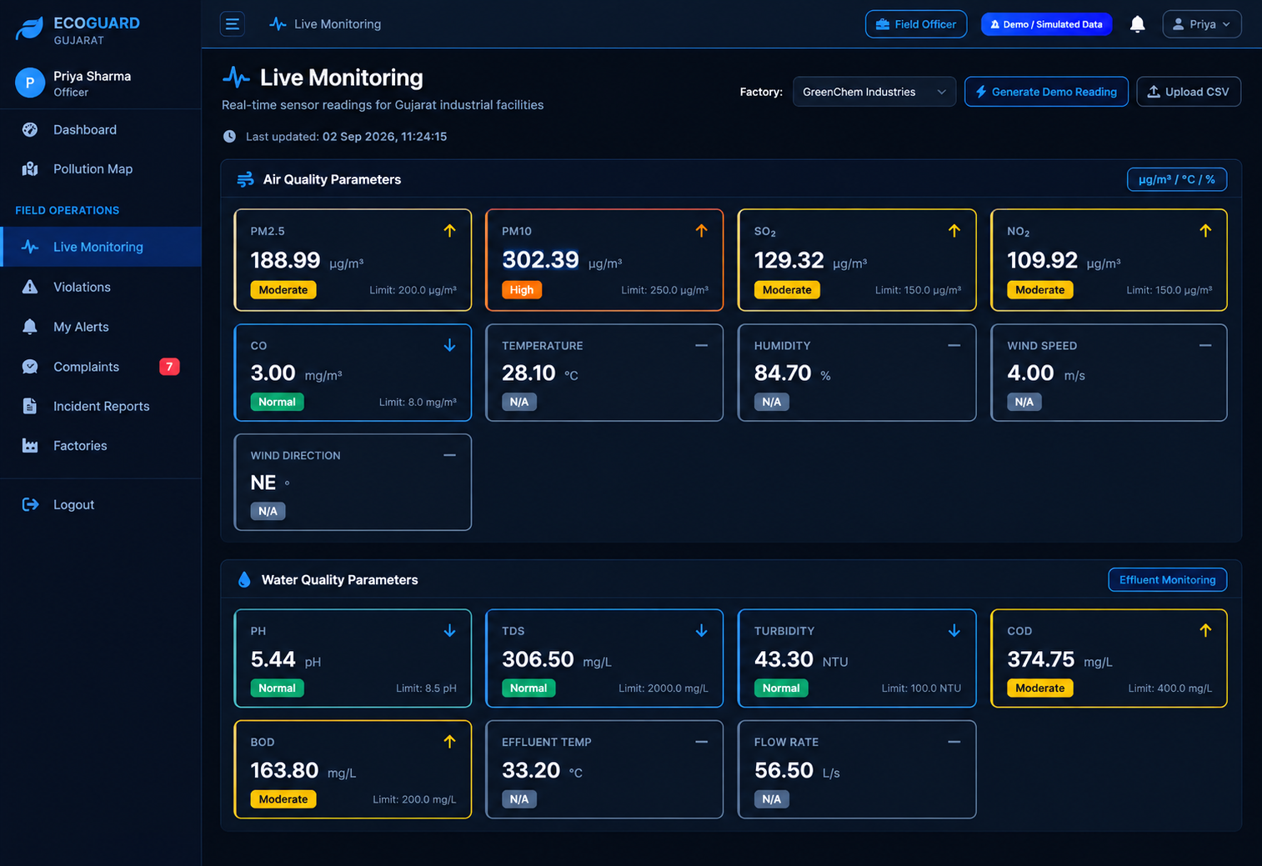

Slide 7
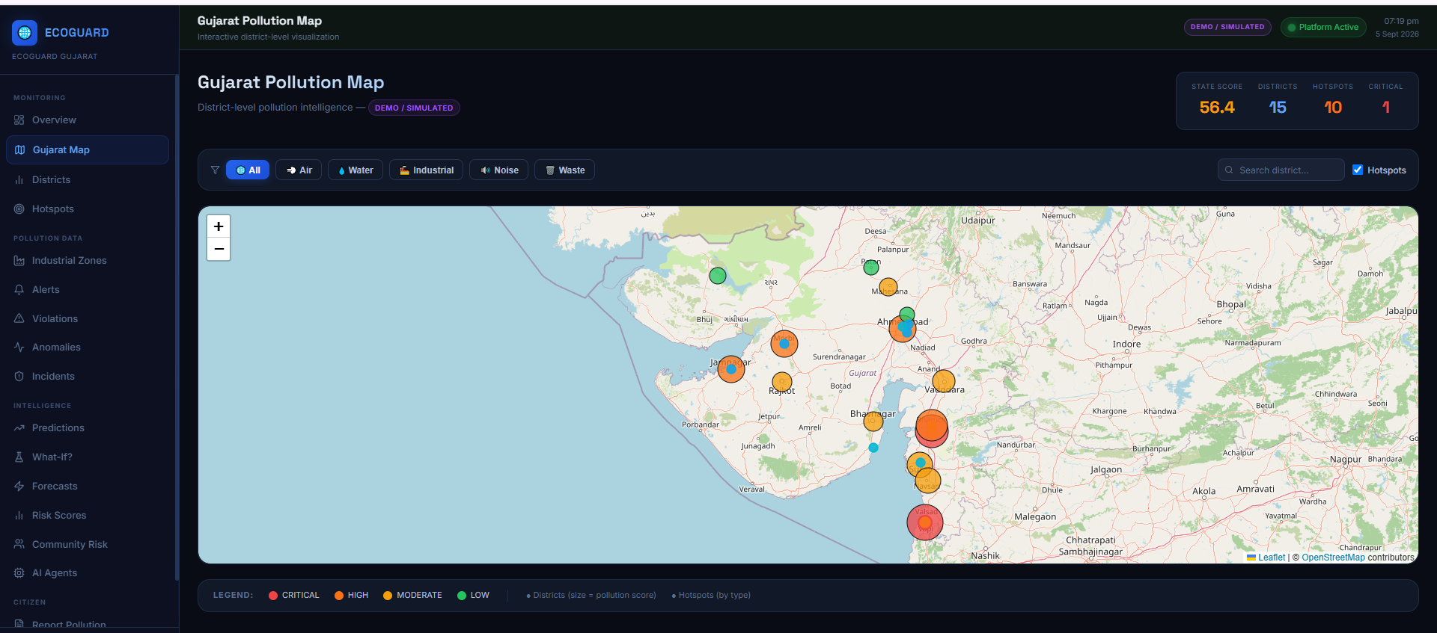

Slide 8
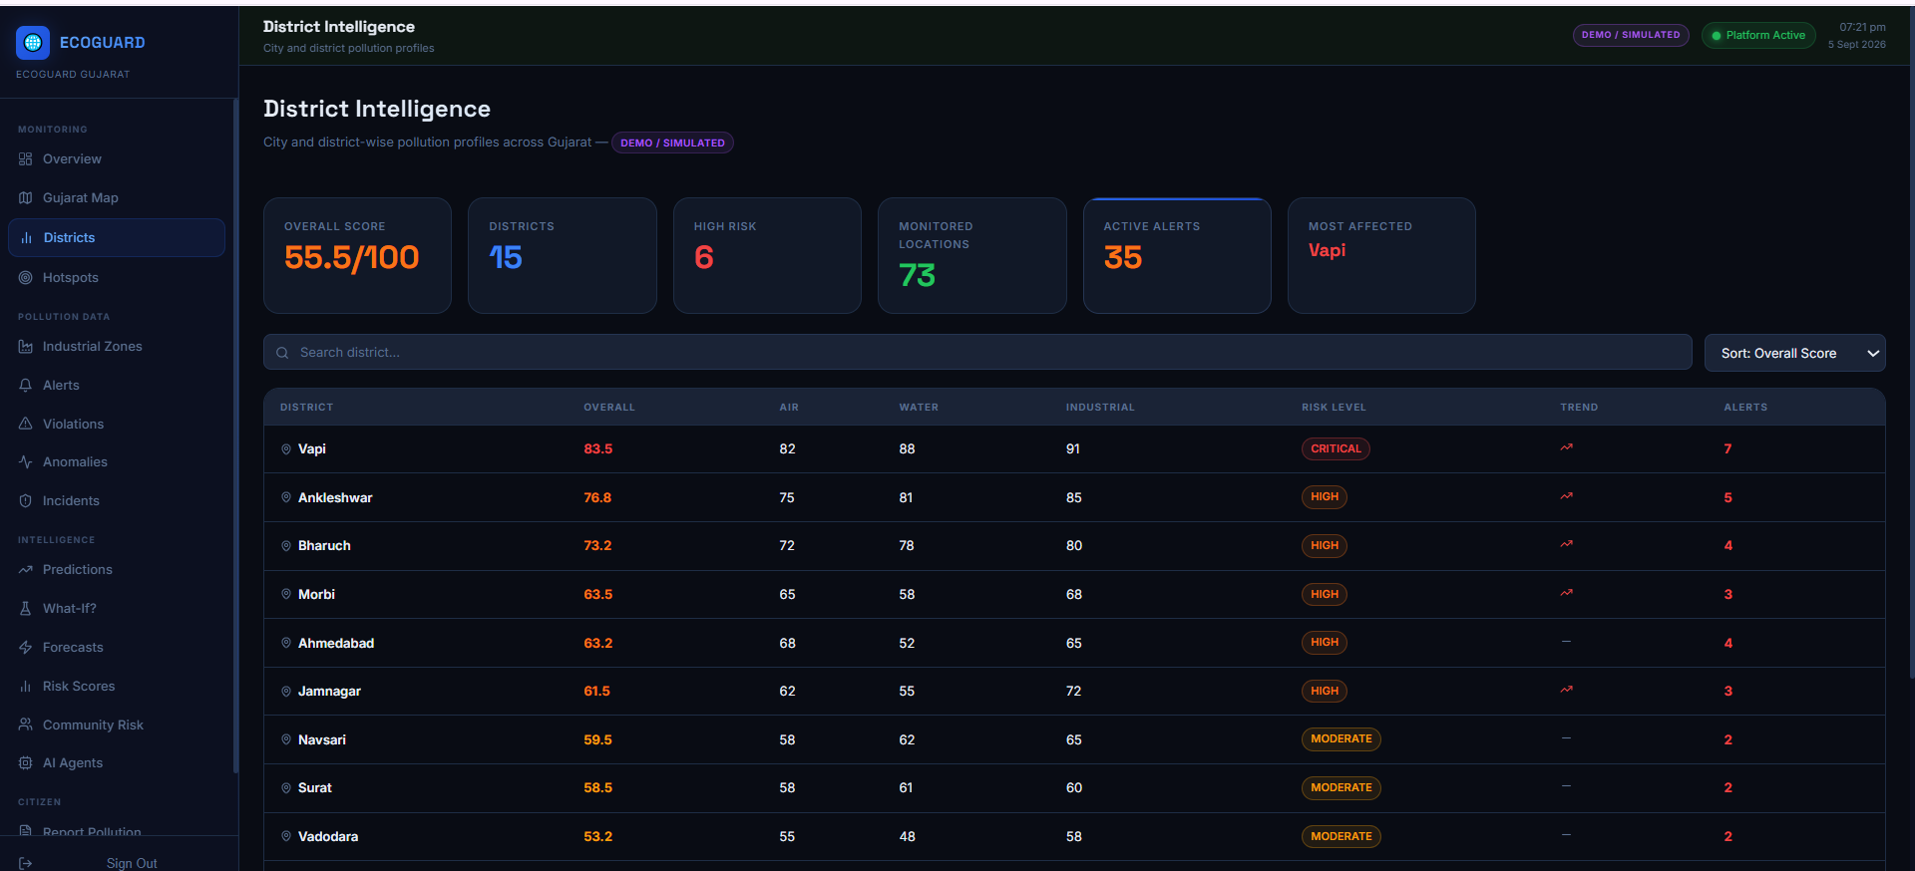

Slide 9
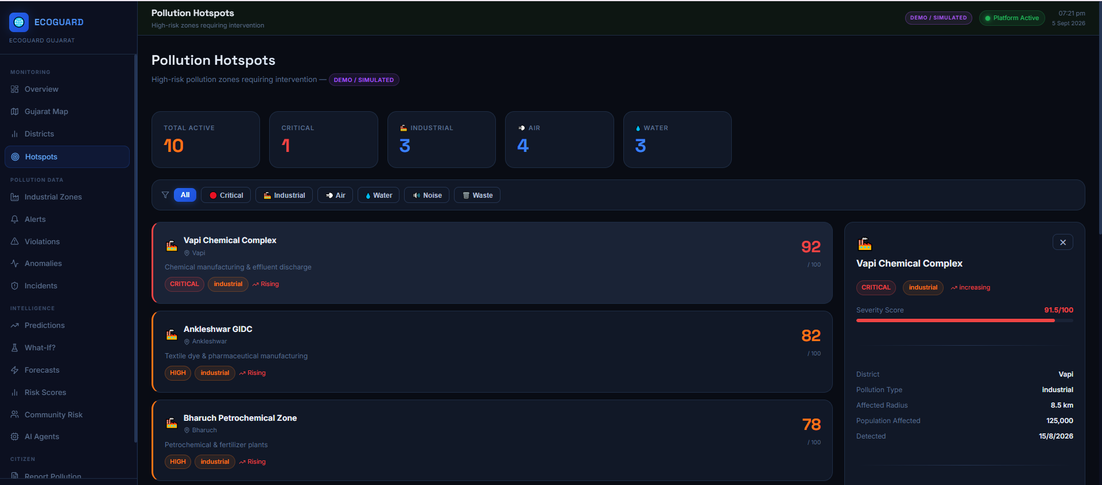

Slide 10
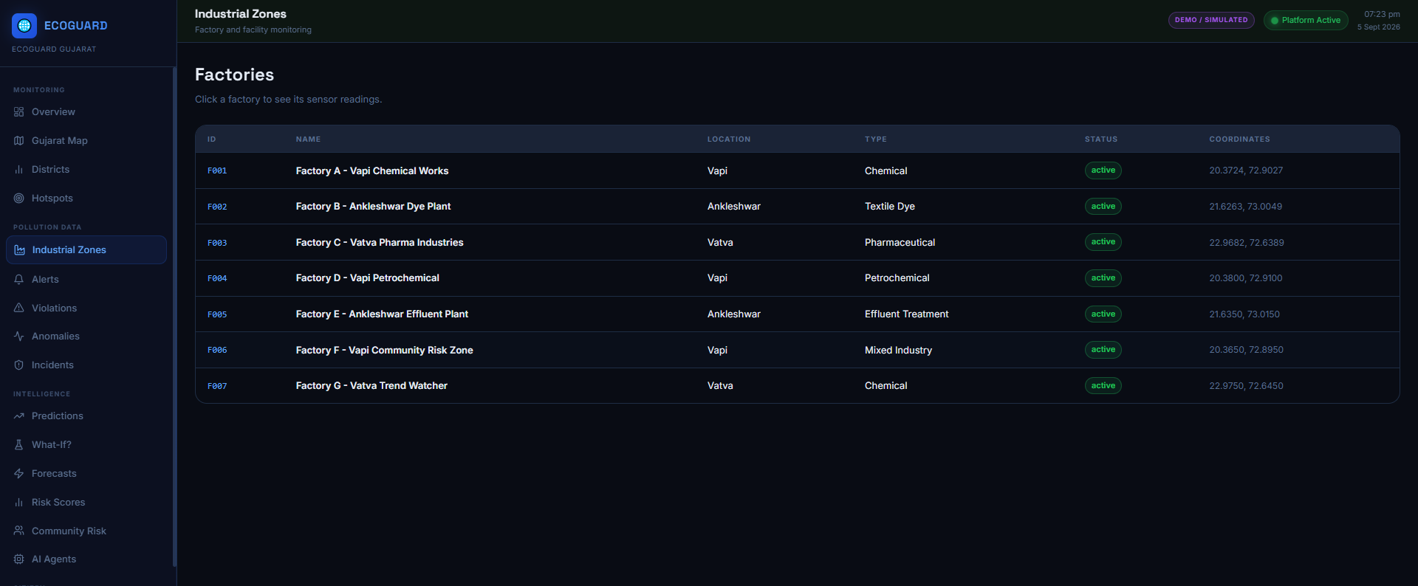

Slide 11
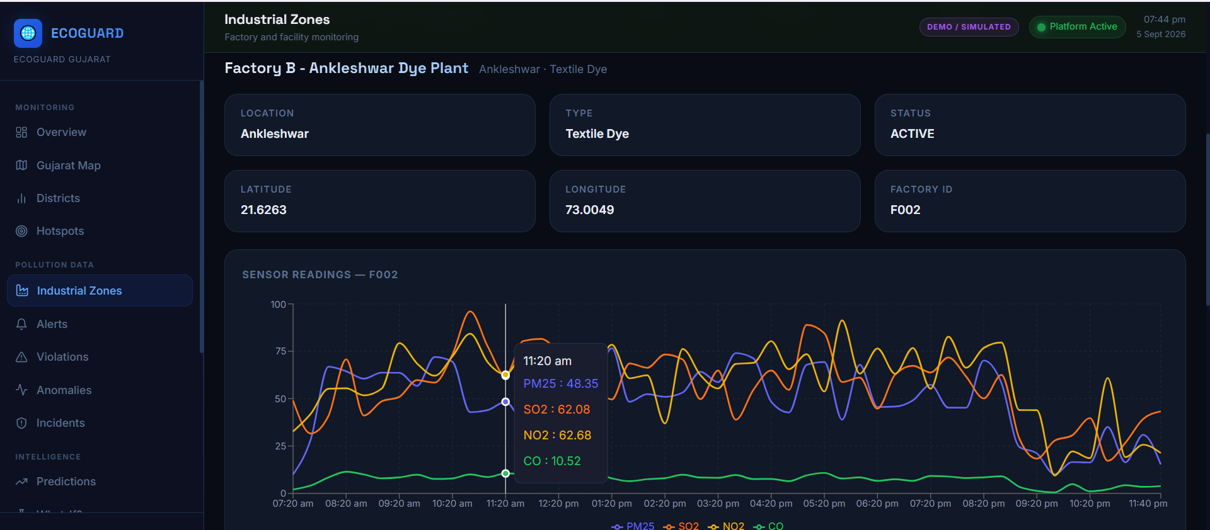

Slide 12
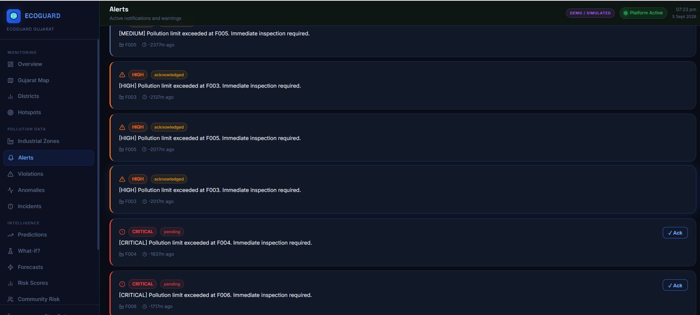

Slide 13
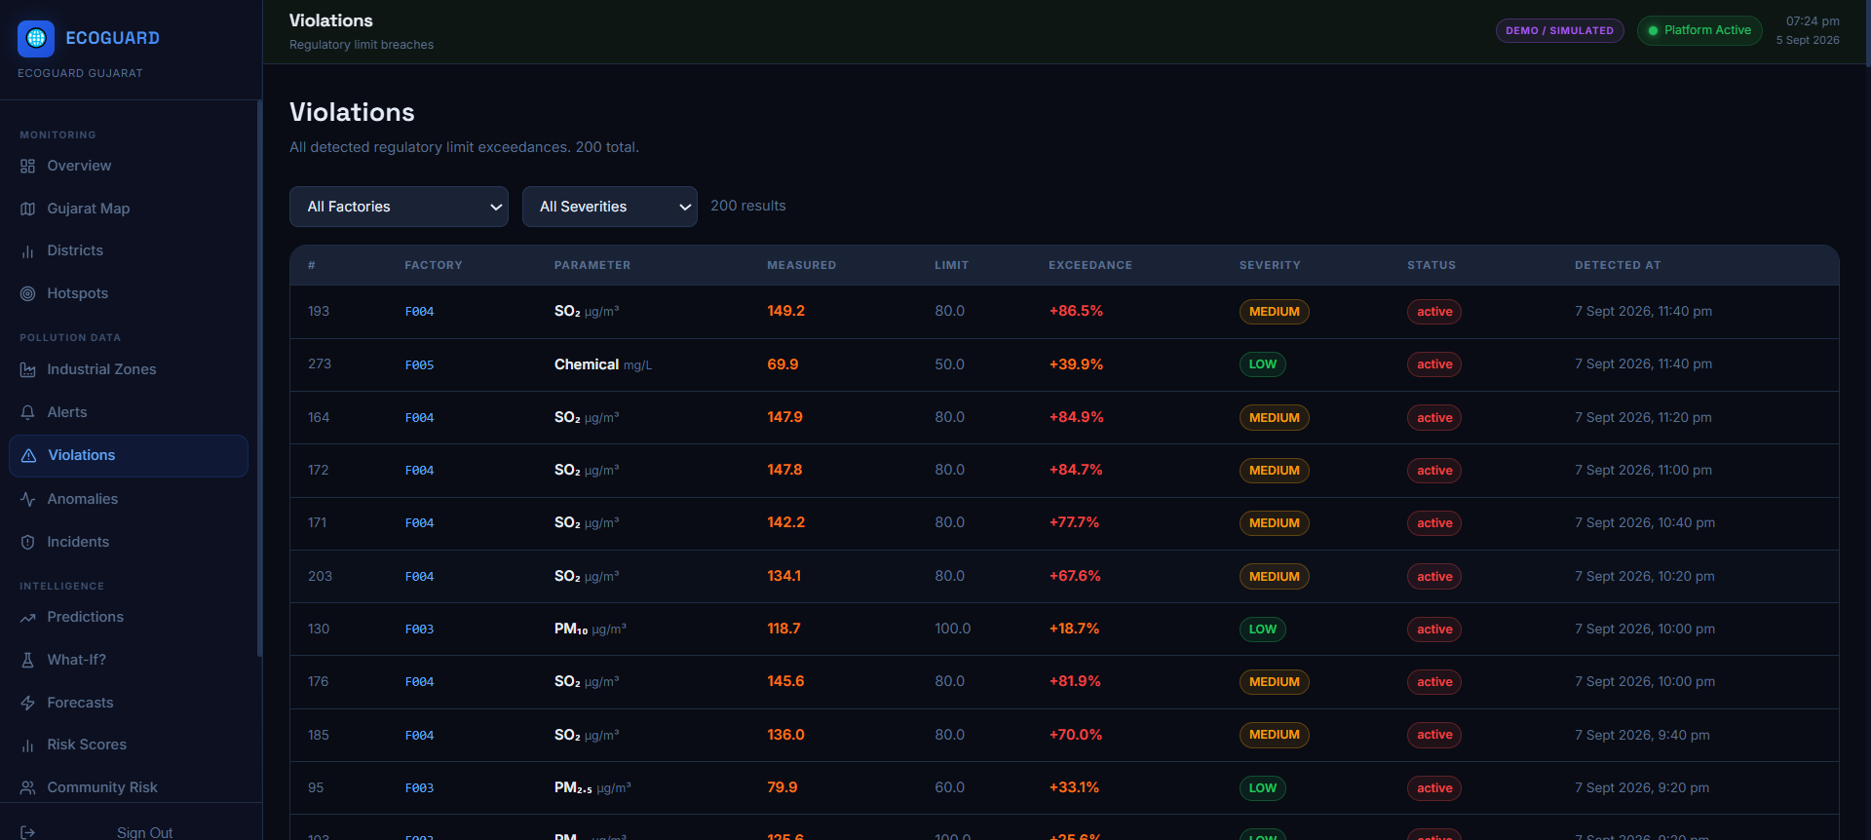

Slide 14
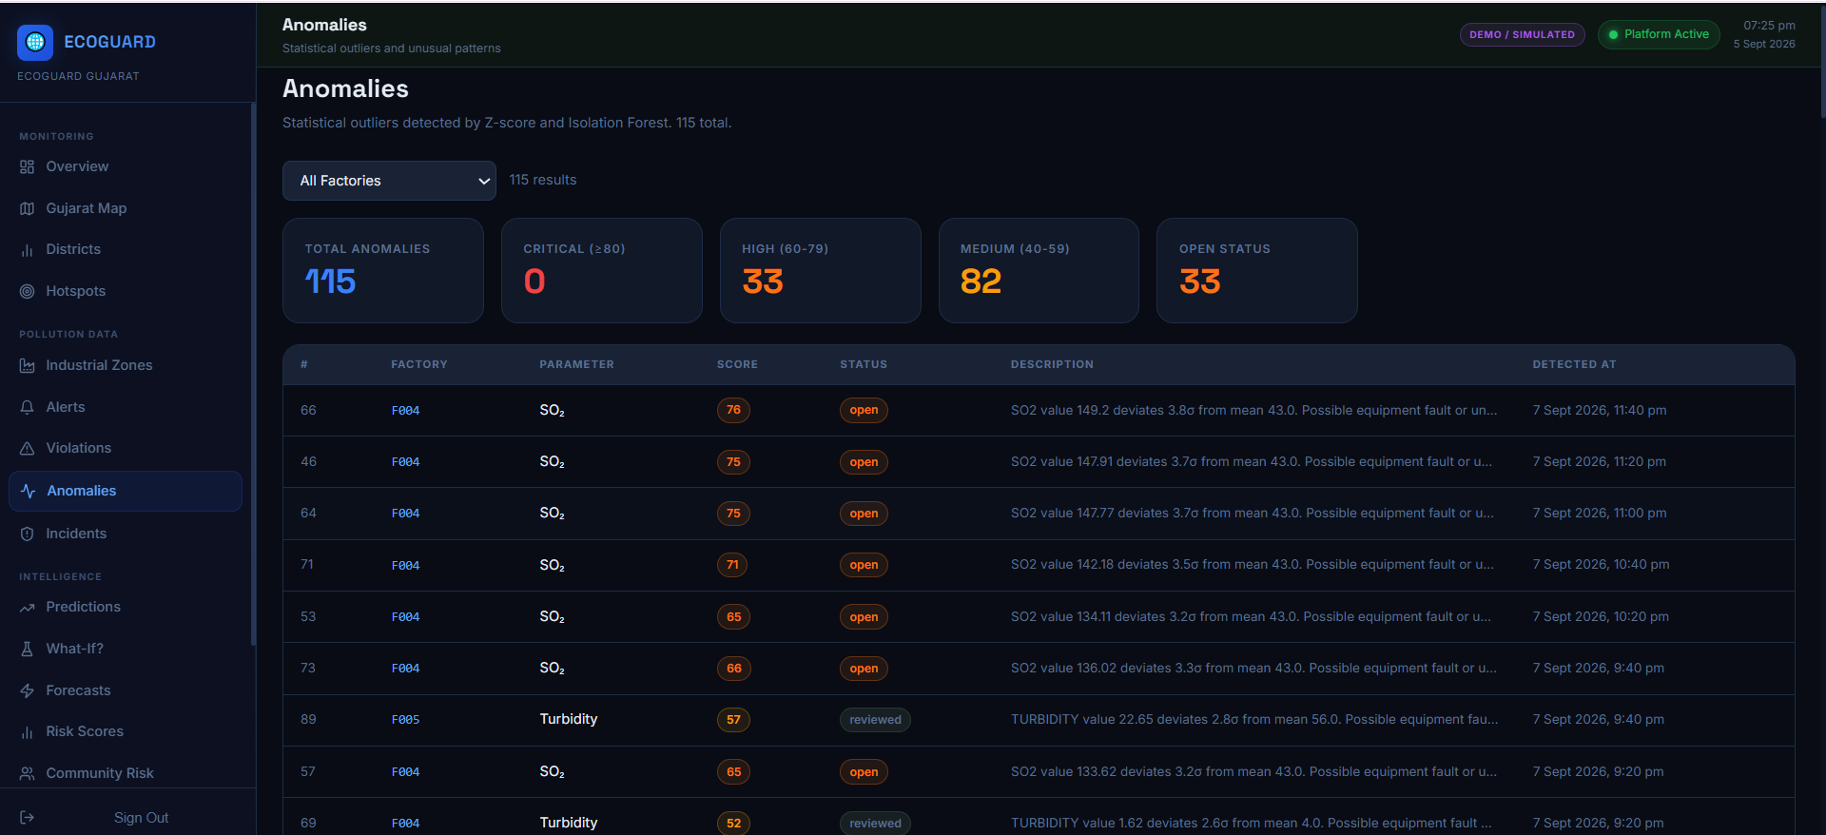

Slide 15
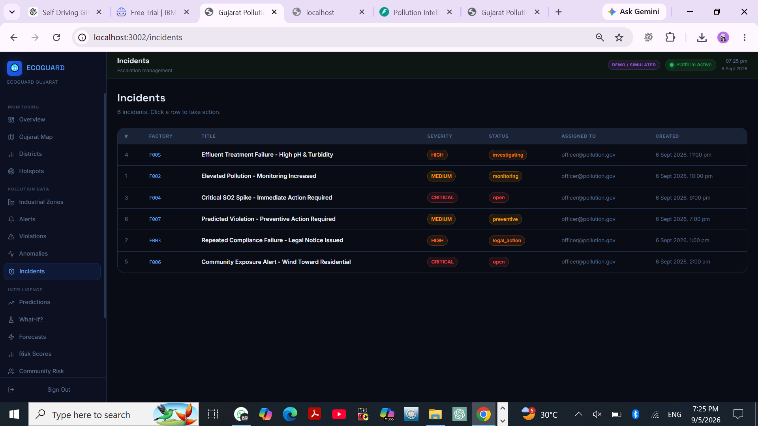

Slide 16
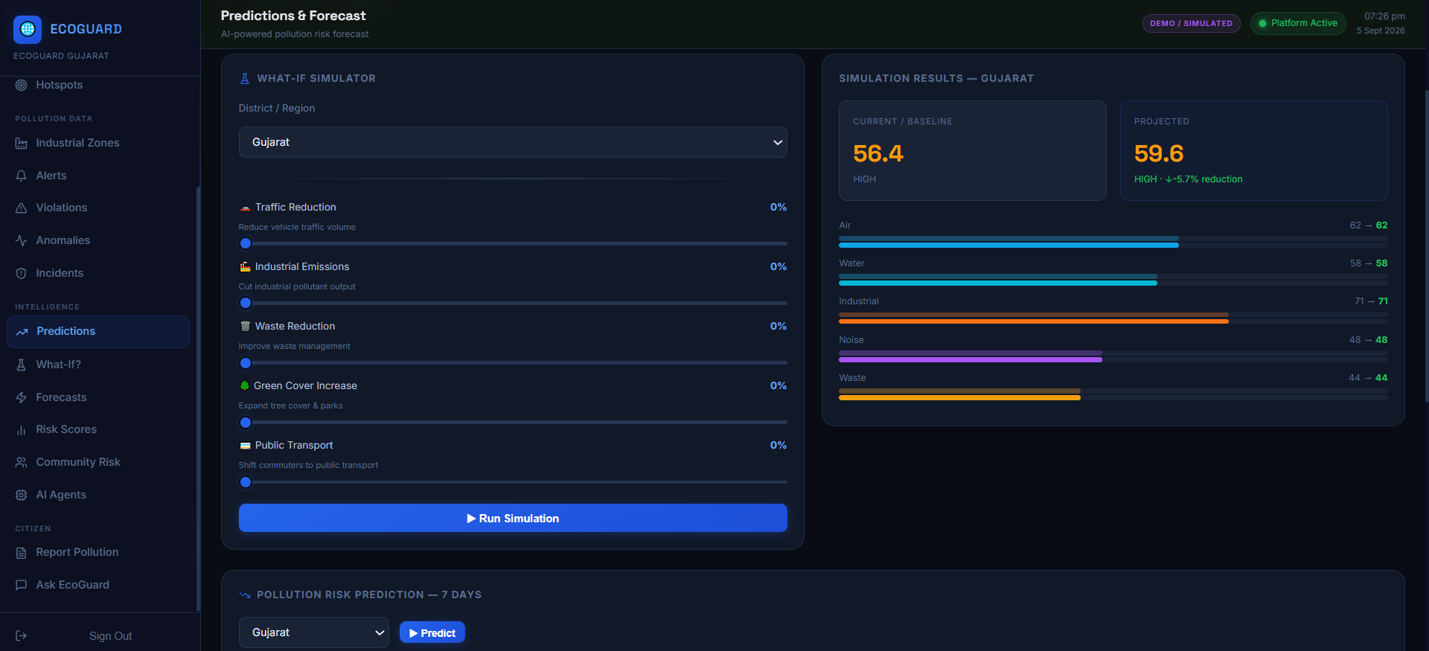

Slide 17
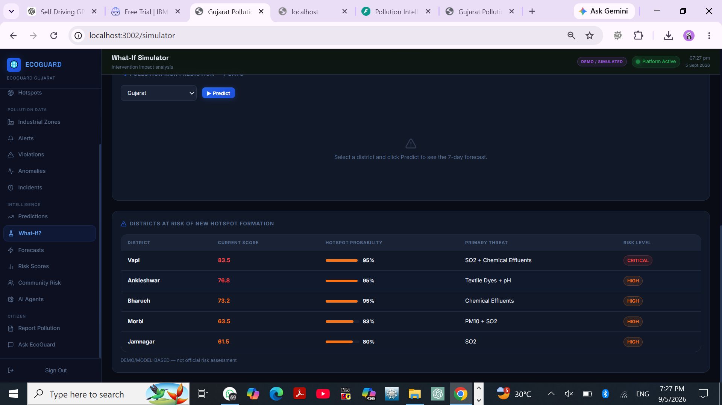

Slide 18
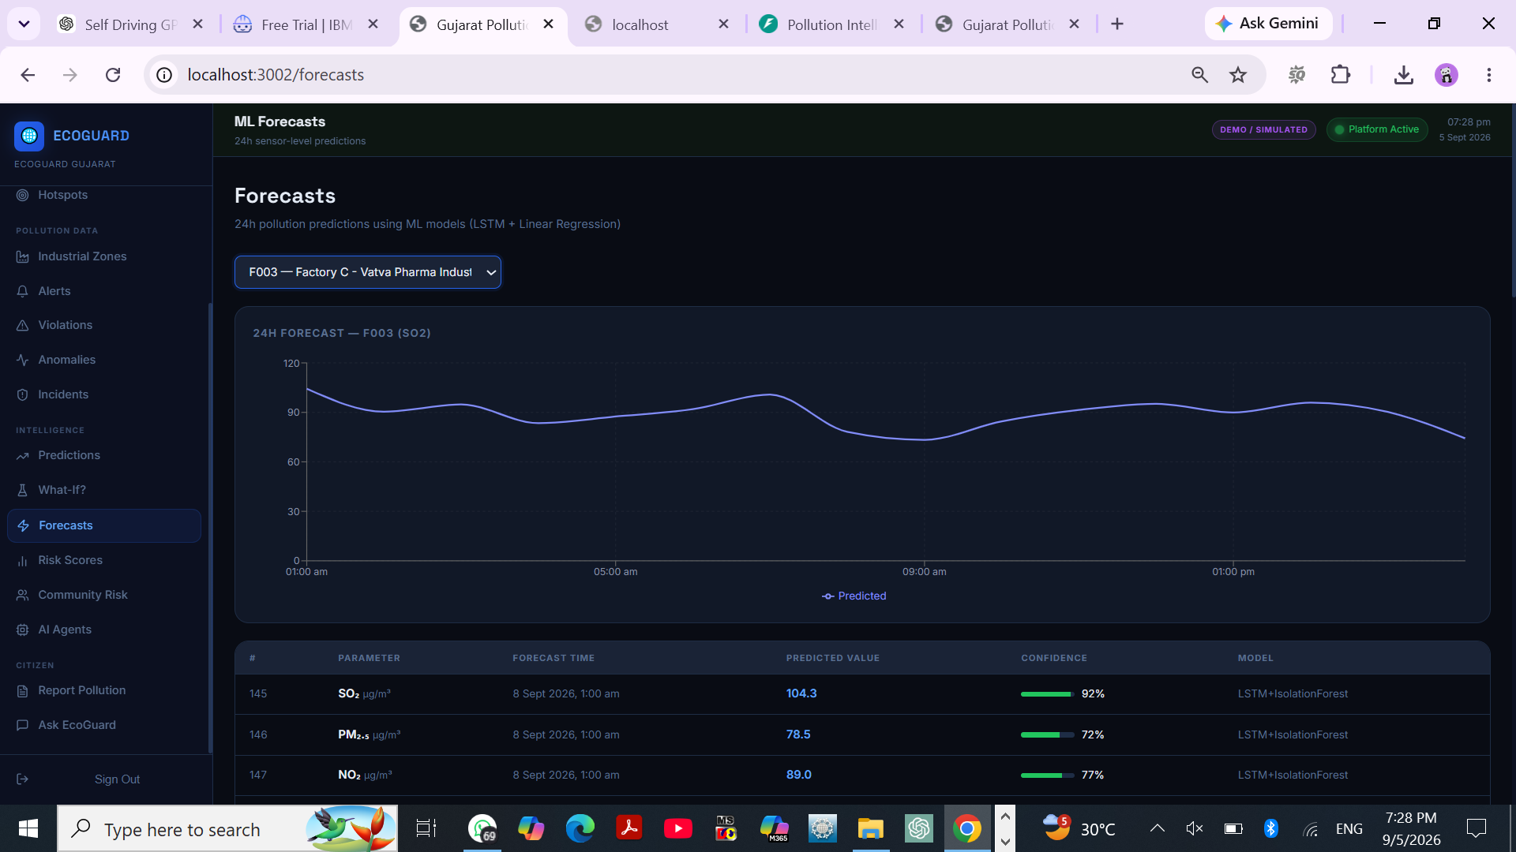

Slide 19
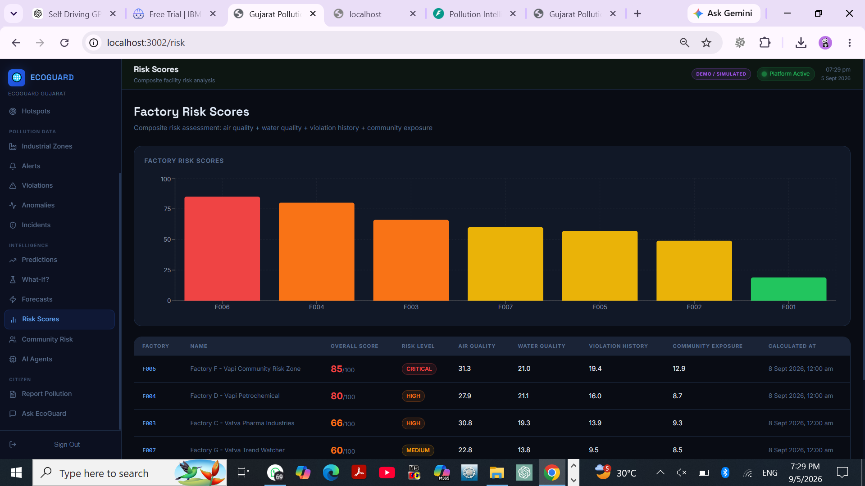

Slide 20
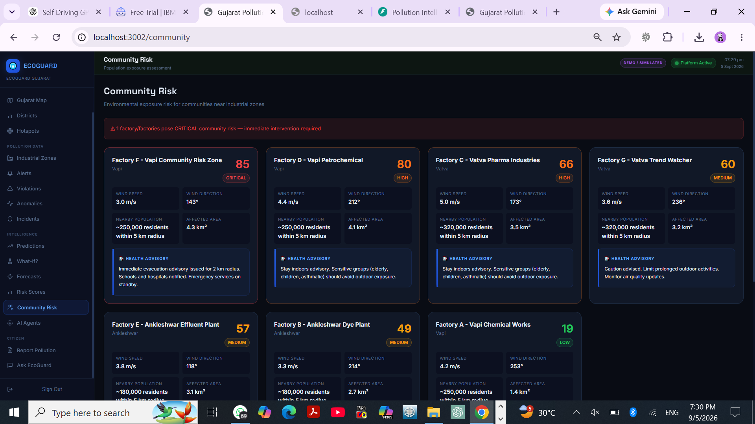

Slide 21
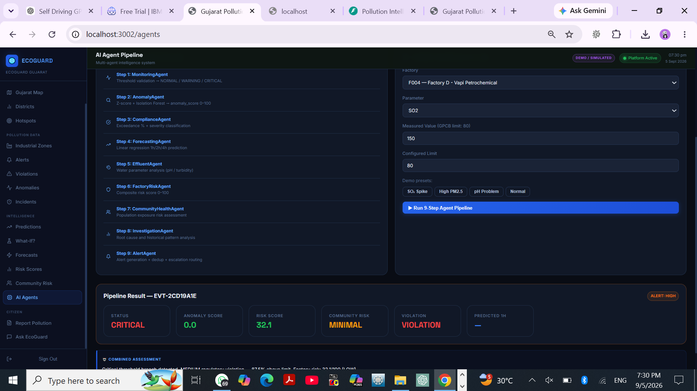

Slide 22
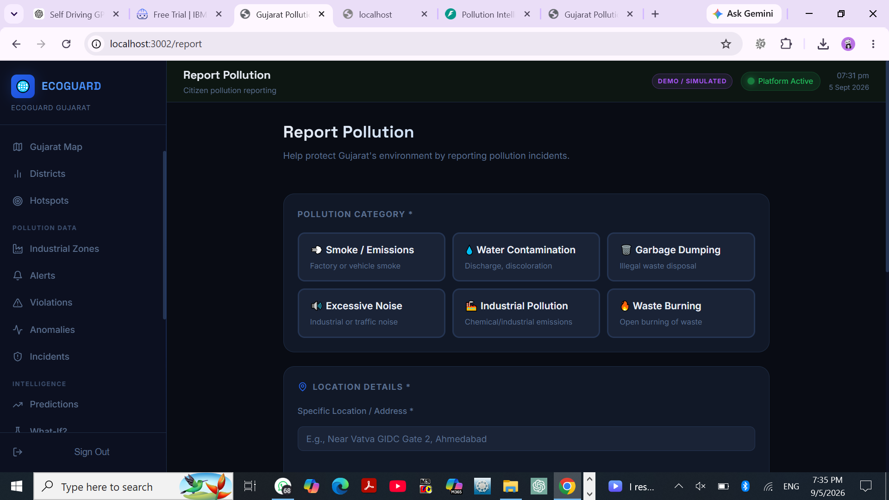
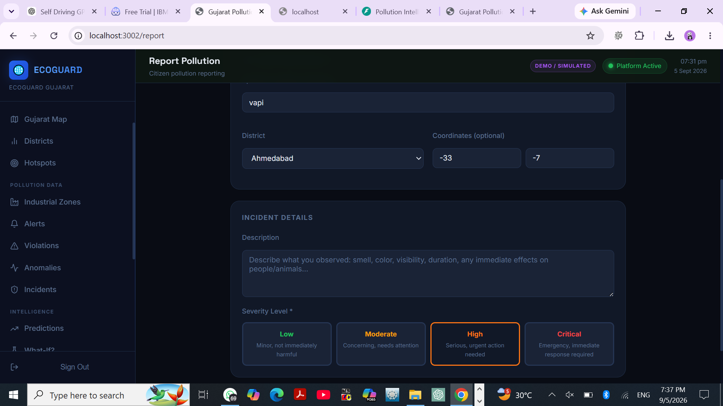

Slide 23
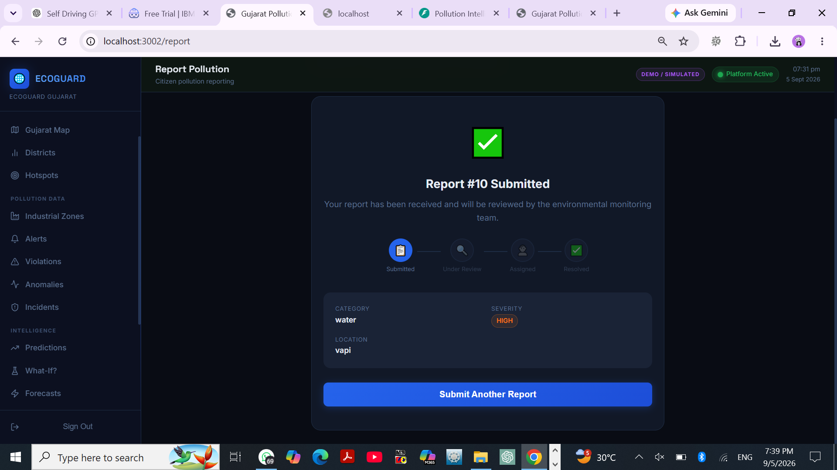

Slide 24
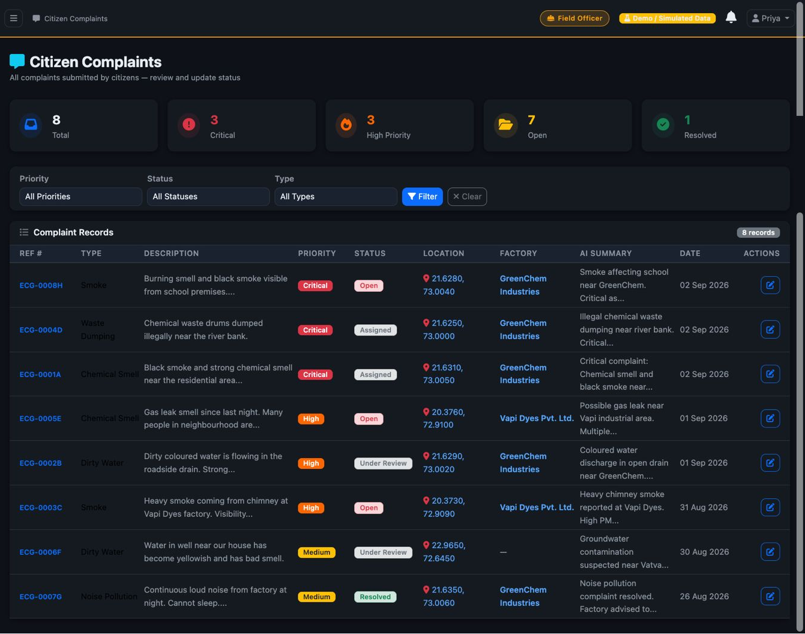

Slide 25
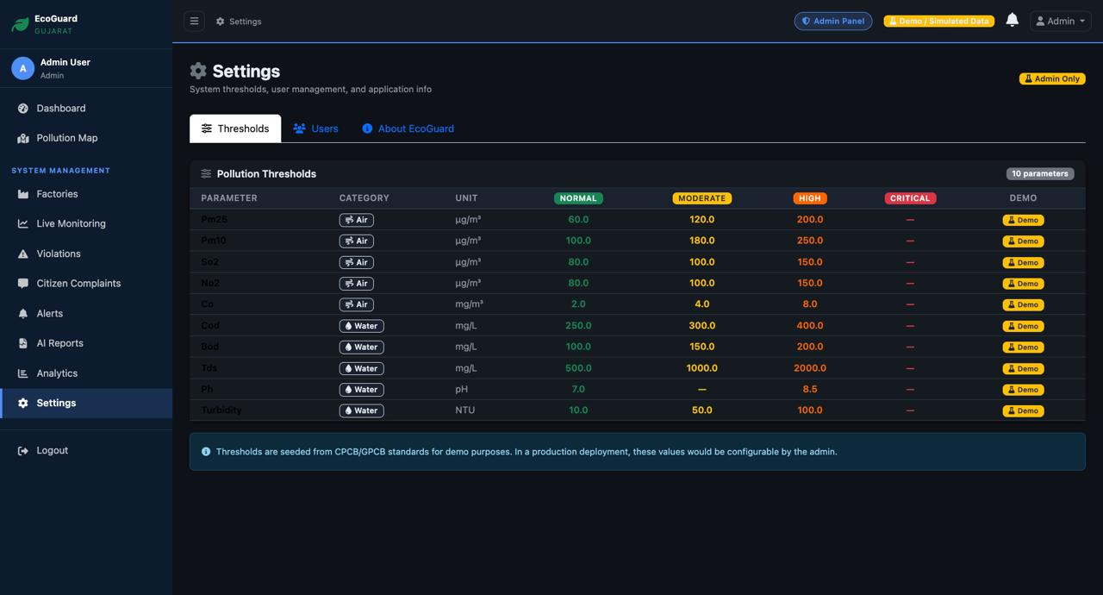

Slide 26
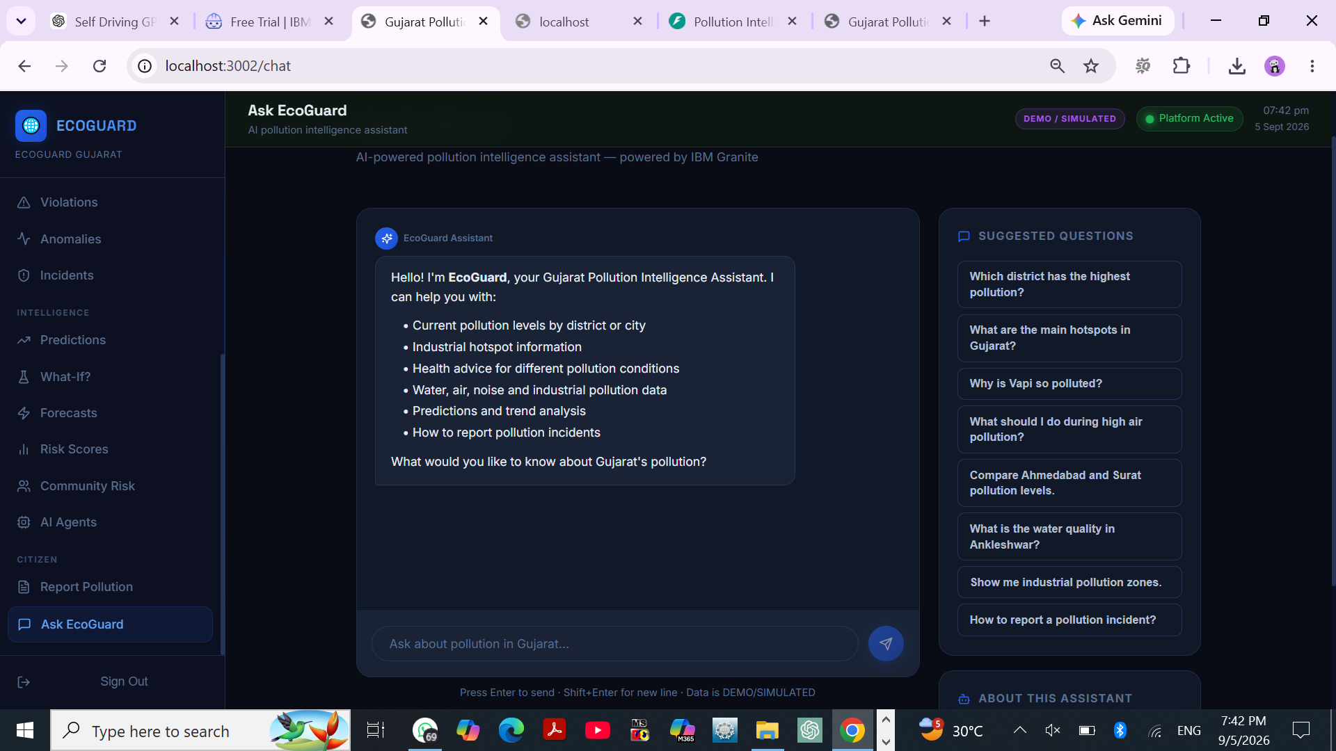

Slide 27
• IBM Bob – AI-assisted software development and agentic application generation. • IBM Granite – LLM reasoning, summarization, explanations and recommendations. • React + TypeScript – responsive web interface and dashboards. • Python + FastAPI – backend services and REST APIs. • Leaflet – interactive Gujarat pollution map and hotspot visualization. • REST/JSON APIs – communication between frontend, backend and intelligence services. • Local database + seeded/demo data – supports the working demonstration and can be replaced by live streams. Design principle: modular agents + shared services + explainable outputs.

Slide 28
Agents / Components Used
1) Emission & Effluent Monitoring Agent – monitors pollution parameters and identifies abnormal readings. 2) Violation & Compliance Agent – detects threshold/compliance violations and prioritizes cases. 3) Regulatory Alert & Escalation Agent – turns high-risk findings into actionable alerts and escalation paths. 4) Public Health Risk Assessment Agent – interprets severity and potential community risk. 5) Industrial Pollution Dashboard Agent – coordinates KPIs, maps, incidents and decision summaries.
6) Anomaly Detection Agent/Module – Identifies unusual pollution patterns and detects abnormal sensor readings.
7) Pollution Forecasting / Prediction Agent – Analyses historical pollution data to forecast future pollution levels and emerging risks.
8) Citizen Assistant / Pollution Chat Agent – Provides citizens with pollution information, answers queries, and offers guidance based on environmental conditions.
9) Incident Management Agent/Module – Tracks pollution incidents, manages reported cases, and supports timely response and resolution.

Slide 29
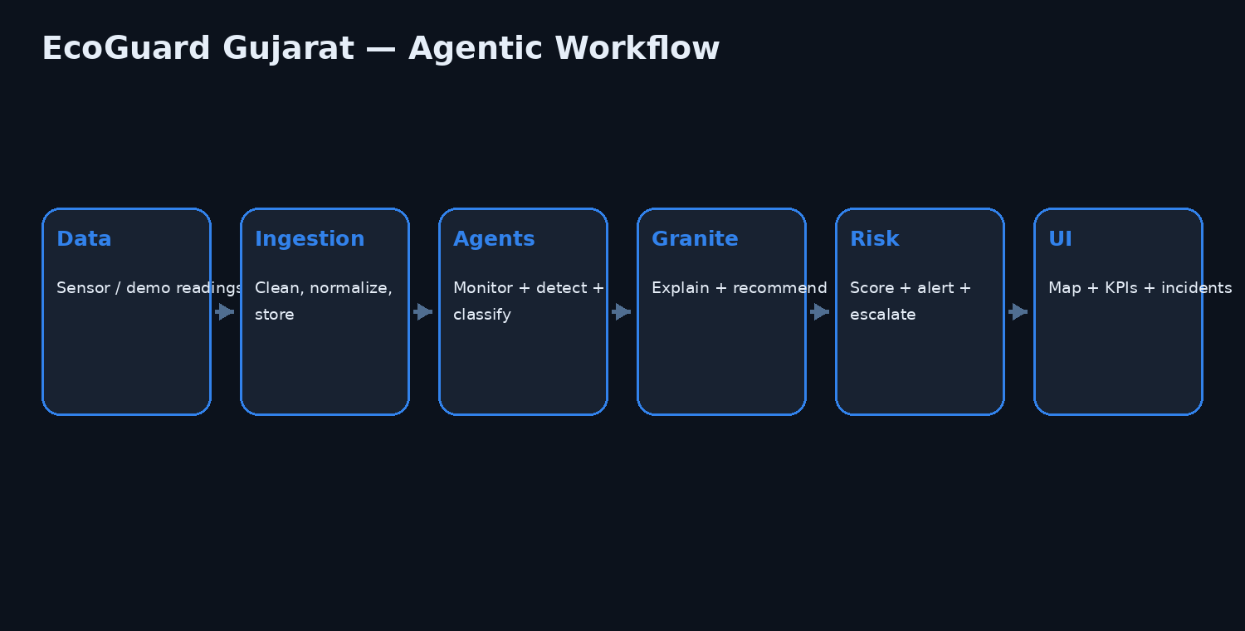
Agentic AI Workflow

Slide 30
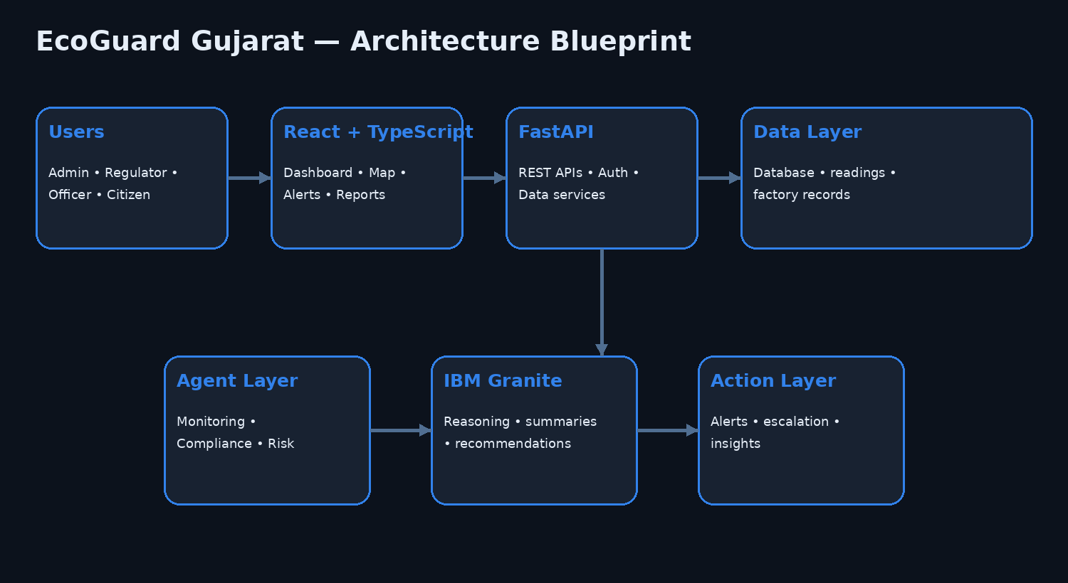
Architecture Blueprint

Slide 31
Role of Agentic AI in the Solution
EcoGuard Gujarat uses Agentic AI to move beyond a static monitoring dashboard. • Goal-driven analysis – agents inspect pollution data against rules, patterns and risk criteria. • Multi-agent collaboration – monitoring, compliance, risk and alerting functions work as specialized modules. • Context-aware decisions – abnormal readings can be combined with factory, location, severity and historical context. • Explainable outputs – IBM Granite can turn technical findings into concise reasons and recommended actions. • Proactive response – high-risk findings are surfaced as alerts instead of waiting for manual inspection. • Human-in-the-loop operations – regulators and officers remain responsible for final regulatory action.

Slide 32
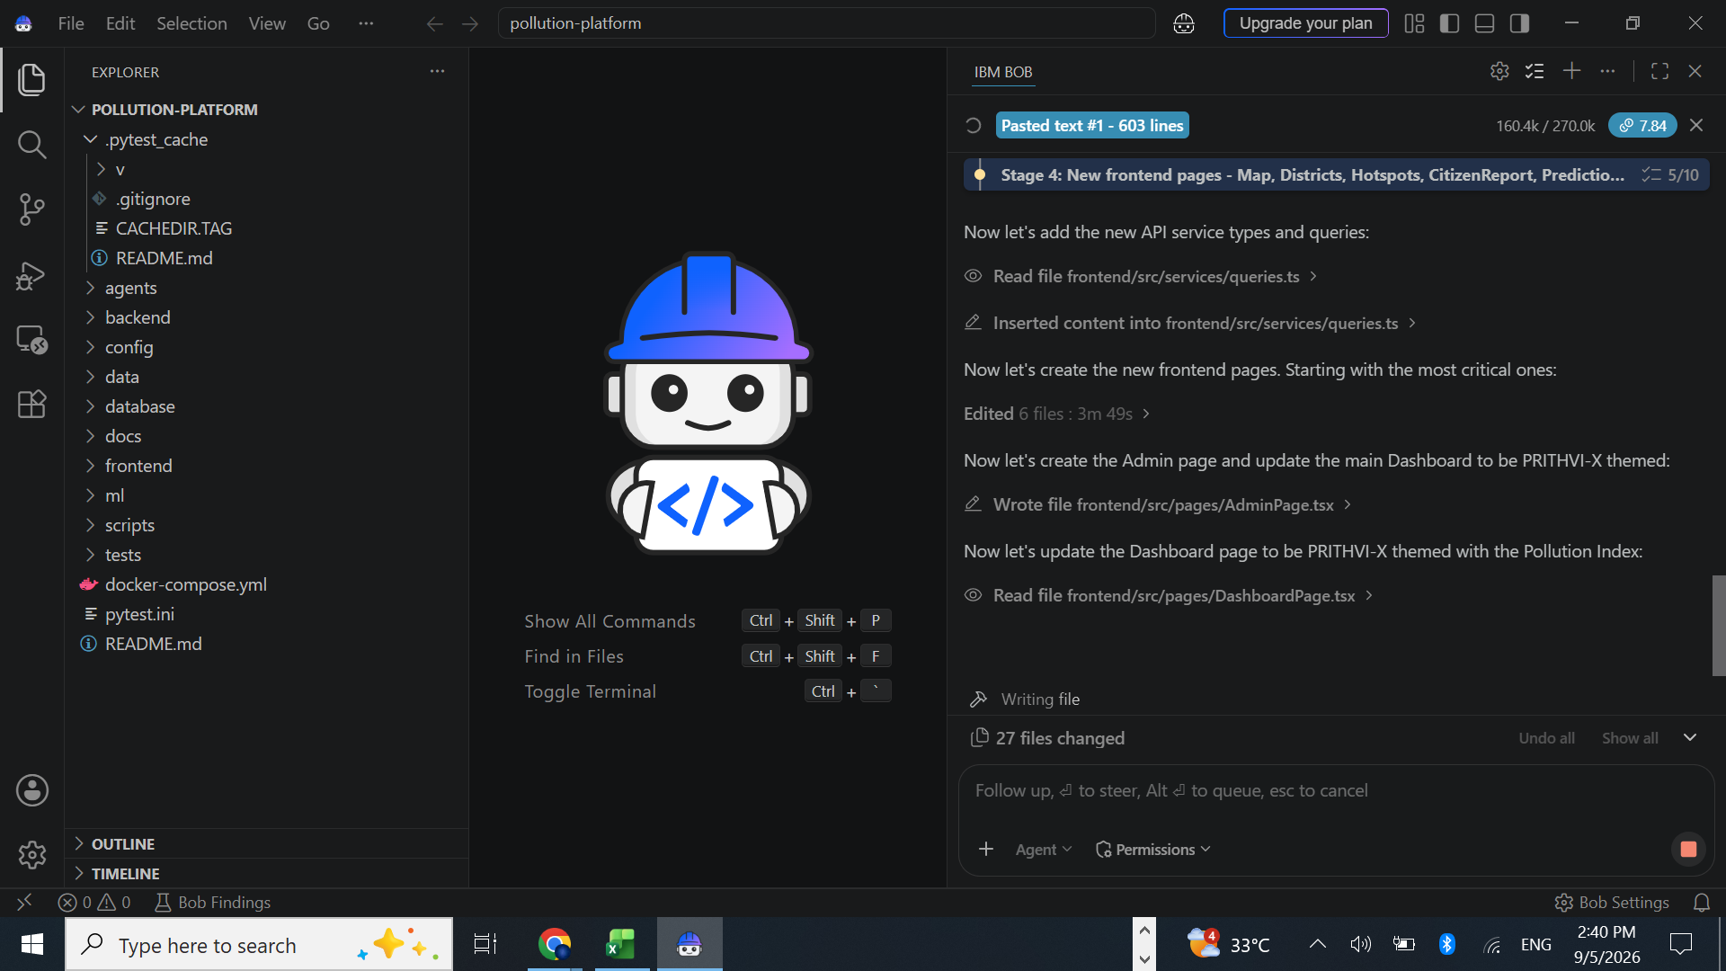
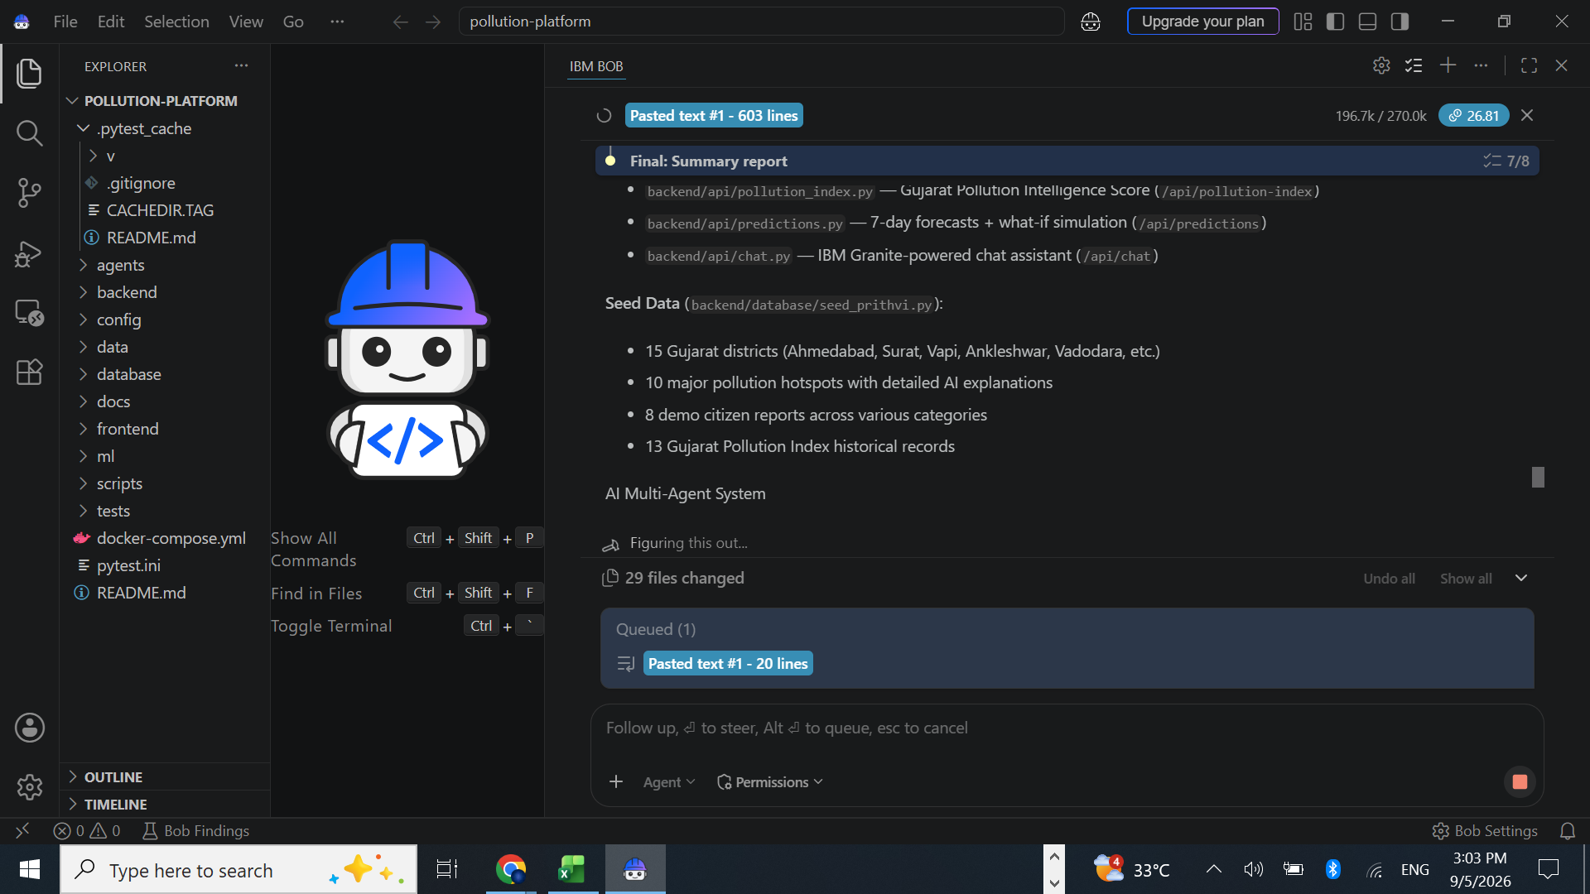
Implementation & Token Usage
IBM Bob usage is session-dependent. Development was completed in targeted stages so later changes could reuse the existing application rather than rebuilding the platform. Optimization approach • Reuse existing components and APIs. • Make targeted code changes. • Avoid unnecessary UI redesign. • Keep backend and frontend structure stable where possible. The screenshots show IBM Bob development iterations used to build and refine the working platform.

Slide 33
Novelty and Uniqueness
Multi-pollutant intelligence – air, water, industrial emissions, noise and waste are represented in one system.
Multi-agent architecture – specialized agents handle monitoring, compliance, risk assessment and alerts.
Unified risk view – pollution score, violations, anomalies, alerts and incidents support faster prioritization.
Geospatial intelligence – the Gujarat Map connects pollution severity with districts, factories and hotspots.
Explainable actions – AI insights address what happened, why it matters and what should be checked next.
Scalable foundation – demo data can be replaced with live sensor/API streams without changing the overall user experience.

Slide 34
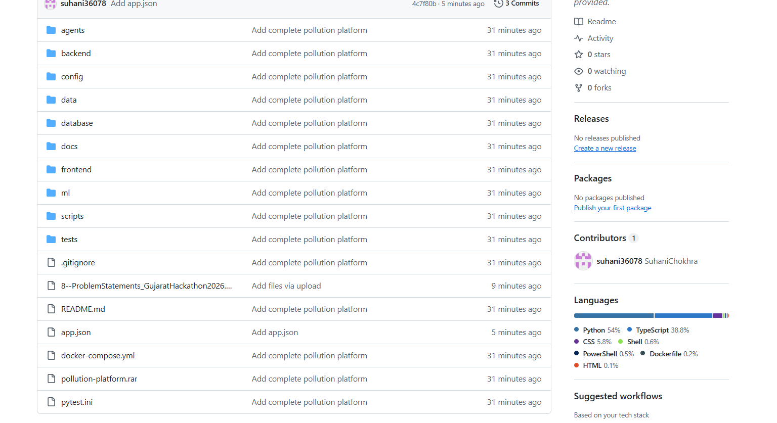
GitHub Link & Submission Package
GITHUB URL:- https://github.com/suhani36078/EcoGuard-Gujarat

Slide 35
Future Scope
1. Live Sensor & Government Data Integration – connect verified GPCB/CPCB/IoT streams for continuous monitoring. 2. Gujarati Voice & Citizen Reporting – enable multilingual text/voice pollution complaints. 3. Predictive Compliance – forecast likely violations and recommend preventive inspections. 4. Satellite & Remote-Sensing Layer – add geospatial evidence for industrial zones and hotspot validation. 5. Automated Regulatory Workflow – route alerts to responsible authorities and track acknowledgements. 6. Cloud Deployment & Scaling – support statewide monitoring with secure role-based access and audit logs.

Slide 36
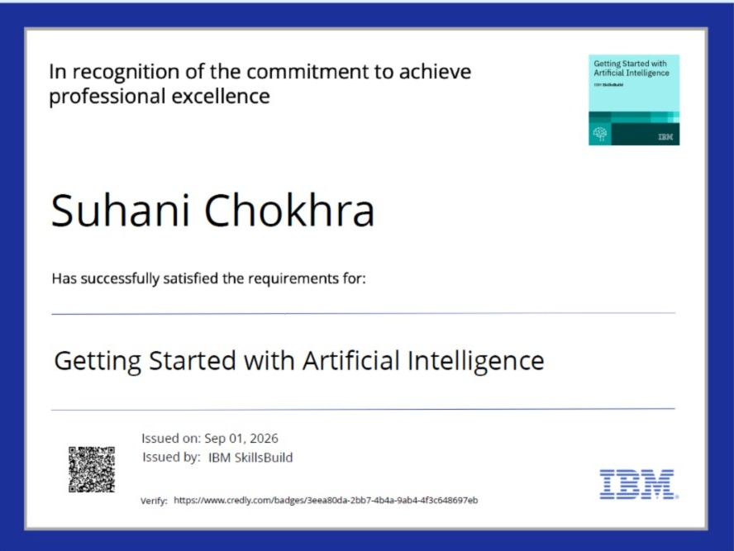
Certificates Earned:
Add your Credly / IBM SkillsBuild certificate screenshot here

Slide 37
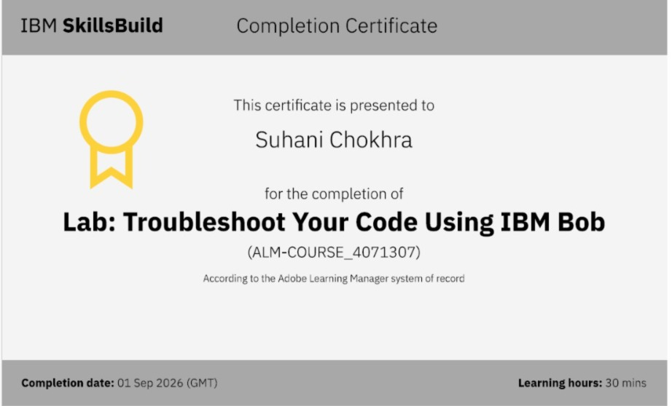
Certificates Earned:
Add your IBM BOB certificate screenshot here

Slide 38

EcoGuard Gujarat • Agentic AI for Industrial Pollution Intelligence

