Slide 1
DEVOPS FINAL CAPSTONE
TeamDesk
An employee directory on AWS EKS
Suhani Awasthi
16 October 2026
TEAMDESK
01

Slide 2
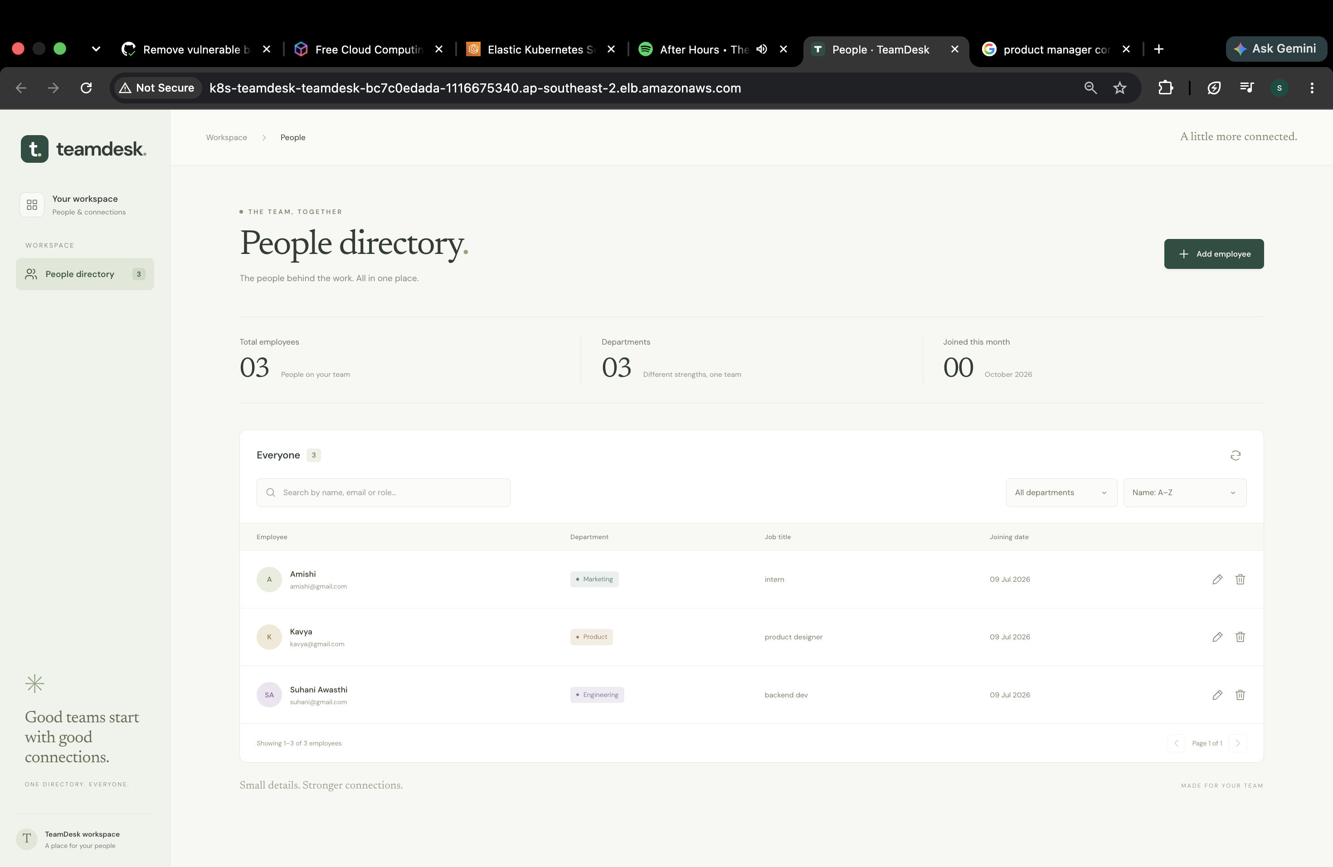
M1 APPLICATION
The employee directory
People in one place
Names, emails, roles, departments and joining dates.
Everyday actions
Add, edit and remove employees. Search and filter the directory.
Application stack
React and Nginx
FastAPI
PostgreSQL 17
TEAMDESK
02

Slide 3
M1 APPLICATION
API and database
Employee endpoints
Data integrity
GET
/api/employees
List employees
Alembic migrations
Unique email addresses
Input validation
GET
/api/employees/{id}
Read one record
POST
/api/employees
Create a record
Operational checks
PUT
/api/employees/{id}
Update a record
/health for liveness
/ready for database access
/metrics for monitoring
DELETE
/api/employees/{id}
Remove a record
TEAMDESK
03

Slide 4
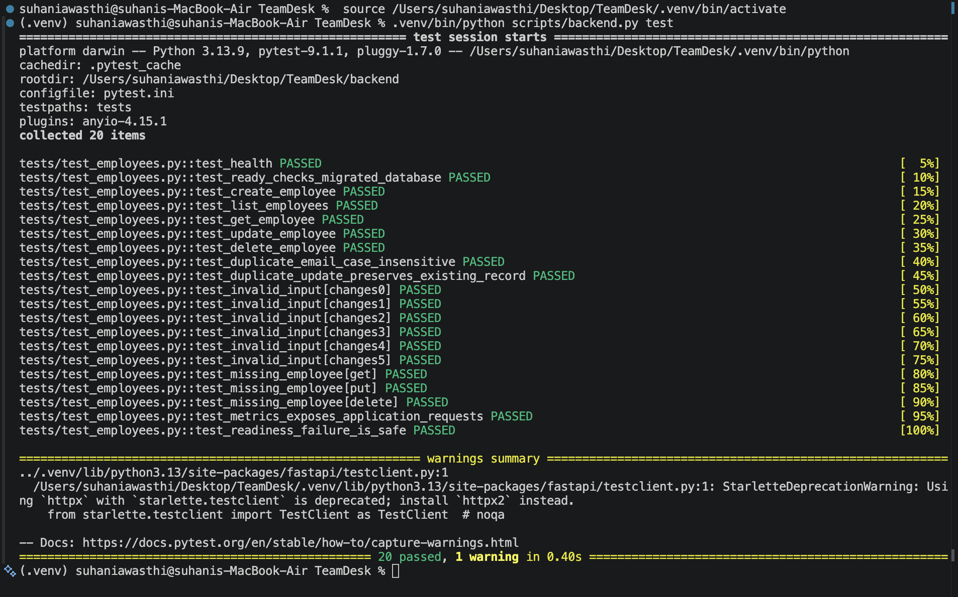
M2 TESTING AND CODE QUALITY
20 API tests pass
20 test cases
CRUD, validation, health, readiness and metrics.
Isolated database
Separate PostgreSQL test database with transaction rollback.
Quality gate
Pytest and Ruff run before container builds.
TEAMDESK
04

Slide 5
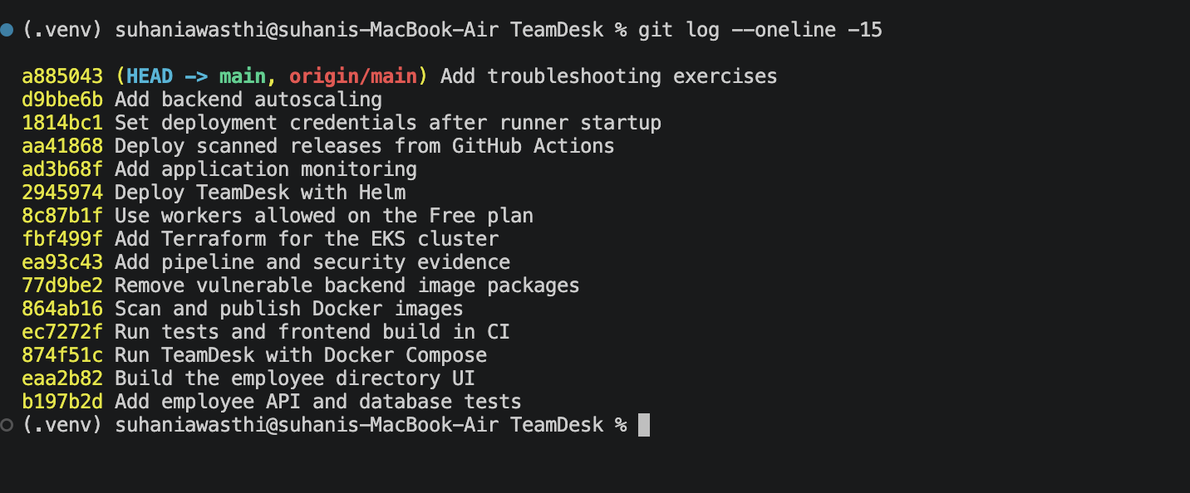
M3 GIT AND GITHUB
A traceable Git history
15 meaningful commits
Public repository: github.com/suhaniawasthi10/TeamDesk-
TEAMDESK
05

Slide 6
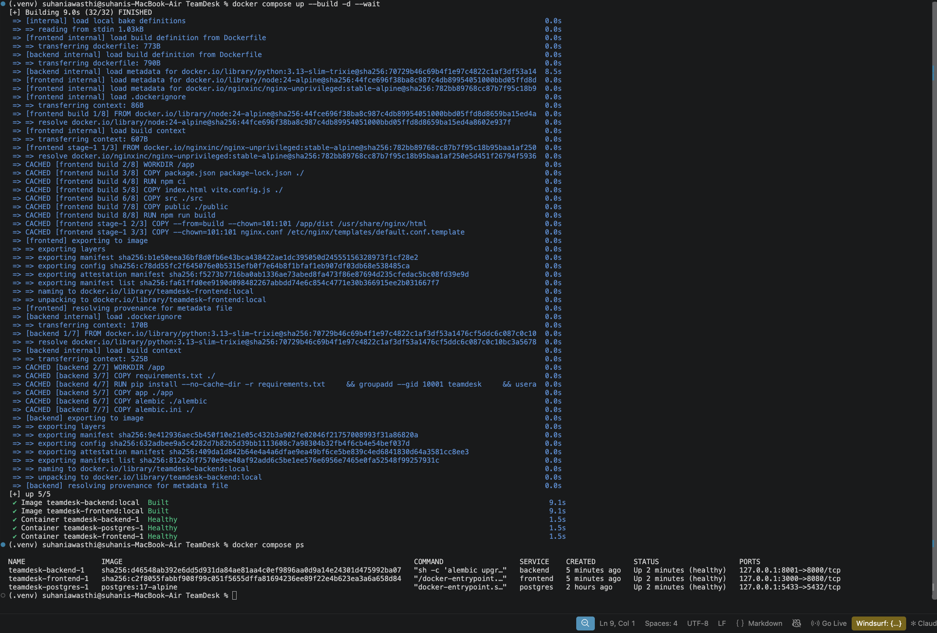
M4 DOCKER AND COMPOSE
One command runs the stack
Three services
Frontend, backend and PostgreSQL start together.
Non-root runtime
Backend UID 10001
Frontend UID 101
Frontend image
Node build stage with an Nginx runtime.
docker compose up --build
TEAMDESK
06

Slide 7
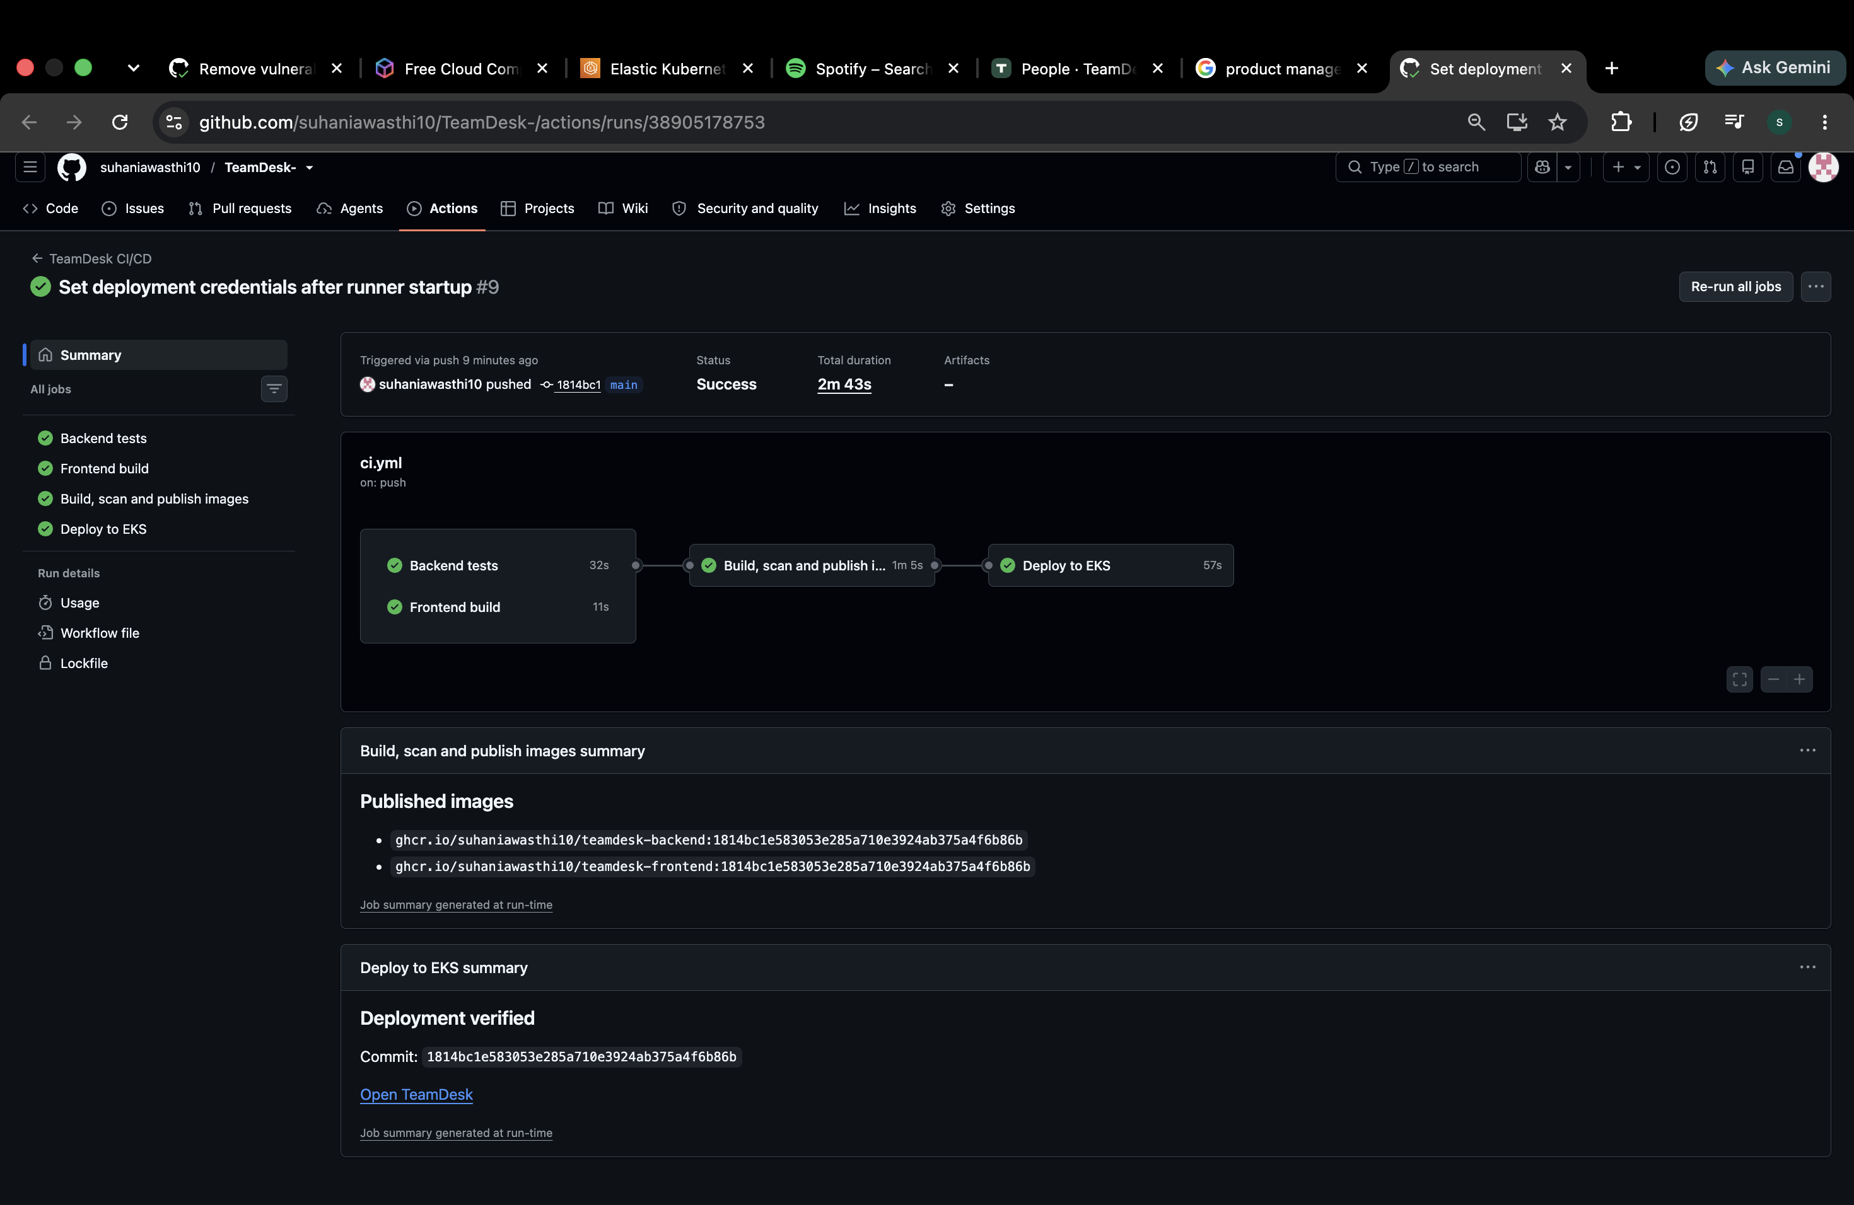
M5 AND M10 CI/CD AND DEPLOYMENT
A push reaches EKS automatically
Four passing jobs
Tests, frontend build, image publication and EKS deployment.
SHA image tags
Both GHCR images use the full Git commit SHA.
Release verification
The running API reports the expected commit version.
TEAMDESK
07

Slide 8
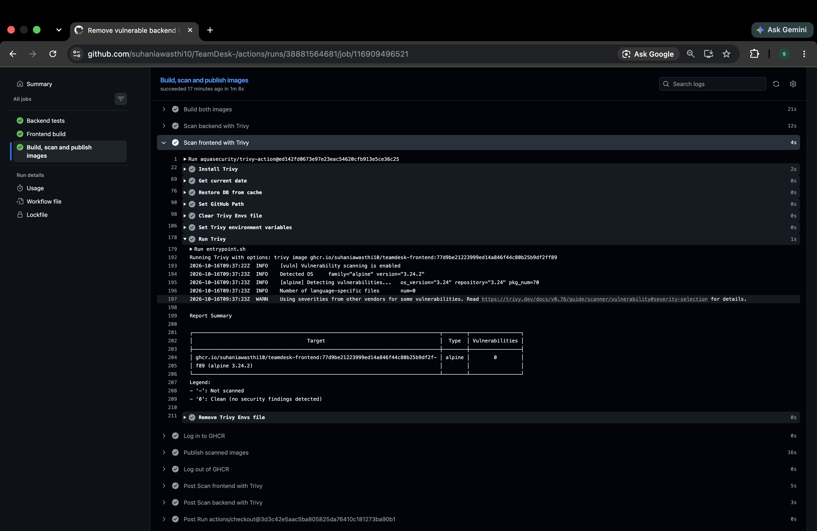
M6 DEVSECOPS
Security checks block unsafe images
Both images scanned
Backend and frontend must pass before publication.
Blocking threshold
HIGH and CRITICAL findings fail the job.
A real remediation
Removed vulnerable build tooling from the backend runtime.
TEAMDESK
08

Slide 9
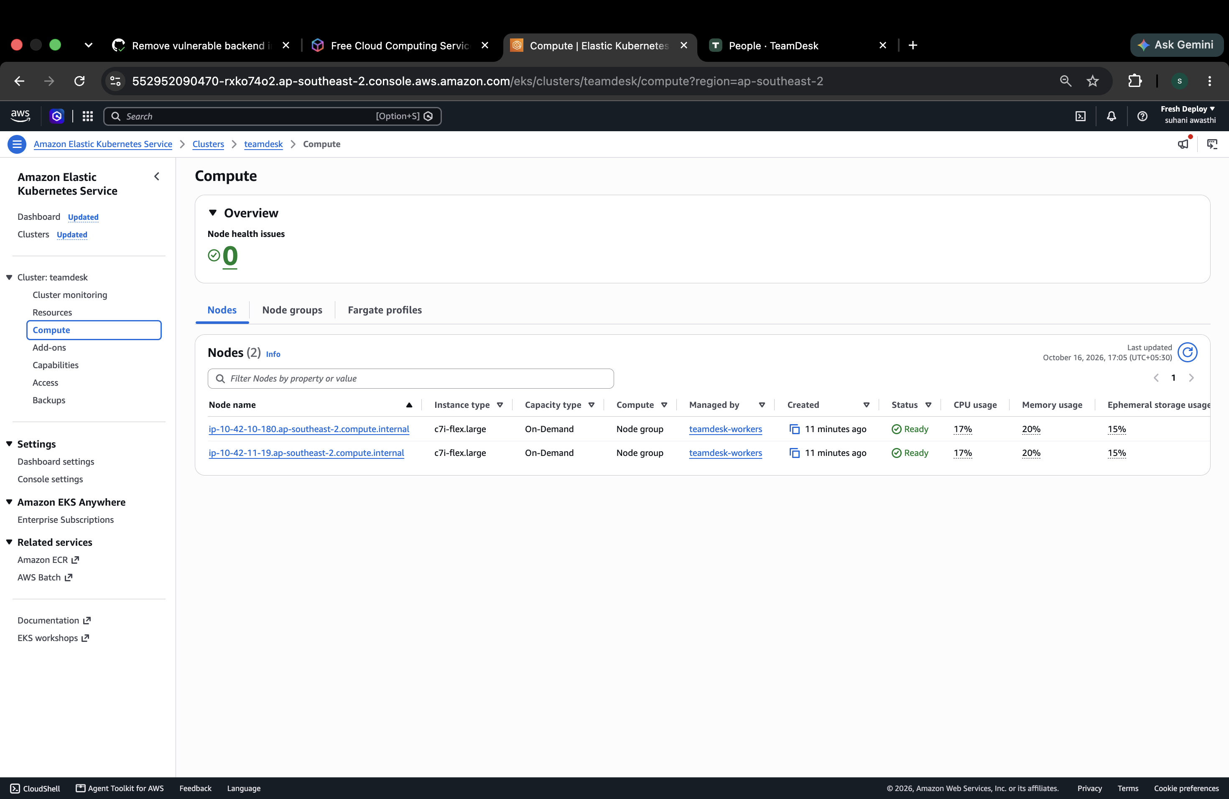
M7 INFRASTRUCTURE AS CODE
Terraform provisions the AWS stack
Sydney region
ap-southeast-2
EKS 1.35
Network
Two public and two private subnets across two zones.
Worker group
Two c7i-flex.large nodes in private subnets.
TEAMDESK
09

Slide 10
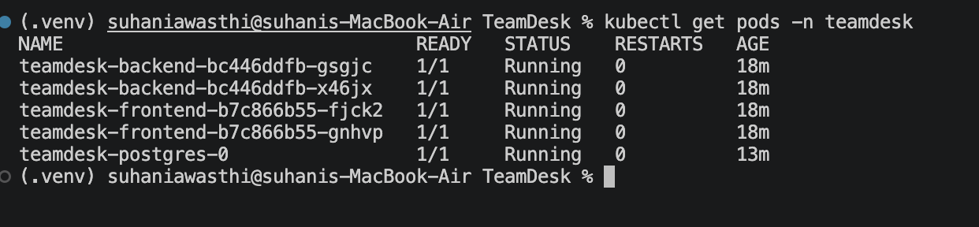
M8 KUBERNETES AND HELM
Helm manages the application
2 backend replicas + 2 frontend replicas
ClusterIP Services and an ALB Ingress
TEAMDESK
10

Slide 11
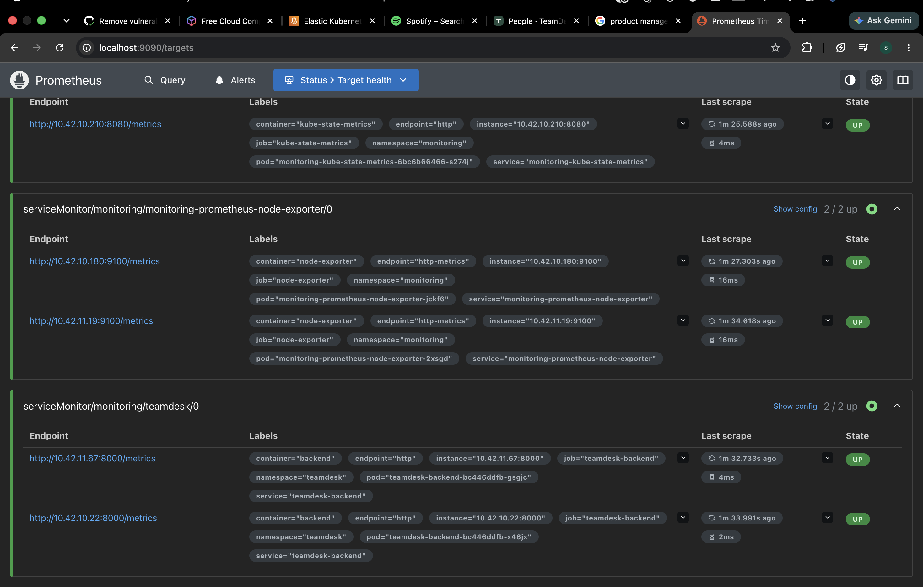
M9 OBSERVABILITY
Prometheus scrapes both backends
/metrics endpoint
HTTP request counts, duration and response status.
Two healthy targets
Prometheus discovers and scrapes both backend replicas.
Private access
Monitoring tools use ClusterIP Services and port forwarding.
TEAMDESK
11

Slide 12
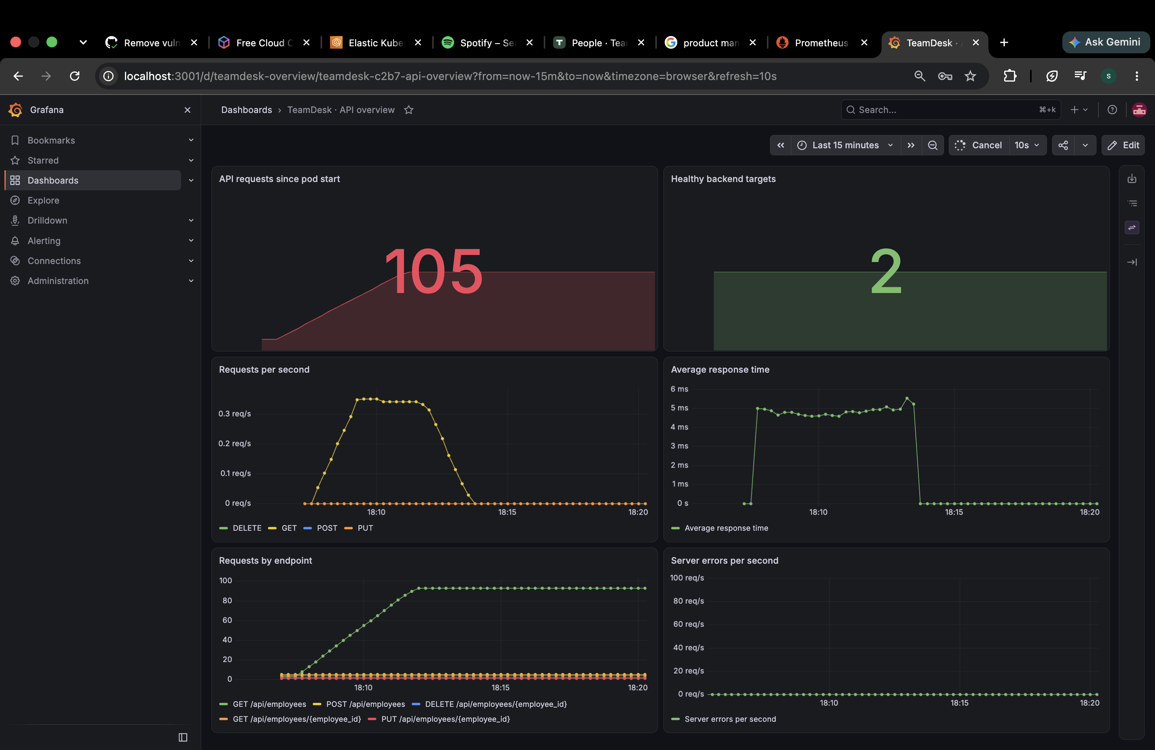
M9 OBSERVABILITY
Grafana shows application traffic
Six live panels
Requests, latency, endpoints, healthy targets and errors.
Captured session
105 requests
2 healthy targets
No server errors
Dashboard in Git
Dashboard JSON and Helm values live in the repository.
TEAMDESK
12

Slide 13
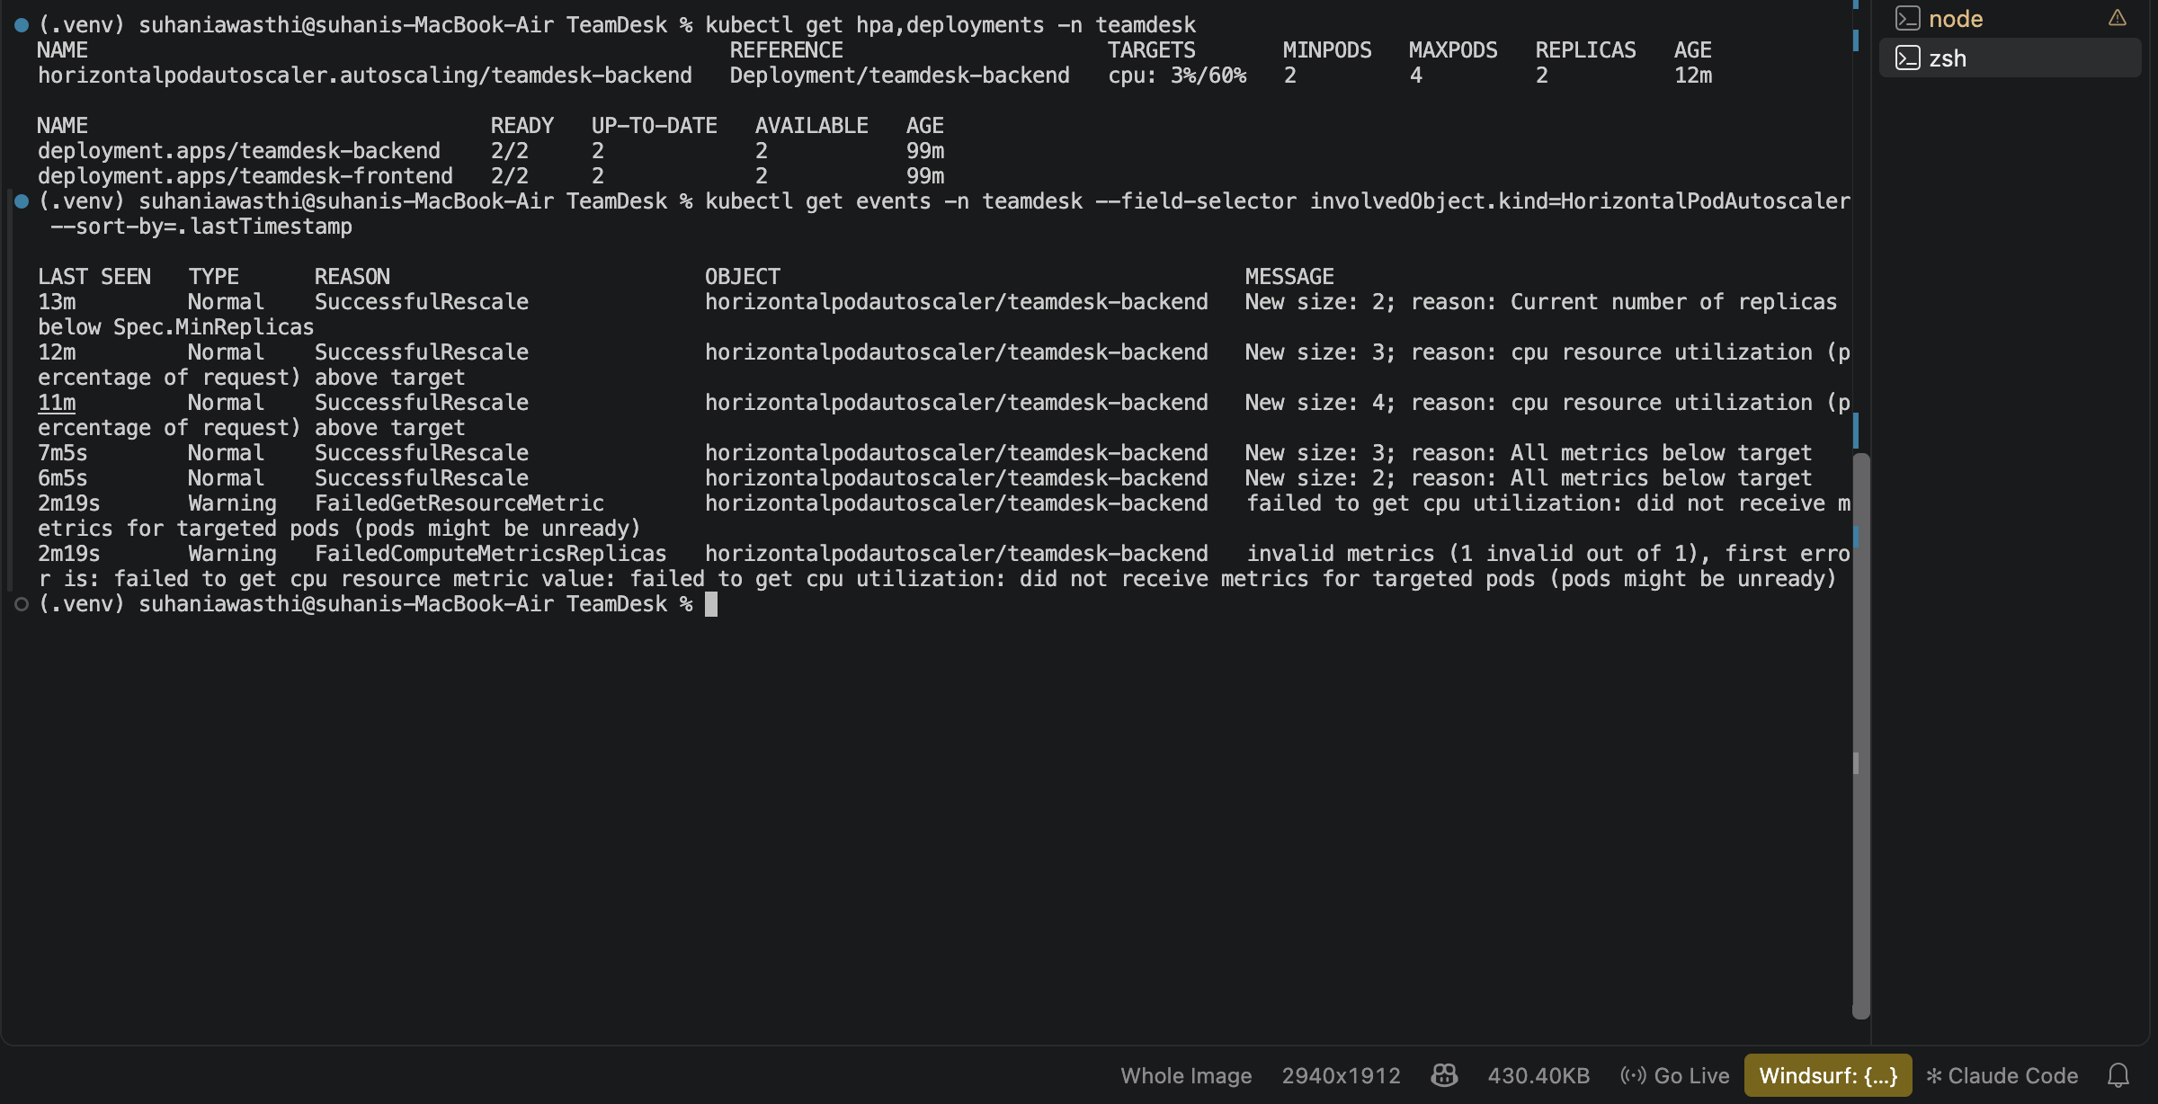
AUTOSCALING DEMONSTRATION
The backend scales with CPU load
21,496
0 errors
successful requests in 180 seconds
2 to 4 replicas, then back to 2
TEAMDESK
13

Slide 14
TROUBLESHOOTING EXERCISES
Two failures, diagnosed and repaired
ImagePullBackOff
Service selector mismatch
Cause
Cause
The image tag did not exist in GHCR.
The selector matched no pods, so the Service had no endpoints.
Repair and verification
Repair and verification
Use a published SHA tag.
The rollout succeeds and the pod is Ready.
Match the pod label.
A ready endpoint appears and the Service returns HTTP 200.
TEAMDESK
14

Slide 15
M7 RESOURCE LIFECYCLE
AWS resource cleanup
01
Disable deployment
Stop automatic releases and revoke the deployment credential.
02
Remove Kubernetes resources
Uninstall releases and remove demo volumes while controllers are running.
03
Destroy infrastructure
Run terraform destroy and verify AWS resource removal.
04
Retain the evidence
Keep the plan, AWS screenshots and destroy completion output.
TEAMDESK
15

Slide 16
M10 PRESENTATION AND DOCUMENTATION
Deployment demonstration
A change in Git becomes a verified release
01
Employee CRUD in the browser
02
A commit and the GitHub Actions run
03
The updated application and matching release SHA
04
Prometheus targets and the Grafana dashboard
github.com/suhaniawasthi10/TeamDesk-
TEAMDESK
16

