Slide 1

Project name Employee Travel Booking Website
Name-Suhani Gaikwad

Slide 2
Content
Introduction
Abstract
Problem Statement
Flow Chart
Application Layer
Business Access Layer
Data Access Layer
Module Of Projects
Project Screens
Conclusion

Slide 3
Introduction
Employee Travel Request Management Provides Ticket Raising facility for employee to travel for business related requirement.
Employee Raising Request And Travel Agent Working On Raise Request of Employee To Approve Or Decline.

Slide 4
Abstract
The Employee Travel Booking Application streamlines travel requests for employees, allowing them to submit requests for domestic and international business travel. The system automates the process, enabling employees to request travel, managers to approve or reject, and travel agents to confirm or mark as "Bookings not available."

Slide 5
Problem Statement
To Give Employee The Platform To Raise a Request and to perform further action by travel agent like approve , reject .
Our Priority will be our Employee Requests and there Travel Status Approval.
We are be giving fields for employee to enter the correct data fields .

Slide 6
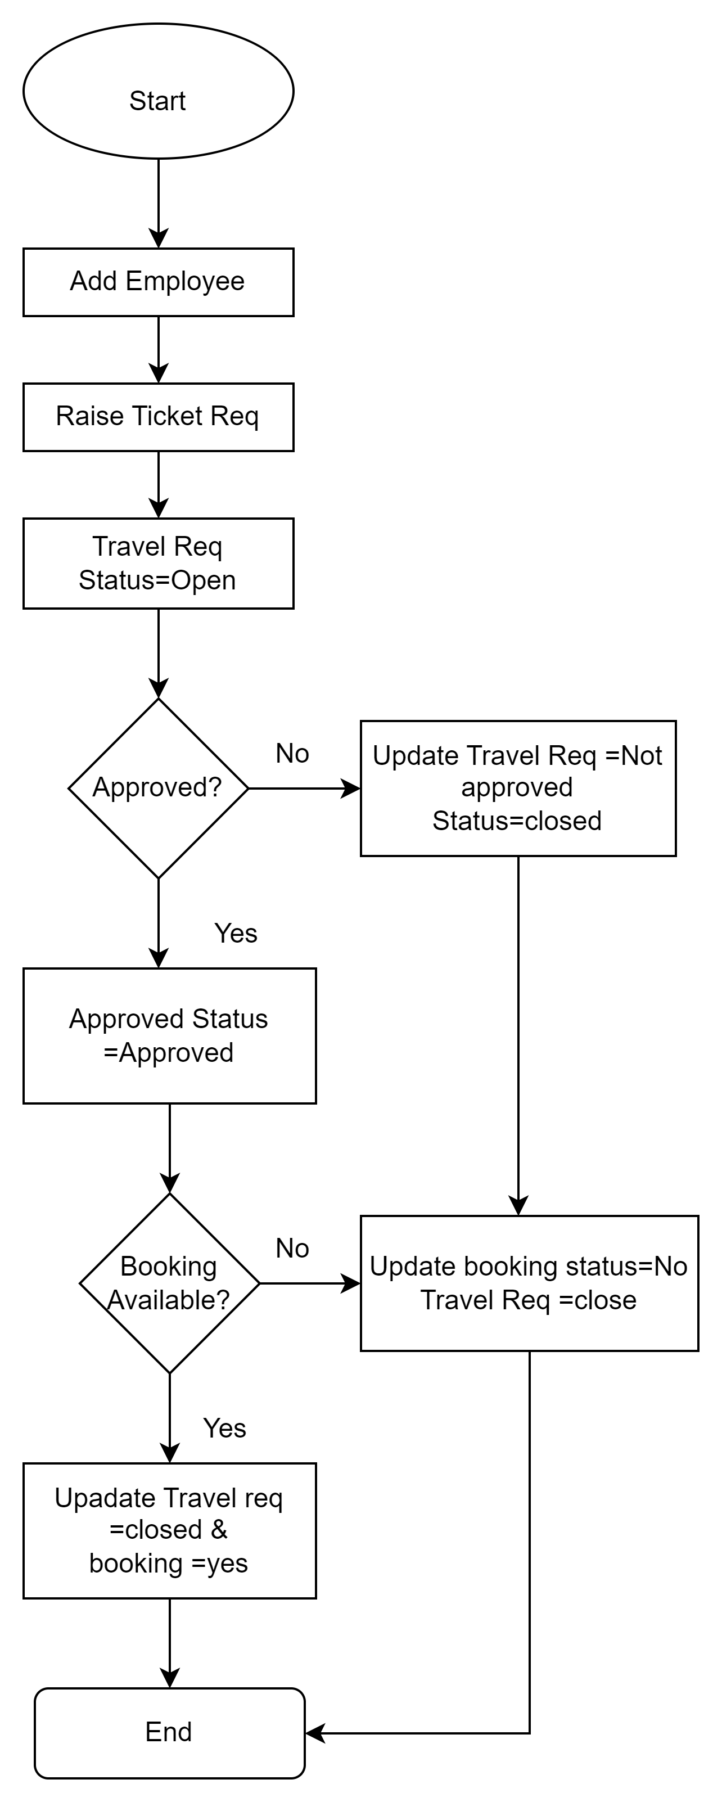
Flow Diagram

Slide 7
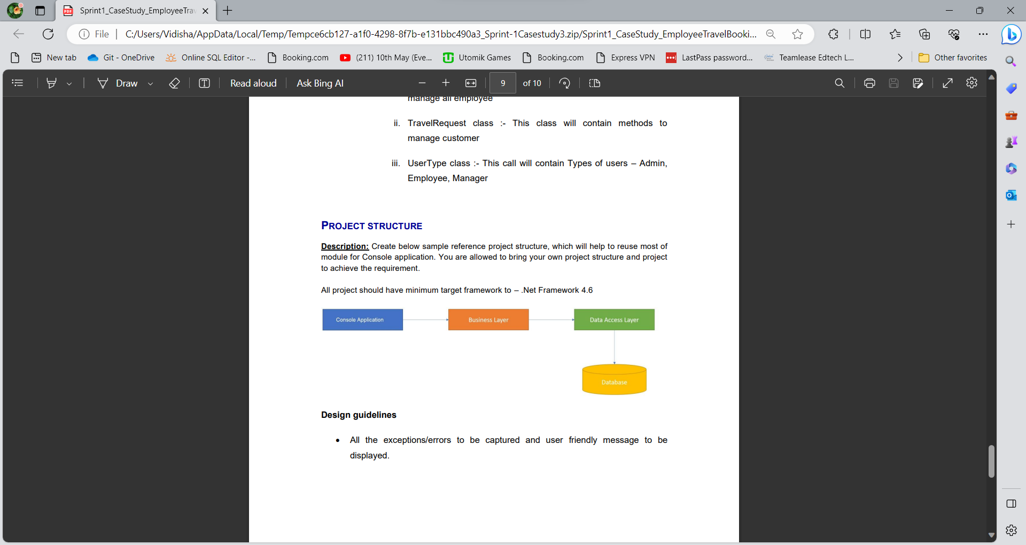
Fig:-Flow Of Application

Slide 8
Data Access Layer
Data Access Layer (DAL) is responsible for handling data-related operations and interactions with the underlying data storage, typically a database.
It provides methods and functions to insert, update, delete, and retrieve data records. For the travel request manager, the DAL might handle actions like creating new travel requests, updating request status, and retrieving request details.
It includes error handling mechanisms to deal with database-related exceptions or issues, providing meaningful error messages or logging for debugging purposes.

Slide 9
Business Access Layer
Business Access Layer (BAL) is a crucial component responsible for managing the business logic and data interactions. It acts as an intermediary between the user interface and the data storage, ensuring that all business rules and processes are properly enforced.
Business Logic: It encapsulates the business rules and logic, such as travel request validation, approval workflows, and status updates. For example, it ensures that travel requests meet specific criteria before they can be approved.

Slide 10
Modules Of Project
Main Menu
Add Employee
Travel Request

Slide 11
Modules Of Project
Employee:-
Add Employee Information
Edit Employee Information
View All Employee
Delete Employee

Slide 12
Travel Request
Raise Travel Request
Edit Travel Request
Show All Requests
Delete Travel Request
Approved Status
Confirm Booking Status
Action on Current Status
Show By Specific Location
View Pending and Approved Status

Slide 13
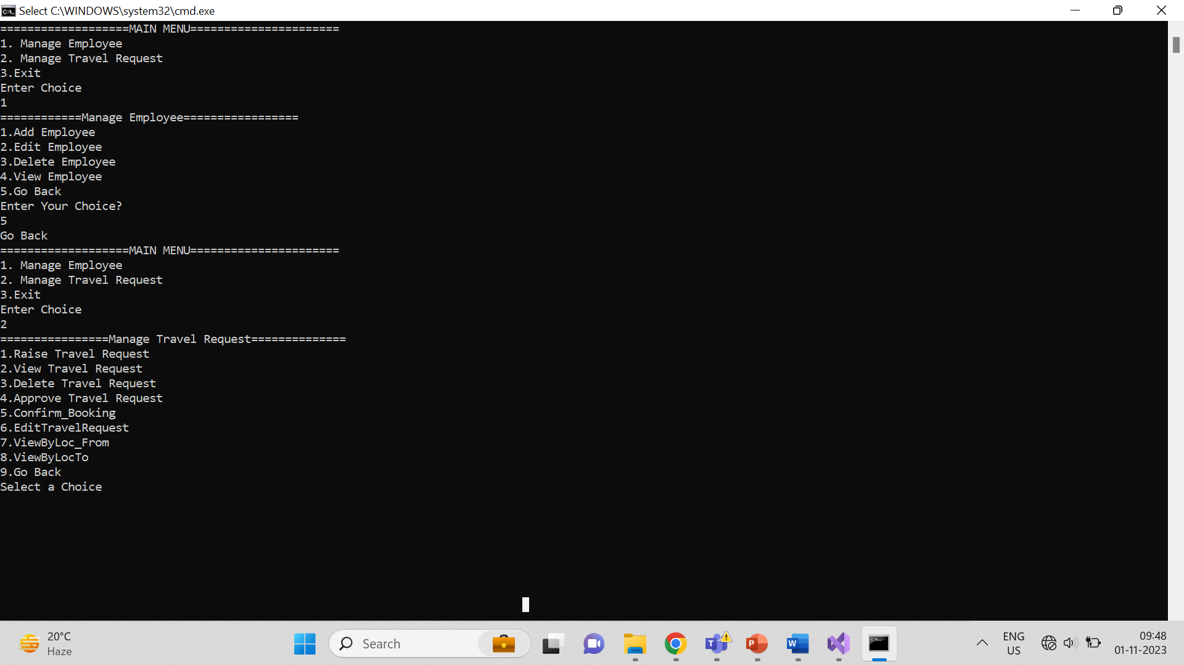

Slide 14
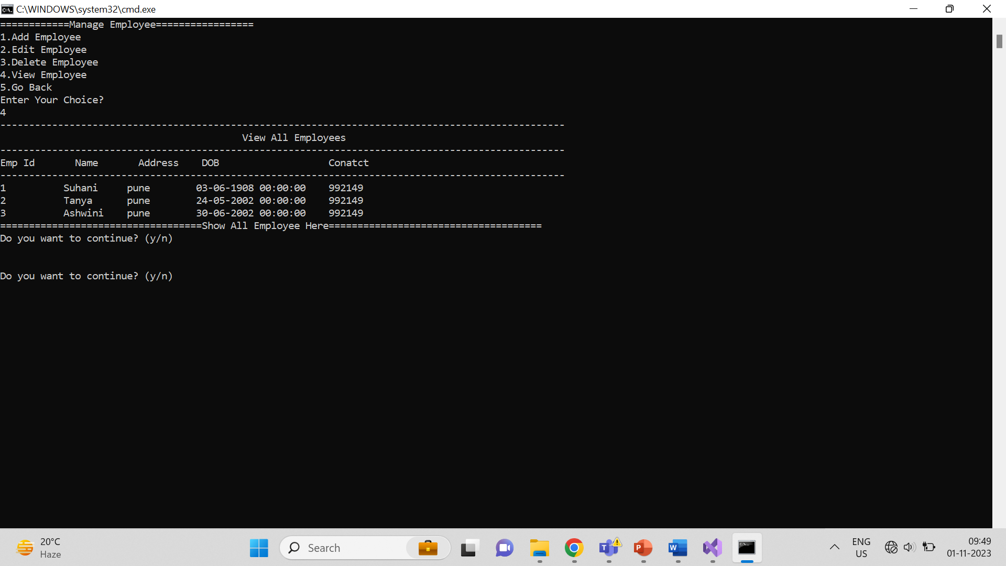

Slide 15
Development Components
•.NET Framework: core development framework.
•C# Programming Language: Primary language used.
•Visual Studio 2022: The Integrated Development Environment (IDE)
•Class Library (.NET Framework): Used to create class objects and relationships.
•Console Application (.NET Framework): The application's user interface.
•Git for Version Control: Ensuring code versioning and collaboration.

Slide 16
Conclusion
The console application streamlines and automates the process of submitting, approving, and managing employee travel requests, making it more efficient and convenient for both employees and managers.
The application provides a user-friendly console interface, allowing employees to submit travel requests and managers to approve or reject them with ease. This simplicity enhances user adoption and reduces training requirements.
The application employs well-structured Business Access Layer (BAL) and Data Access Layer (DAL) components to manage business rules, data interactions, and data storage effectively.

Slide 17
Thank You..!

