Slide 1

MTR-KV
Motion to Residency Reconciliation
Artificial Intelligence BCSE306L
Professor Jayalakshmi P
Suhani Gupta 24BDE0042
Kunwar Shaurya Pratap Singh 24BDE0061
Kanan Tayal 24BDE0040
Notes:
Good morning ma'am. We are Suhani Gupta, Kunwar Shaurya Pratap Singh, and Kanan Tayal. Our project is MTR-KV, which stands for Motion to Residency Reconciliation. We use motion information from compressed video to guide the storage of intermediate data used by an AI attention layer. I will first explain the problem, then the workflow, and finally the measured results and limitations.
Source: MTR-KV project README.md and source modules in the supplied project snapshot.

Slide 2
The project in one sentence
We use video motion to guide where
AI attention data is stored.
A still background may need different treatment from a moving object.
The controller checks safety before the model uses the data.
02
Notes:
We use video motion to guide where attention data is stored. Imagine a video with a still background and a moving object. Different regions may need different treatment. We first use motion as a clue. We then check temporal history and model feedback before making or correcting a memory decision. The important point is that motion is only evidence. Quiet content can still matter to the model.
Source: MTR-KV project README.md and source modules in the supplied project snapshot.

Slide 3
Three terms used in this project
Term | Simple meaning
Token and page | A token represents an image patch. A page groups several tokens.
K and V | Keys and values hold intermediate features used by attention.
Residency | The storage location and representation of a page.
03
Notes:
A token represents one small image patch. A page groups several tokens so the controller can manage them together. K and V mean keys and values. They are temporary feature tensors produced during attention, not the learned model weights. Residency means where a page is stored and in which representation. You can remember the project as deciding where attention pages should live.
Source: mtr_kv/data_objects.py, config.py and tensor_store.py. Transformer background: Vaswani et al., Attention Is All You Need, 2017, arXiv:1706.03762.

Slide 4
Why the project is useful
Video frames often contain repeated visual content.
Attention still produces K and V for many image patches.
We study how each page can use a suitable storage representation.
Goal: reduce avoidable storage work while preserving safe access.
04
Notes:
Attention creates key and value tensors for visual patches. Repeated video frames can contain regions that remain quiet, but they can also contain scene changes. A policy that treats every page identically misses this difference. Our project studies how to make more selective residency decisions. We do not assume every quiet region is unimportant, and we do not claim that compression automatically makes the entire model faster.
Source: MTR-KV project README.md and source modules in the supplied project snapshot.

Slide 5
The AI components
ViT-Tiny supplies model feedback.
The model processes small image patches using attention.
Attention scores provide a signal about page importance.
Temporal rules track whether activity stays low or changes.
We use a pretrained classifier. We do not train a new model.
05
Notes:
The prototype uses a pretrained Vision Transformer called ViT-Tiny. We do not train a new neural network. The classifier processes image patches using attention. We derive a page importance signal from class token attention, and a rule based temporal engine reasons about whether motion has stayed low or whether the scene has changed. Our contribution is the connection between these observations and the memory controller.
Source: README.md, mtr_kv/vision_feedback.py, semantic.py and temporal.py. ViT background: Dosovitskiy et al., An Image is Worth 16x16 Words, ICLR 2021, arXiv:2010.11929.

Slide 6
How one video frame moves through the system
01
Read motion information from the encoded video.
02
Match video regions to the model's image tokens.
03
Use recent history to choose a storage tier.
04
Commit the mapping before attention reads the page.
Model feedback can request a correction through the same controller.
06
Notes:
First, the decoder reads the compressed video and extracts available motion vectors. Second, the reconciliation engine matches codec regions to image tokens. Third, the temporal engine considers the current motion together with recent history. Fourth, the memory controller commits a page mapping before the attention block reads it. Model feedback can later request a promotion through the same controller.
Source: MTR-KV project README.md and source modules in the supplied project snapshot.

Slide 7
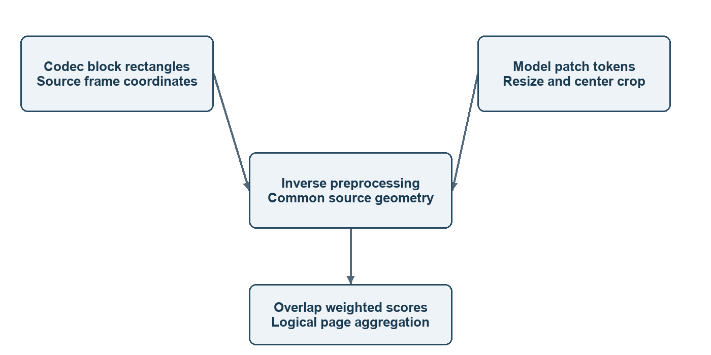
Matching motion regions to image tokens
The codec uses video blocks.
The model uses image patches.
We map both to the original
frame before comparing them.
This step prevents incorrect motion to token matching.
07
Notes:
The video codec divides a frame into blocks, while ViT divides its input into patches. These boundaries do not necessarily match. The model also resizes and crops the image. We reverse that preprocessing transformation and put both kinds of region into the same source coordinate system. Overlap then tells us which motion observations contribute to each token. MTRE stands for Motion to Token Reconciliation Engine.
Source: mtr_kv/mtre.py, docs/OPTIMIZATION.md. Diagram: geometry.png in the final report assets, derived from the source interfaces.

Slide 8
The three live storage tiers
Tier | Representation | Simple explanation
T0 | fp16 | Keep the preferred tensor format.
T1 | int8 on CPU | Use reduced precision.
T2 | Compressed fp16 on CPU | Store compressed tensor bytes.
The controller chooses a tier for each logical page.
08
Notes:
T0 keeps fp16 tensors on the selected torch device. The recorded demo selects CPU. T1 stores a symmetric int8 representation on CPU, which can reduce precision and introduce error. T2 compresses fp16 bytes on CPU and decompresses them when needed. The tier labels describe implemented representations, not a measured three level GPU memory hierarchy. Their conversion and compression can also add overhead.
Source: mtr_kv/tensor_store.py and README.md.

Slide 9
Recent history changes the decision
Moving content stays active.
Repeated quiet frames can make a page static.
A scene change resets assumptions about stability.
Missing motion information triggers conservative handling.
09
Notes:
One low motion observation is not enough to prove stability. The temporal engine uses thresholds and counters. Reliable high activity leads to ACTIVE behavior. Repeated low activity can reach STATIC. Scene changes lead to TRANSITIONING, while missing or low confidence metadata leads to UNKNOWN and conservative handling. The reference low and high thresholds are 0.20 and 0.35, with persistence and stable parameters of four and six frames.
Source: mtr_kv/temporal.py and config.py.

Slide 10
Quiet content can still be important
Example: a stationary sign may
still matter to the model.
Motion alone may suggest that its page is quiet.
Model feedback can promote the page to a preferred tier.
This correction favors useful information over maximum savings.
10
Notes:
Imagine a stationary sign in a video. It may have little motion but still influence the classifier. The semantic correction path uses a model derived attention score to identify a page that may deserve a preferred representation. It sends a promotion request through the controller. The T03 simulator example illustrates this behavior: full correction rescues 40 pages and therefore reports less modeled storage savings than codec only mode. Attention scores are a signal, not ground truth semantic importance.
Source: docs/DEMO.md, mtr_kv/semantic.py, configs/reference.json and tmp/local-check/simulation.json.

Slide 11
Reuse needs more than low motion
The page must have reliable quiet history.
Its input features must exactly match the previous frame.
The current frame must have a valid ready mapping.
If a check fails, we recompute K and V.
11
Notes:
This is the most important safety point. Even if pixels appear still, earlier transformer layers may change their features. We therefore compare the actual input features of a page at the final attention block. Reuse requires exact equality plus valid controller identity, a current ready mapping, and an age within the reuse window. The default age bound is eight processed generations. If any check fails, the adapter recomputes K and V. A generation is the identity of one processed frame.
Source: docs/KV_REUSE.md and mtr_kv/vision_feedback.py.

Slide 12
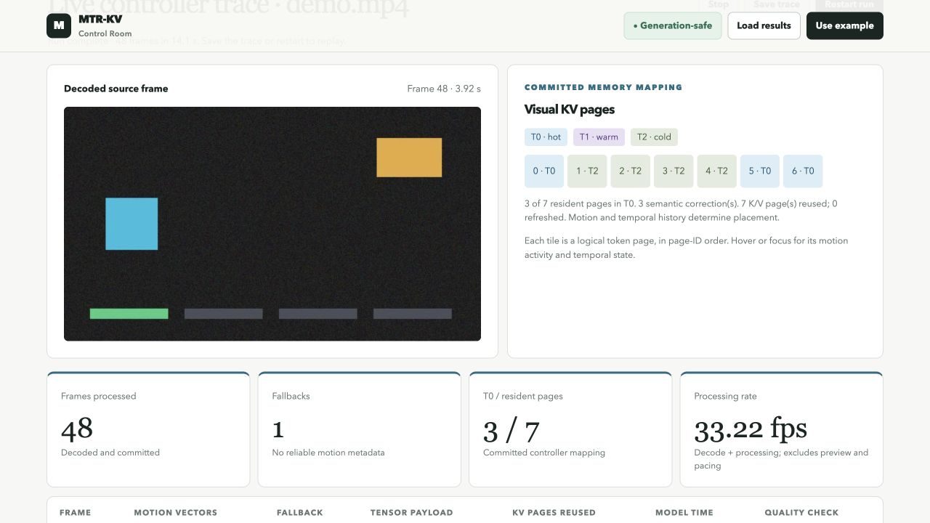
The demonstration dashboard
Recorded interface: the video and mapping show the same processed frame.
12
Notes:
The left side shows the decoded video. The right side shows the committed logical K/V pages and their selected tiers. Page tiles represent groups of tokens, not rectangular image areas. The generated clip has four phases: still content, motion, still content again, and a scene cut. Restart replays it, and Save trace exports measured JSONL records. This screenshot is a recorded interface example. Its instantaneous displayed processing rate is not the paired benchmark result on the next slide.
Source: docs/DEMO.md and output/evidence/prototype-video-and-pages.png.

Slide 13
Measured reconciliation performance
52.34%
lower median mean
frame time in the
paired CPU comparison
Oracle: 55.570 ms. Indexed: 26.484 ms.
This compares reconciliation paths. It does not establish overall ViT speedup.
13
Notes:
The exhaustive implementation checks geometry directly and acts as a correctness oracle. The indexed implementation narrows the block candidates. The repository records three alternating paired runs using the same input and principal settings. Each run decodes 60 frames and excludes the first six from timing summaries. The medians of the per run mean frame times are 55.570 and 26.484 milliseconds, which gives a 52.34 percent reduction. Matching paired controller decision hashes support equivalent decisions on these runs. This comparison is between reconciliation paths in the CPU pipeline. It includes a baseline inference comparison and is not an overall speedup over standard ViT.
Source: results/optimization-20261021/paired-serial/manifest.json and docs/OPTIMIZATION.md.

Slide 14
Reuse depends on the video content
Measurement | Generated clip | Natural H.264 clip
Compared frames | 216 | 171
Pages reused | 862 | 0
Agreement with standard ViT | 216 of 216 | 170 of 171
Zero reuse is valid when input features keep changing.
14
Notes:
The generated clip contains intentionally repeated content and records 862 page reuses over 216 frames. The natural H.264 clip records zero exact reuse over 171 frames, which is valid because features may change. The generated clip agrees with standard ViT on all 216 frames. The natural clip agrees on 170 of 171 frames. Agreement compares two implementations of the same classifier. We do not have labeled task accuracy from these numbers. The clips have different lengths and content, so the raw reuse totals do not provide a controlled performance comparison.
Source: results/optimization-20261021/full-demo-serial-evaluation.json and results/freeze-v1/derived-h264-evaluation.json.

Slide 15
Conclusion and next steps
MTR-KV connects video motion
to safe attention data storage.
The current prototype changes one final ViT-Tiny attention block.
The next step is broader video testing and task quality evaluation.
The repository records 128 passed tests.
15
Notes:
Our prototype connects codec motion evidence to safe K/V storage decisions. It combines geometry matching, temporal rules, semantic feedback, and controller checks. The CPU experiment demonstrates an indexed reconciliation improvement and the reuse experiment demonstrates workload dependence. The live integration affects only the final ViT-Tiny attention block, while earlier blocks still execute. The repository retains 128 passed tests, but that is an existing test record rather than a new run on this presentation computer. Future work should test more natural videos, measure labeled quality and total memory, and evaluate a selected GPU or full VLM integration.
Source: README.md, docs/KV_REUSE.md, docs/OPTIMIZATION.md and results/optimization-20261021/test-results.txt.

Slide 16
Viva support Key concepts
Question | Short answer
What are K and V? | They are intermediate features used by attention.
What is a page? | It is a group of image tokens managed together.
Why use motion? | It gives a clue about which content is changing.
Did you train a model? | We use a pretrained ViT-Tiny classifier.
16
Notes:
Use these short answers if the teacher asks for clarification. Keep the first answer to one or two sentences, and expand only if asked. K and V are temporary features for attention. A logical page groups tokens. Low motion is a clue for placement, while exact feature equality decides reuse eligibility. ViT-Tiny is the pretrained classifier we use to demonstrate the model path.
Source: MTR-KV project README.md and source modules in the supplied project snapshot.

Slide 17
Viva support Results and safety
Question | Short answer
Why can natural video show zero reuse? | Exact input features may change every frame.
How do you avoid stale data? | We allow reads only from the matching ready generation.
Is the complete model twice as fast? | We measured an improvement between reconciliation paths.
Does agreement prove task accuracy? | Agreement measures consistency with standard ViT.
17
Notes:
If asked whether the whole model is twice as fast, say that the measured 52.34 percent reduction belongs to the paired reconciliation comparison, not the whole model against standard ViT. If asked about zero reuse in natural video, say that exact input equality did not hold often enough to produce a valid reuse hit. If asked about safety, explain that every processed frame has a generation number and consumers read only a matching ready page. If asked about accuracy, describe classifier agreement and say that labeled task quality still needs evaluation.
Source: docs/KV_REUSE.md, docs/OPTIMIZATION.md and retained video evaluation records.

Slide 18
Sources
Project implementation and walkthrough
README.md, docs/DEMO.md and docs/KV_REUSE.md
Measurements and verification
docs/OPTIMIZATION.md and paired-serial/manifest.json
Generated and natural video evaluation JSON files
results/optimization-20261021/test-results.txt
AI background
Vaswani et al. Attention Is All You Need. 2017.
Dosovitskiy et al. An Image is Worth 16x16 Words. 2021.
18
Notes:
The main implementation and result sources are listed here. The report references trace files and manifests for numerical claims. Speaker notes on the relevant slides identify the exact project file or academic paper used.
Repository identifier: Shaurya002800/MTR-KV. Local snapshot supplied by the project team.

