Slide 1
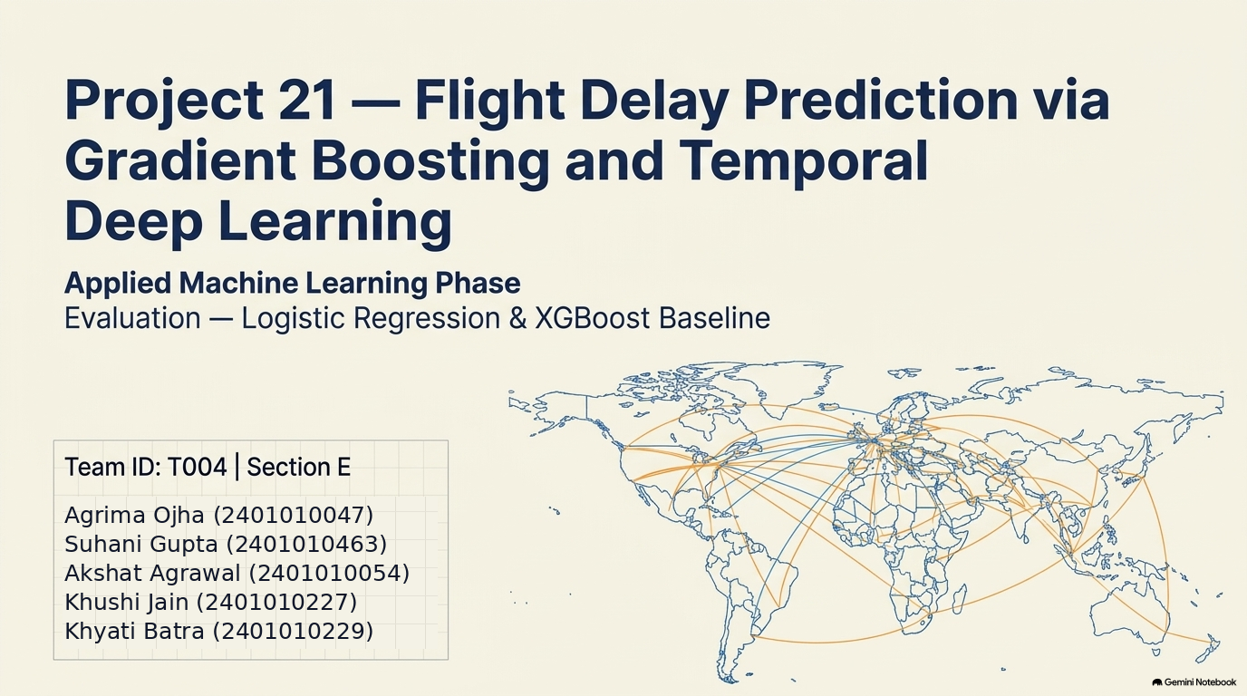
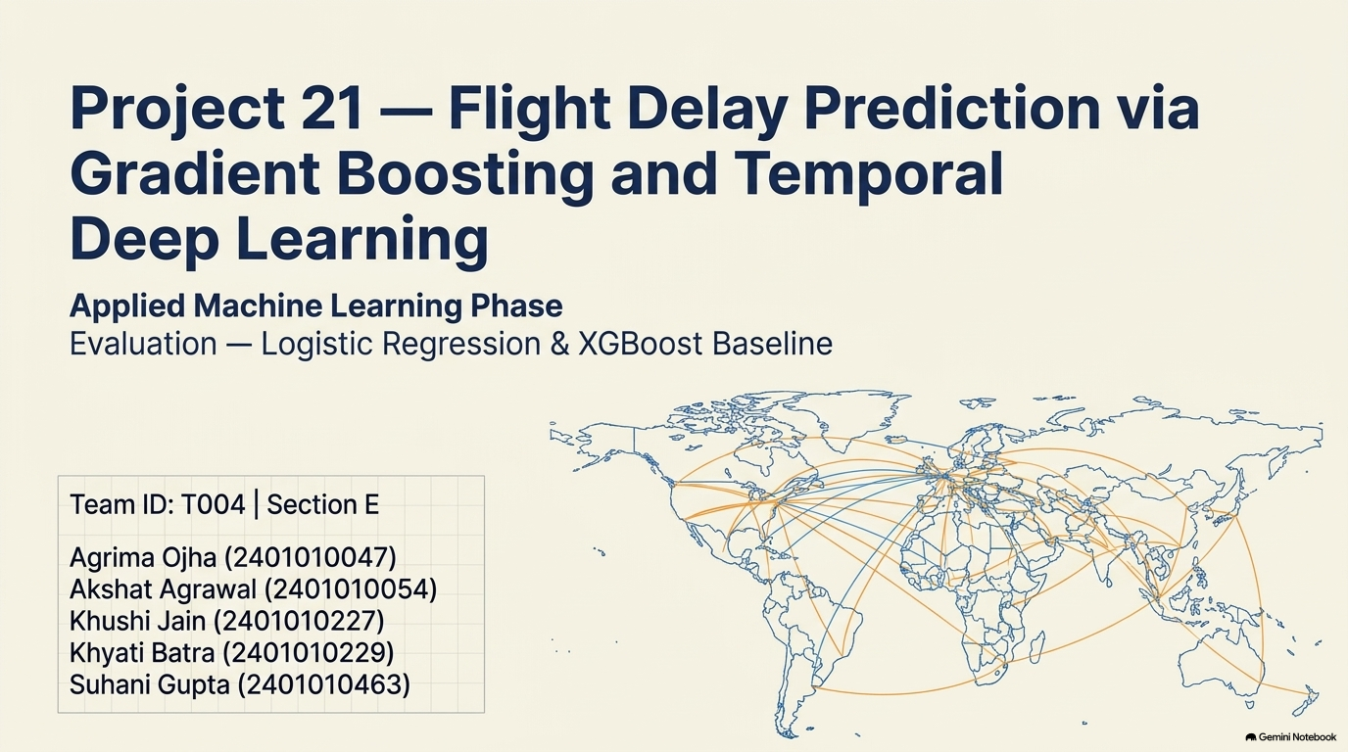

Slide 2
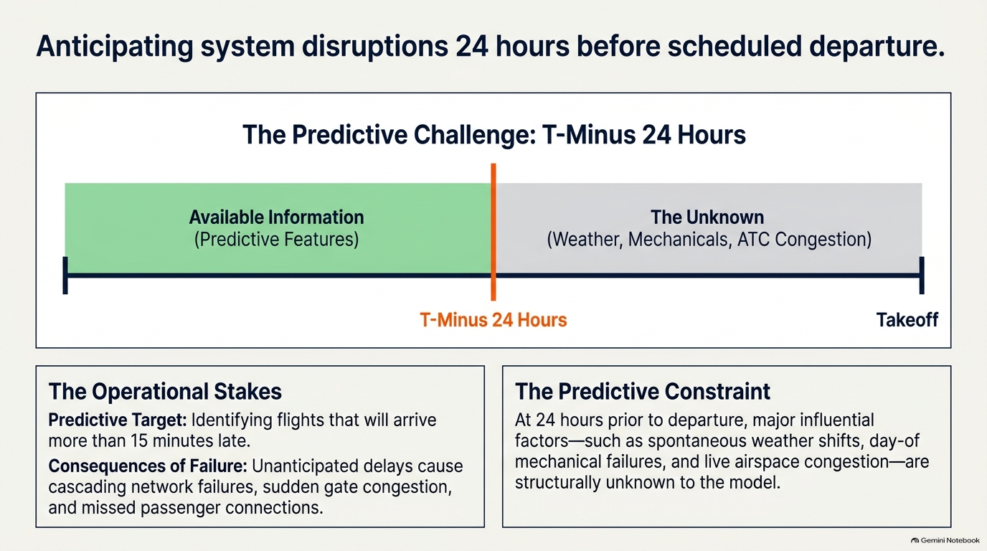

Slide 3
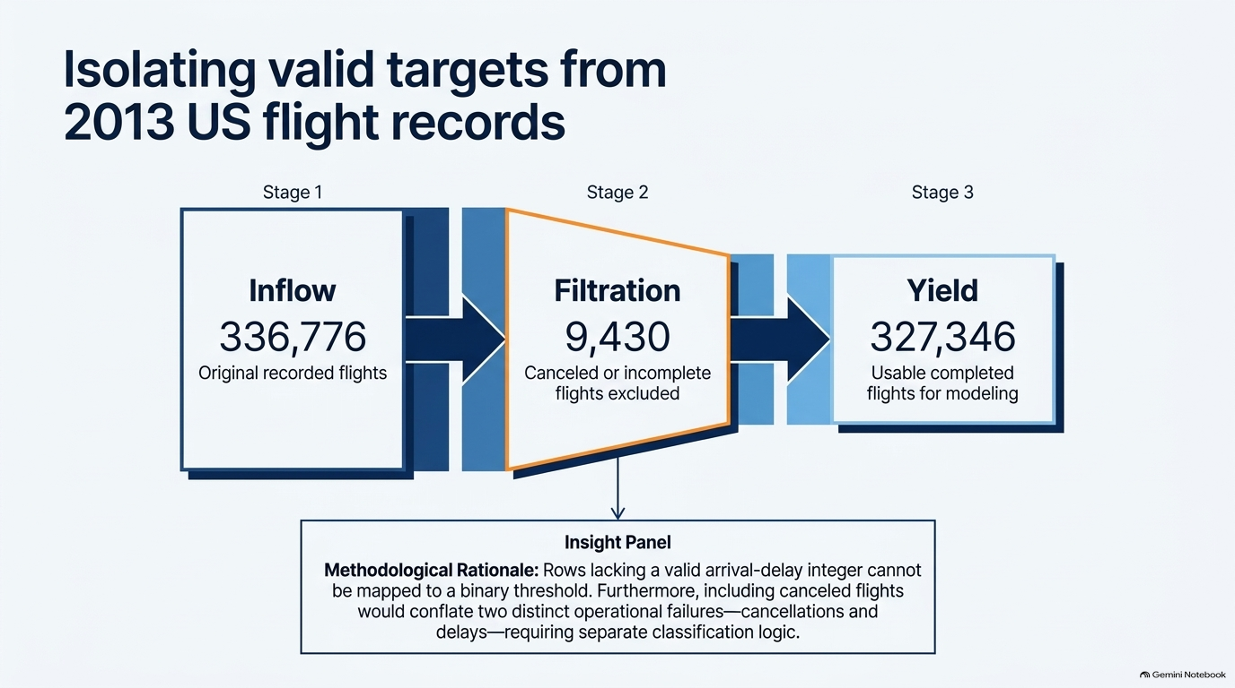

Slide 4
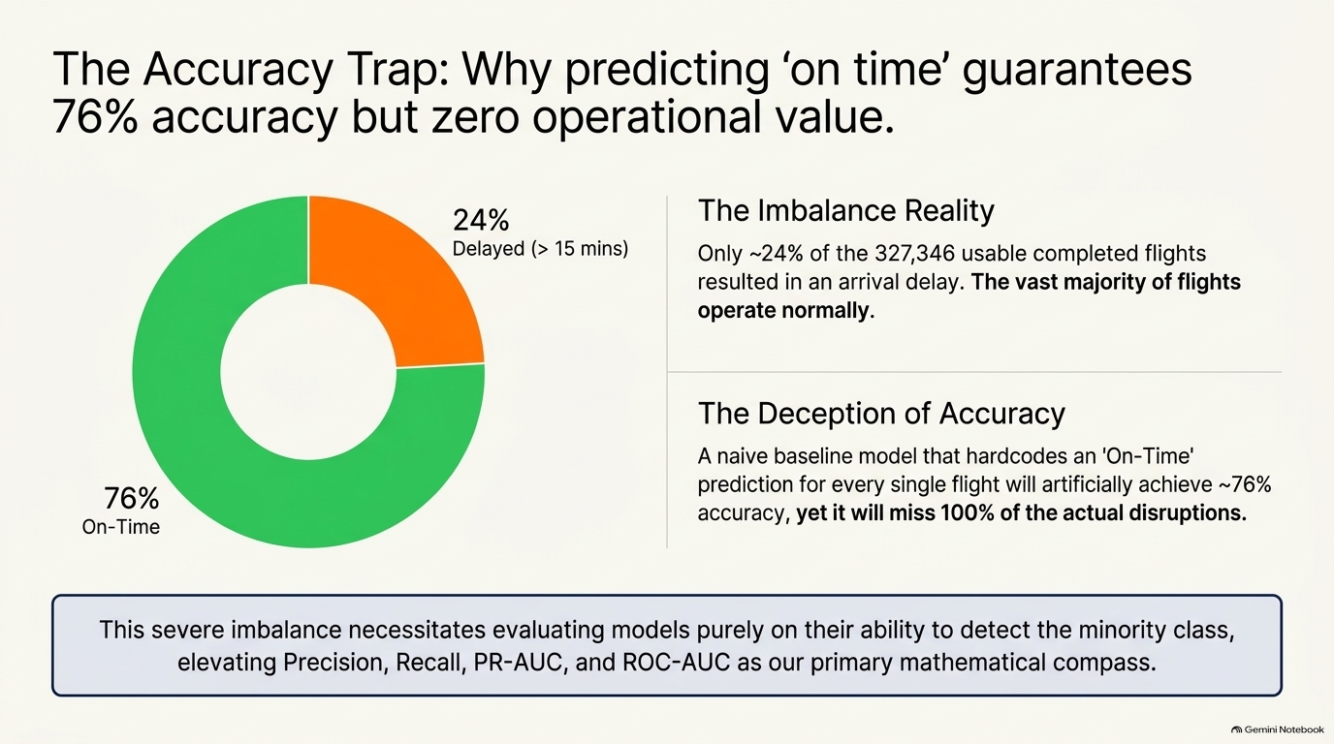

Slide 5
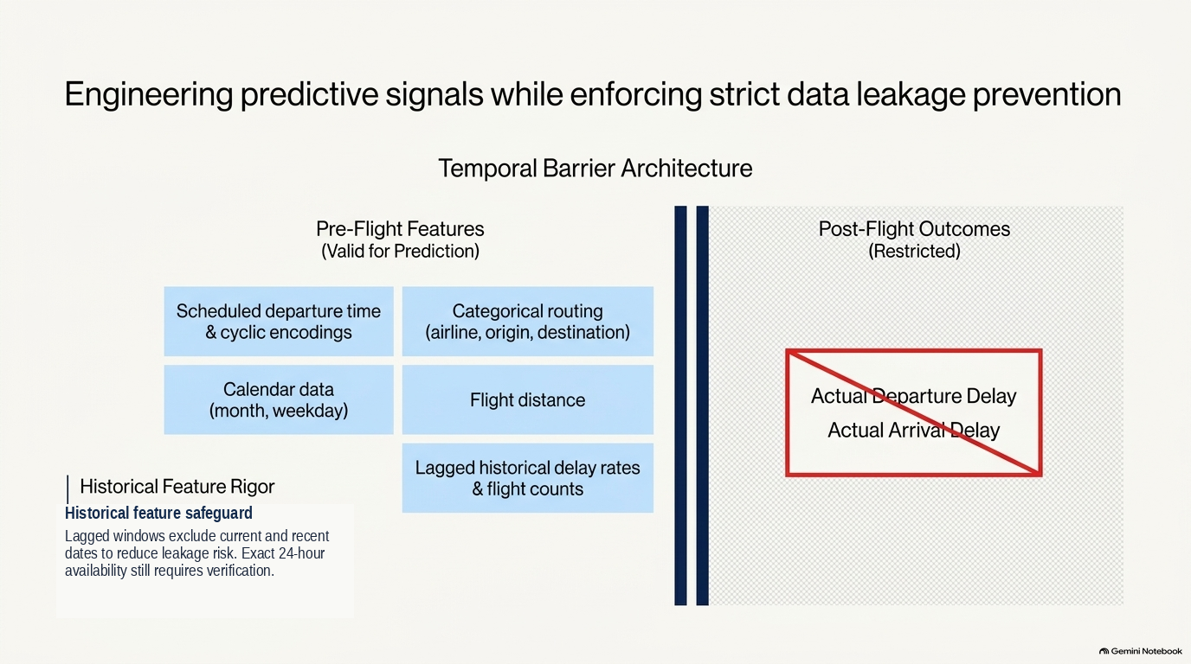

Slide 6
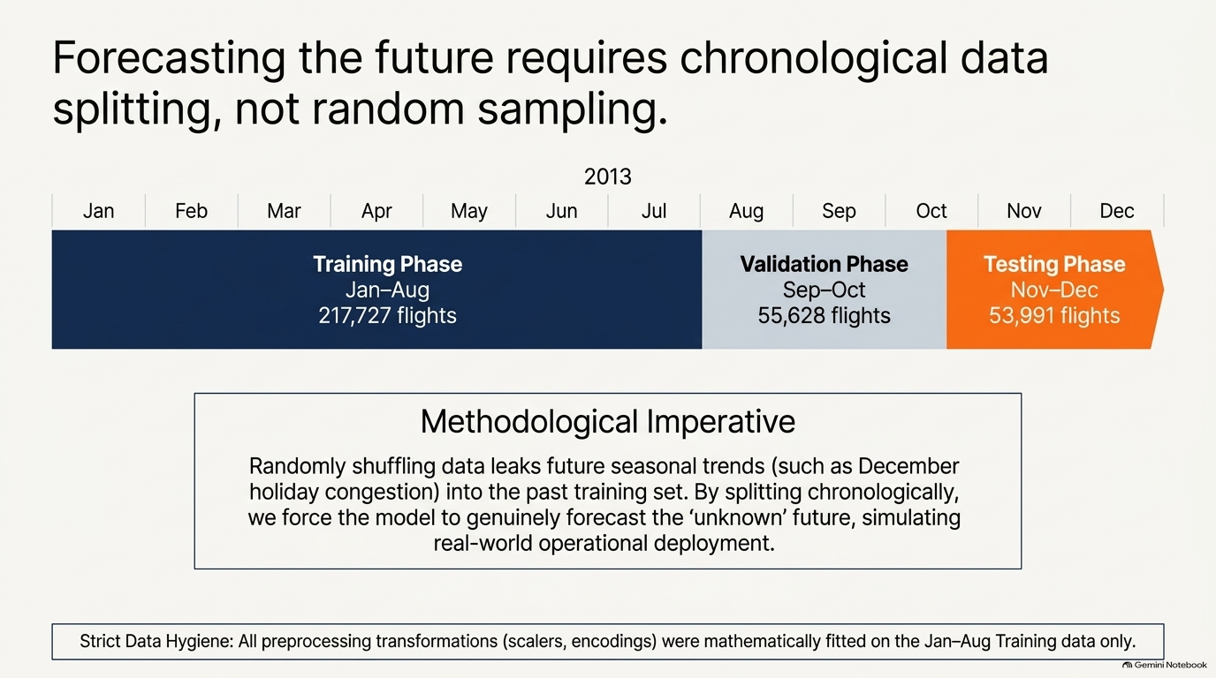

Slide 7
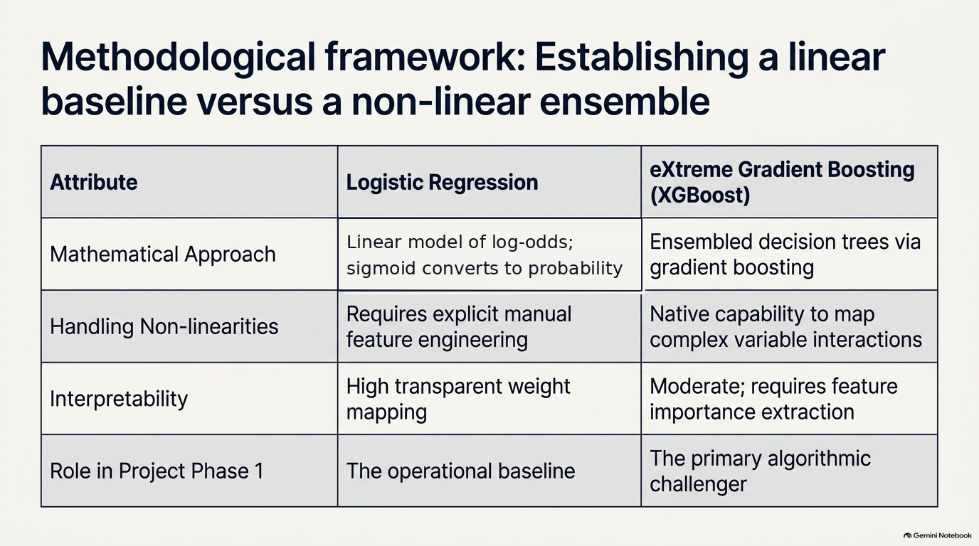
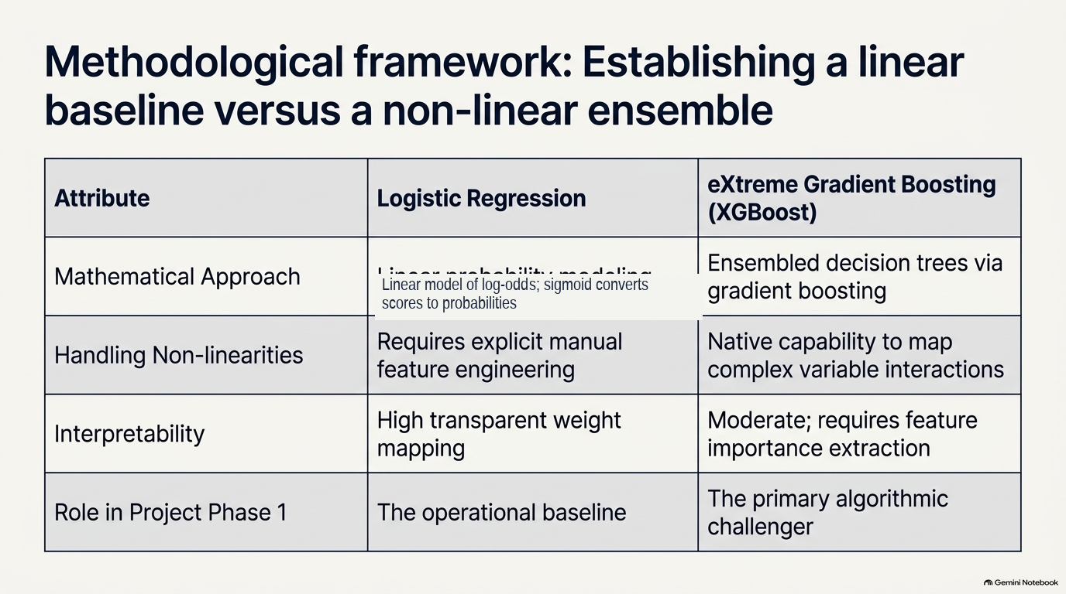

Slide 8
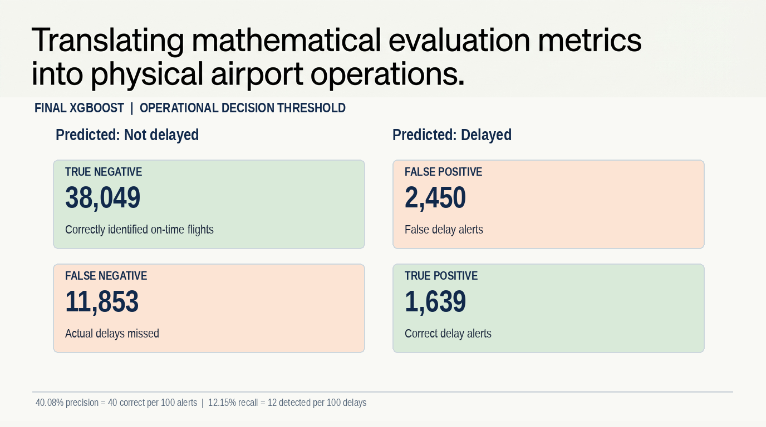
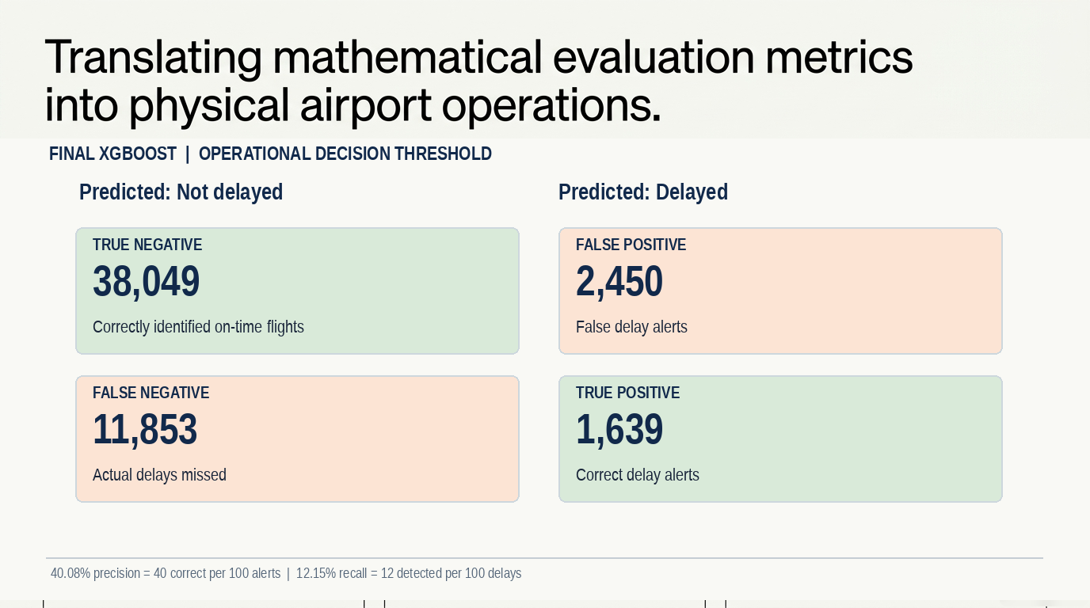

Slide 9
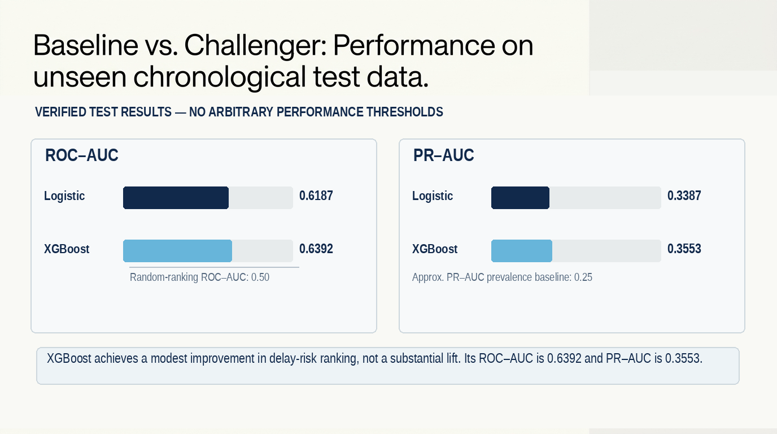

Slide 10
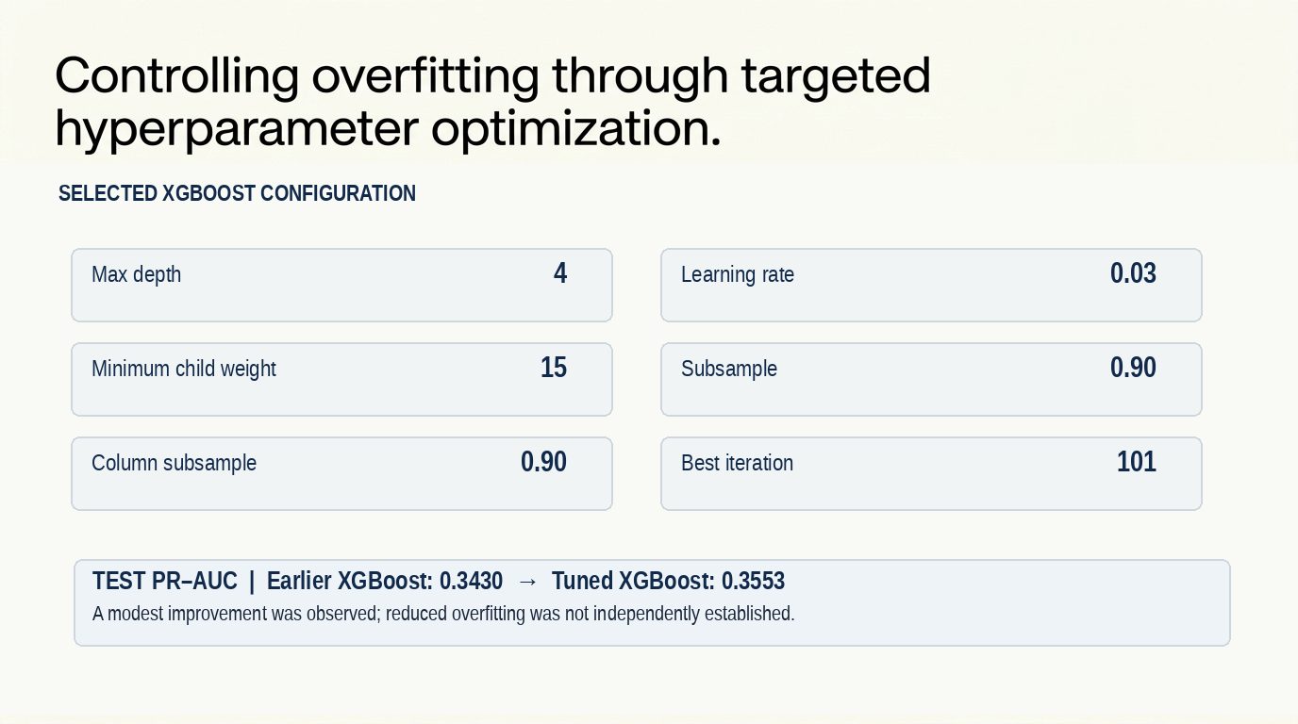

Slide 11
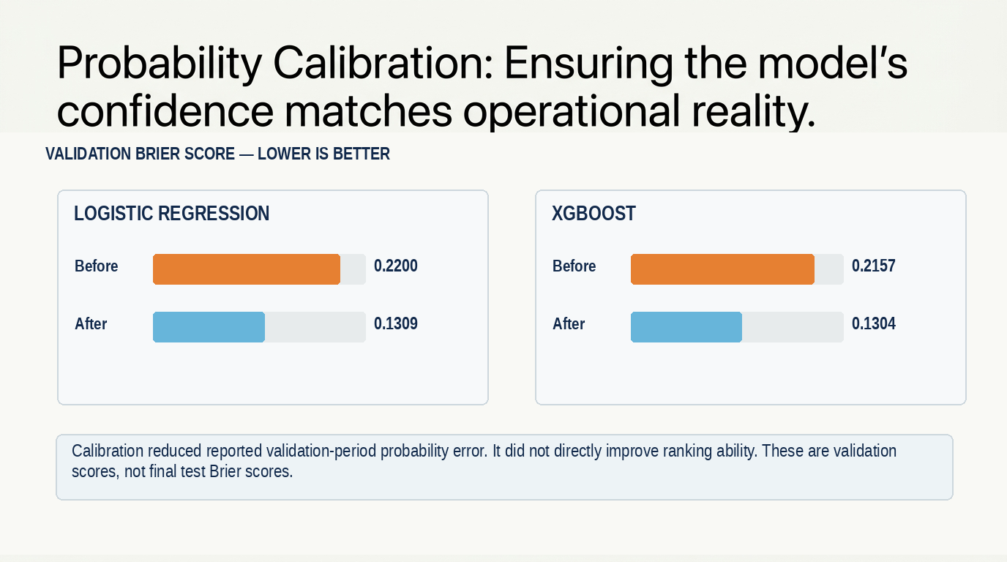

Slide 12
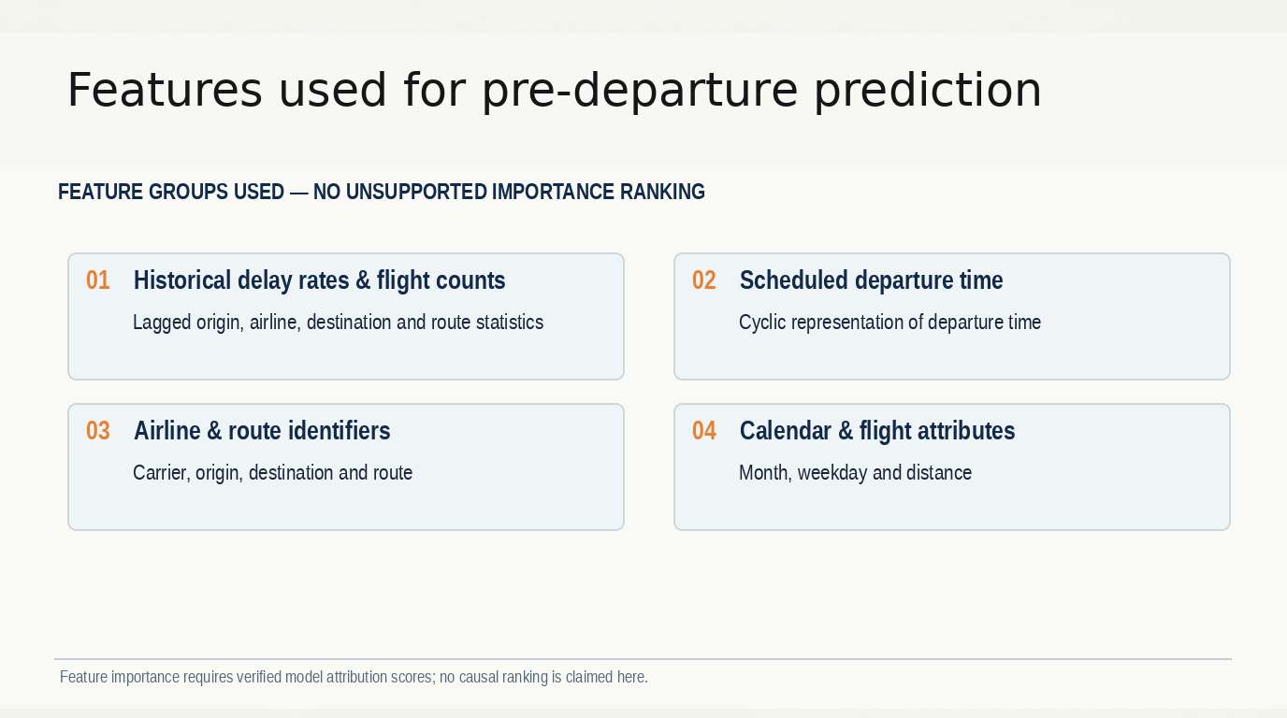
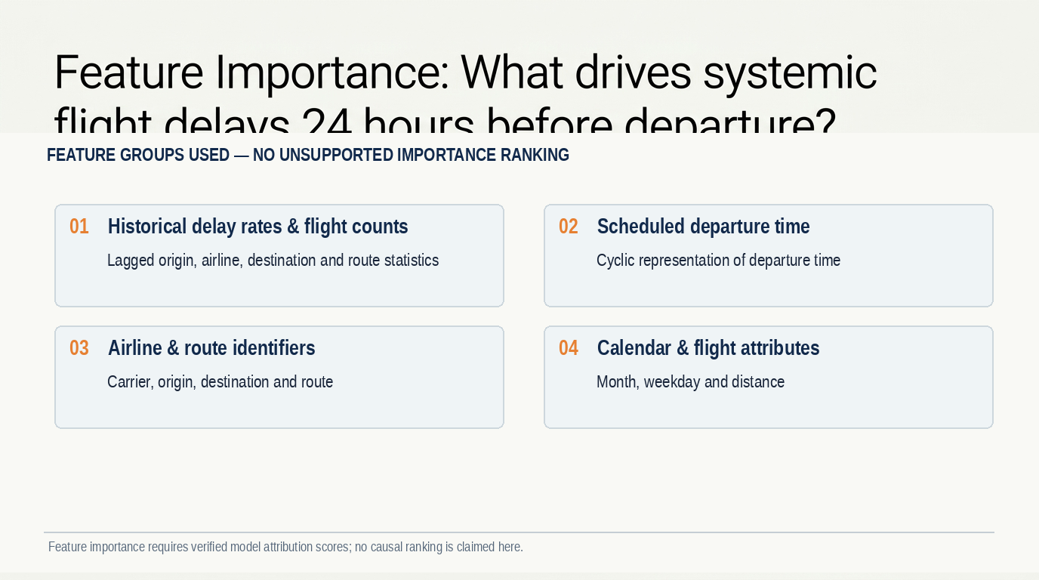

Slide 13
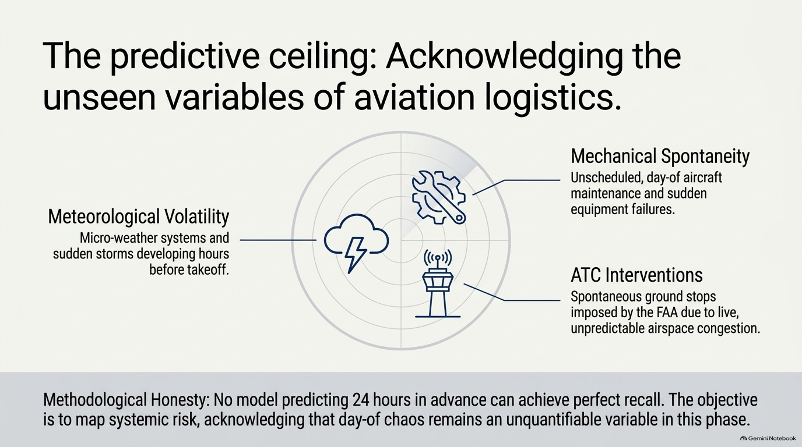

Slide 14
What the final AML models actually achieved
Final Task 7 • 53,991 unseen test flights • Operational precision constraint
TEST METRIC
LOGISTIC REGRESSION
XGBOOST
Accuracy
73.86%
73.51%
Precision
41.21%
40.08%
Recall
10.78%
12.15%
F1-score
17.09%
18.65%
ROC-AUC
0.6187
0.6392
PR-AUC
0.3387
0.3553
Brier score ↓
0.1942
0.1919
ACCURACY IS NOT ENOUGH
PRECISION: ALERT QUALITY
RECALL: MISSED DELAYS
73.51%
40.08%
12.15%
An always-on-time baseline gets ~75.01% on this test set.
About 40 in 100 predicted delay alerts are correct.
Only about 12 in 100 actual delayed flights are caught.
CONCLUSION · XGBoost ranks delay risk modestly better, but low recall limits operational usefulness.

Slide 15
