Slide 1
SecureMed VPD
Row & Column Level Security using a Virtual Private Database
21CSE361T · DATABASE SECURITY & PRIVACY · UNIT 3
VPD
A hospital records system where the database itself decides which rows and columns each user can see
PRESENTED BY
SUHANI JAIN
NAMAN TYAGI
SHIVAM YADAV
KARTIK MALIK
RA2411003030412
RA2411003030400
RA2411003030403
RA2411003030402
Notes:
Introduce the team and the topic: a Virtual Private Database (VPD) implementing row- and column-level security for hospital patient records. Unit 3 - Database Application Security Models.

Slide 2
The problem: one database, many kinds of staff
A hospital database stores highly sensitive data such as Aadhaar numbers, diagnoses, phone numbers and dates of birth. Each staff role needs a different slice of it.
D
Doctor
Only their own patients, with full detail
N
Nurse
The usual approach
Only patients in their own ward; Aadhaar masked
Rules written as if-statements in application code. One forgotten check, one new report or one direct SQL query, and the data leaks.
R
Receptionist
No diagnoses and no VIP patients
A
Admin (DBA)
Our approach: move the rules into the database itself, using a Virtual Private Database.
Manages the system but cannot read clinical data
Notes:
Explain why application-level checks are fragile and motivate pushing security into the database layer.

Slide 3
Objectives and syllabus mapping
Objectives
Unit 3 syllabus topics covered
Enforce row-level security: each user sees only the records their policy allows
Enforce column-level security: sensitive columns are shown, masked or hidden
Bind every database session to the logged-in user through an application context
Make the policy impossible to bypass, for reads and for writes
Make policies visible and manageable through a data dictionary and a web UI
✓
Implementation of VPD using Views
✓
Application Context
✓
Implementing VPD policies
✓
Viewing VPD Policies (data dictionary)
✓
Implementing Row and Column level Security
Notes:
Map each objective to the exact syllabus lines from Unit 3 so the examiner can see coverage.

Slide 4
What is a Virtual Private Database?
Same table. Same query. Different answers.
A VPD adds a security predicate (an extra WHERE clause) to every query on a protected table, based on who is asking. Users cannot see or remove it.
21 rows
dr.mehta (Doctor)
own patients · every column visible
Every user runs
18 rows
nurse.anita (Nurse)
Cardiology ward · Aadhaar masked
SELECT * FROM vpd_patients;
54 rows
reception
non-VIP · diagnosis hidden
0 rows
intern
no policy → denied by default
Notes:
Core idea: the security predicate is attached to the table or view, not to the application. Every access path gets the same filter.

Slide 5
Architecture: how a query is secured
1
2
3
4
Login
→
Application context
→
Policy function
→
Secure view
Password is verified (salted hash). A fresh session is created.
user_id, role and ward are written to a TEMP table private to this DB session.
Looks up the role's row predicate and column rules in the policy tables.
vpd_patients filters the rows and masks the columns before data leaves the DB.
Example: what the database actually runs for nurse.anita
-- the application asks for
SELECT * FROM vpd_patients;
-- the database executes (predicate from the policy + values from the context)
SELECT ..., 'XXXX-XXXX-' || substr(aadhaar,-4) AS aadhaar ... FROM patients p WHERE p.ward = 'Cardiology';
Notes:
Walk through the four steps. Emphasise that steps 2-4 happen inside SQLite, so any query path inherits the policy.

Slide 6
Row-level security: one predicate per role
Role | Policy | WHERE clause added
ADMIN | ALL_ROWS | 1 = 1
DOCTOR | OWN_PATIENTS | p.doctor_id = ctx.user_id
NURSE | OWN_WARD | p.ward = ctx.ward
RECEPTIONIST | NON_VIP | p.is_vip = 0
INTERN | NO_ROWS | 1 = 0
Deny by default
The predicate is wrapped in EXISTS over the policy table. A role with no enabled policy, or a session with no context, gets zero rows. A row outside your policy returns 404, not 403, so you can't even tell it exists.
Notes:
Each role has exactly one row policy on the patients table (UNIQUE constraint). The chart is the real output of the policy simulator on the seeded data.

Slide 7
Column-level security: SHOW, MASK or HIDE
Role | aadhaar | diagnosis | phone | dob
ADMIN | MASK | HIDE | MASK | MASK
DOCTOR | SHOW | SHOW | SHOW | SHOW
NURSE | MASK | SHOW | SHOW | SHOW
RECEPTIONIST | MASK | HIDE | SHOW | MASK
INTERN | HIDE | HIDE | HIDE | HIDE
What each action returns
SHOW
Real value
4532-5183-3937
MASK
Redacted inside the view
XXXX-XXXX-3937
Policies are rows in the column_policies table, so an admin can change them live from the VPD policies page. A missing rule counts as HIDE.
HIDE
Value never leaves the DB
NULL
Notes:
Masking is computed inside the SQL view with CASE expressions, so masked values are produced by the database, never by front-end code.

Slide 8
Application context and the secure view
1 · Application context (like SYS_CONTEXT)
2 · Secure view: VPD using views
-- TEMP = private to each DB session
CREATE TEMP TABLE app_context (
id INTEGER PRIMARY KEY CHECK (id = 1),
user_id INTEGER, username TEXT,
role_id INTEGER, role_name TEXT,
ward TEXT, set_at TEXT);
-- set on every request after login
INSERT INTO temp.app_context
VALUES (1, :uid, :user, :role_id,
:role, :ward, datetime('now'));
CREATE TEMP VIEW vpd_patients AS
SELECT p.id, p.mrn, p.full_name, p.ward, ...,
CASE <column action for aadhaar>
WHEN 'SHOW' THEN p.aadhaar
WHEN 'MASK' THEN 'XXXX-XXXX-'
|| substr(p.aadhaar,-4)
ELSE NULL END AS aadhaar, ...
FROM patients p
WHERE EXISTS (SELECT 1 FROM vpd_policies v,
temp.app_context ctx
WHERE v.role_id = ctx.role_id AND v.enabled = 1
AND ( (type='OWN_PATIENTS' AND p.doctor_id = ctx.user_id)
OR (type='OWN_WARD' AND p.ward = ctx.ward) ... ));
Because the context is a TEMP table, two users querying at the same time each get their own context. One session can never see or change another's.
Notes:
These objects are generated by security/vpd.py and installed on every new database connection.

Slide 9
Protecting writes with INSTEAD OF triggers
U
UPDATE / DELETE
CREATE TEMP TRIGGER vpd_patients_update
INSTEAD OF UPDATE ON vpd_patients
BEGIN
SELECT RAISE(ABORT, 'VPD update_check:
new values would move this row
outside your policy')
WHERE NOT <policy predicate on NEW>;
UPDATE patients SET
full_name = NEW.full_name, ...,
aadhaar = CASE WHEN <action>='SHOW'
THEN NEW.aadhaar
ELSE aadhaar END
WHERE id = OLD.id;
END;
Only reach rows the view exposes. An UPDATE on a hidden row matches nothing.
C
update_check
nurse.anita moving a patient to Neurology is rejected: the row would leave her policy.
I
Insert check
reception registering a VIP patient is rejected: she could not see that row afterwards.
P
Protected columns
A value sent for a column the role cannot SHOW is ignored and the old value is kept.
Notes:
This mirrors Oracle's update_check => TRUE and statement_types for INSERT, UPDATE and DELETE.

Slide 10
The policy cannot be bypassed
A SQLite authorizer callback runs on every statement in the SQL console. The base table patients may only be read from inside the vpd_patients view. Only SELECT is allowed.
Attempt | Query | Result | Why
Read the secure view | SELECT * FROM vpd_patients | ALLOWED | Returns only your rows, already masked
Read the base table | SELECT * FROM patients | BLOCKED | access to patients.id is prohibited
SQL injection | ... WHERE 1=1 OR 1=1 | ALLOWED | Still only your rows: the predicate is ANDed inside the view
Steal password hashes | SELECT password_hash FROM users | BLOCKED | users is not readable from the console
Hide in a CTE | WITH x AS (SELECT * FROM patients) ... | BLOCKED | The authorizer sees the underlying read
Modify data | DELETE FROM vpd_patients | BLOCKED | Only SELECT statements are authorised
Notes:
Demonstrate live in the SQL console page. The error text shown is the actual SQLite authorizer message.

Slide 11
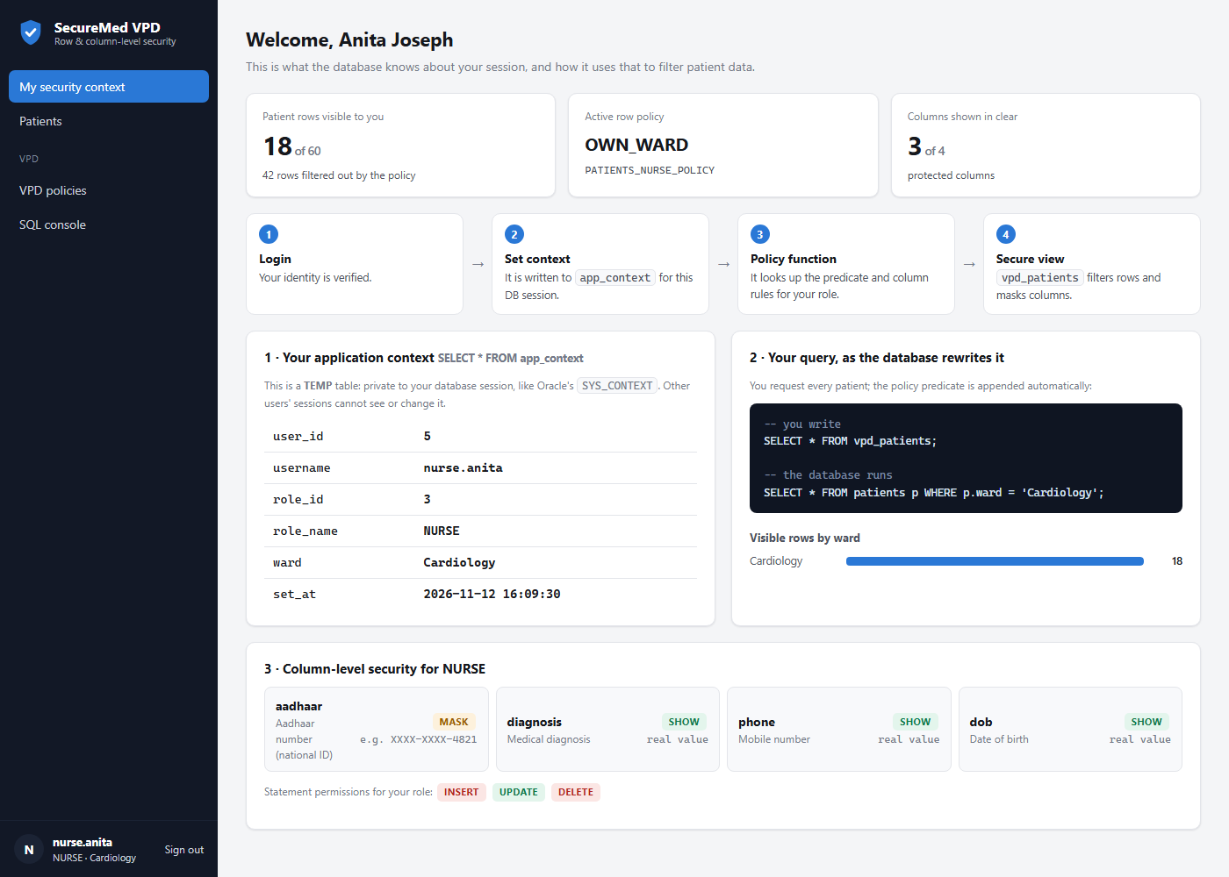
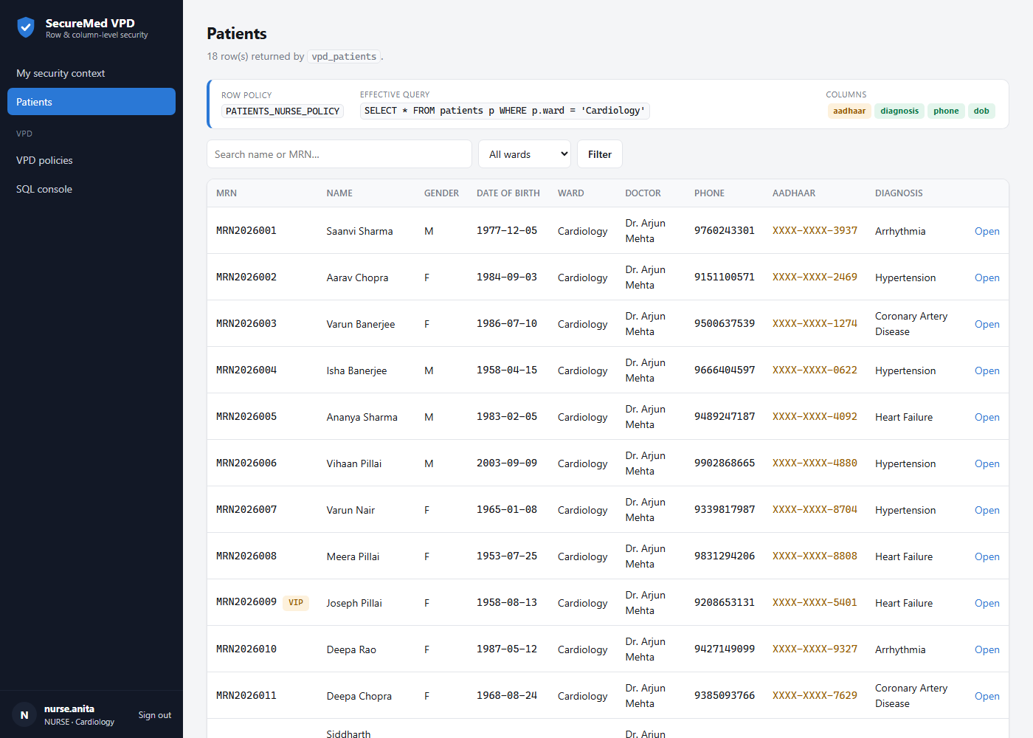
Application: security context and patients
My security context: the live application context, the rewritten query, and the column rules for the signed-in user.
Patients as nurse.anita: only Cardiology rows (18 of 60), with Aadhaar masked by the column policy.
Notes:
Screens from the running Flask application.

Slide 12
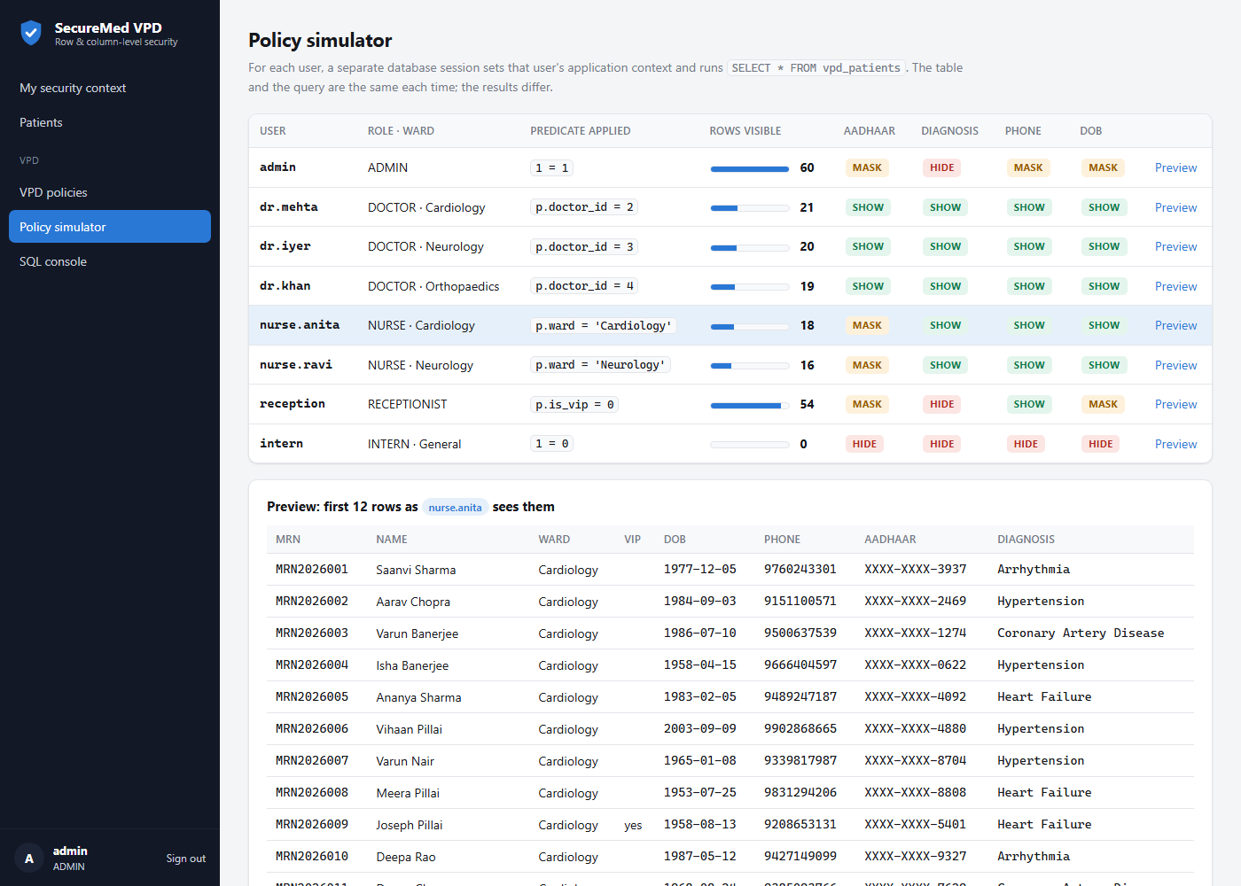
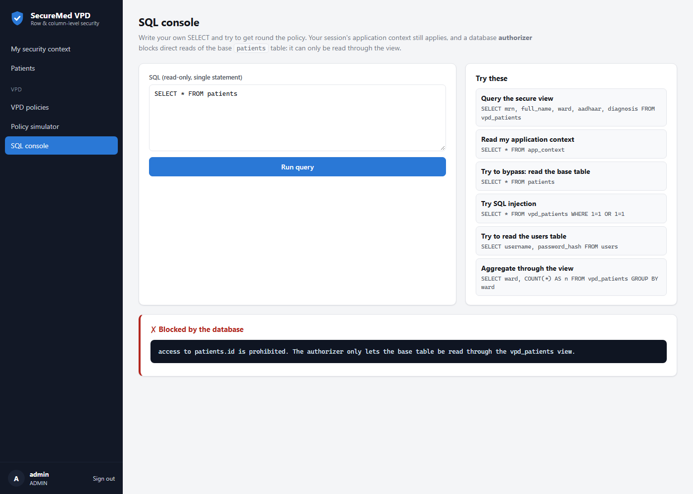
Application: policy simulator and SQL console
Policy simulator (admin): every user's context applied in a separate DB session, compared side by side.
SQL console: a direct read of the base table is blocked by the database authorizer.
Notes:
The simulator opens a new SQLite connection and sets each user's context in turn.

Slide 13
Testing and results
Test case | Observed result | Status
Doctor sees only own patients | dr.mehta → 21 rows | PASS
Nurse sees only own ward; Aadhaar masked | nurse.anita → 18 rows, XXXX-XXXX-… | PASS
Receptionist: no VIPs, diagnosis hidden | 54 rows, diagnosis NULL | PASS
Role without a policy is denied | intern → 0 rows | PASS
Hidden row cannot be opened or updated | 404, base row unchanged | PASS
Nurse moves a patient to another ward | Rejected by update_check | PASS
Receptionist registers a VIP patient | Rejected by insert check | PASS
Disable the receptionist policy live | 0 rows → back to 54 when re-enabled | PASS
SELECT * FROM patients in the console | Blocked by the authorizer | PASS
Form posted without a CSRF token | 400 Bad Request | PASS
10 / 10
test cases passed
5
roles with distinct policies
0
ways found to read the base table
Notes:
All cases were run end to end against the Flask app with the test client.

Slide 14
Technology stack and project structure
Py
Python 3 + Flask
DSP-PROJECT/
├─ app.py Flask routes
├─ database.py schema + policy tables
├─ seed.py demo users and data
├─ security/
│ └─ vpd.py the VPD engine
├─ templates/ Jinja2 pages
├─ static/ CSS + JS
└─ instance/ SQLite DB
-- run
python app.py
-- open
http://127.0.0.1:5000
Web server, routing, sessions
DB
SQLite
Policy tables, secure view, triggers, authorizer
UI
HTML, CSS, JavaScript (Jinja2)
Responsive pages, light and dark themes
Sec
Werkzeug security
Salted password hashing, CSRF tokens, security headers
Notes:
Explain that security/vpd.py is the heart of the project.

Slide 15
Conclusion and future scope
What we achieved
Future scope
Built a working VPD in which row and column rules are enforced inside the database
Used an application context, a policy function and a secure view, as in Oracle VPD
Protected writes with update_check and insert checks
Made bypass impossible, even with hand-written SQL
Made policies viewable and editable live
Port to Oracle DBMS_RLS or SQL Server row-level security in production
Time-based and location-based predicates (e.g. on-shift only)
Encrypt sensitive columns at rest in addition to masking
Fine-grained auditing of who viewed which sensitive values
Multi-table policies (billing, lab reports)
Notes:
Summarise and point to how this extends to commercial databases.

Slide 16
Thank you
Q&A
Questions?
Live demo: sign in as dr.mehta, nurse.anita and reception and compare the Patients page, then try SELECT * FROM patients in the SQL console.
Suhani Jain · RA2411003030412
Naman Tyagi · RA2411003030400
Shivam Yadav · RA2411003030403
Kartik Malik · RA2411003030402

