Slide 1

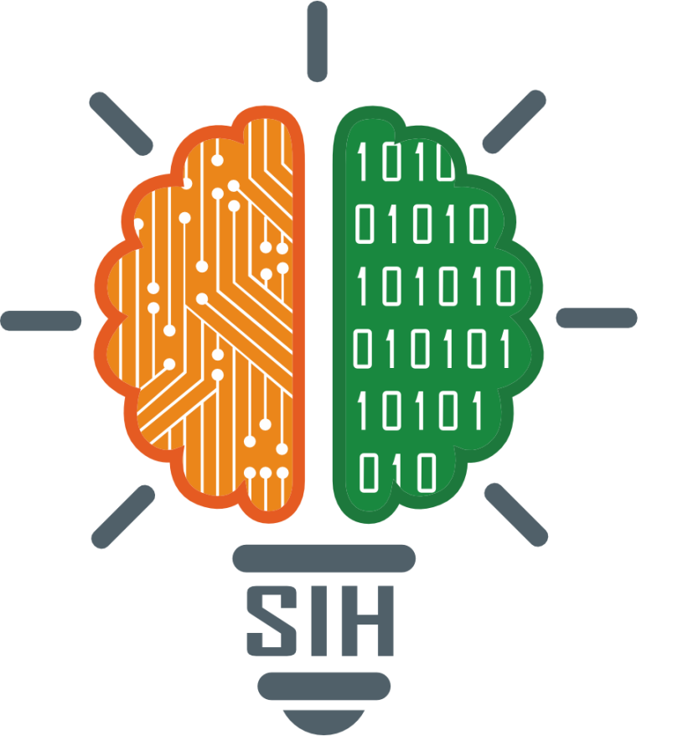
SMART INDIA HACKATHON 2025
SMART INDIA HACKATHON 2025
Problem Statement ID – XXX
Theme – open innovation
PS Category – Software
Team ID – T033
Team Name – Collage Crew

Slide 2
IDEA TITLE
Collage crew
Proposed Solution:
- AI-powered adaptive learning platform.
- Provides quizzes, notes, and chatbot tutoring personalized for each learner.
Detailed Explanation:
- Monitors student performance in real-time.
- Adapts question difficulty, provides hints, and generates notes.
Innovation & Uniqueness:
- Real-time adaptation unlike static platforms.
- Teacher dashboard with analytics.
- Focused initially on learn with different language.

Slide 3
TECHNICAL APPROACH
Collage crew
Technologies:
- Frontend: React / HTML / CSS
- Backend: Node.js / Python
- Database: firebase
- AI: python
Methodology:
1. Student logs in → takes quiz.
2. AI analyzes performance.
3. Adaptive system adjusts difficulty.
4. Chatbot provides explanations.
5. Dashboard shows progress & weak areas.

Slide 4
FEASIBILITY AND VIABILITY
Collage crew
Feasibility:
- Already implemented MVP with quizzes & chatbot.
- Easy integration with college systems.
Challenges:
- Collecting large-scale training data.
- Ensuring multi-language support.
- Keeping it lightweight for low-end devices.
Strategies:
- Start with rule-based AI, then scale to ML.
- Use modular architecture.
- Cloud + local hybrid deployment.

Slide 5
IMPACT AND BENEFITS
Collage crew
Impact:
- Personalized attention to students.
- Saves teacher time with automated analytics.
- Boosts student motivation with adaptive learning.
Benefits:
- Social: Equal access to quality education.
- Economic: Cost-effective alternative for institutions.
- Educational: Improves learning outcomes significantly.

Slide 6
RESEARCH AND REFERENCES
Collage crew
Research & References:
- Adaptive Learning Systems (Smart Sparrow, Dream Box).
- AI Tutors and Chatbots in EdTech.
- Coursera, Byju's, Khan Academy use cases.

Slide 7
Collage crew
Thanks and Regards
@SIH Idea submission- Template

