Slide 1
End-to-End Project Presentation
Sentiment Analysis of Zomato Play Store Reviews for Brand Strategy
Project Focus
Prepared by:
Suhani Shrivastava
Roll Number:
24EMBA1442
Guide:
Dr. Suraj PG
Platform: Google Play Store
Brand: Zomato
Dataset: 41,597 cleaned reviews
Best model: SentiLens
Output: business insights for brand strategy
VIT ONLINE MBA
Slide 01

Slide 2
Project Overview
Abstract-level summary of the complete study
This project analyzes customer sentiment toward Zomato using Google Play Store reviews as a large-scale source of digital customer feedback.
The review corpus was cleaned, deduplicated, standardized, and labeled using a rating-based sentiment proxy and rule-based theme classification.
The study combines descriptive review analytics, NLP-based modeling, benchmark comparison, and dashboard-driven interpretation.
The final goal is not only to classify sentiment, but to identify customer pain points and convert them into managerial actions for customer experience and brand strategy.
Keywords
Zomato
Sentiment analysis
Google Play reviews
NLP
Customer experience
Brand strategy
Study Contribution
Converts unstructured reviews
into interpretable insights
for service improvement,
trust repair, and
competitive positioning.
VIT ONLINE MBA
Slide 02

Slide 3
Problem and Research Gap
Problem / Gap
Project Response
Large review volume is difficult to interpret manually.
Use structured NLP workflow and sentiment/theme analysis to scale interpretation.
Star ratings alone do not explain why customers are satisfied or dissatisfied.
Combine rating proxy with review text and theme classification.
Managers often lack evidence linking app reviews to action areas.
Translate review patterns into brand, delivery, refund, and support recommendations.
The central research gap is not lack of feedback, but lack of structured interpretation. Zomato receives a very large volume of app reviews, yet those reviews need an end-to-end analytical process before they become useful for customer-experience and brand decisions.
This project addresses that gap by converting raw review text into measurable sentiment patterns, theme-level pain points, and managerially usable findings.
VIT ONLINE MBA
Slide 03

Slide 4
Project Objectives
Objective 1
Objective 2
Objective 3
Objective 4
Collect and preprocess
Zomato-related Google Play
reviews into a usable
master dataset
Classify reviews into
positive, negative,
and neutral sentiment
categories
Identify major themes such as
delivery, refund/cancellation,
support, pricing, and
app experience
Interpret the results for
customer experience,
service recovery, and
brand strategy decisions
Objective Logic
The project moves from
data collection to modeling,
then from analysis to
managerial interpretation.
VIT ONLINE MBA
Slide 04

Slide 5
Literature and Research Framework
The literature positions sentiment analysis as a practical way to extract structured insight from unstructured customer opinions.
Online reviews act as both feedback and electronic word-of-mouth, shaping customer trust, trial, and purchase decisions.
For food-delivery platforms, reviews reflect both service execution and digital interface quality.
This study adopts a framework where reviews provide raw evidence, sentiment indicates emotional orientation, themes explain issue drivers, and managerial interpretation converts findings into business action.
Research Framework
1. Google Play reviews
2. Sentiment labeling
3. Theme identification
4. Theme-wise interpretation
5. Brand strategy implications
Literature Positioning
This project extends beyond
pure classification by adding
theme analysis, priority logic,
dashboard interpretation, and
benchmark comparison.
VIT ONLINE MBA
Slide 05

Slide 6
Research Methodology
Research Design
Data Source
Collection Modes
Processing
Descriptive + exploratory
Applied in nature
Business-focused interpretation
Google Play Store
Zomato app reviews
Ratings + text + metadata
Newest
Most relevant
Rating-based
Multi-pull strategy
Cleaning
Deduplication
Theme mapping
Sentiment modeling
Method Layer
Implementation
Sentiment logic
Ratings 1-2 = negative, 3 = neutral, 4-5 = positive, with text mismatch used as a caution flag.
Theme logic
Ordered first-match keyword rules with fallback to earlier theme hints when no clean rule match exists.
Tools
Python scripts, scikit-learn, custom data pipelines, and Streamlit dashboard outputs for interpretation.
VIT ONLINE MBA
Slide 06

Slide 7
End-to-End Analytical Flow
Sample User Input
Pre-processing
SentiLens Output
Final Business Output
Review: "Order got cancelled
after one hour and support
did not help at all"
Rating: 1 star
Lowercasing
Noise removal
Normalization
Deduplication checks
Sentiment: Negative
High confidence score
TF-IDF + Logistic
Regression pipeline
Theme: refund/cancellation
Priority flag: high
Dashboard summary
Managerial action point
Stage
Illustration
Input layer
A raw app review enters the pipeline with text and star rating metadata.
Modeling layer
The cleaned text is transformed into TF-IDF features and classified by SentiLens.
Interpretation layer
The review is linked to a dominant theme and aggregated into dashboard-level insight.
VIT ONLINE MBA
Slide 07

Slide 8
Data Collection Strategy
Relevant Reviews
Rating-Based Pulls
Newest Pulls
Merged Corpus
output_playstore_relevant_en
22,773 reviews
Captures commonly surfaced
issue-oriented feedback
output_playstore_rating_en
15,942 reviews
Captures stronger positive
and negative extremes
Newest review pulls
2,882 reviews
Adds recent and
time-based coverage
All cleaned exports merged
before deduplication
to reduce sort bias
Selection Principle
Explanation
Multi-sort coverage
A single Play Store retrieval mode can over-represent one type of feedback. Multi-sort pulls improved coverage across issue intensity and time.
Recency coverage
Newest review pulls were included so the analysis captures both long-run patterns and more recent customer feedback.
Final selection
After merging and cleaning, 41,597 unique Google Play reviews formed the final analytical dataset.
VIT ONLINE MBA
Slide 07

Slide 9
Pre-processing and Dataset Construction
Step
What Was Done
Effect
Merge
Combined cleaned exports from relevant, rating-based, and newest review files into one analytical corpus.
46,193 rows before dedupe
Normalize
Applied lowercase conversion, punctuation cleanup, hyperlink/noise removal, and whitespace compaction.
Comparable normalized text
Dedup by ID
Removed repeated reviews using review identifiers after priority sorting by relevance score, thumbs-up count, and rating.
41,657 rows
Dedup by Text
Removed repeated content using normalized review text to avoid counting the same wording multiple times.
41,597 rows
Structure
Retained fields such as text, normalized text, rating, year, recency bucket, sentiment label, and theme label.
Final master dataset
VIT ONLINE MBA
Slide 09

Slide 10
Real Examples from Cleaning
Raw Review Text
Normalized Text
I loved this app so much i loved its delivery and all.Its probably the best app to order the food...
i loved this app so much i loved its delivery and all its probably the best app to order the food...
Such a bad customer service .....my order got cancelled and they didn't refund.....
such a bad customer service my order got cancelled and they didn t refund ...
Duplicate Type
Observed Example
Cleaning Decision
Same review ID
Record ID c9c028a3-4be2-44fd-934b-56a7aae70b10 appeared in newest_en, relevant_en, and rating_en with the same review content.
Kept one row after priority sorting; removed repeated IDs.
Same normalized text
"Best app for food delivery", "Best app for food delivery...", and "Best app for food delivery" normalized to the same final string.
Kept one representative row; removed repeated wording.
Cleaning summary: 46,193 merged rows -> 41,657 after review-ID dedupe -> 41,597 after normalized-text dedupe.
VIT ONLINE MBA
Slide 10

Slide 11
Final Dataset Profile
Measure
Value
Total reviews in final dataset
41,597
Largest Themes
Positive labeled reviews
21,487
Delivery: 16,106
Refund/cancellation: 8,545
App experience: 5,812
Customer support: 3,191
Pricing/fees: 3,100
Negative labeled reviews
18,923
Neutral labeled reviews
1,187
Recent reviews (2024+)
15,320
Average text length
271.97 chars
Dataset Scope
Source: Google Play Store
Recent subset: 15,320
Average text: 271.97 chars
App-review focused design
Median text length
260 chars
VIT ONLINE MBA
Slide 11

Slide 12
SentiLens Architecture
Input Review Text
TF-IDF Vectorizer
Sparse Feature Space
Logistic Regression
Cleaned Google Play
review sentence
with sufficient text length
Word n-grams: 1 to 2
min_df = 2
max_features = 40,000
lowercase = True
Transforms review text
into weighted term features
for model learning
C = 2.5
max_iter = 1500
class_weight = balanced
random_state = 42
SentiLens result: 90.17% accuracy | 90.40% weighted F1
Output Class
Model Meaning
Indicative Terms
Negative
Probability that the review expresses dissatisfaction
worst, fraud, bad, support, horrible, order
Neutral
Probability that the review is mixed or balanced
stars, but, late delivery, was not, good
Positive
Probability that the review expresses satisfaction
great, best, amazing, love, quick, easy, thanks
VIT ONLINE MBA
Slide 12

Slide 13
Model Example and Performance
Example Input Review
I ordered food and I waited for an hour and then they cancelled the order because of no delivery man very bad experience I recommend not trusting this app
Theme Context
Predicted Class
Probability Scores
Why It Works
refund_cancellation
Actual label: negative
NEGATIVE
High-confidence output
Negative: 99.31%
Neutral: 0.11%
Positive: 0.58%
Complaint terms such as
"cancelled", "waited",
"very bad", and
"not trusting" drive
the negative score upward.
Performance Metric
Value
Interpretation
Accuracy
90.17%
SentiLens performs strongly
on positive and negative classes.
Neutral remains the hardest class,
which is common in review datasets
with limited middle-rating volume.
Macro F1
0.6811
Weighted F1
0.9040
Negative recall
0.9342
Positive recall
0.9109
Neutral recall
0.2152
VIT ONLINE MBA
Slide 13

Slide 14
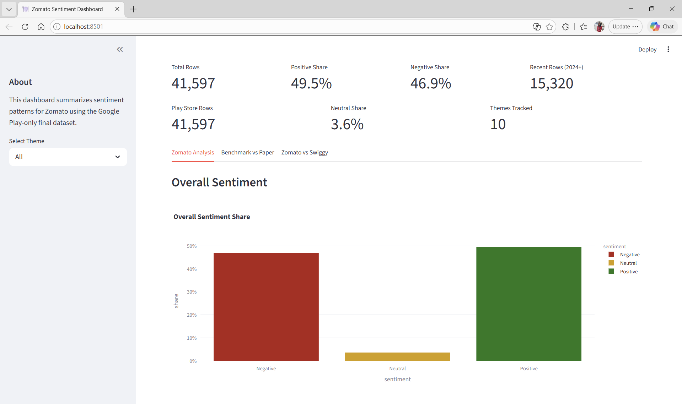
Overall Sentiment and Dashboard View
Dashboard Overview
Predicted Sentiment
Count / Share
Positive
20,587 | 49.49%
Negative
19,505 | 46.89%
Neutral
1,505 | 3.62%
Key Takeaway
Positive and negative review
volumes are both large, so
overall sentiment alone does
not explain the full story.
Managerial Read
Theme-level analysis is needed
to separate operational pain
points from broad brand loyalty.
Headline KPIs and overall sentiment distribution
VIT ONLINE MBA
Slide 14

Slide 15
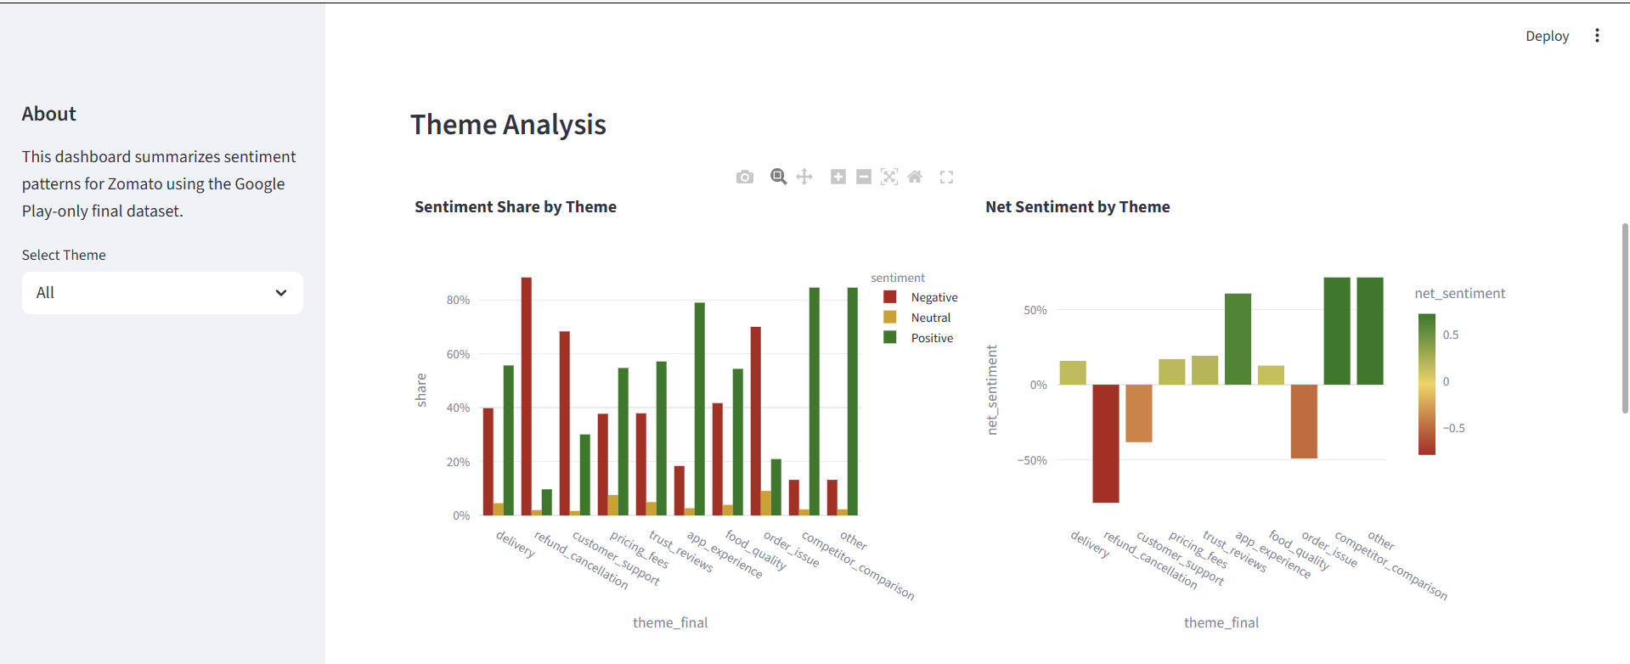
Theme Analysis and Priority Areas
Theme-Level Dashboard View
Theme
Key Result
Refund/cancellation
88.32% negative share
Customer support
68.29% negative share
Delivery
16,106 rows; largest theme
App experience
78.97% positive share
Pricing/fees
Mixed but mildly positive
Priority Interpretation
Highest priority: refund/cancellation and customer support.
Largest discussion area: delivery.
Relative strength: app experience.
Pricing/fees remains mixed and should be monitored.
Theme-wise sentiment share and net sentiment
VIT ONLINE MBA
Slide 15

Slide 16
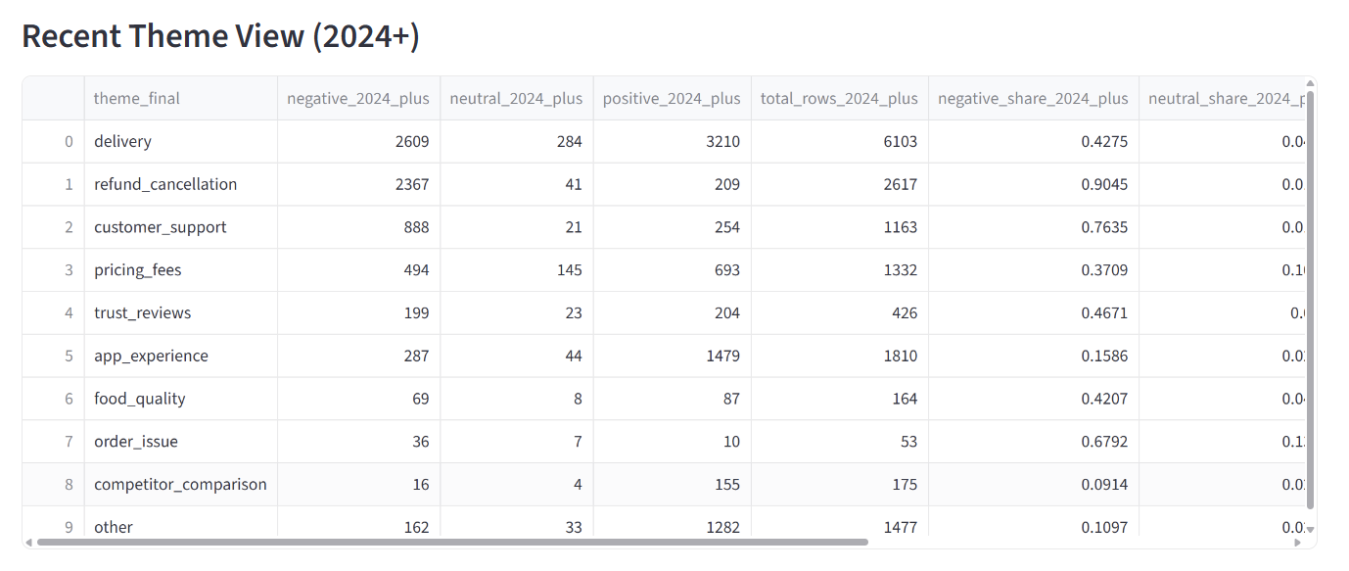
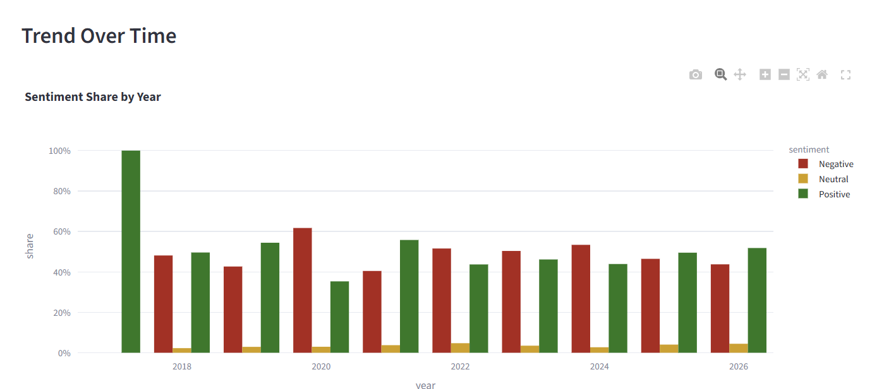
Recent Trends and Current Feedback
Recent Theme View
Trend Over Time
2024+ review subset
Sentiment share across years
The recent-period subset contains 15,320 reviews and confirms the same structural pain points seen in the full dataset.
Refund/cancellation becomes even more negative in recent reviews, while customer support also worsens.
Delivery remains high-volume with slightly weaker net sentiment than the full dataset.
App experience stays comparatively strong, suggesting usability remains better than post-order resolution processes.
VIT ONLINE MBA
Slide 16

Slide 17
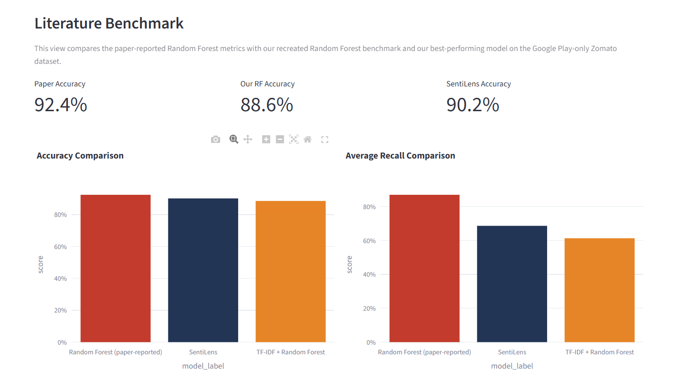
Benchmark Comparison with Prior Paper
Benchmark Dashboard
Model / Study
Acc.
Prec.
Rec.
Paper RF (2019)
92.44%
0.9300
0.8700
Recreated TF-IDF + RF
88.58%
0.6519
0.6135
SentiLens
90.17%
0.6771
0.6868
Interpretation
The prior paper used a different dataset and labeling process.
Within this project's holdout setting, SentiLens outperforms the recreated Random Forest baseline.
That supports using a tuned linear text model for this Google Play-only Zomato dataset.
Paper result vs recreated benchmark vs SentiLens
VIT ONLINE MBA
Slide 17

Slide 18
Our Study vs Previous Zomato Research
Comparison Area
Previous Paper
Our Study
Data source
Kaggle Bangalore restaurant reviews
Google Play Store app reviews for Zomato
Customer context
Restaurant opinion and dining-focused review text
App and service journey covering delivery, refund, support, pricing, and app experience
Research focus
Primarily sentiment-classification performance
End-to-end review analytics plus managerial interpretation
Model emphasis
TF-IDF + Random Forest benchmark paper
SentiLens with recreated TF-IDF + Logistic regression
Output style
Model-oriented findings
Themes, trends, dashboard views, benchmark, and competitor context
Interpretation: the previous paper remains a useful benchmark, but our project studies a different feedback environment and extends the analysis from pure classification to decision-support insight.
VIT ONLINE MBA
Slide 18

Slide 19
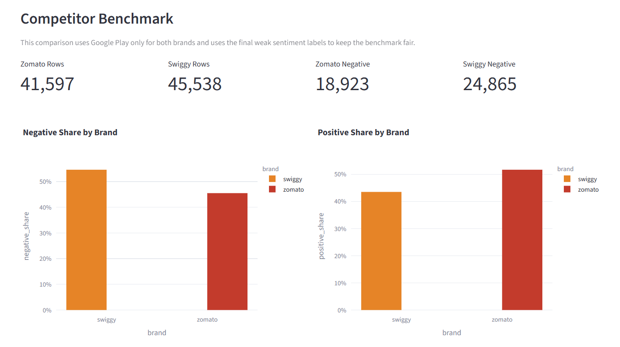
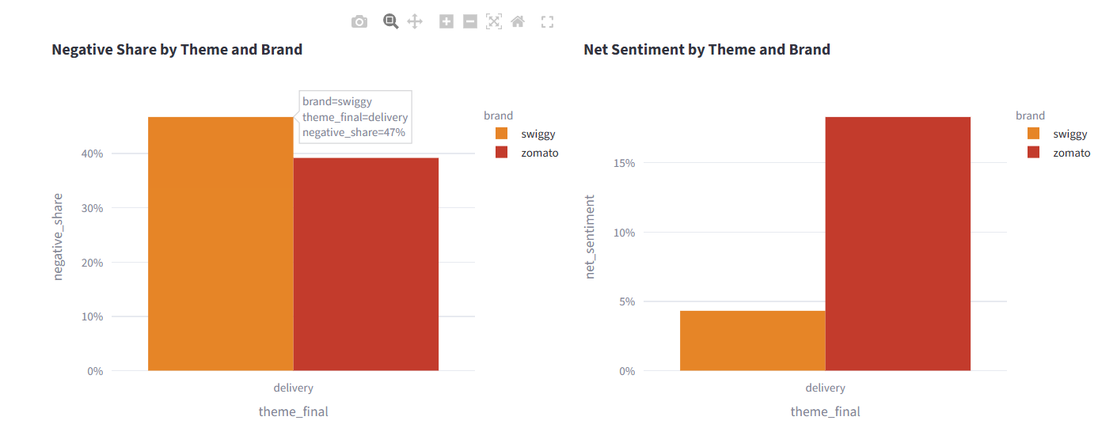
Competitor Context: Zomato vs Swiggy
Brand-Level Comparison
Theme-Level Comparison
Google Play-only sentiment benchmark
Negative share and net sentiment by theme
The competitor view adds market context by showing whether Zomato's brand-level and theme-level sentiment patterns are relatively stronger or weaker than a key food-delivery competitor under the same analytical framework.
VIT ONLINE MBA
Slide 19

Slide 20
Managerial Implications, Limitations, and Conclusion
Managerial Implications
Limitations
Conclusion
Treat refund and cancellation as the highest strategic priority.
Strengthen customer support as a service-recovery function.
Maintain delivery reliability because it drives the largest feedback volume.
Build on app experience as a relative digital strength.
Google Play-only dataset does not capture all customer voice channels.
Rule-based theme assignment keeps only one final theme per review.
Objective 1 met: 41,597 Google Play reviews were collected, cleaned, normalized, and deduplicated into a final master dataset.
Objective 2 met: sentiment was classified with SentiLens, which achieved 90.17% accuracy on the project holdout set.
Objective 3 met: the analysis identified delivery, refund/cancellation, customer support, pricing/fees, and app experience as the main themes.
Objective 4 met: the findings were translated into clear managerial priorities for service recovery and brand strategy.
VIT ONLINE MBA
Slide 20

