Slide 1
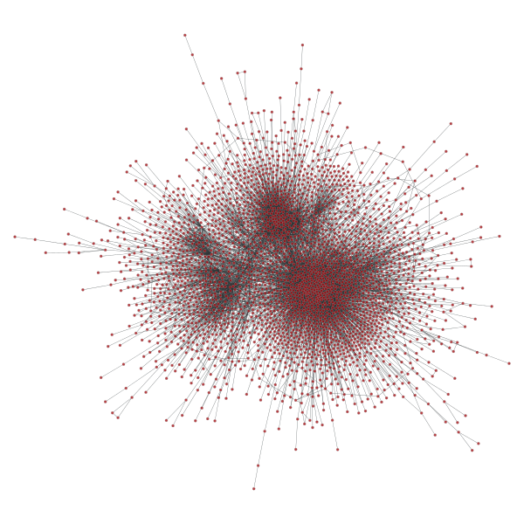
Exploring Recommenders with Networks
By Suhan Ree
07/01/2015

Slide 2

Can networks improve our predictions in machine learning algorithms?
If we know friendship relations between users, can it help us to improve recommendation systems?
YES, but how?

Slide 3
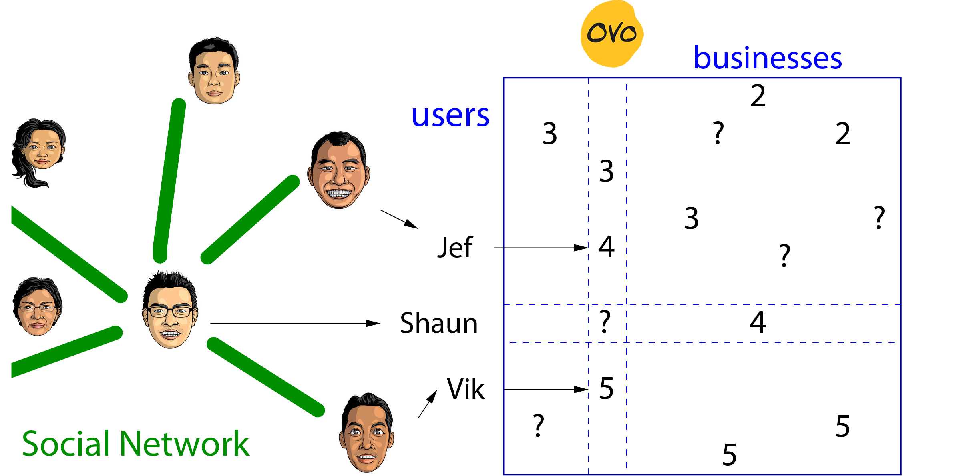

Slide 4
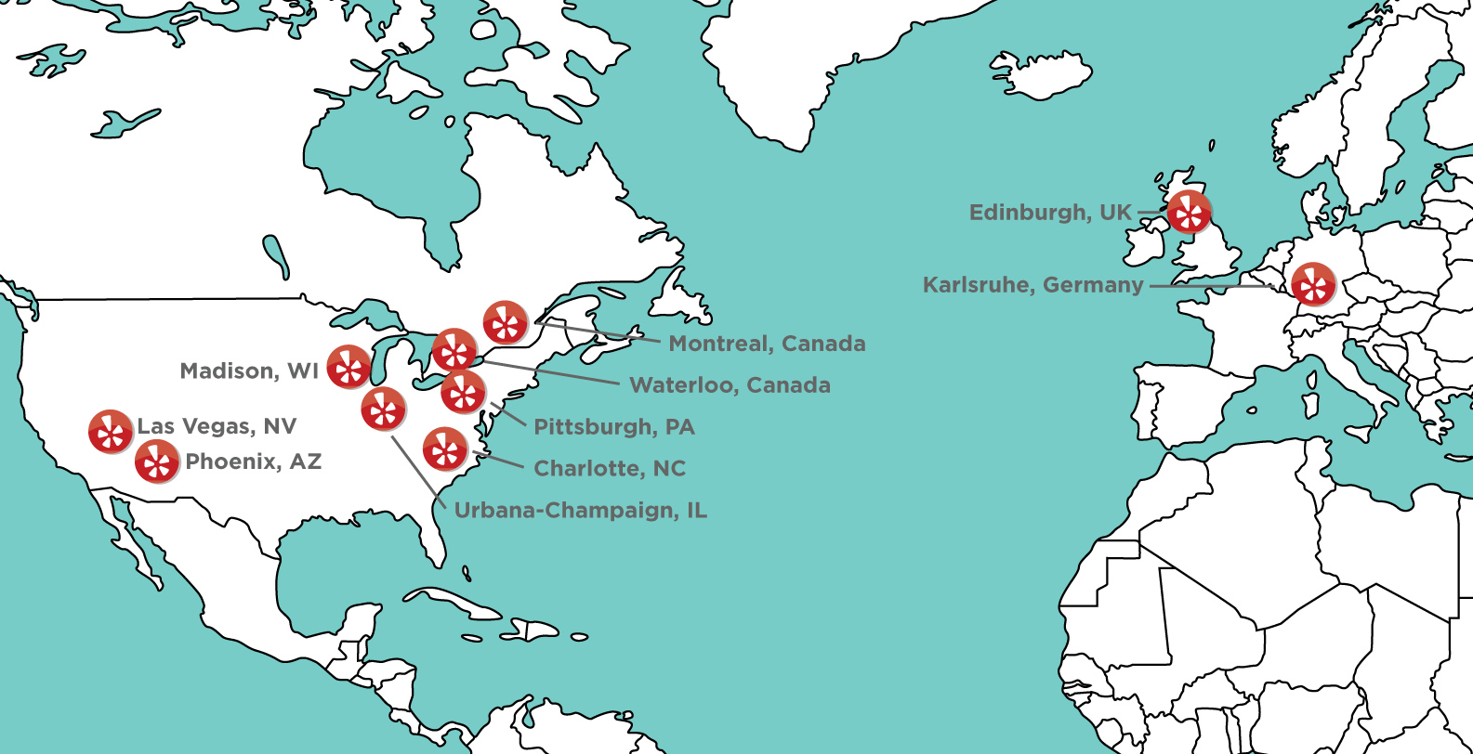
Data from Yelp Dataset Challenge
Reviews: 1.6 M (10/12/2004 ~ 01/08/2015)
Businesses: 61K (on 10 cities)
Users: 366K with social network (2.9M edges)
U.K.: Edinburgh
Germany: Karlsruhe
Canada: Montreal and Waterloo
U.S.: Pittsburgh, Charlotte, Urbana-Champaign, Phoenix, Las Vegas, Madison
(Image from Yelp)

Slide 5
Finding communities
Businesses are classified as 10 cities based on their locations.
Cities are assigned to users based on where they left their reviews.
Only 5% of users left reviews on multiple cities. → Look at their friends; and assign cities where the majority of their friends reside (if tied, choose at random among tied cities).

Slide 6
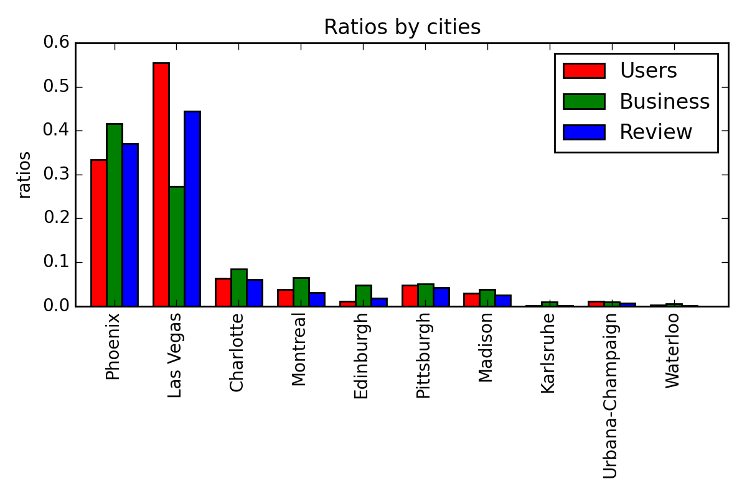
Counts per city

Slide 7
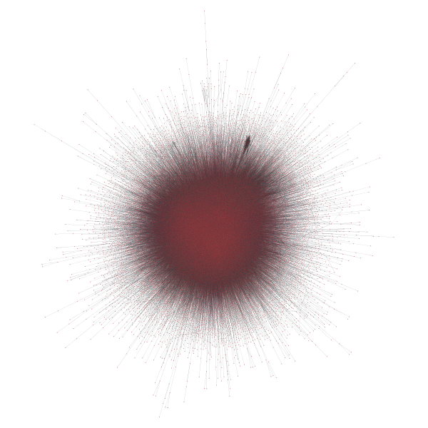

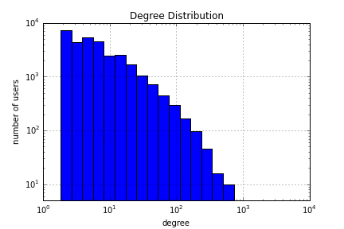
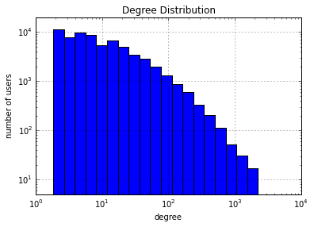
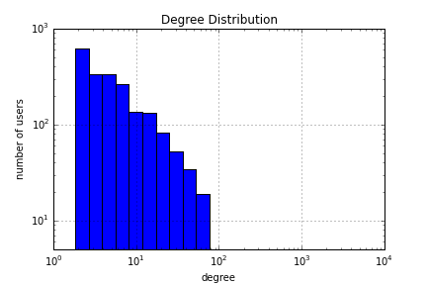
Looking at subnetworks of 3 cities
Phoenix
43K nodes
194K edges
Las Vegas
85K nodes
757K edges
Montreal
3.1K nodes
9.1K edges

Slide 8
Recommender with a Network: the simplest approach
Predict ratings for (user, business) pairs using the past ratings of the user's friends (and friends of friends, if necessary).
  Similar method has been used before.
“A social network-based recommender system,”
by Chu and He, Dissertation, UCLA (2010).
Will be compared with the baseline model using just the average, and the one using the latent-factor Collaborative Filtering.

Slide 9
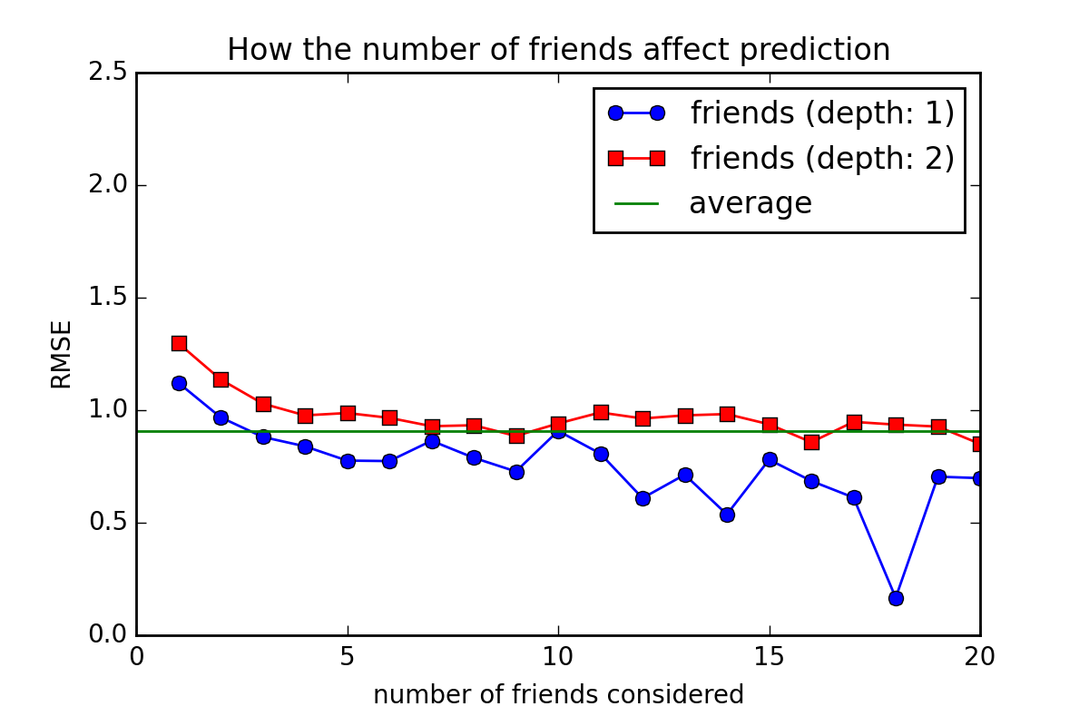
Why friend-based network model?

Slide 10
How to evaluate models?
Use K-fold cross validation
The average RMSE (Root Mean Squared Error) will be found for each model.
The lower, the more accurate!

Slide 11
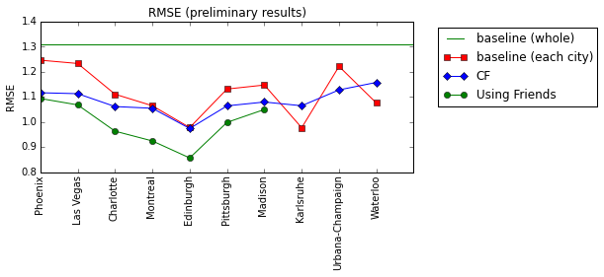
Results: RMSE for models used

Slide 12
Conclusions
Social networks can be useful.
There are many ways to incorporate them. More to explore!
Hybrid models should be considered to have better results.
Many possible applications.

