Slide 1
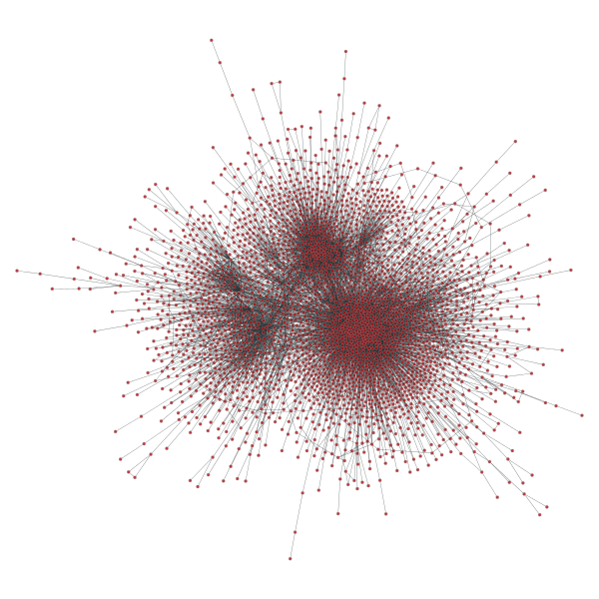
Exploring Recommenders with Networks
By Suhan Ree
At Galvanize
07/01/2015

Slide 2
If we know friend relationships between users, can it improve recommendation systems?
Maybe Yes, but how?

Slide 3
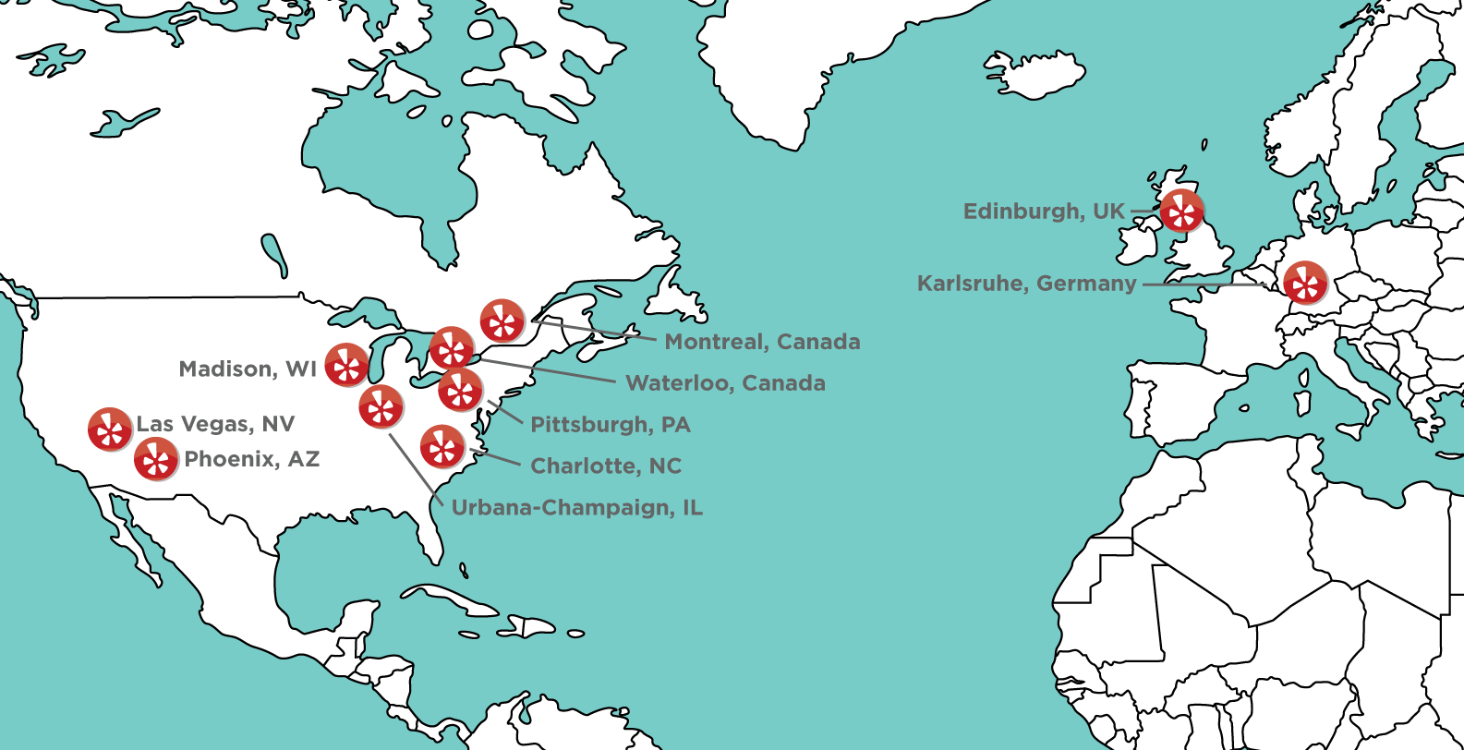
Data from Yelp Dataset Challenge
Ratings: 1.6 M (10/12/2004 ~ 01/08/2015)
Businesses: 61K (on 10 cities)
Users: 366K with social network (2.9M edges)
U.K.: Edinburgh
Germany: Karlsruhe
Canada: Montreal and Waterloo
U.S.: Pittsburgh, Charlotte, Urbana-Champaign, Phoenix, Las Vegas, Madison
(Image from Yelp)

Slide 4
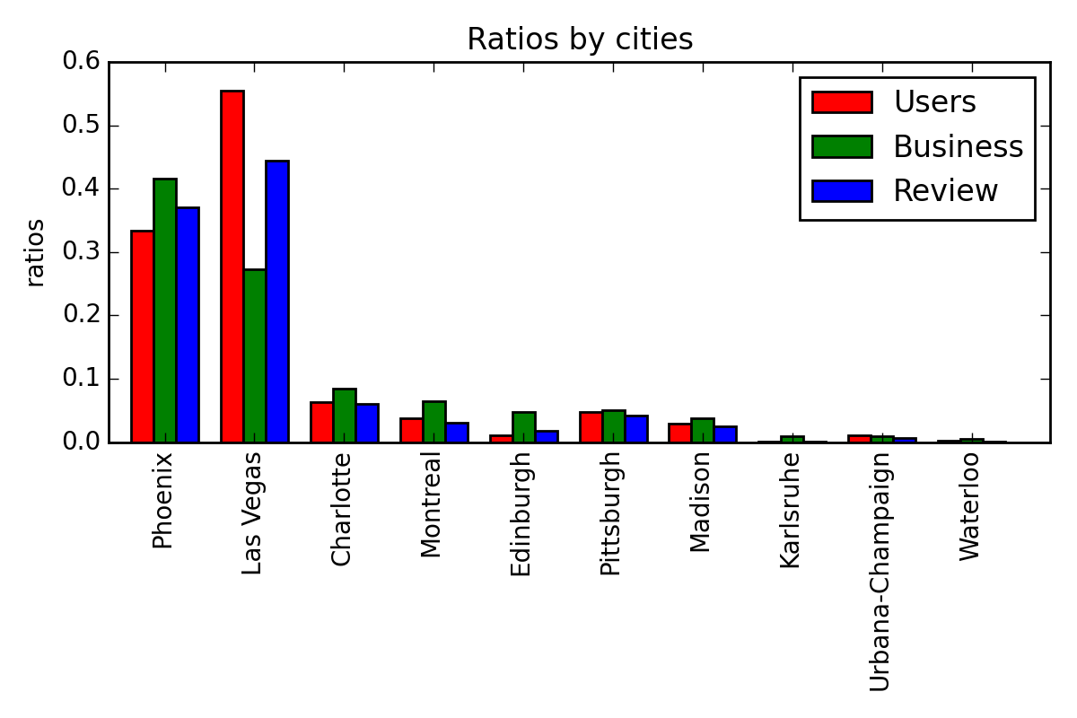
Data preprocessing
10 subsets of data, one for each city, are prepared.
social network for the city of Montreal.

Slide 5
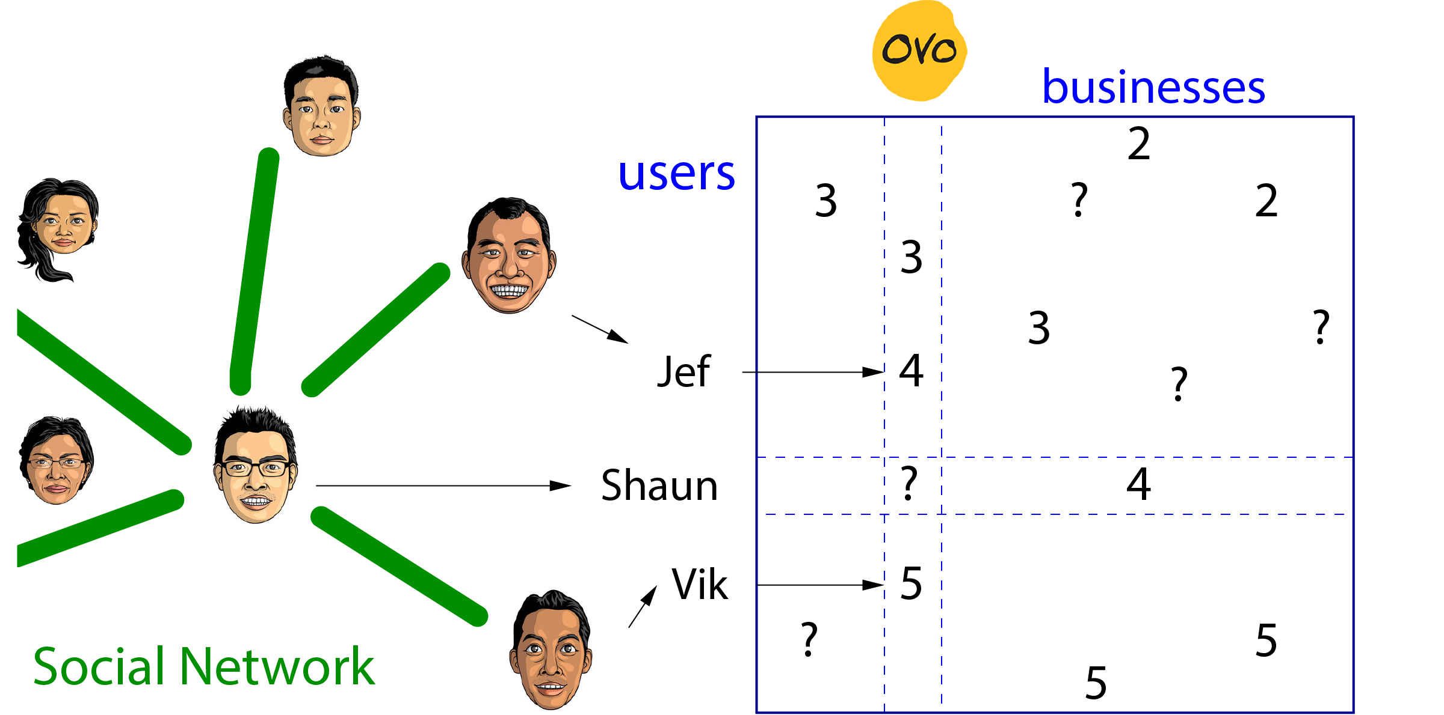
How it works.

Slide 6
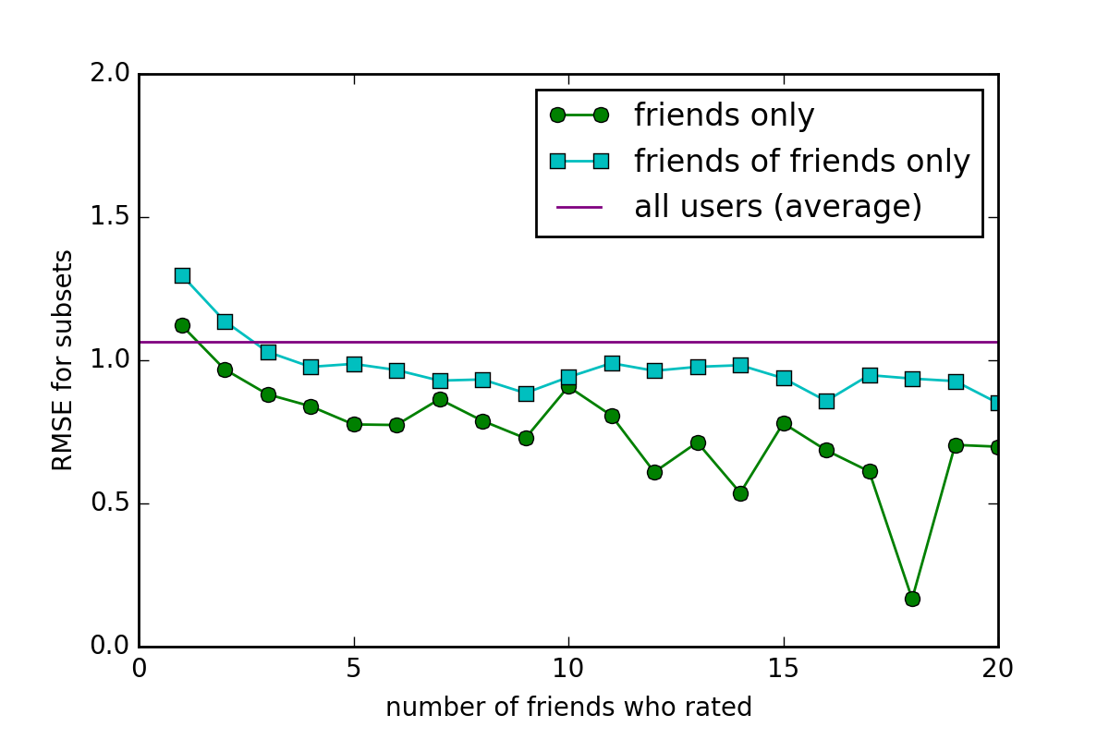
Why it might work.
(for the city of Montreal)

Slide 7
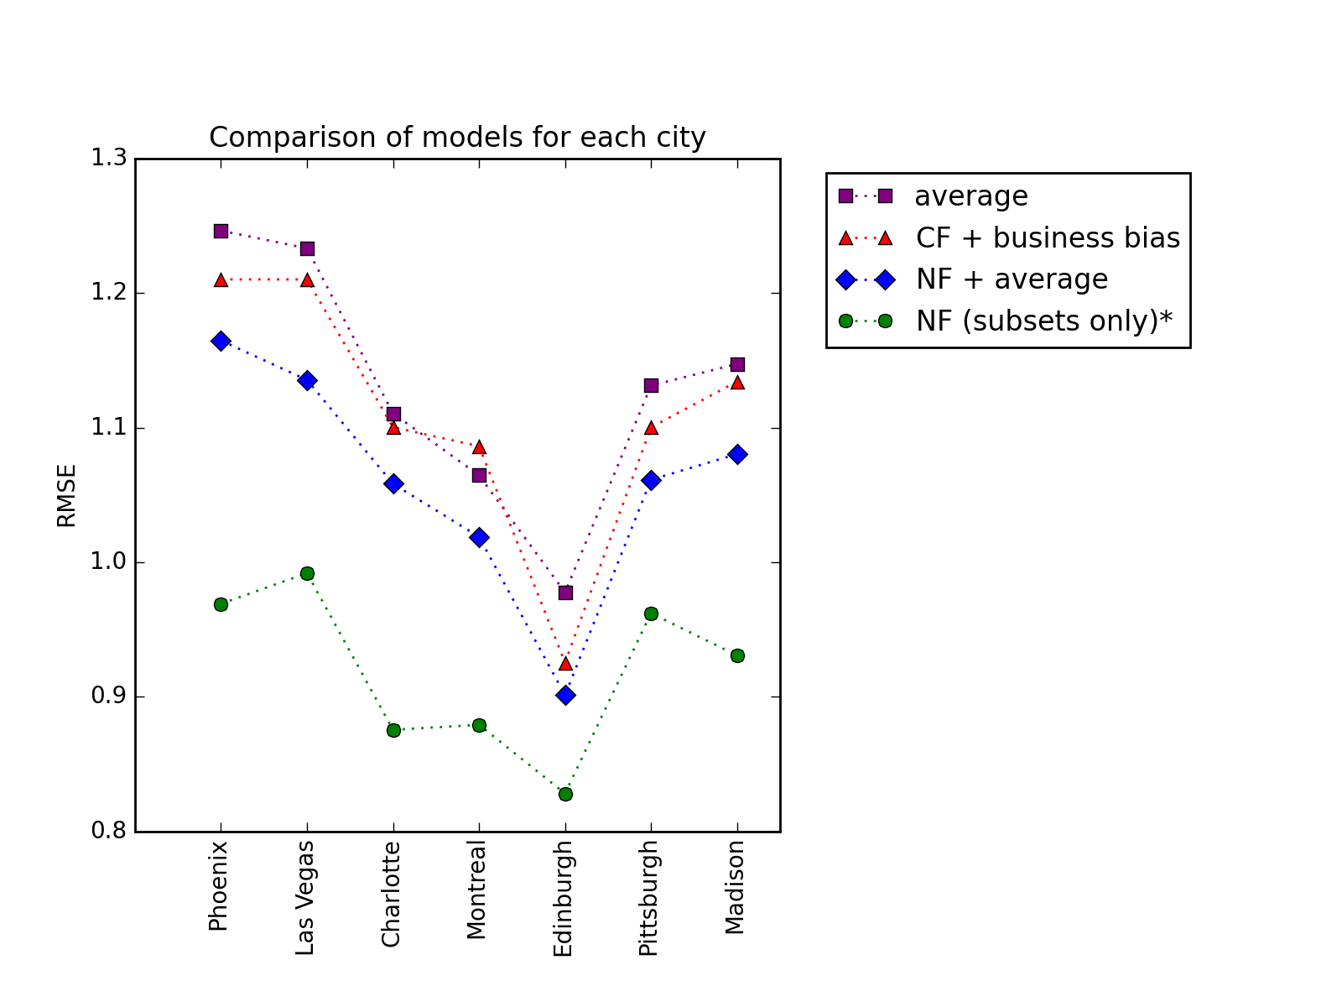
How it performed
Computed average RMSE using K-fold cross validation at k=10 for each city.
*: it was computed for the cases when (ratings by friends) ≥ 2.

Slide 8
What we learned.
Social networks can be useful for recommenders.
There are many ways to incorporate them. More to explore, and many attempts are being made.
Ref) “A social network-based recommender system,”
by Chu and He, Dissertation, UCLA (2010), and so on.
Hybrid models should be considered.
Many possible applications.

