Slide 1
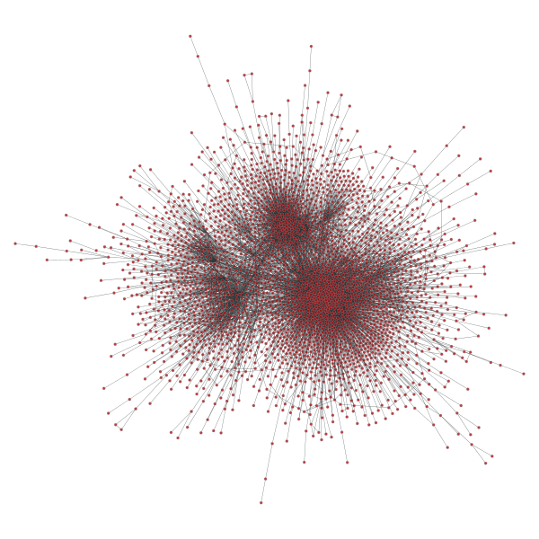
Exploring Recommenders with Networks
By Suhan Ree
at Galvanize
07/01/2015

Slide 2
Can social networks help
machine-learning algorithms?
With friend relationships between users,
can it improve recommendation systems?
Maybe Yes, but how?

Slide 3
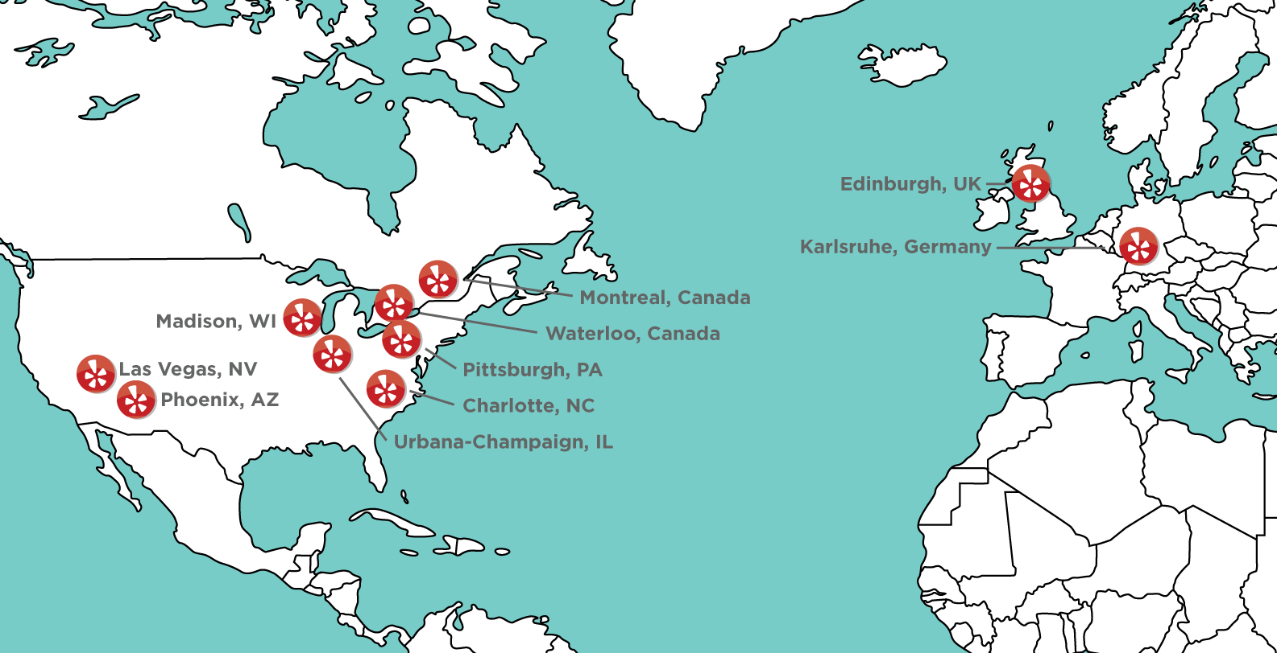
Data: Yelp Dataset Challenge
Ratings (+reviews): 1.6 M (10/12/2004 ~ 01/08/2015)
Businesses: 61K (on 10 cities)
Users: 366K with social network (2.9M edges)
10 cities
Edinburgh, Karlsruhe,
Montreal, Waterloo, Pittsburgh, Charlotte, Urbana-Champaign, Phoenix, Las Vegas, Madison
(Image from Yelp)

Slide 4
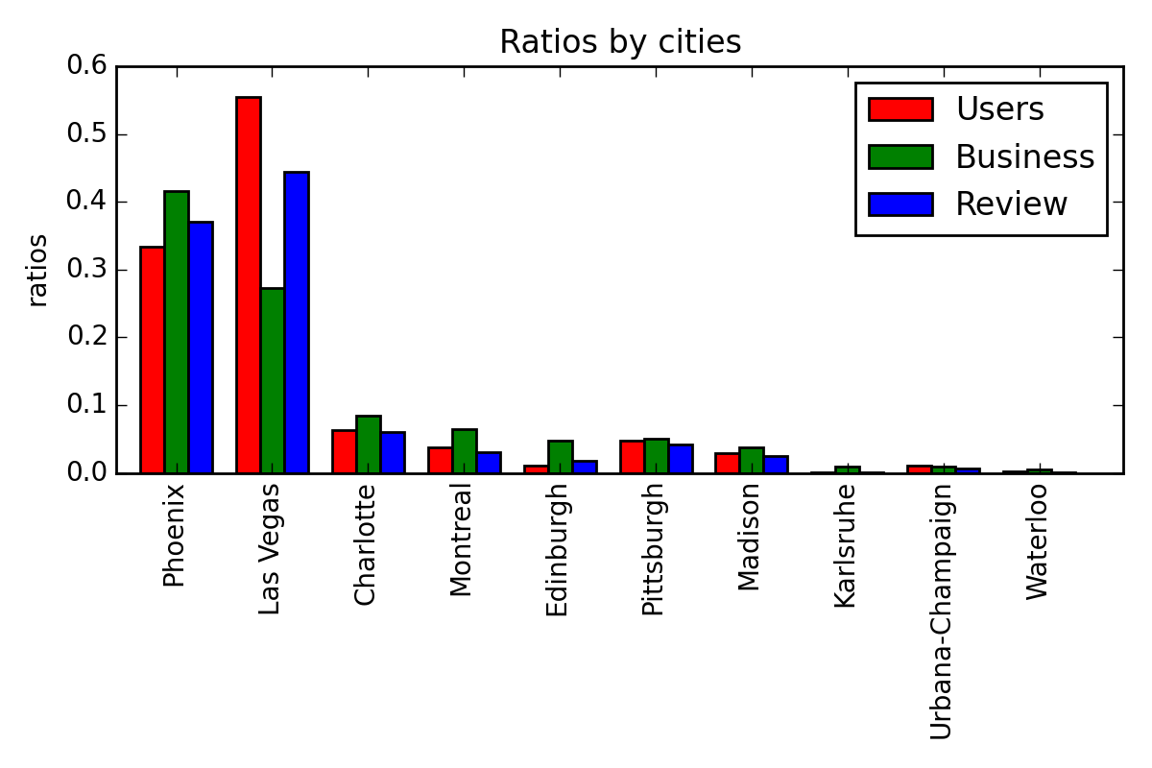

Data: Preprocessing
10 subsets of data, one for each city, are prepared.
Las Vegas Montreal
Only ratings + networks will be used here.

Slide 5
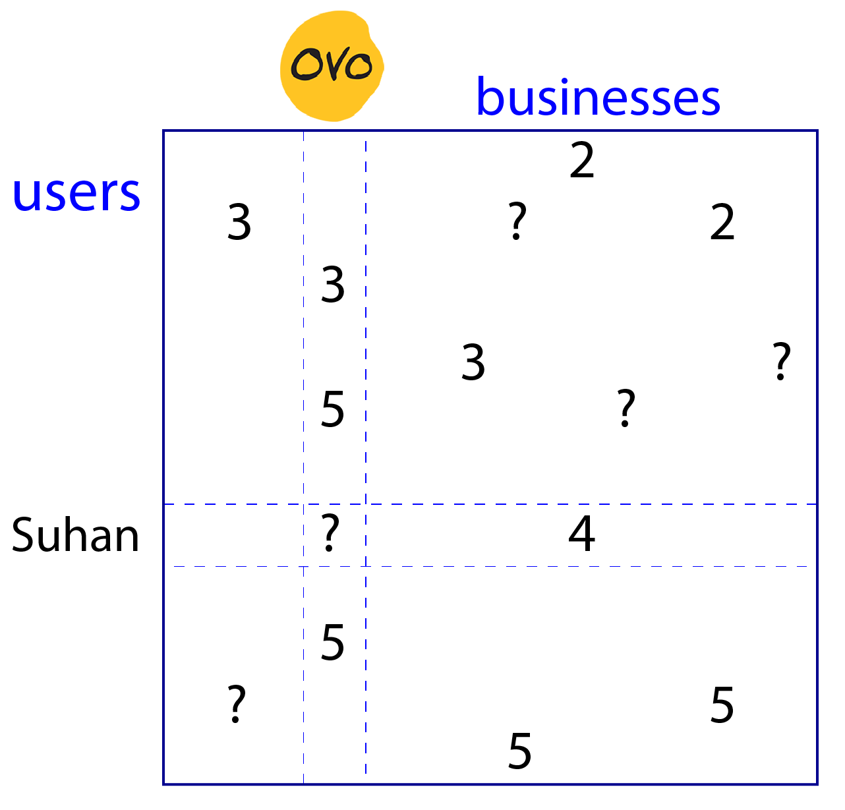
Typical Recommender Systems
Models
Average rating (baseline)
Content-based
Demographic Filtering
Collaborative Filtering (CF)
User-based
Business-based
Latent factors (SVD)
And so on…

Slide 6
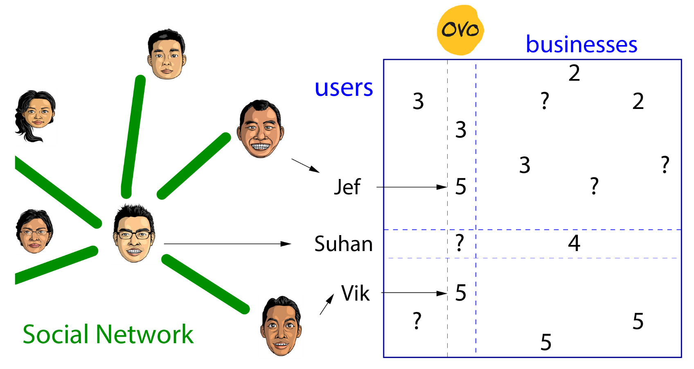
A Network-Based Model

Slide 7
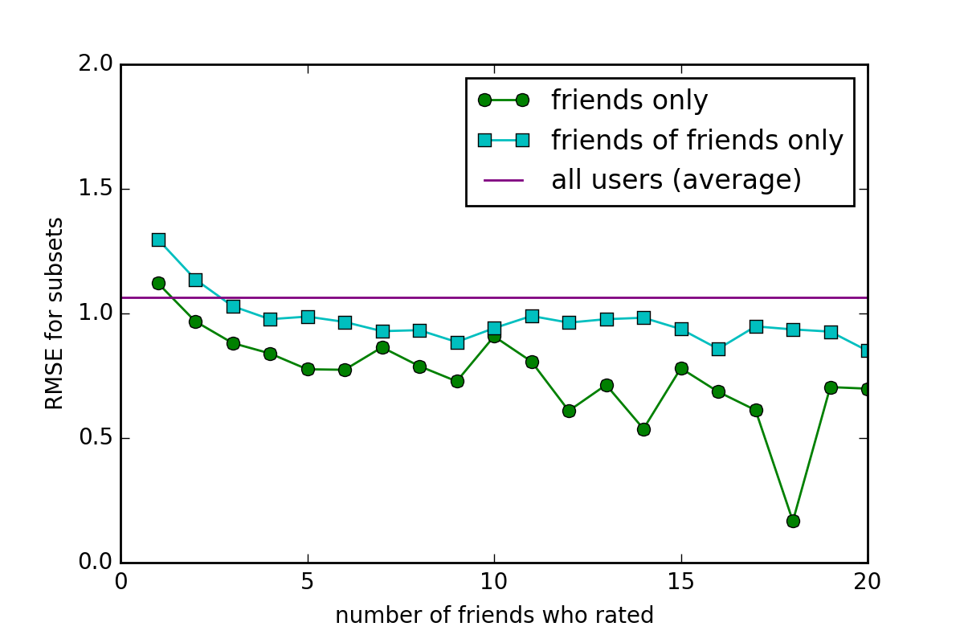
Network-Based Model: will it work?
for the city of Montreal

Slide 8
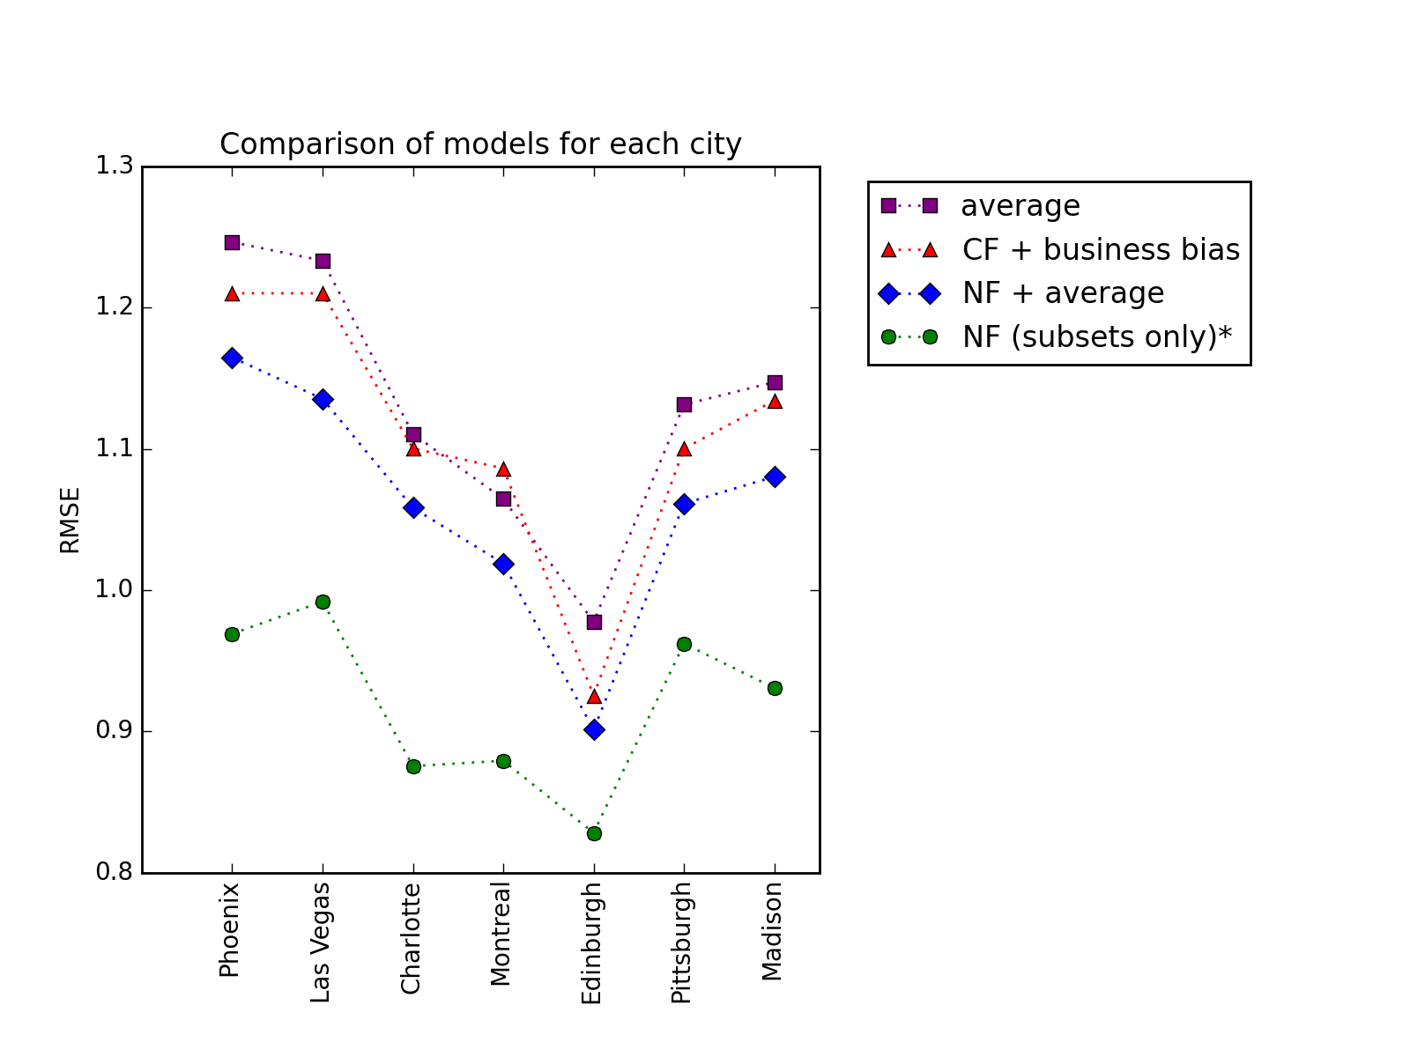
Comparing Models: it works!
Computed average RMSE using K-fold cross validation at k=10 for each city.
*: it was computed for the cases
when (ratings by friends) ≥ 2.

Slide 9
Conclusion
Social networks can be useful
for recommender systems!
Thank you!

