Slide 1
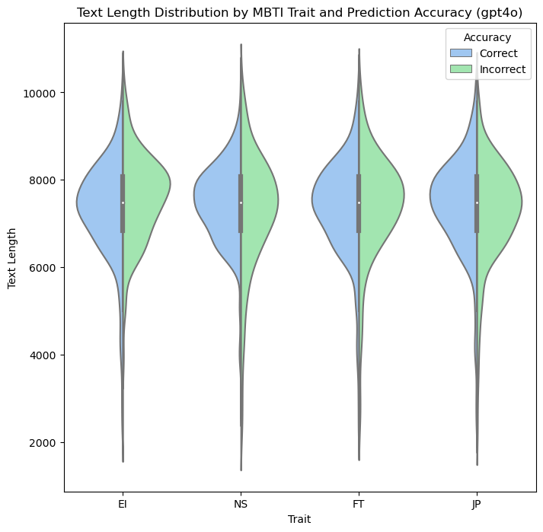


Slide 2
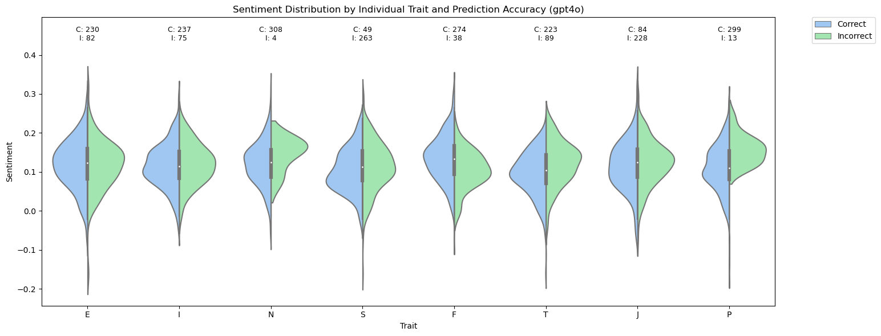
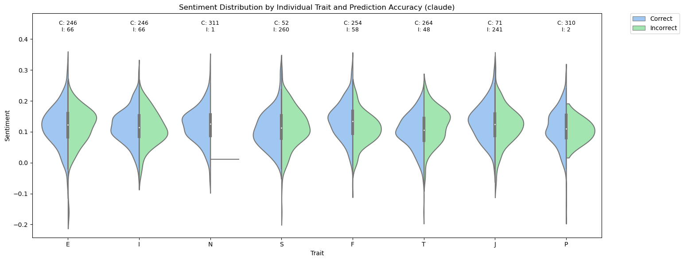

Slide 3
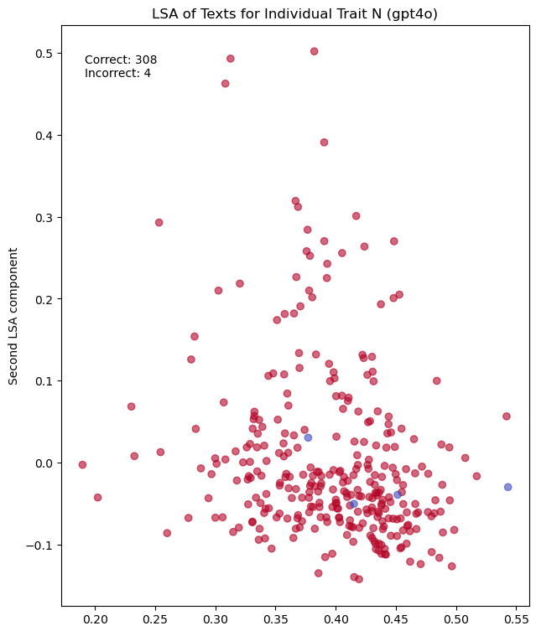
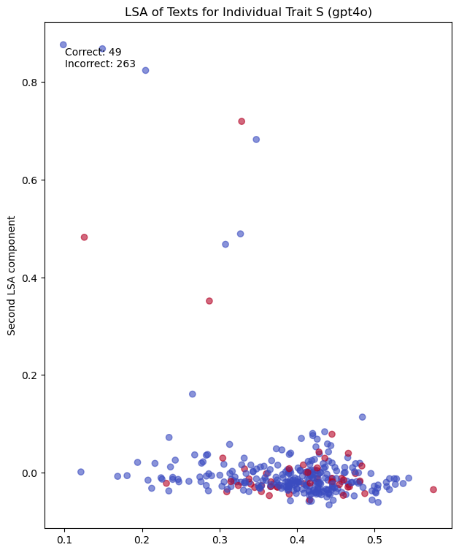
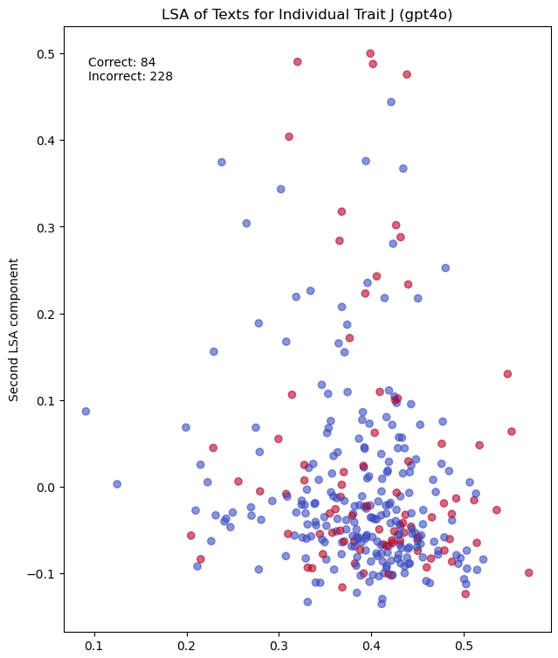
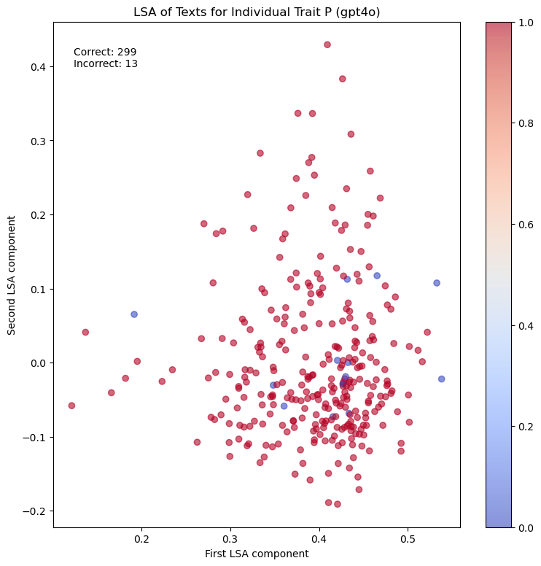



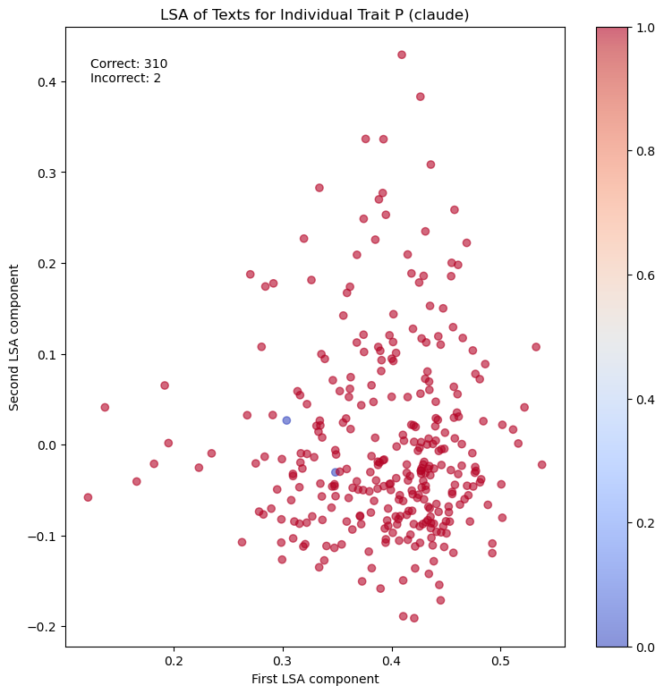
Cognitive Functionality and Personality Theory
Technical Communication and Product Interaction
Cognitive Functionality and Personality Theory
Cognitive Functionality and Personality Theory
Technical Communication and Product Interaction
Cognitive Functionality and Personality Theory
Cognitive Functionality and Personality Theory
Cognitive Functionality and Personality Theory
Personal Reflection and Emotional Expression
General Thought and Emotional Expression
Personal Reflection and Emotional Expression
Personal Reflection and Emotional Expression
Notes:
N
Left Graph (First LSA Component)
The words in this component, such as "like," "think," "people," "feel," and "love," suggest a focus on personal experiences, emotions, and general reflections. This component appears to capture the "Personal and Reflective Communication" aspect of language.
Right Graph (Second LSA Component)
The words in this component, such as "ni," "fe," "cognitive," "function," and "dominant," indicate a focus on psychological concepts, cognitive functions, and personality theory. This component seems to represent the "Cognitive Function and Personality Theory" aspect of language.
So, the best names for the two LSA components might be:
First LSA Component (Left): "Personal and Reflective Communication"
Second LSA Component (Right): "Cognitive Function and Personality Theory"
S
Left Graph (First LSA Component)
The words in this component, such as "like," "think," "people," "know," and "feel," suggest a focus on personal thoughts, general interactions, and emotional expressions. This component seems to capture the "General Thought and Emotional Expression" aspect of language.
Right Graph (Second LSA Component)
The words in this component, such as "tapatalk," "sent," "iphone," "nexus," and "functions," indicate a focus on technical terms, product usage, and communication platforms. This component seems to represent the "Technical Communication and Product Interaction" aspect of language.
So, the best names for the two LSA components might be:
First LSA Component (Left): "General Thought and Emotional Expression"
Second LSA Component (Right): "Technical Communication and Product Interaction"
J
Left Graph (First LSA Component)
The words in this component, such as "like," "think," "people," "know," and "feel," suggest a focus on personal reflections, social interactions, and emotional expressions. This component seems to capture the "Social Interaction and Reflective Thought" aspect of language.
Right Graph (Second LSA Component)
The words in this component, such as "fe," "ni," "cognitive," "function," and "dominant," indicate a focus on cognitive processes, personality functions, and theoretical discussions. This component seems to represent the "Cognitive Functionality and Personality Discourse" aspect of language.
So, the best names for the two LSA components might be:
First LSA Component (Left): "Social Interaction and Reflective Thought"
Second LSA Component (Right): "Cognitive Functionality and Personality Discourse"
P
Left Graph (First LSA Component)
The words in this component, such as "like," "think," "people," "really," and "know," suggest a focus on personal opinions, general reflections, and emotional responses. This component seems to capture the "Personal Reflection and Emotional Expression" aspect of language.
Right Graph (Second LSA Component)
The words in this component, such as "fi," "fe," "cognitive," "functions," and "socionics," indicate a focus on cognitive functions, personality theory, and analytical discussions. This component seems to represent the "Cognitive Processes and Personality Theory" aspect of language.
So, the best names for the two LSA components might be:
First LSA Component (Left): "Personal Reflection and Emotional Expression"
Second LSA Component (Right): "Cognitive Processes and Personality Theory"

Slide 4
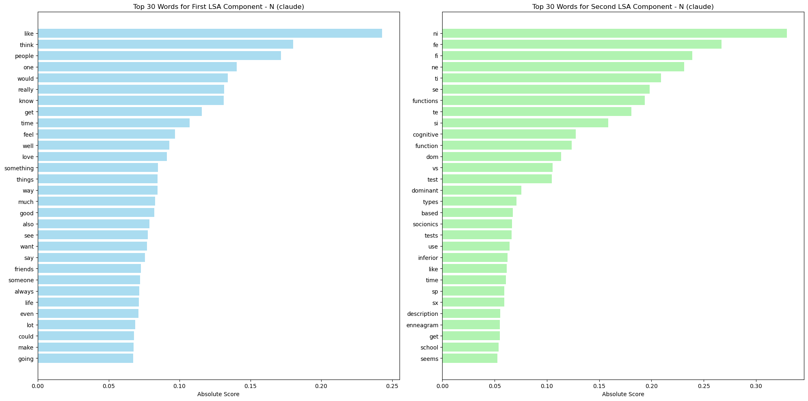
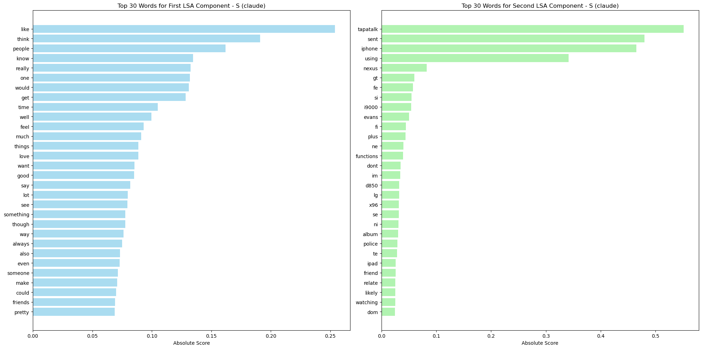
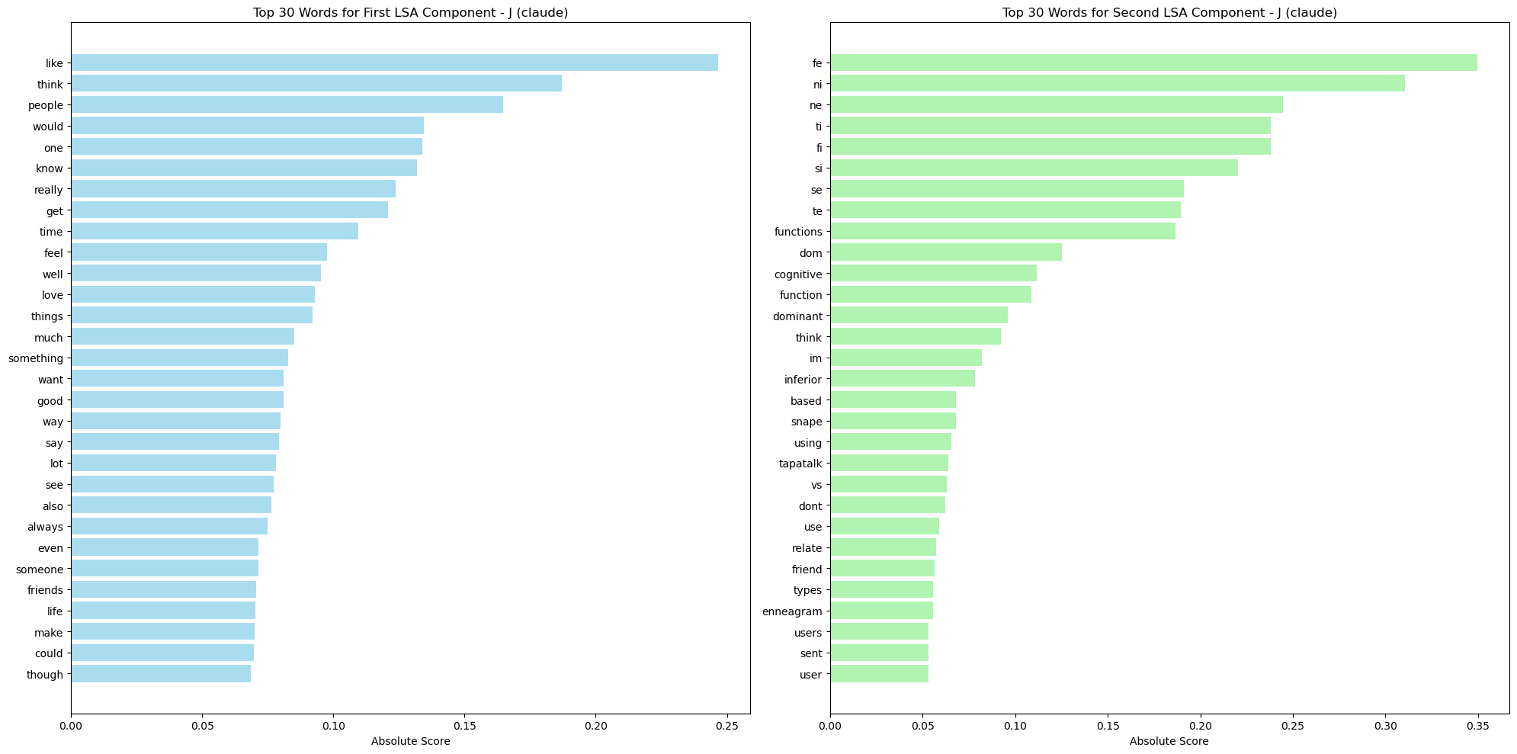
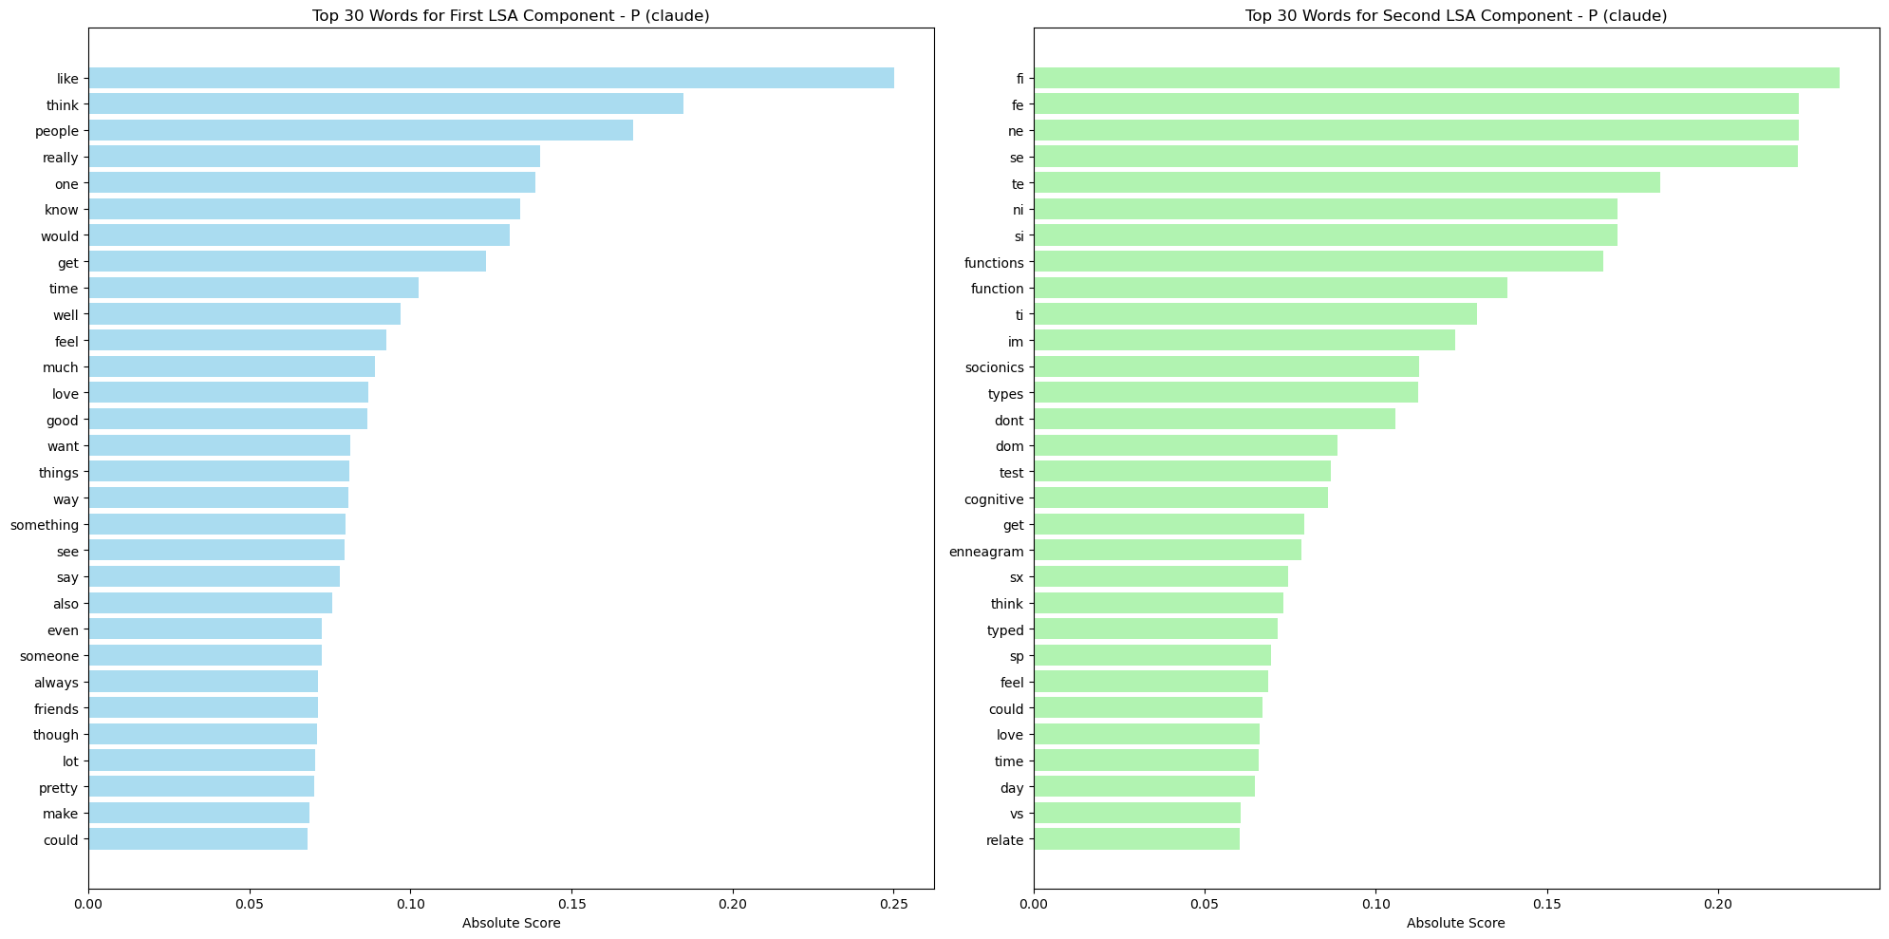
Notes:
GPT4o
Left Graph (First LSA Component)
The words in this component, such as "like," "think," "people," "know," and "feel," suggest a focus on personal experiences, emotions, and interpersonal interactions. This component seems to capture the "Interpersonal and Emotional Engagement" aspect of language.
Right Graph (Second LSA Component)
The words in this component, such as "functions," "cognitive," "dominant," "inferior," and "enneagram," indicate a focus on technical terminology, cognitive functions, and personality theory. This component seems to reflect the "Cognitive and Theoretical Analysis" aspect of language.
So, the best names for the two LSA components might be:
First LSA Component (Left): "Interpersonal and Emotional Engagement"
Second LSA Component (Right): "Cognitive and Theoretical Analysis"

Slide 5
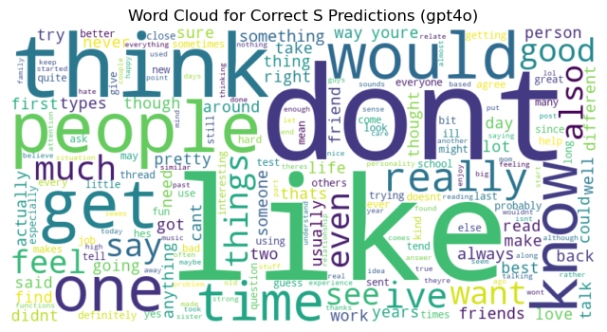
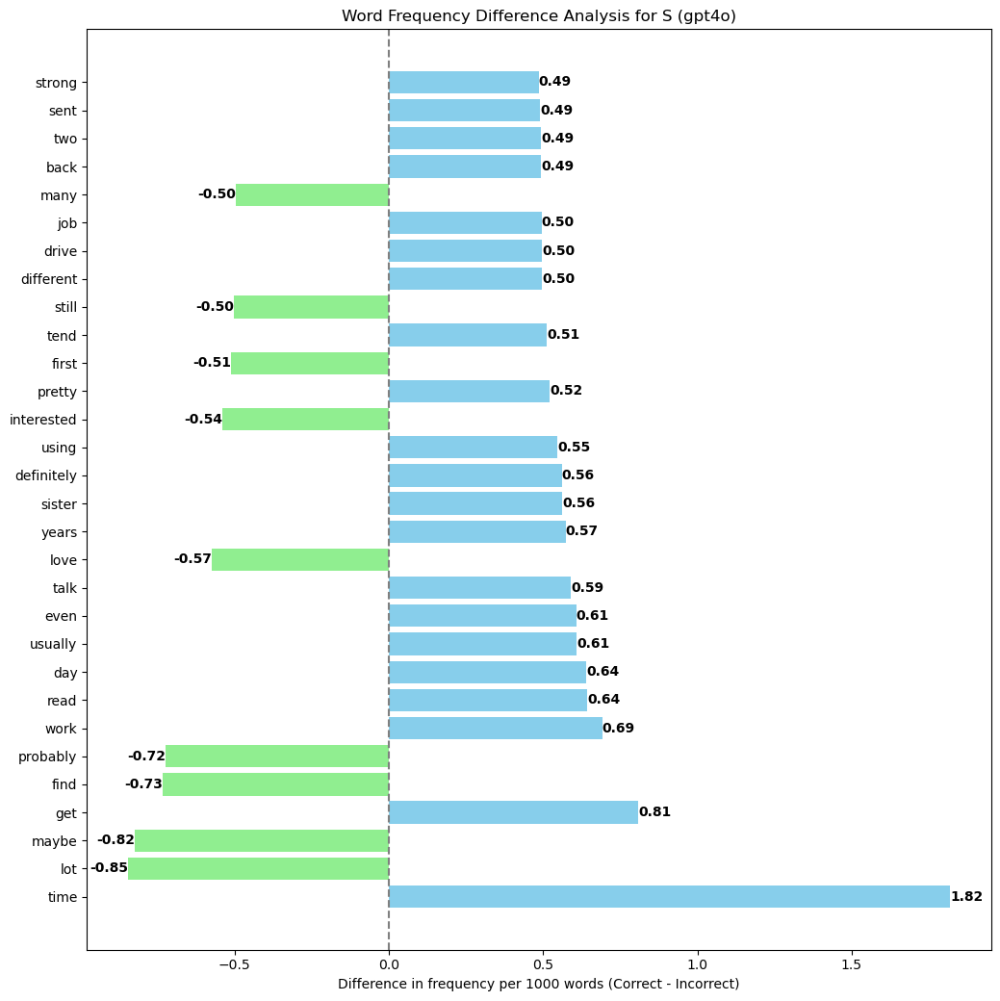
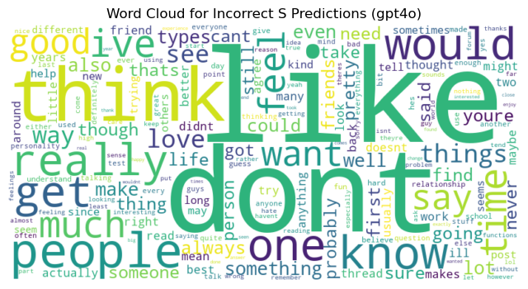
Notes:
Word Cloud Analysis:
Correct Predictions: The word cloud for correct predictions in the S trait shows a focus on words such as "think," "don't," "people," "get," "know," and "like." These terms suggest a focus on immediate experiences, practical considerations, and concrete details, which align with the Sensing trait's preference for focusing on the present moment and tangible realities.
Incorrect Predictions: The word cloud for incorrect predictions also features many of the same words, but with a more pronounced presence of terms like "want," "really," and "good." This may indicate that incorrect predictions are associated with language that is less grounded in the here-and-now and more abstract or emotionally driven.
Word Frequency Difference Analysis:
The third graph, which shows the difference in word frequency between correct and incorrect predictions, reveals some interesting trends:
Words More Frequent in Correct Predictions: Words like "time," "get," "using," "job," and "day" are more frequently used in texts that were correctly predicted as Sensing. These terms are associated with practical activities, timelines, and tangible outcomes, reflecting the S trait's focus on concrete experiences.
Words More Frequent in Incorrect Predictions: On the other hand, words like "maybe," "probably," "love," "interested," and "tend" are more frequently found in incorrect predictions. These words imply uncertainty, emotional involvement, or abstract tendencies, which might lead the model to misclassify the trait as something other than Sensing.
Possible Trend:
The analysis suggests that the model may struggle with S trait predictions when the language used is less concrete and more abstract or emotionally expressive. Sensing individuals tend to focus on what is real and tangible, so when the language in the text reflects this (e.g., using words related to time, actions, or specific objects), the model performs better. However, when the language becomes more speculative or emotionally driven, the model may incorrectly predict the trait, possibly confusing it with traits like Intuition (N) or Feeling (F).
In summary, the model's mispredictions for the S trait may stem from texts that deviate from the typical Sensing language, which is grounded in practicality and the present moment. The presence of more abstract, speculative, or emotionally expressive language in these texts seems to lead to a higher rate of incorrect predictions.

Slide 6
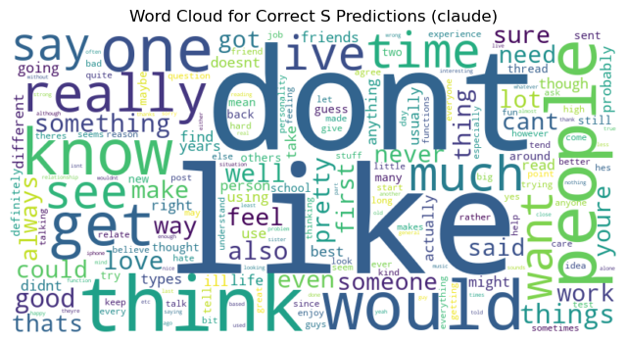
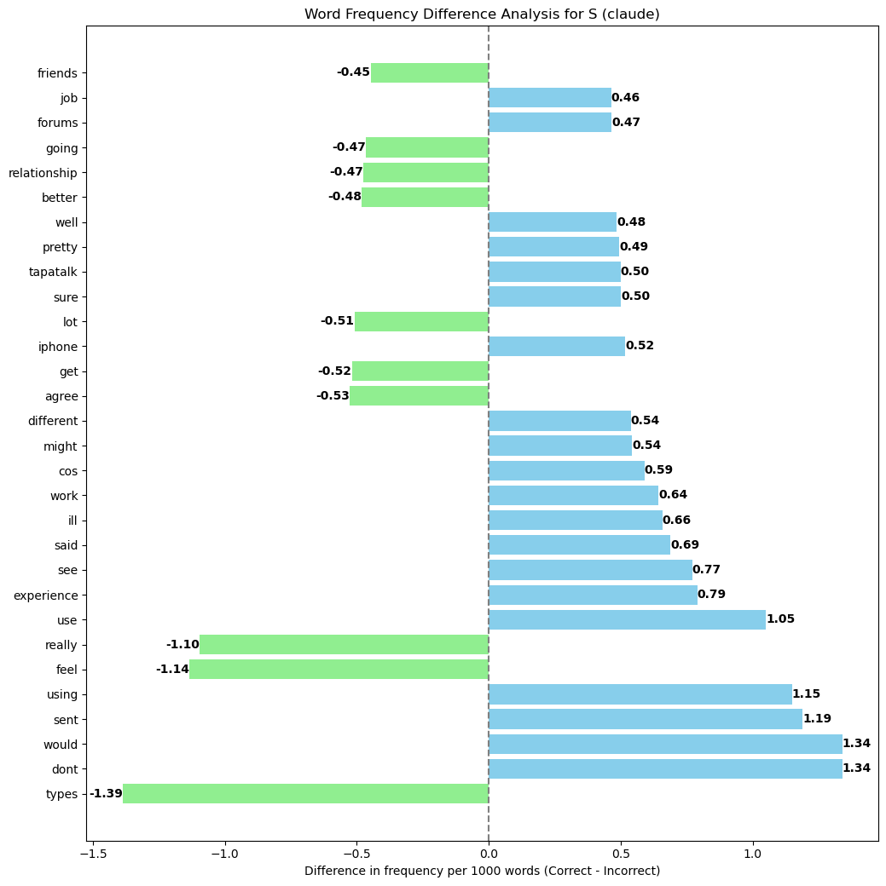
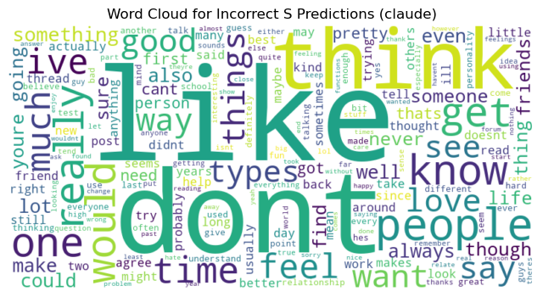

Slide 7
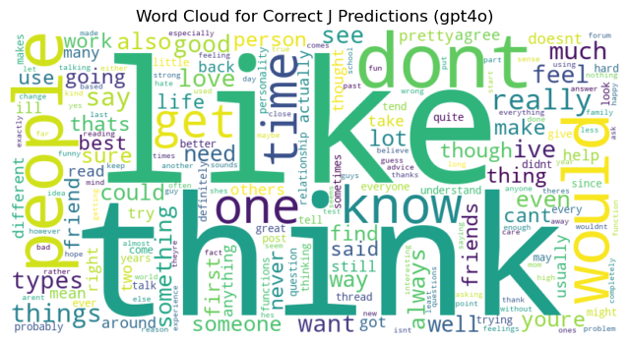
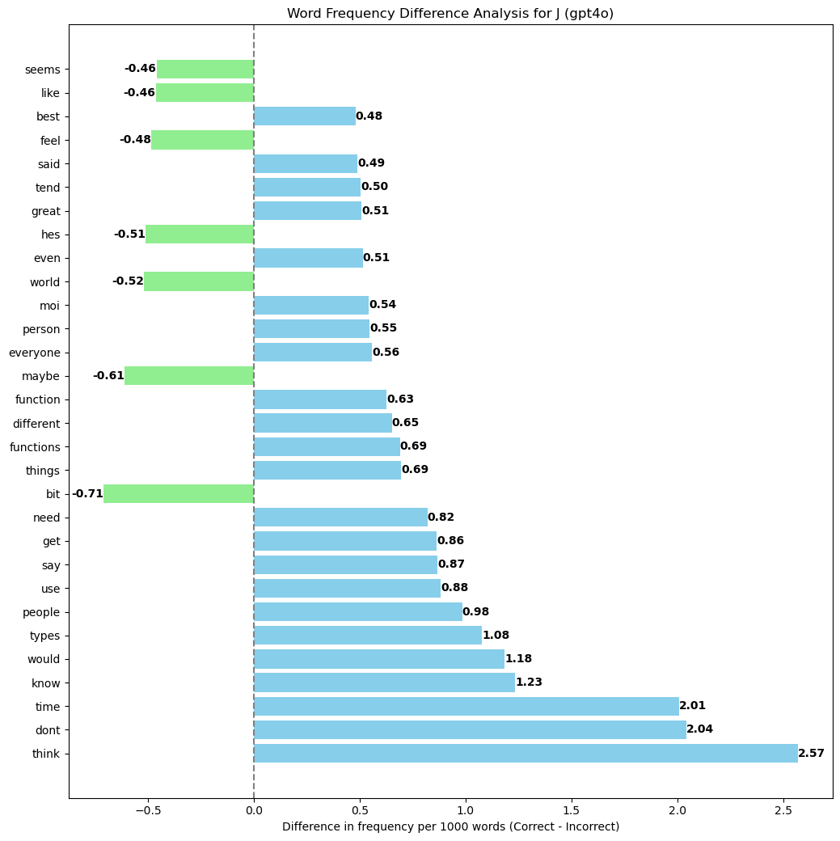
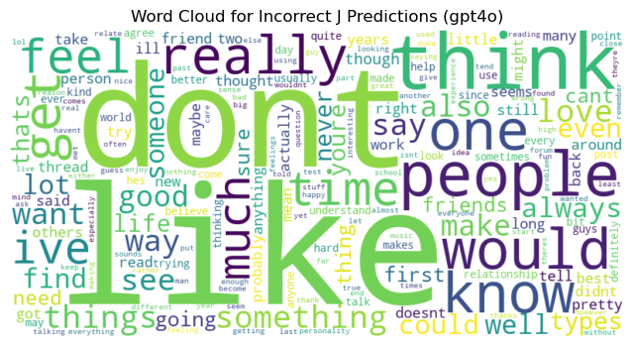
Notes:
Word Cloud Analysis:
Correct Predictions:
In the word cloud for correct predictions, prominent words include "think," "like," "time," "people," and "get." These terms suggest a focus on planning, structured thinking, and concrete actions, which are characteristic of the Judging trait. Words like "time" and "get" imply an orientation towards organization and the completion of tasks, aligning with the Judging preference for structure and decision-making.
Incorrect Predictions:
The word cloud for incorrect predictions features words such as "feel," "really," "much," and "good," which are more associated with emotion and less structured thinking. The presence of words like "feel" and "really" indicates a focus on subjective experiences and emotions, which may lead the model to confuse Judging with traits like Feeling (F) or Perceiving (P), where flexibility and emotional consideration are more prominent.
2. Word Frequency Difference Analysis:
The third graph shows the difference in word frequency between correct and incorrect predictions. Key observations include:
Words More Frequent in Correct Predictions:
Words like "time," "dont," "think," "know," "would," "types," and "people" are significantly more common in correct predictions. These words reflect an emphasis on structured decision-making, practical considerations, and logical reasoning, all of which are hallmarks of the Judging trait. The focus on time management ("time") and direct actions ("get," "would") suggests that when texts contain these elements, the model is better at accurately identifying the Judging trait.
Words More Frequent in Incorrect Predictions:
On the other hand, words like "bit," "maybe," "seems," "feel," and "really" are more frequently found in incorrect predictions. These words are associated with uncertainty, emotional expression, and tentative language, which are less aligned with the Judging trait's preference for decisiveness and structure. This misalignment could lead the model to mistakenly predict another trait, particularly those associated with more flexible and emotionally driven preferences, like Perceiving (P) or Feeling (F).
3. Possible Trend:
The analysis suggests that the model performs better in predicting the Judging trait when the text includes language that is structured, time-oriented, and action-focused. Incorrect predictions tend to occur when the language is more subjective, emotionally expressive, or uncertain, which may cause the model to confuse Judging with traits that prioritize flexibility and emotional consideration.
Summary:
The model's challenges in accurately predicting the Judging trait seem to be linked to the presence of less structured, more emotionally driven language in the text. When the language aligns with the Judging trait's characteristics—structured thinking, time management, and decisive action—the model performs better. However, when the text is more tentative or emotionally focused, the model is more likely to make incorrect predictions, potentially confusing Judging with other traits.

Slide 8
