Slide 1
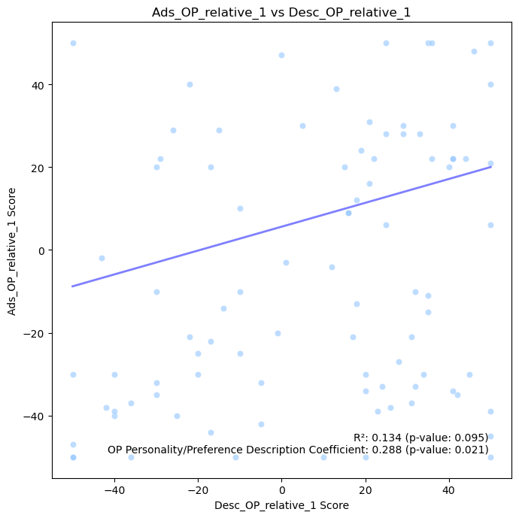
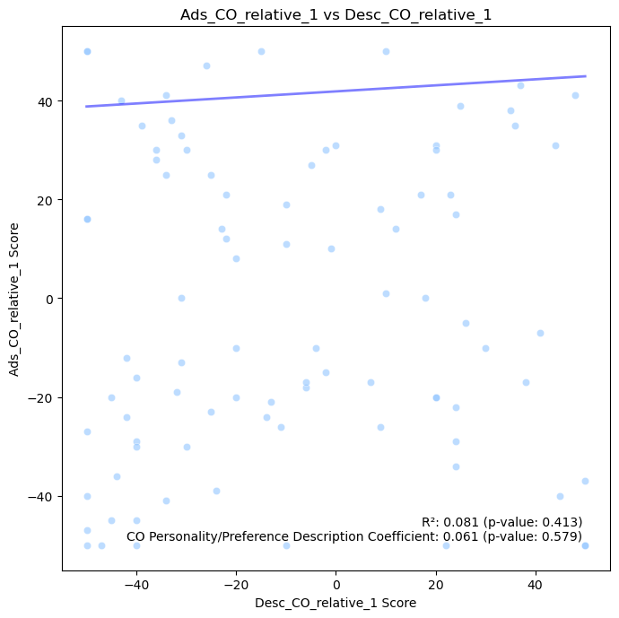
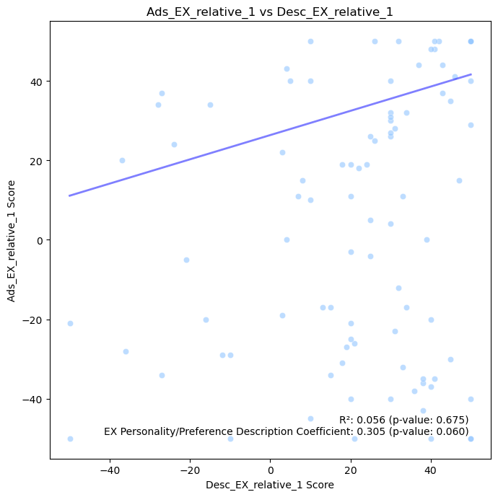
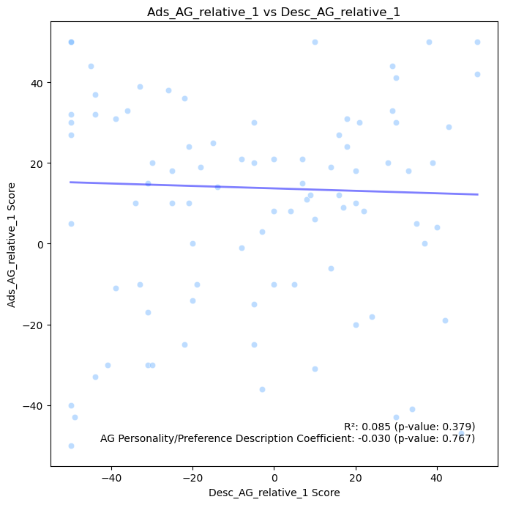
OP Perceived Personalization vs Personality and Ad Preference Match
CO Perceived Personalization vs Personality and Ad Preference Match
Perceived Personalization Score (zero-centered)
Perceived Personalization Score (zero-centered)
Personality and Ad Preference Match Score (zero-centered)
Personality and Ad Preference Match Score (zero-centered)
EX Perceived Personalization vs Personality and Ad Preference Match
AG Perceived Personalization vs Personality and Ad Preference Match
Perceived Personalization Score (zero-centered)
Perceived Personalization Score (zero-centered)
Personality and Ad Preference Match Score (zero-centered)
Personality and Ad Preference Match Score (zero-centered)

Slide 2
