Slide 1
LAN Whiteboard
Computer Networks Lab Project
Bupesh CS24B2029
Rakesh CS24B2039
Suhas CS24B2040
Guna CS24B2043
CN Lab | 1
Notes:
Computer Networks lab project. A central TCP server keeps one board per room. Desktop clients draw and chat over the local network.

Slide 2
What the application does
Draw together using pen, eraser, shapes and text.
Chat in the room and see who is connected.
Undo your own strokes and save a shared board.
Join late or reconnect and get the current board.
CN Lab | 2
Notes:
Clients join by server address, room code and password. Pen and eraser send short point batches while dragging. Shapes commit on release. The host can save, clear or load a board. All clients receive the accepted edit order from the server.

Slide 3
Client-server design
Client A
Server
Client B
↔
↔
TCP connection
Room state + edit order
TCP connection
A lock gives simultaneous edits one order.
Each client receives the same update numbers.
CN Lab | 3
Notes:
The server owns the room state. One lock orders changes. Each connection has its own outgoing queue and writer thread, so sending to a slow client does not write a socket inside the state lock.

Slide 4
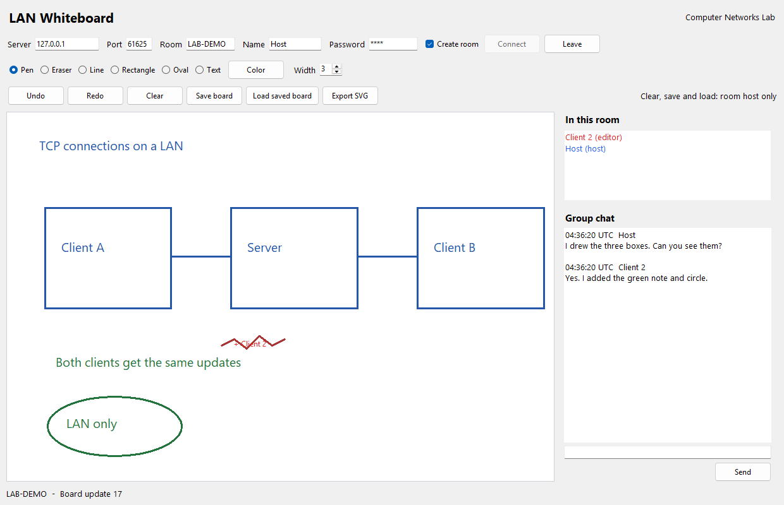
Running board: host window
CN Lab | 4
Notes:
Actual screenshot from the local two-client GUI test. The host drew the blue boxes. Client 2 added the green note and circle. Both windows received the same operations and chat.

Slide 5
Messages over TCP
First 4 bytes | Next N bytes
Payload length N | UTF-8 JSON message
recv() may return only part of a message.
The server checks the action and assigns an update number.
Duplicate request IDs receive an acknowledgement.
CN Lab | 5
Notes:
protocol.py reads four bytes for the length, then loops until all payload bytes arrive. The JSON object identifies the action. The server adds the sender identity and update number to accepted edits. A request ID prevents a retried action from appearing twice.

Slide 6
Undo, save and reconnect
One drag is one undo group. Other users' work stays.
Save board keeps one copy. Load saved board restores it.
Only the host can save, load or clear.
A dropped client retries every 2 seconds and catches up.
CN Lab | 6
Notes:
A drag has one group ID even when it sends several point batches. Undo changes the latest active group belonging to that user. New drawing discards their redo branch. Save stores one copy per room. The reconnecting client receives full state before retrying unacknowledged requests.

Slide 7
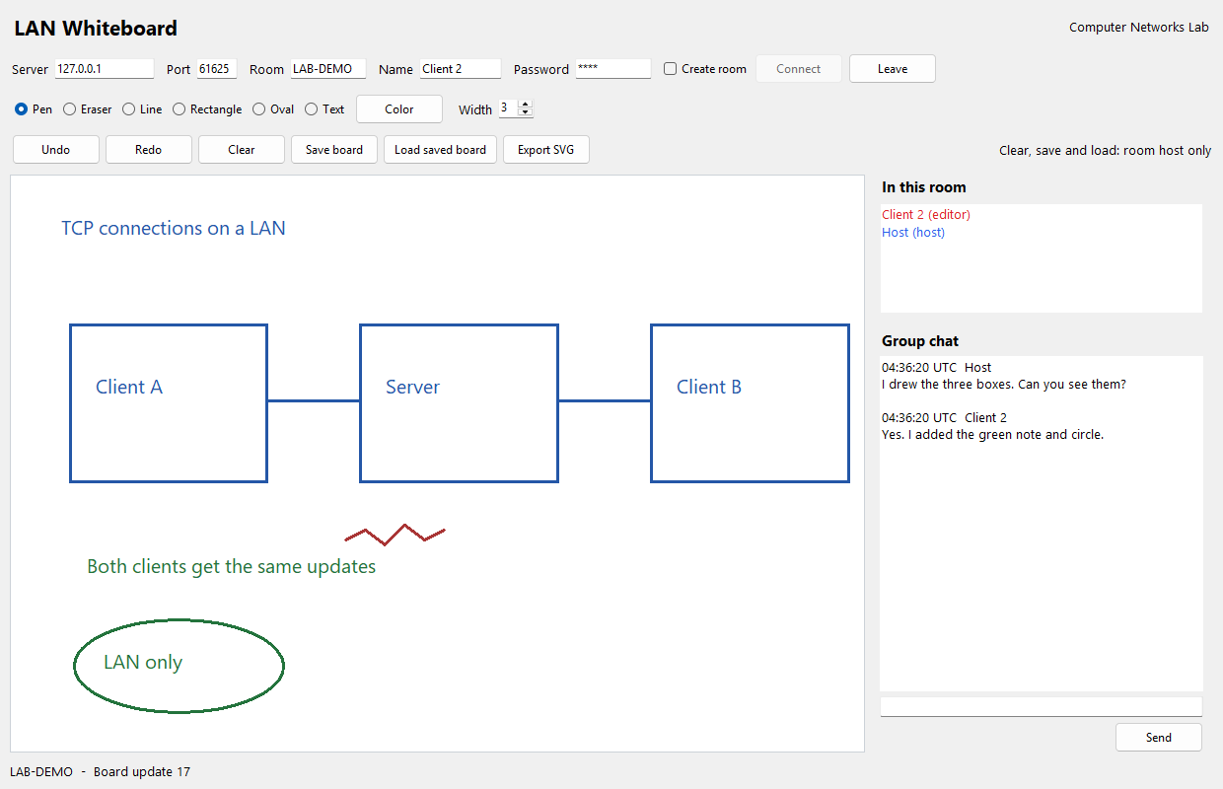
Running board: second client
CN Lab | 7
Notes:
Actual second client window in the same local test. The test compared the clients' operation lists after drawing, undo/redo, clear/load and forced disconnection. This is a loopback test on one Windows machine, not a physical LAN measurement.

Slide 8
Checks and limits
10 automated tests passed.
4 clients received the same 40 drawing updates.
Two GUI clients passed save/load, reconnect and export checks.
Still needed: a two-computer LAN rehearsal.
Limits: 1000 drawing segments and 500 chat messages per room.
CN Lab | 8
Notes:
All 10 automated tests passed. Four socket clients sent 40 drawing events and received the same order. Two desktop clients passed drawing, chat, undo/redo, late join, save/load, reconnect and SVG export checks. The next lab check is two physical computers with internet disabled.

