Slide 1
DLDCA Lab 2
x86-64 Assembly
Notes:
Need to cover the following:
Some motivation for asm
Structure of asm programs (maybe show objdump)
Define registers
Explain instructions
Explain sections (.data, .text)
Getting started - simple hello world in asm?
Explain syscalls - what they are, how they work
Anything else?

Slide 2
What is Assembly?
Representation of machine code which is readable by humans
Each CPU architecture has its own assembly language
This is what the compilation pipeline for C/C++ looks like:
C/C++
Pre-processed code
Assembly
preprocessor
compiler
assembler
Executable
linker
Object file

Slide 3
Why should we study assembly?
OS programming
Some parts of the OS, such as the bootloader need to be written in asm
Debugging
With asm, you can get an insight into the exact instructions being run on the cpu
Performance
Can generate code specific to your machine, can use fast machine specific instructions
Cybersecurity
Exploits occur at a machine level, assembly is needed to understand it
Reverse Engineering
Need to understand assembly as it can be obtained from binaries

Slide 4
Getting Started

Slide 5
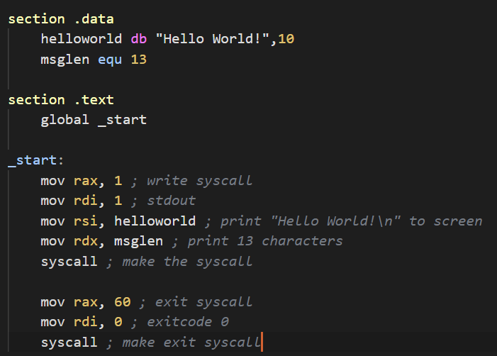
“Hello World” in asm
What’s a section?
What’re rax, rdi, rsi, rdx?
What is a ‘syscall’?
What is ‘_start’?
What is ‘mov’?
Why is there a 10 after “Hello World!”?

Slide 6
Sections
Different regions of the assembly code
.data contains initialised global/static data
.text contains the actual instructions to be executed

Slide 7
Instructions and Registers
Instructions are the commands given to the CPU, they tell it what to do
To the CPU, an instruction is just a sequence of bits. In assembly language, these are represented as mnemonics (textual names) like mov, add, jmp
The mov instruction copies data from one location (register/memory address/immediate value) to another
Registers are small, fast chunks of memory inside the CPU used to hold data the CPU is currently working with
Instructions can manipulate the contents of these registers
rax, rdi, rsi and rdx are different registers
A list of x86-64 registers can be found here

Slide 8
Syscalls
User programs not allowed to directly access hardware
Only kernel can directly access hardware
Access hardware: read/write files, allocate memory, print to screen, take input etc
Syscalls way for user programs to say “Hey OS, do this for me please”
How do syscalls work?
Each syscall has a specific number, number is put in rax register
Arguments to the syscall, put in rdi, then rsi, then rdx, then r10, r8 and r9 registers
Call syscall and get return value in rax
List of syscall is in /usr/include/x86_64-linux-gnu/asm/unistd_64.h
More about syscalls

Slide 9
Miscellaneous
What is ‘_start’?
The entry point to asm code, like “int main(int argc, char **argv)” in C/C++
Why is there a 10 after “Hello World!”?
10 is the decimal value for the newline character
Here is a general guide to x86

Slide 10
Thank You

