Slide 1


CUSTOMER INSIGHTS IN FOOD DELIVERY PLATFORMS
By Suhas S Gowda

Slide 2
Project Overview
Analyzed customer preferences and behavior in food delivery apps
Built an interactive Power BI dashboard
Focused on spending patterns, platform usage, and order habits

Slide 3
Dataset summary
Number of records :79
Columns used :24
Fields like: Platform, Spending, Cuisine, Ratings, Time Slot, Frequency
Cleaned data and removed inconsistent values

Slide 4
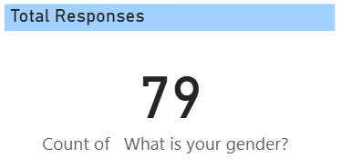
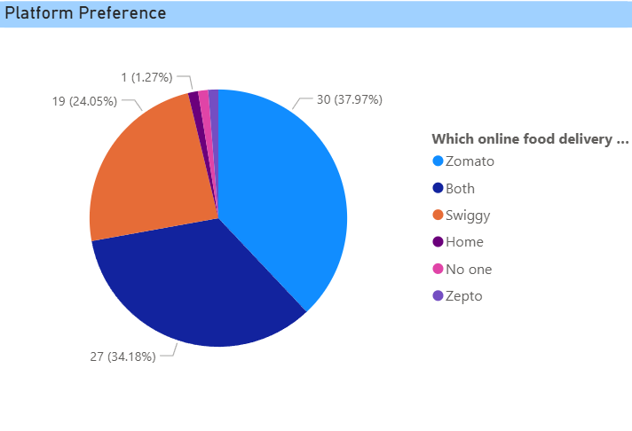
Platform Insights

Slide 5
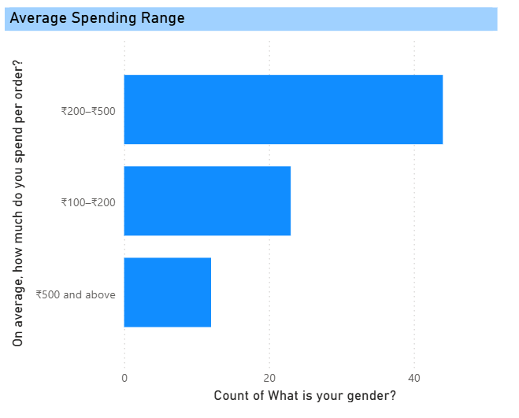
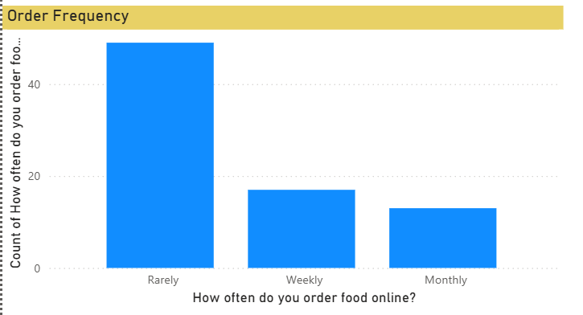
Customer Spending Behavior

Slide 6
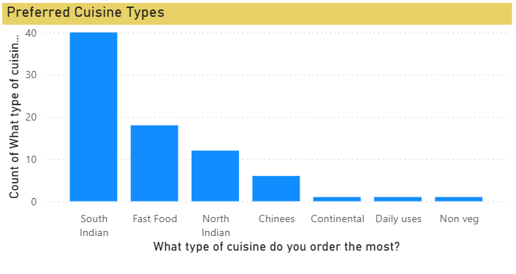
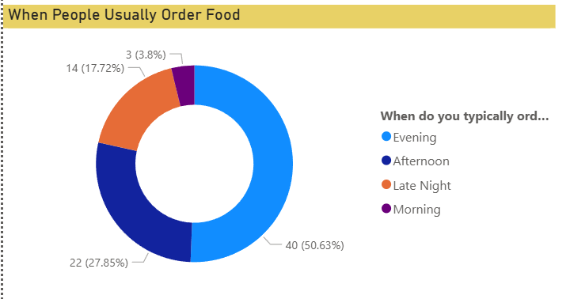
Food & Time Preferences

Slide 7
Key Insights
Zomato leads in platform preference
Highest spending range is ₹200–₹500
South Indian most popular
Offers influence most purchasing decisions
Evening is peak order time

Slide 8
Conclusion
Dashboard helps understand user habits
Useful for marketing, targeting, and improving customer experience
Future additions: predictive models

Slide 9
THANK
YOU

