Slide 1
CS 31007 Autumn 2021 COMPUTER ORGANIZATION AND ARCHITECTURE
Instructors
Rajat Subhra Chakraborty (RSC)
Bhargab B. Bhattacharya (BBB)
Lecture #22: Computer Arithmetic
20 September 2021
Indian Institute of Technology Kharagpur
Computer Science and Engineering
Notes:
Good Morning!
The title of today’s talk is “On some Planar Partitioning Problems”.

Slide 2
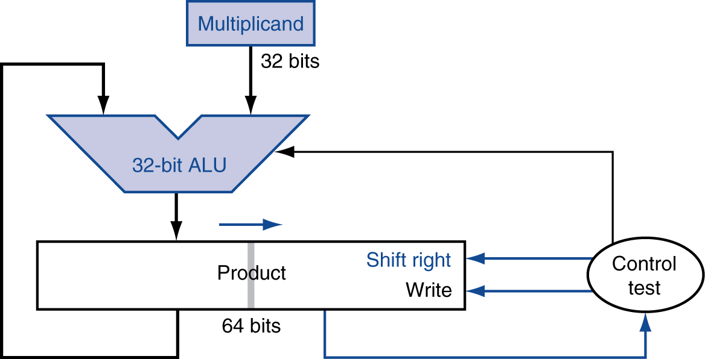
Recap: Integer Multiplier using Repeated Add/Shift
Multiplier
(32-bits)
Can we expedite multiplication?
Handling negative numbers?
- Booth’s Algorithm

Slide 3
Recall: Multiplication Example
0010 × 0110 = ? 0010 (+ 2, multiplicand); 0110 (+ 6, multiplier)
logical shift
+12

Slide 4
Booth’s Encoding (valid for signed multiplication as well)
Recall old trick
Example: 123454 × 9
⇒ six partial products plus addition of six numbers
123454 × 9 = 123454 × (10 – 1) = 1234540 – 123454
Transform addition of six partial products to
one shift and one subtraction!
Booth’s algorithm applies the same principle
in binary we have just ‘1’ and ‘0’

Slide 5
Booth’s Encoding
Multiply x by 0111
x (multiplicand); 0111 (multiplier) => x ×7
Search for a run of ‘1’ bits in the multiplier
e.g. ‘0111’ has a run of 3 consecutive ‘1’ bits
Multiplying by ‘0111’ (7 in decimal) is equivalent to multiplying by 8 and subtracting once, since
x ×7 = x ×(8 – 1) = 8x – x =>(shift-left x, three times) - x
Hence, iterate right to left and look for “runs of 1”:
x × 111 = x × (1000 – 1) = (x ×2³) – x
Subtract multiplicand from product at first ‘1’
Shift multiplicand by 3-bits on left and add to the partial product after the last ‘1’
Do nothing for the consecutive 1-bits/in the middle, or for 0-runs (actually, we keep on shifting the product register)

Slide 6
Booth’s Encoding for Multiplier
middle of 1-run (11)
beginning of 1-run (10)
0 1 0 0 0 0 1 1 1 1 0 0
0-run (00)
end of 1-run (01)

Slide 7
Booth’s Algorithm
Current bit | Bit to right | Explanation | Example (multiplier) | Operation
1 | 0 | Begins run of ‘1’ | 00001111000 | Subtract/shift
1 | 1 | Middle of run of ‘1’ | 00001111000 | Nothing/shift
0 | 1 | End of a run of ‘1’ | 00001111000 | Add/shift
0 | 0 | Middle of a run of ‘0’ | 00001111000 | Nothing/shift

Slide 8
Booth’s algorithm: Example
0010 × 1101 = ? 0010 (+ 2, multiplicand); 1101 (- 3, multiplier)
arithmetic shift
op performed in the left half
initialization
start of
1-run
end of
1-run
-6

Slide 9
MIPS Multiplication
Two 32-bit registers for product
HI: most-significant 32 bits
LO: least-significant 32-bits
Instructions
mult rs, rt / multu rs, rt
64-bit product in HI/LO
mfhi rd / mflo rd
Move from HI/LO to rd
Can test HI value to see if product overflows 32 bits
mul rd, rs, rt
Least-significant 32 bits of product –> rd

Slide 10
So far covered in computer arithmetic…
Integer Number Systems and Overflow
Ripple-Carry Adder (RCA)
Carry-Lookahead Adder (CLA)
Hybrid Adder, CLT
Carry-Select Adder (CSA)
Brent-Kung’s Parallel Prefix Adder (PPA)
Carry-Save Adders (for adding multiple operands)
Integer Multiplication
Integer Division: Reading Assignment
Floating-Point Arithmetic and Hardware
Notes:
Good Morning!
The title of today’s talk is “On some Planar Partitioning Problems”.

Slide 11
Division
Implemented by successive subtractions
Result must verify the equality
Dividend = (Multiplier × Quotient) + Remainder
Another powerful division method (Goldschmidt’s algorithm):
In computer science, division can be accomplished by multiplying a number with the reciprocal of the multiplier!
In biology, multiplication is accomplished by division!

Slide 12
Decimal division
 | 303
7 | 2126
 | -210
 | 26 -21 5
What are the rules?
Repeatedly try to subtract a multiple of divisor from dividend
Record multiple (or zero)
At each step, repeat with a lower power of ten
Stop when remainder is smaller than divisor

Slide 13
Integer Division in Binary
§3.4 Division
Check for 0 divisor
Long division approach
If divisor ≤ dividend bits
1 bit in quotient, subtract
Otherwise
0 bit in quotient, bring down next dividend bit
Restoring division
Do the subtract, and if remainder goes < 0, add divisor back
Signed division
Divide using absolute values
Adjust sign of quotient and remainder as required
quotient
dividend
1001
1000 1001010
-1000
10
101
1010
-1000
10
divisor
remainder
n-bit operands yield n-bit quotient and remainder

Slide 14
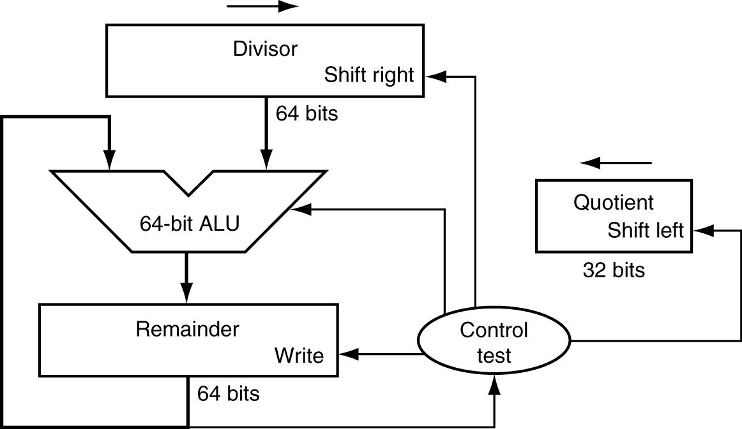
Division Hardware
Initially divisor in left half
Initially dividend

Slide 15
Restoring Division

Slide 16
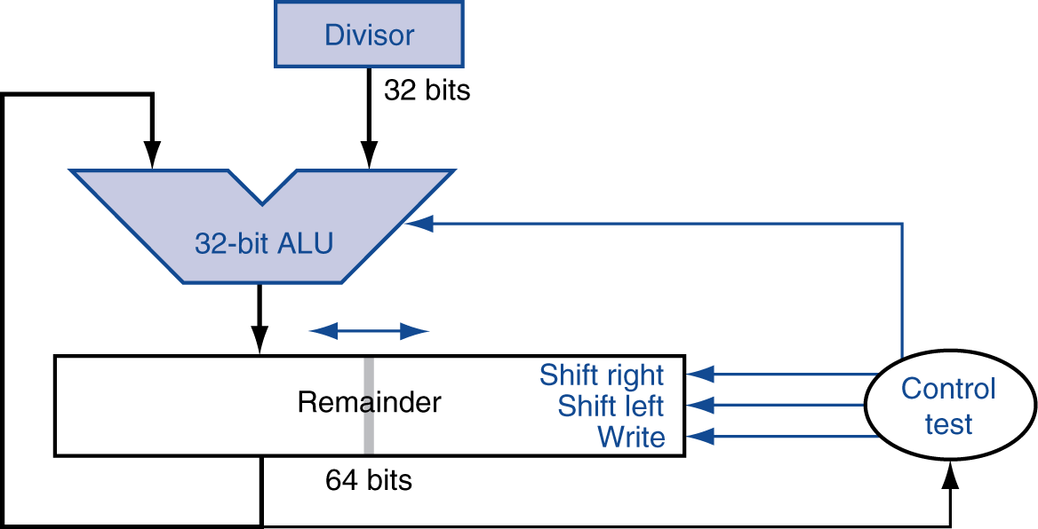
Optimized Divider
One cycle per partial-remainder subtraction
Looks a lot like a multiplier!
Same hardware can be used for both

Slide 17
Faster Division
Can’t use parallel hardware as in multiplier
Subtraction is conditional on sign of remainder
Faster dividers (e.g. SRT devision) generate multiple quotient bits per step
Still require multiple steps

Slide 18
MIPS Division
Use HI/LO registers for result
HI: 32-bit remainder
LO: 32-bit quotient
Instructions
div rs, rt / divu rs, rt
No overflow or divide-by-0 checking
Software must perform checks if required
Use mfhi, mflo to access result

Slide 19
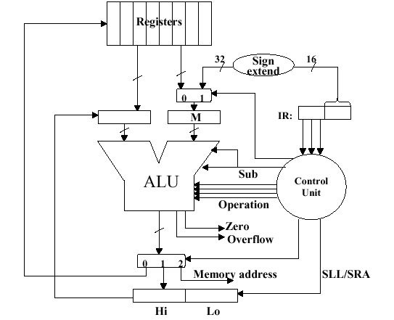
MIPS Architecture for Integer Arithmetic: Multiplication and Division

Slide 20
CS 31007 Autumn 2021 COMPUTER ORGANIZATION AND ARCHITECTURE
Instructors
Rajat Subhra Chakraborty (RSC)
Bhargab B. Bhattacharya (BBB)
Lecture #23, #24: Floating-Point Arithmetic
21 September 2021
Indian Institute of Technology Kharagpur
Computer Science and Engineering
Notes:
Good Morning!
The title of today’s talk is “On some Planar Partitioning Problems”.

Slide 21
Floating Point: Format, Arithmetic, and Hardware Implementation
software
instruction set
hardware

Slide 22
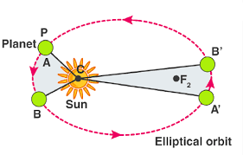

A fundamental theoretical question: Can we prove Kepler’s Law of planetary motion by virtue of experiments?
The IEEE Floating-Point Standard
So far as the theories of mathematics are about reality, they are not certain; so far as they are certain, they are not about reality. - Albert Einstein

Slide 23
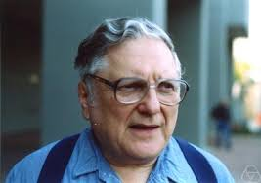
A computation error observed by a UG student led to the ACM Turing Award later ….
1953: Willian Kahan, a UG student of Math at the University of Toronto was simulating numerically the dynamics of the wing controller of an aircraft during take-off and landing
Observed certain unexpected results due to errors in computation
=> concept of floating-point (FP) arithmetic
=> principal architect behind IEEE 754 FP standard (1985)
=> Kahan honored with ACM Turing Award (1989)
William Kahan (1933 - )

Slide 24
Floating-Point Representation
Used to represent real numbers: -34.986×10⁻²², π, e, √2
Defined by IEEE 754 Standard
--- Kahan (1985)
Developed in response to divergence of representations
Portability issues for scientific code
Now almost universally adopted
Two representations
Single precision (32-bit)
Double precision (64-bit)
Infamous Intel Pentium Bug (1994) =>FDIV => loss of $300 Million

Slide 25
IEEE Floating-Point Format
Fraction
≡Mantissa
≡ Significand
single: 8 bits double: 11 bits
single: 23 bits double: 52 bits
S
Exponent (E)
Mantissa (M)
$$N=(−1)^{S}×(1.M)×2^{(Exponent−Bias)}$$
S: sign bit (0 ⇒ non-negative, 1 ⇒ negative)
Normalize significand: 1.0 ≤ |significand| < 2.0
Always has a leading pre-binary-point 1 bit, so no need to represent it explicitly (hidden bit)
Normalized Significand is Mantissa with the “1.” restored
Exponent: excess representation: actual exponent + Bias
Ensures exponent is unsigned
Single: Bias = 127; Double: Bias = 1023
Trade-off between range (E) and precision (M)

Slide 26
IEEE 754 Single-Precision Floating-Point
Representation of floating point numbers in IEEE 754 standard:
single precision
1
8
23
sign
S
E
M
FP-exponent E:
excess 127 binary coding
mantissa:
sign + magnitude, normalized
binary significand w/ hidden
integer bit: 1.M
Actual exponent is e = E – 127
Floating-point exponent E = e + 127
FP-exponent (E) Actual exponent e
00000000 (0) Special use
00000001 (1) - 126
00000010 (2) - 125
…………. …….
01111111 (127) 0
…………. …….
11111110 (254) + 127
11111111 (255) Special use

Slide 27
IEEE 754 floating-point standard
Leading “1” bit of significand is implicit
Exponent is “biased” to make comparison easier
all 0s is smallest exponent; all 1s is largest
bias of 127 for single precision and 1023 for double precision
summary: (–1)^{sign} × (1+significand) × 2^{exponent – bias}
Example 1 (Encoding):
For a given decimal number, construct its FP-representation
decimal: - 0.75
→ binary: - 0.11 = - 1.1 x 2⁻¹ (normalized)
→ Floating-point exponent = - 1 +127 = 126 = 01111110
IEEE single precision:
- 0.75 = 1 01111110 10000000000000000000000

Slide 28
Decoding a floating-point number
S
E
M
Sign indicated by first bit S → (-1)^{S}
Subtract 127 from biased exponent E to obtain the actual exponent e = E - 127
Number in binary = (-1)^{S} 1.M × 2e

Slide 29
Example (Decoding)
0
1000 0000
1000 0000 0000 0000 0000 000
Sign bit is zero: Number is positive
Biased exponent E = 1000 0000 |₂ = 128;
Actual exponent e = E – 127 = 1 → 2¹
Significand → 1.1 (restored the hidden bit)
The number = + 1.1 × 2¹ |₂ = + 11 |₂ = + 3.0|₁₀

Slide 30
Example (Decoding)
1
0111 1110
11000000000000000000000000000
Sign bit is one: Number is negative
Biased exponent E = 0111 1110 |₂ = 126;
Actual exponent e = E – 127 = - 1 → 2⁻¹
Significand → 1.11 (restored the hidden bit)
The number = - 1.11 × 2⁻¹ |₂ = - 0.111 |₂ = -0.875|₁₀

Slide 31
Example (Encoding)
Represent –2 in FP-format
Convert to binary: 10
Normalize: 1.0×2¹
Sign bit is 1
FP-exponent is 127 + 1 = 128 = 10000000_{two}
Mantissa is 00…0
1
1000 0000
0000 0000 0000 0000 0000 000

Slide 32
How do I represent zero then ? → 1. M × 2^{E -127}
0/1
0000 0000
0000 0000 0000 0000 0000 000
FP-exponent (E) Actual exponent e
00000000 (0) Special use
00000001 (1) - 126
00000010 (2) - 125
…………. …….
01111111 (127) 0
…………. …….
11111110 (254) + 127
11111111 (255) Special use
* Any non-zero number that is smaller than the smallest normalized FP-number is a denormal number (consider magnitude only)

Slide 33
Single-Precision Range
Exponents 00000000 and 11111111 reserved
Smallest value
Exponent: 00000001 ⇒ actual exponent = 1 – 127 = –126
Mantissa: 000…00 ⇒ normalized significand = 1.0
±1.0 × 2^{–126} ≈ ±1.2 × 10^{–38}
Largest value
exponent: 11111110 ⇒ actual exponent = 254 – 127 = +127
Mantissa: 111…11 ⇒ normalized significand ≈ 2.0
±2.0 × 2⁺¹²⁷ ≈ ±3.4 × 10⁺³⁸

Slide 34
Double-Precision Range
Exponents 0000…00 and 1111…11 reserved
Smallest value
Exponent: 00000000001 ⇒ actual exponent = 1 – 1023 = –1022
Mantissa : 000…00 ⇒ norm. significand = 1.0
±1.0 × 2^{–1022} ≈ ±2.2 × 10^{–308}
Largest value
Exponent: 11111111110 ⇒ actual exponent = 2046 – 1023 = +1023
Mantissa: 111…11 ⇒ norm significand ≈ 2.0
±2.0 × 2⁺¹⁰²³ ≈ ±1.8 × 10⁺³⁰⁸

Slide 35
Floating-Point Precision
Relative precision
all mantissa-bits are significant
Single: approx 2^{–23}
Equivalent to 23 × log₁₀2 ≈ 23 × 0.3 ≈ 6 decimal digits of precision
Double: approx 2^{–52}
Equivalent to 52 × log₁₀2 ≈ 52 × 0.3 ≈ 16 decimal digits of precision

Slide 36
Single-Precision Normalized Range
Exponents 00000000 and 11111111 reserved
Smallest value
±1.0 × 2^{–126} ≈ ±1.2 × 10^{–38}
Largest value
= ±(2.0 – 2⁻²³) × 2⁺¹²⁷ ≈ ±3.4 × 10⁺³⁸
0/1
0000 0001
0000 0000 0000 0000 0000 000
0/1
1111 1110
1111 1111 1111 1111 1111 111
-1.0 × 2^{–126}
+1.0 × 2^{–126}
≈ -2.0 × 2⁺¹²⁷
≈ +2.0 × 2⁺¹²⁷
representable normalized -ve FP-numbers
-ve
under-flow
+ve
under-flow
representable normalized +ve FP-numbers
-ve overflow
+ve-overflow
0
real line

Slide 37
Single-Precision FP-Denormal Numbers
Exponents 00000000 and 11111111 reserved
Smallest value (normalized)
±1.0 × 2^{–126} ≈ ±1.2 × 10^{–38}
Denormal numbers (gradual underflow)
= ± 0.M × 2⁻¹²⁶ {min: ± 2⁻²³ × 2⁻¹²⁶; max: ± (1-2⁻²³ ) × 2⁻¹²⁶}
0/1
0000 0001
0000 0000 0000 0000 0000 000
0/1
0000 0000
M ≠ 0
≈ -2.0 × 2⁺¹²⁷
-1.0 × 2^{–126}
+1.0 × 2^{–126}
≈ +2.0 × 2⁺¹²⁷
representable normalized -ve FP-numbers
representable normalized +ve FP-numbers
under-flow
under-flow
overflow
overflow
0
real line

Slide 38

Denormal FP-Numbers
Exponent = 000...0 ⇒ hidden bit is 0
N$=(−1)^{S}×(0.Mantissa)×2^{− 126}$
Smaller than normalized numbers
allow for gradual underflow, with diminishing precision
Denormal with mantissa = 000...0
→ +0, -0

Slide 39
Infinities and NaNs
Exponent = 111...1, Mantissa= 000...0
± Infinity
Can be used in subsequent calculations, avoiding need for overflow check
Exponent = 111...1, Mantissa ≠ 000...0
Not-a-Number (NaN)
Indicates illegal or undefined result
e.g., 0.0 / 0.0, √-3
Can be used in subsequent calculations

Slide 40
Floating Point Complexities
Operations are somewhat more complicated
In addition to overflow, we may have “underflow”
Accuracy can be a big problem
IEEE 754 keeps three extra bits, guard, round, and sticky
several rounding modes
Non-zero number divide-by-zero yields “infinity” → overflow
Non-zero number divide-by-infinity yields → underflow
zero divide-by-zero yields “not a number (NaN)”
Implementing the standard can be tricky
Not using the standard can be even worse
Remember the 1994 Pentium FDIV bug; write-off cost US$ 300 M

Slide 41
CS 31007 Autumn 2021 COMPUTER ORGANIZATION AND ARCHITECTURE
Instructors
Rajat Subhra Chakraborty (RSC)
Bhargab B. Bhattacharya (BBB)
Lecture #25: Tutorial on Floating-Point Arithmetic
23 September 2021
Indian Institute of Technology Kharagpur
Computer Science and Engineering
Notes:
Good Morning!
The title of today’s talk is “On some Planar Partitioning Problems”.

Slide 42
Floating-Point Addition
overflow?
1.111
1.111
+ ------
11.110
Consider a 3-digit mantissa binary example
1.000₂ × 2^{–1} + –1.111₂ × 2^{–2}
1. Align binary points
Shift right the number with smaller exponent
1.000₂ × 2^{–1} + –0.111₂ × 2^{–1} ; rightmost 1 is lost
2. Add significands (integer addition)
1.000₂ × 2^{–1} + –0.111₂ × 2–1 = 0.001₂ × 2^{–1}
3. Normalize result & check for over/underflow
1.000₂ × 2^{–4}, with no over/underflow
4. Round and renormalize if necessary
1.000₂ × 2^{–4} (no change) = 0.0625
How do you determine the sign of the result?

Slide 43
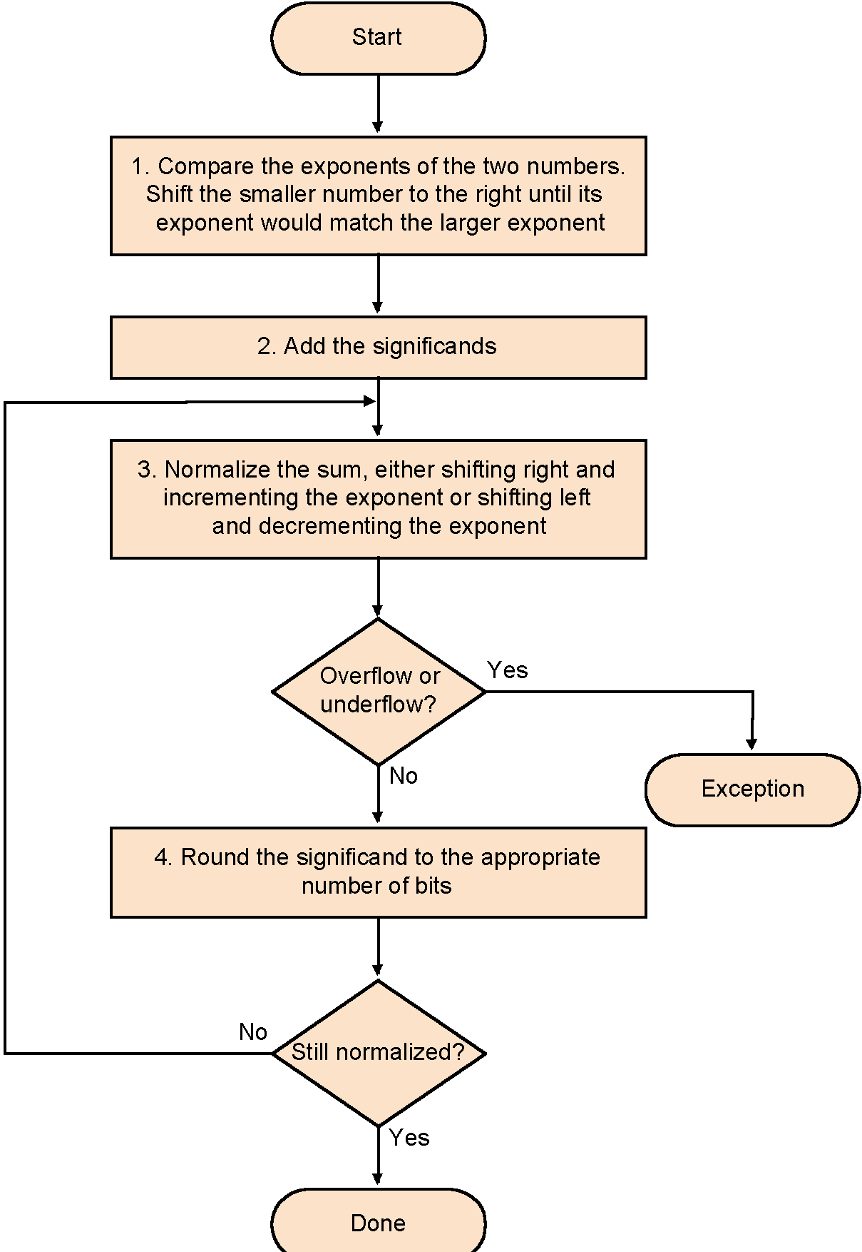
Floating Point Addition
A
0.1000 0000 0000 0000 0000 000
B
1.1000 0000 0000 0000 0000 000
A
0
0111 1111
0000 0000 0000 0000 0000 000
B
0
1000 000
1000 0000 0000 0000 0000 000

Slide 44
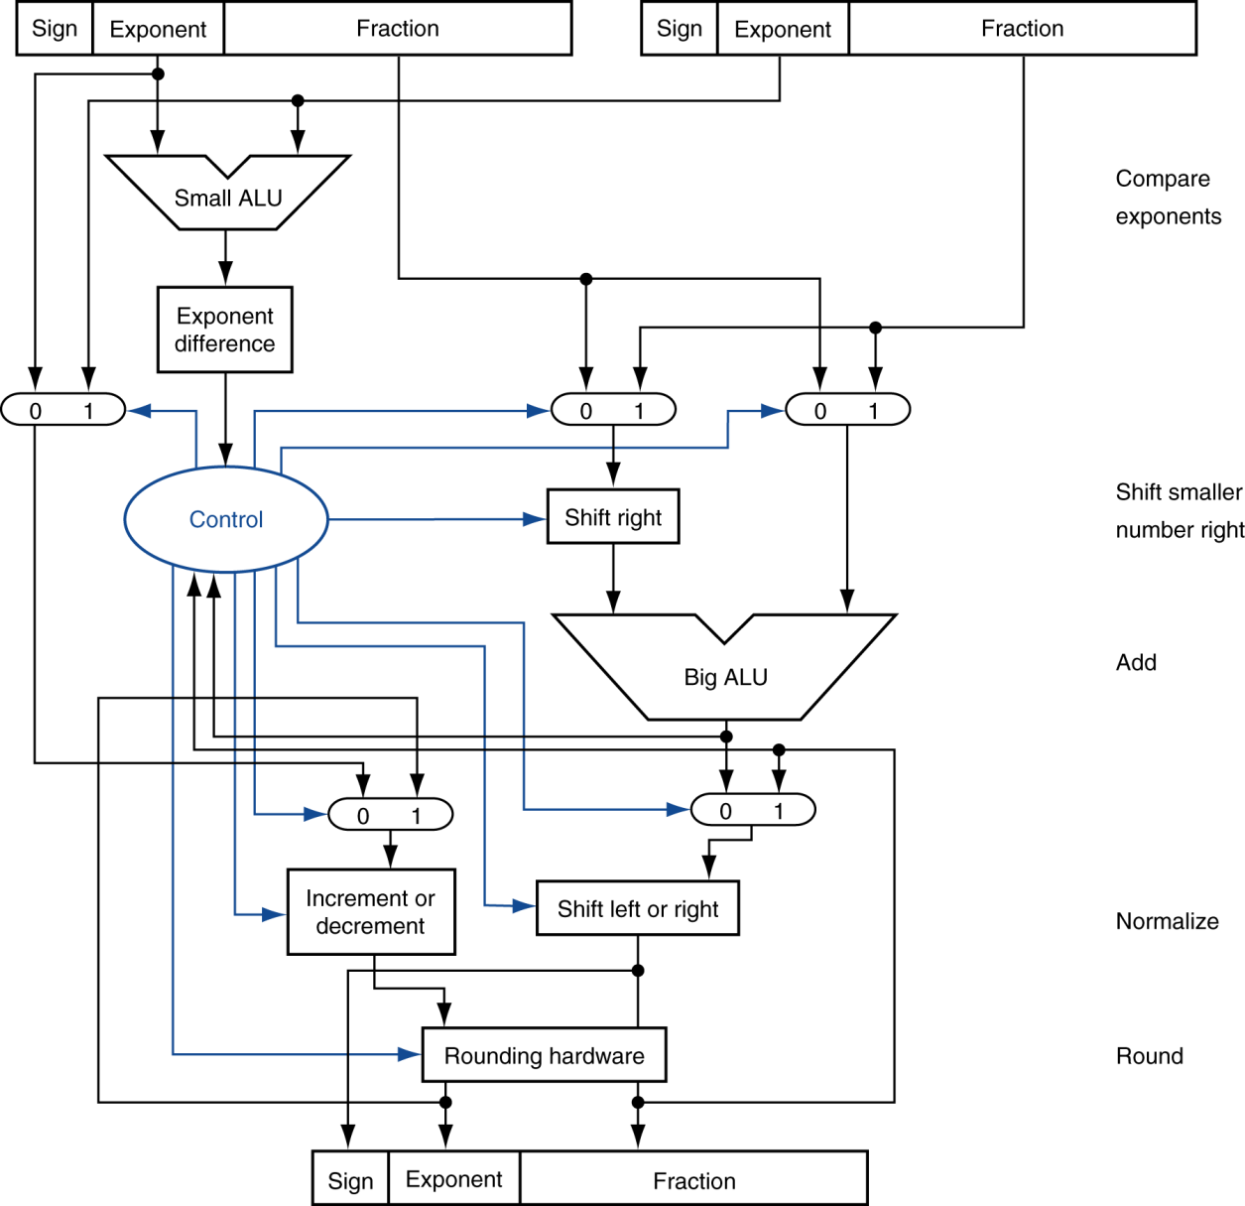
FP Adder Hardware
Step 1
compare exponents
Step 2
equalizing exponents
Integer addition
Step 3
normalize
Step 4
round
Step 5
Result

Slide 45
Three Extra Bits for Internal Use
Three extra bits are added called Guard, Round, Sticky
To achieve accurate arithmetic such as rounding of significand, otherwise some bits would have been lost during right shifts
Reduces hardware without compromising precision
FP fields (32 or 64 bits)
1
1
1
S
E
M
G
R
S
Guard, Round, Sticky
Logical OR of all
shifted-out bits after R

Slide 46
Guard Bit
When we shift bits to the right for alignment, some bits are lost
We may need to shift the result to the left for normalization after operation
Storing the lost bits shifted to the right will make results more accurate during normalization
Round and Sticky bits provide further handles for accurate rounding

Slide 47
Guard, Round, and Sticky Bits
Two extra bits are needed for rounding
Rounding performed after normalizing a result significand
Round bit: appears after the guard bit
Sticky bit: appears after the round bit (OR of all additional bits)
Guard bit
Round bit
1.00000000000000000000000 × 2⁵
-0.01111111111111111111111 1 1 00110 × 2⁵(shifted right 7 bits)
0.10000000000000000000001 1 1 1 × 2⁵ (sum)
1.00000000000000000000000 1 1 1 × 2⁴ (normalized)
OR-reduce
Round bit
Sticky bit
0.11111111111111111111110 × 2⁴
1.11111111111111111111110 × 2³

Slide 48
Floating-Point Multiplication
Now consider a 3-digit mantissa binary example
1.000₂ × 2^{–1} × –1.110₂ × 2^{–2} (0.5 × –0.4375)
1. Add exponents
Unbiased: –1 + –2 = –3
Biased: (–1 + 127) + (–2 + 127) = –3 + 254 – 127 = –3 + 127
2. Multiply significands
1.000₂ × 1.110₂ = 1.1102 ⇒ 1.110₂ × 2^{–3}
3. Normalize result & check for over/underflow
1.110₂ × 2^{–3} (no change) with no over/underflow
4. Round and renormalize if necessary
1.110₂ × 2^{–3} (no change)
5. Determine sign: +ve × –ve ⇒ –ve
–1.110₂ × 2^{–3} = –0.21875

Slide 49
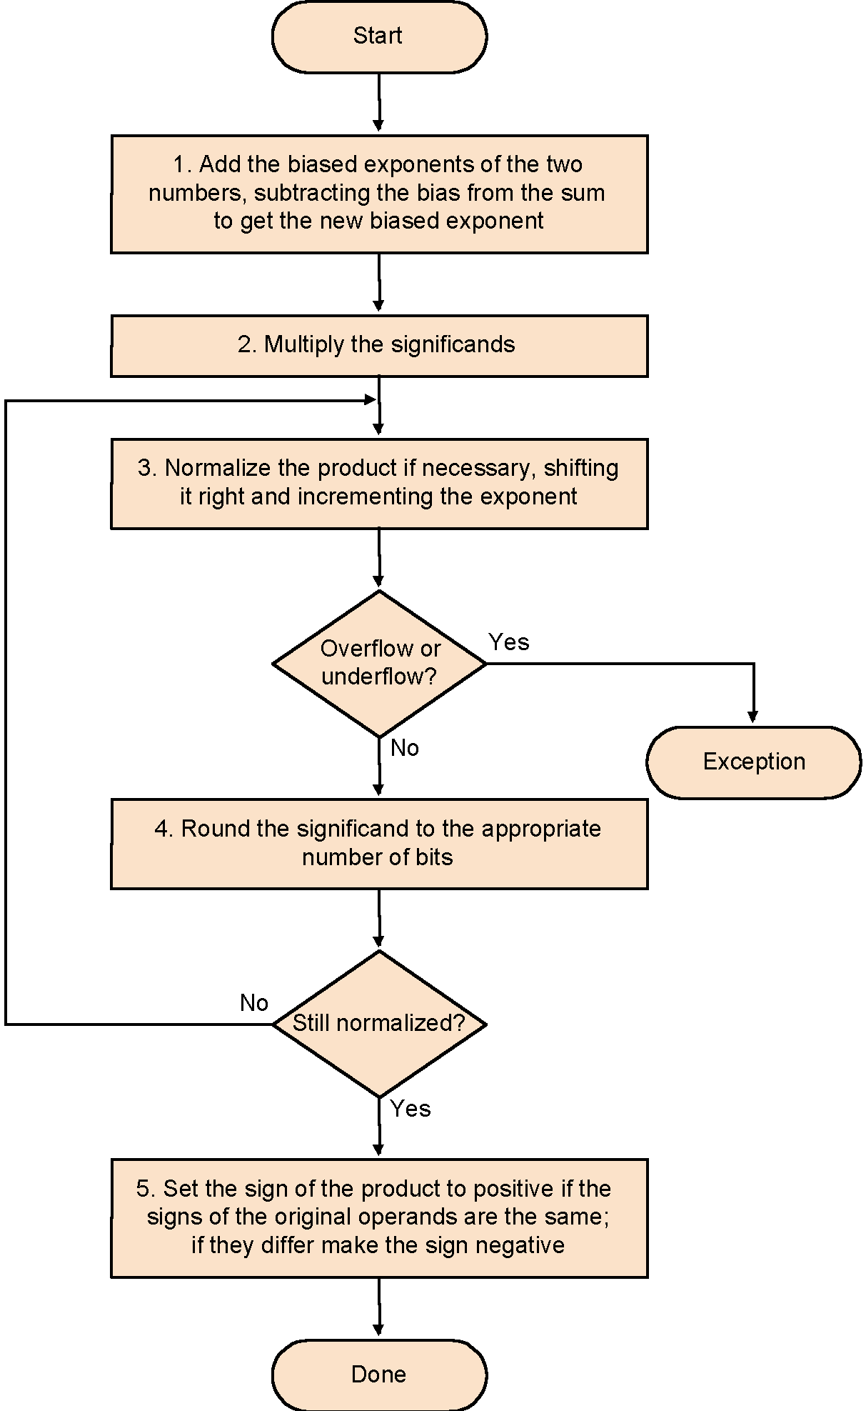
Floating Point Multiplication

Slide 50
Optimized Integer Multiplier
Perform steps in parallel: add/shift
One cycle per partial-product addition
That’s ok, if frequency of multiplications is low

Slide 51
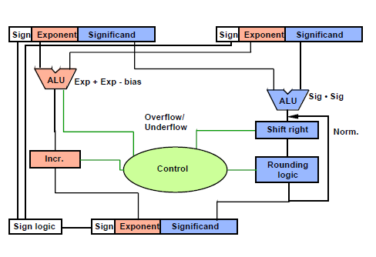
FP Multiplier – Hardware Realization
integer multiplier

Slide 52
FP Arithmetic Hardware
FP multiplier is of similar complexity to FP adder
But uses a multiplier for significands instead of an adder
FP arithmetic hardware usually does
Addition, subtraction, multiplication, division, reciprocal, square-root
FP ↔ integer conversion
Operations usually takes several cycles
Can be pipelined

Slide 53
FP Instructions in MIPS
FP hardware is Co-processor 1
Adjunct processor that extends the ISA
Separate FP registers
32 single-precision: $f0, $f1, … $f31
Paired for double-precision: $f0/$f1, $f2/$f3, …
Release 2 of MIPs ISA supports 32 × 64-bit FP reg’s
FP instructions operate only on FP registers
Programs generally don’t do integer ops on FP data, or vice versa
More registers with minimal code-size impact
FP load and store instructions
lwc1, swc1,
e.g., lwc1 $f8, 32($sp)

Slide 54
FP Instructions in MIPS
Single-precision arithmetic
add.s, sub.s, mul.s, div.s
e.g., add.s $f0, $f1, $f6
Double-precision arithmetic
add.d, sub.d, mul.d, div.d
e.g., mul.d $f4, $f4, $f6
Single- and double-precision comparison
Branch on FP condition code true or false

Slide 55
FP Example: °F to °C
C code:
float f2c (float fahr) { return ((5.0/9.0)*(fahr - 32.0)); }
fahr in $f12, result in $f0, literals in global memory space
Compiled MIPS code:
f2c: lwc1 $f16, const5($gp) lwc2 $f18, const9($gp) div.s $f16, $f16, $f18 lwc1 $f18, const32($gp) sub.s $f18, $f12, $f18 mul.s $f0, $f16, $f18 jr $ra

Slide 56
Summary
Computer arithmetic is constrained by limited precision
Bit patterns have no inherent meaning but standards do exist
two’s complement
IEEE 754 floating point
Computer instructions determine “meaning” of the bit patterns
Performance and accuracy are important so there are many complexities and implementation challenges in real machines

Slide 57

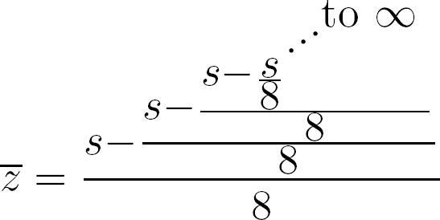
Problem: Compute z = ⎣s/9⎦ using only integer addition/subtraction, and shift; s: integer
Division operation not allowed
Hardware requirement:
Only shifter and integer adder;
Iterate a few times to obtain a close approximation!
z
z = (s – z )/8
8z = s – z
z = s/9

