Slide 1
SuViv SER 502 Project
Suhas Chandrashekar
Vivek Jadon
(Group 12)

Slide 2
Key Aspects of SuViv
Expressions
Arithmetic
Relational
Modular Programming
Control Statements
Looping constructs
Recursion
Data Types
Int
Bool
String
Abstract Data Type – Stack
Scope Resolution

Slide 3
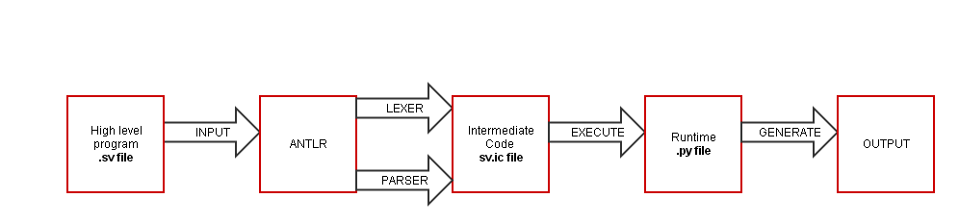
Language Design Flow

Slide 4
Tools and Environment
ANTLR 4 - Another Tool for Language Recognition
JAVA - Intermediate Code Generation
Python - Runtime Handling

Slide 5
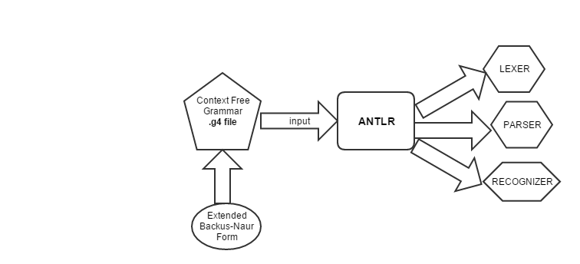
ANTLR 4 : Lexer, Parser and Recognizer

Slide 6
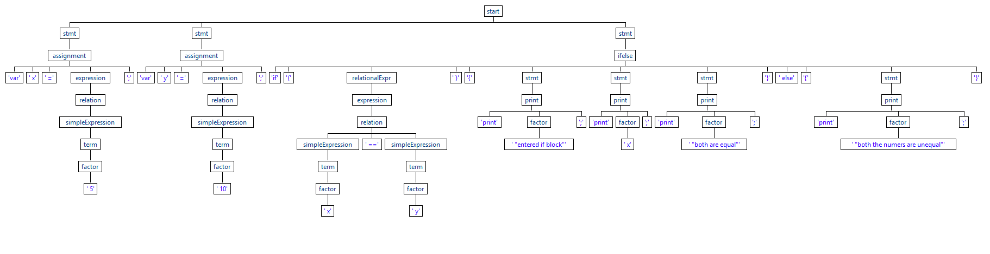
Parse Tree: Sample if…else program

Slide 7
Intermediate Code Generation
SuVivListener is the interface generated by ANTLR4 which is implemented by SuVivBaseListener.
SuVivWalker class extends SuVivBaseListener class for Intermediate code generation
SuVivWalker scans the parse tree and handles the corresponding matched parse rule.
This way, it generates intermediate instructions.

Slide 8
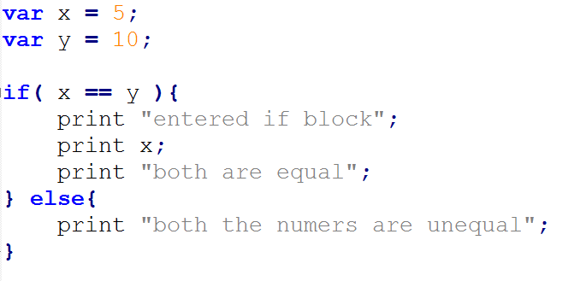
Sample Programs If-else Construct

Slide 9
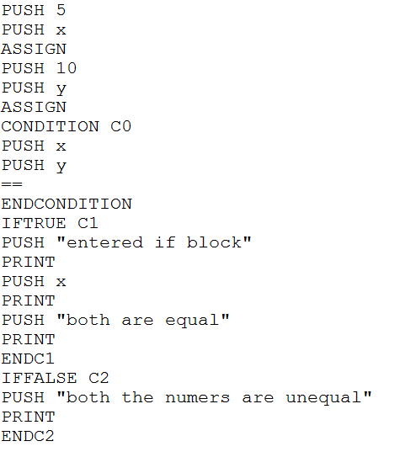
Intermediate Code Sample if-else Construct

Slide 10
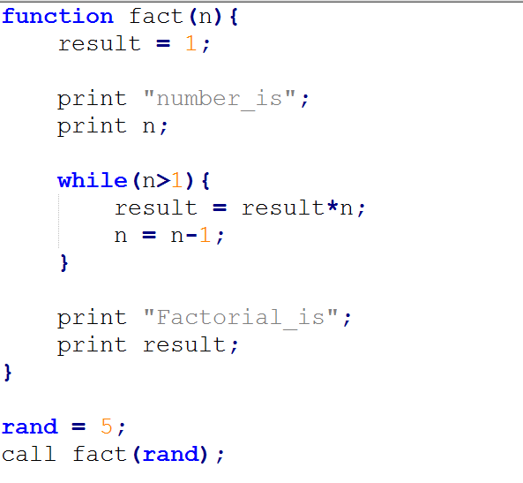
Factorial of a number

Slide 11
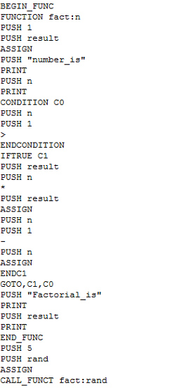
Factorial Program

Slide 12
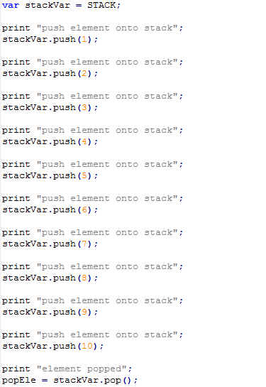
Stack Data Structure Implementation

Slide 13
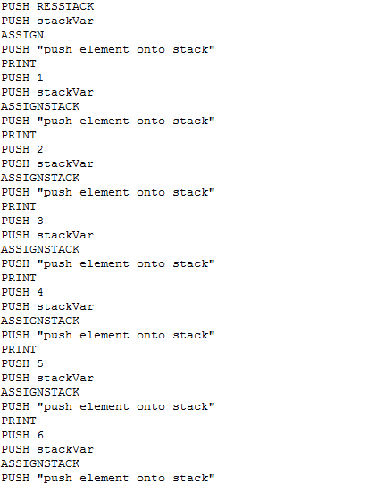
Stack Program

Slide 14
Thank You

