Slide 1
Panther Bridge

Slide 2
1)Wannabe operator deploys PantherBridge contract to the mainnet
One of the operator’s many roles is to aggregate and order transactions into blocks, then to commit a hash of the PantherBridge block to the root chain.
There are many ways to implement PantherBridge. Different PantherBridge chains can have different governance rules, different tokens, methods of storing state, etc. but all PantherBridge chains commit a hash periodically on to the root chain in order to inherit the security guarantees of the root chain.
Deploys Panther PantherBridge Contract to
-----------------------------------------→ Can be Ethereum,
Tron, Binance
Mainnet
.
PantherBridge Operator

Slide 3
2)PantherBridge operator creates a block
One of the operator’s many roles is to aggregate and order transactions into blocks, then to commit a hash of the PantherBridge block to the root chain.
There are many ways to implement PantherBridge. Different PantherBridge chains can have different governance rules, different tokens, methods of storing state, etc. but all PantherBridge chains commit a hash periodically on to the root chain in order to inherit the security guarantees of the root chain.
PantherBridge block < ----------------------------------- PantherBridge Operator ------------------------------------→ Ethereum,Tron, Binance
creates PantherBridge block commits PantherBridge block
hash to root chain

Slide 4
3)Alice, who is a new user, deposits ETH into the PantherBridge contract and is assigned PantherBridgeETH in return
In both of the main PantherBridge designs you can deposit any token and receive that token on the PantherBridge chain. So if Kanye deposits ETH, he’ll get PantherBridgeETH! If he deposits BTC he gets PantherBridgeBTC

Slide 5
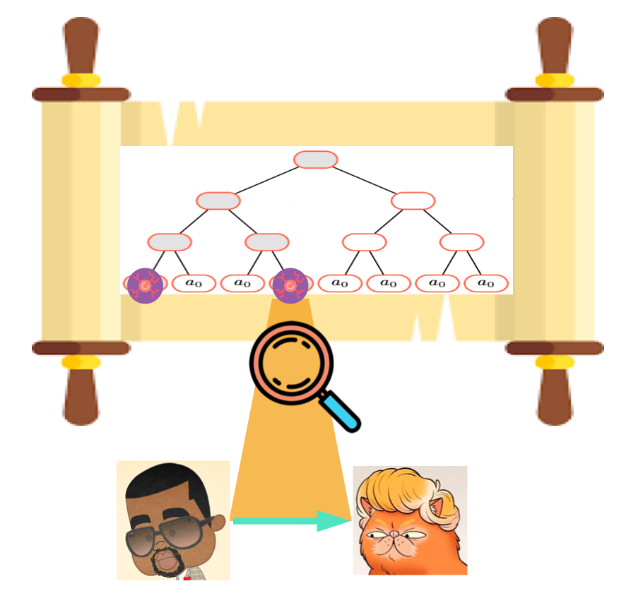
4: Alice sends money to Bob, who is not part of the PantherBridge smart contract already
Alice isn’t limited to sending money only to those who are already members of the PantherBridge contract! He can also send money to Bob, who is an Ethereum whale.In the PantherBridge Cash specification, each token you deposit is assigned a unique ID. These unique IDs are stored in a sparse Merkle tree. The index of the leaf that the coin is assigned to is the only place the coin can be transacted.This makes it extremely easy to check the history of the token because you know where in the tree to look.

Slide 6
Here we zoom in on the index of the token that Alice sent Bob. Alice must include the history of the token when he sends a token. If a token gets transacted many times, this history can get really large!. But for now, this is great for Bob who only has to download the histories of the tokens he cares about
.
5: Bob has two choices: continue spending PantherBridgeETH or create an exit transaction to redeem for ETH on the root chain.
Bob doesn’t need to submit a message to the operator for membership in the PantherBridge contract in order to exit his PantherBridgeETH into ETH. Bob wants to immediately tumble his tokens for anonymity, so he doesn’t want to continue transacting his PantherBridgeETH. He gets a history of the token to prove ownership and includes it in an exit request to the PantherBridge contract. His exit transaction also includes gas fees and a bond as a security deposit against lying. Everything checks out, nobody challenges Bob, and he redeems his PantherBridgeETH for ETH on the root chain.

