Slide 1

Secure Intelligent Electronic Devices (SIEDs)
Carl A. Gunter
With Sam King
and Jianqing Zhang
University of Illinois

Slide 2
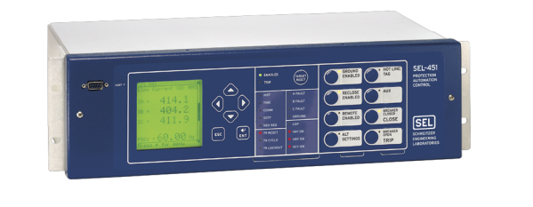
Control Systems, Computers, and Digital Networks
Control systems began many years ago to replace electro-mechanical devices with networked computers
  Improved flexibility, reduced cost
Trend in power distribution network: Advanced Meter Infrastructure (AMI)
Trend in power substations: Intelligent Electronic Devices (IEDs) and Supervisory Control and Data Acquisition (SCADA)

Slide 3

Networked Computers in Aircraft
Current design isolates aircraft and provides two semi-isolated subsystems, one for control and one for entertainment
Next generation will link entertainment network to Internet
Future: link the control system to the enterprise network.
Nick Multari – Boeing/FAA

Slide 4


Generations of Networked Computers in Aircraft
Computer Entertainment
No
Computers
No
Computers
Computer Control
Internet
Enterprise Network

Slide 5
Tradeoffs in Security and Performance
Benefits:
  Monitor airline health
  Update onboard information
  Update “parts”
Drawbacks
  Enterprise network is typically attached to the Internet so the airplane control system may have broad exposure to attack
  Design issues about connecting devices that work in real-time to the Internet

Slide 6
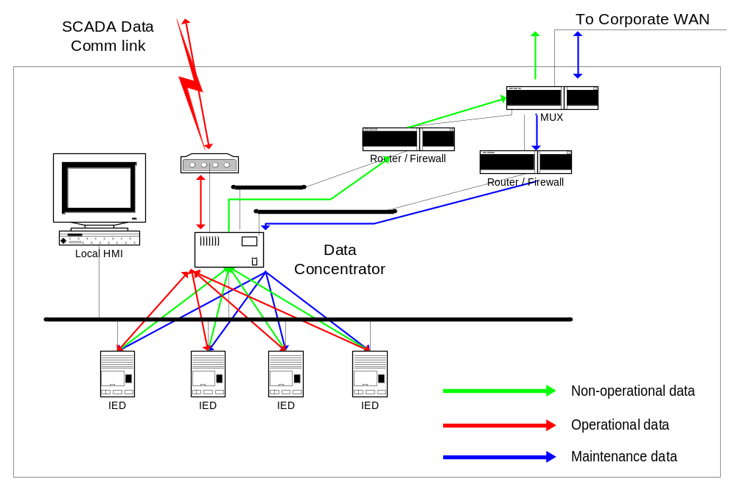
Networked Computers in Power Substations
Scott Mix – NERC/Kema
Notes:
https://fj.crhc.uiuc.edu/iti-wiki/bin/view/TCIP/ScottMix

Slide 7
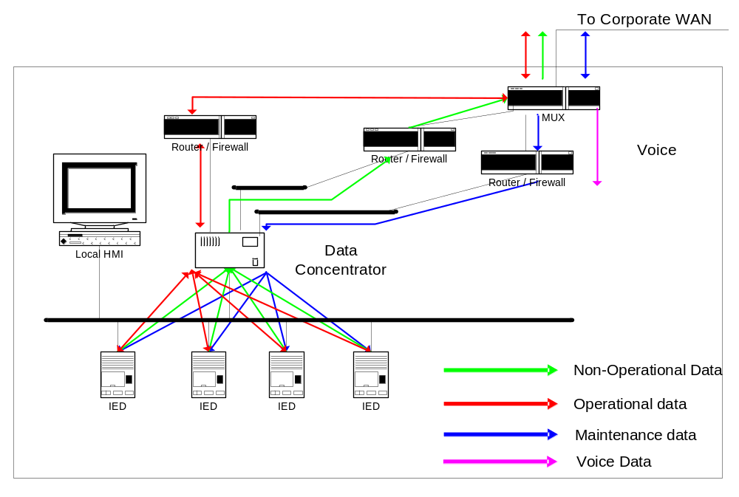
Power Substation Comm (Under Development)

Slide 8
Secure IEDs (SIEDs)
A SIED is an IED that has sufficient security capabilities to be on the Internet
Some (most?) IEDs currently produced are designed to handle some exposure
Many experts fear this exposure: advocate isolating IEDs or hiding them behind a perimeter
This latter approach has many drawbacks
  Sacrifices potential defense in depth
  Mediated access increases complexity
  Access control decisions complicated

Slide 9
SIED Project
The aim of the SIED project is to explore the issues in developing SIEDs.
Approach:
  Use stock platforms: Unix, Vista
  Use stock security techniques and software whenever possible: SSL, IPsec, etc.
  Take account of the special demands on SIEDs: act as IEDs within the IEC 61850 architecture

Slide 10
IEC 61850 Vision
Interoperable communications is an old idea. Recent success story for digital communications: IETF TCP/IP RFCs
IEC 61850 offers an interoperation foundation for power substations

Slide 11
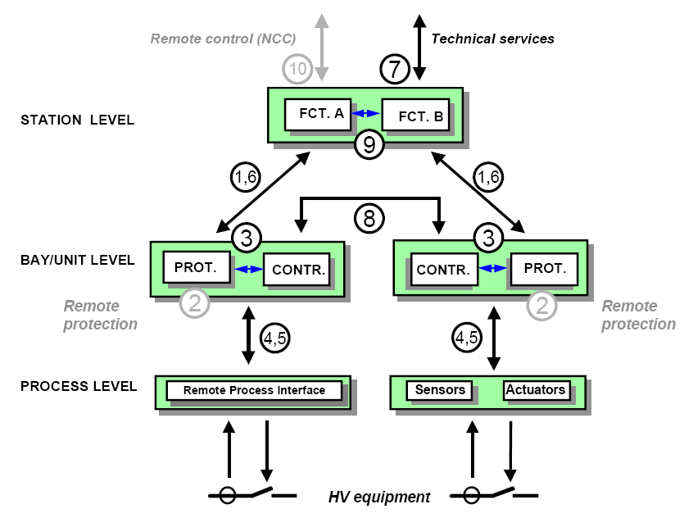
61850 Scope
Protection-data exchange between bay and station level
Protection-data exchange between bay level and remote protection
Data exchange within bay level
CT and VT instantaneous data exchange between process and bay levels
Control-data exchange between process and bay level
Control-data exchange between bay and station level
Data exchange between substation and remote engineer’s workplace
Direct data exchange between the bays especially for fast functions like interlocking
Data exchange within station level
Control-data exchange between substation (devices) and a remote control center

Slide 12








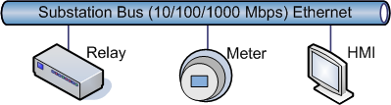
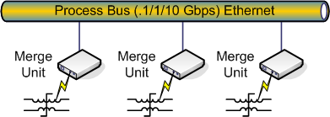
SIED Design Context

Slide 13
Core Design Challenge
No security / networking design has demonstrated this contrasting combination of features
Authenticated
Reliable
Authorized
Encrypted
Seconds and Megabits
Milliseconds and Bytes
Authenticated
Reliable

Slide 14


IEC61850 Protocol Stack
ACSI Core Services
MMS (ISO/IEC 9506)
SMV
GOOSE
Application
Presentation
ISO Presentation (ISO 9576)
ASN.1 (ISO/IEC 8824/8825)
Over Engineered
Session
ISO Session (ISO 8327)
Transport
ISO Transport (ISO/IEC 8073)
Transport Class 0
ISO Adapter (RFC 1006)
Under
TLS (RFC 2246)
TCP (RFC 793)
Engineered
Network
IP (RFC 791)
ARP (RFC 826)
Data Link
Logical Link Control (ISO 8802), 802-3 Ethertype
Media Access Control (ISO 8803)

Slide 15
Experimental IEC61850 Protocol Stack
Saves this much space!
ACSI Core Services
SMV
GOOSE
Application
Web Services
Presentation
XML/SOAP
Transport
HTTP
TLS (RFC 2246)
TLS
TLS
TCP (RFC 793)
TCP
TCP
Network
IP (RFC 791)
ARP (RFC 826)
IP
ARP
IP
ARP
Data Link
Logical Link Control (ISO 8802), 802-3 Ethertype
Media Access Control (ISO 8803)

Slide 16

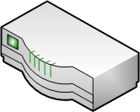
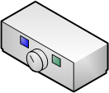
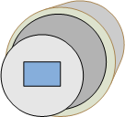
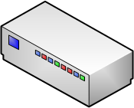





Secure and Reliable LAN Multicast
1
3
2
3
1. SIED sets up tunnel to MR and negotiates session keys
2. SIED sends message to MR using its session key
3. MR multicasts it to intended recipients using their session keys

Slide 17
Target Demonstration
100 SIEDs on a 1Gbps LAN
<4ms for substation multicast with typical substation traffic
500 Kbps and 25ms for technical support to SIEDs under no load
Gateway provides no protections except throttling
Under full attack from Internet, substation operations are unaffected

Slide 18
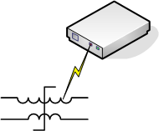
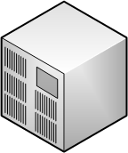
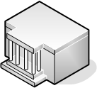

Elements

