Slide 1
Table of Contents
Introduction
Problem Statement
Methodology
Data Collection
Exploratory Data Analysis (EDA)
Statistical/ Machine Learning Models
Results
Challenges
Lessons Learned & Future Work
Conclusion
References
Acknowledgments
Q&A

Slide 2






Data Understanding
Data Collection:
The dataset, obtained from Kaggle, comprises information categorized into
four groups:
Mapping Data Inpatient Data
Beneficiary Data Outpatient Data
The final dataset consists of 558,211 rows and 55 columns
Data Cleaning:
Eliminating columns with 100% missing values, we addressed the remaining missing values based on the specific needs of the problem.
For instance, despite 99.26% of missing values in the DOB column, we retained it to extract the AGE feature, acknowledging that not all patients admitted to the hospital pass away.

Slide 3

Research Questions
1- How does healthcare fraud influence the financial health of the healthcare system and insurers?
2-Does the target variable exhibit signs of class imbalance? If so, what strategies can be employed to address class imbalance?
3-Are certain racial groups disproportionately represented in the dataset?
4-Do the extracted features demonstrate any signs of multicollinearity among them?
5-Does age have a noticeable impact on the total claim amount?
6-How do our response variables perform concerning the target feature?

Slide 4
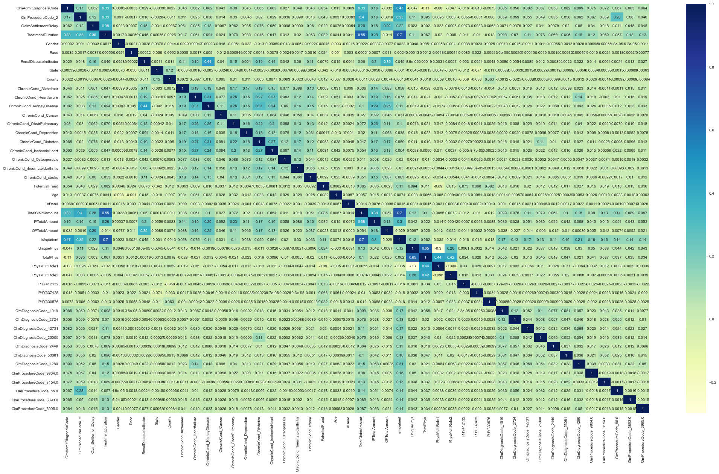
Correlation Analysis

Slide 5
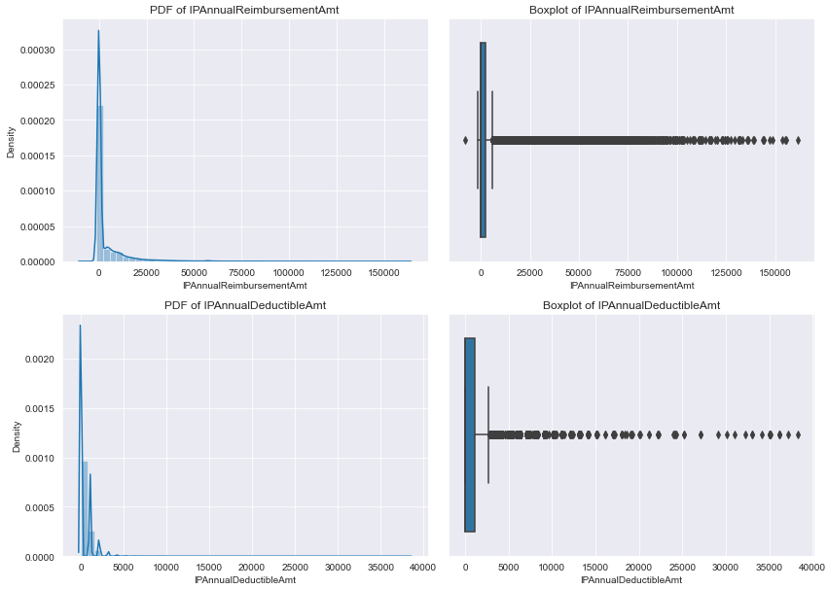
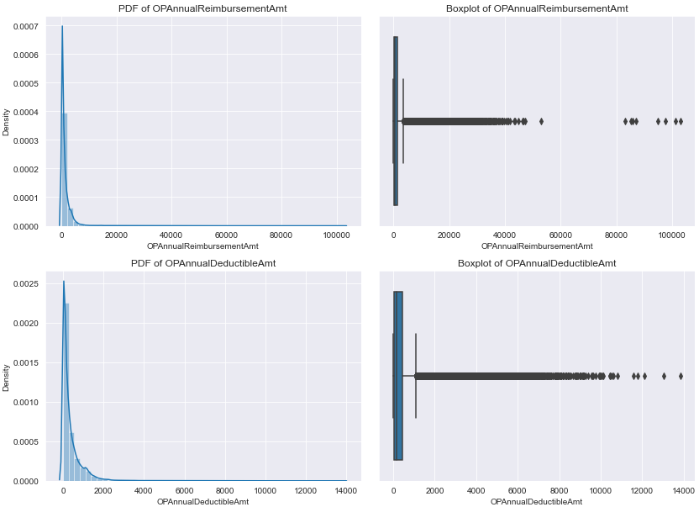
Utilizing Outliers: Unveiling the Hidden Insights in Our Investigation

Slide 6
Methodology: Enhanced Categorical Feature Encoding:
Enhanced Categorical Feature Encoding:
Developing function to create new encoded features for categorical variables based on value frequency across key columns
Physician, Claims Diagnosis Codes, Claims Procedure Codes, Claim Admit Diagnosis Code, and Diagnosis Group Code. Enhancing dataset with additional features for improved analysis and modeling.

Slide 7
Binary Encoding and Response Encoding
Binary Encoding:
Simplifying our dataset for clarity and ease of use.
'Potential Fraud' now represented as 1 for 'Yes' and 0 for 'No'.
'RenalDiseaseIndicator' 'Y' mapped to 1 for uniformity.
Chronic conditions re-encoded: 1 for diagnosed, 0 for not diagnosed.
'Gender' feature updated: 1 for Male, 0 for Female.
Response Encoding:
-Implementing response encoding.
-Targeting 'State' and 'County' categorical features.
-Enhancing efficiency for high-dimensional data.

Slide 8
Feature Filtering and Data Splitting
Feature Filtering
Remove date, amount, and physician-related columns, as new features have been derived from them.
Exclude all unique identifiers from the dataset as they serve only to identify rows and offer no value for analysis or modeling.
Dataset Split for Model Training:
Splitting dataset into training and testing sets.
Allocating 70% of dataset for training, 30% for testing.
Balancing size consideration with effective model training.

Slide 9
Feature Scaling and Oversampling using SMOTE
Feature Scaling:
Standardizing quantitative variables with Standard Scaler.
Utilizing Mean 0 and SD 1 for normalization.
Why Standard Scaler? Robustness against outliers.
Oversampling using SMOTE
Over-sampling increases the number of instances in the minority class.
SMOTE generates synthetic samples rather than replicating existing ones, which can mitigate overfitting.

Slide 10
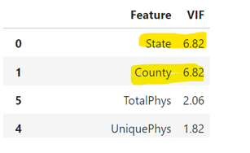
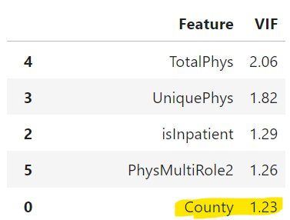
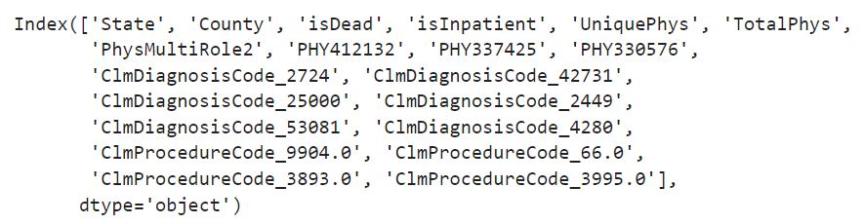
Regression Analysis
Coarse Tuning using RFE
A feature selection is a method in machine learning aimed at boosting model accuracy and curbing overfitting by choosing only the most crucial features for prediction.
In this session, we'll focus on selecting the top 20 features.
Fine tuning using VIF
VIF detects multicollinearity in regression analysis, especially when dealing with multiple predictor variables.

Slide 11
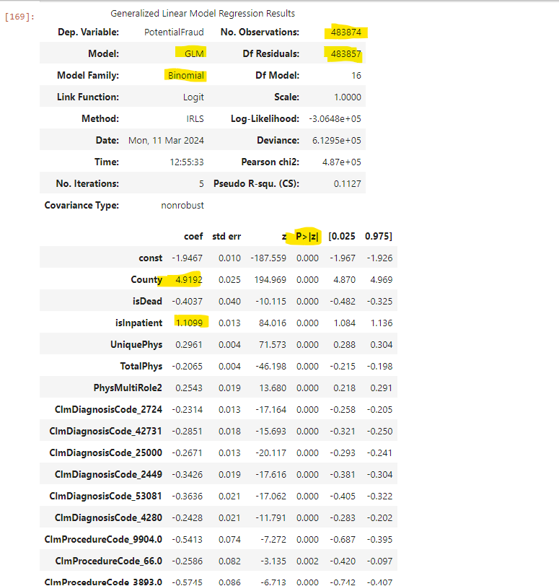
Optimized Model

Slide 12
Top 10 Variables
County (4.9192)
isInpatient (1.1099)
ClmProcedureCode_3893.0 (-0.5745)
ClmProcedureCode_9904.0 (-0.5413)
ClmProcedureCode_3995.0 (-0.5286)
ClmDiagnosisCode_53081 (-0.3636)
ClmDiagnosisCode_2449 (-0.3426)
UniquePhys (0.2961)
ClmDiagnosisCode_42731 (-0.2851)
PhysMultiRole2 (0.2543)

Slide 13
Model Evaluation
Performance Metrics:
1. Confusion Matrix
2. Accuracy, Precision, Recall
3. FNR and FPR
The metrics to focus on:
Recall and FNR
Why Recall or FNR?
Since, we are detecting the fraudulent transactions, False Negative Rate (FNR) should be as low as possible. However, FNR should always be minimum, otherwise, the actual fraud Providers would escape and continue to impact the healthcare system.
Accuracy | Precision | Recall
Number of Correct PredictionsTotal Number of Predictions | True Positives True Positives+False Positives | True Positives True Positives + False Negatives
FNR=False Negatives False Negatives + True Positives | FPR=False Positives False Positives + True Negatives

Slide 14
Machine Learning Outflow:
1. Decision Trees
3. KNN
4. SVM
5. AdaBoost
Concluding the model & ROC-AUC Curve
2.Random Forests
6.CatBoost
7.XgBoost

Slide 15
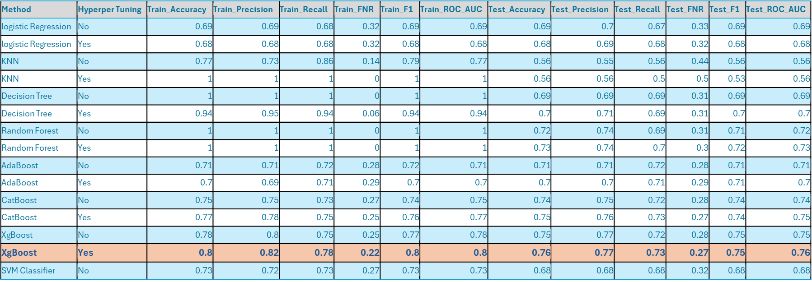
Comprehensive Classifier Comparison Table

Slide 16
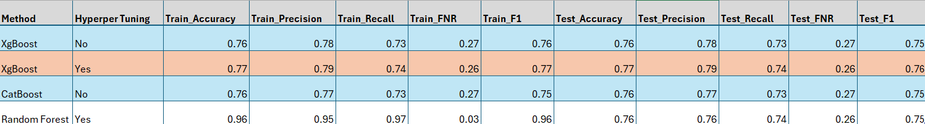
Model Performance on Population Data

Slide 17
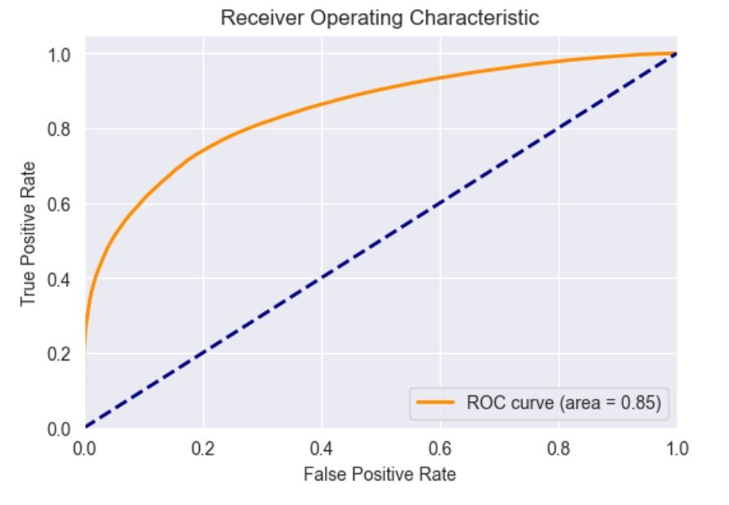
Result
Impressive Performance: Achieved AUC-ROC score of 0.85!
High Recall: Boasts a recall rate of 0.74, ensuring thorough fraud detection.
Low FNR: With an FNR of just 0.26, minimizes unnecessary alerts.
Zero Overfitting: Demonstrates robust generalization to unseen data

Slide 18
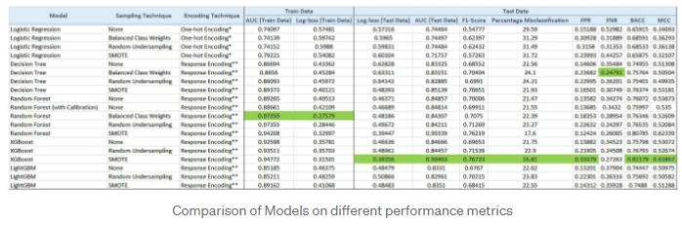
Comparison with the previous published case study
Our best performer model outperforms the case study’s optimal model by nearly 0.02 in terms of recall and FNR.

Slide 19

Confronting the Challenge: Our Strategic Approach
Challenge:
Dealing with categorical variables encoded with specific codes was a major challenge.
These variables constituted around 70% of our dataset, requiring specialized handling.
Traditional encoding methods like one-hot encoding or label encoding weren't sufficient due to the unique encoding scheme.
Here's how we addressed it:
Developed a custom function to generate new encoded features for categorical variables.
Utilized the count of values within the existing set of features to create these new encoded features.

Slide 20
Lessons Learned & Future Work
Lesson Learnt:
Explored the intricacies of healthcare fraud, gaining insights into its prevalence and impact on the industry.
Engaged in an end-to-end Data Science project, delving into data analysis, data mining, and data visualization using tools like Tableau.
Applied Regression Analysis techniques with stats models and advanced machine learning methods using popular libraries such as sci-kit-learn, SVM, and Gradient Boosting.
Future steps and extensions:
Future steps include deploying the model using Flask API for production and exploring cloud deployment options with AWS SageMaker, AWS Glue for ETL, and AWS Redshift for analytical workloads.
Potential extensions involve implementing advanced ensemble modeling techniques like stacking and cascading, as well as developing a deep Multi-layer Perceptron (MLP) Model for enhanced performance.
Enhancing model interpretability using advanced techniques such as SHAP or LIME remains a key focus area for future exploration.

Slide 21

Conclusion
Our project has successfully enhanced healthcare fraud detection within a strict 3-month timeframe. The XGBoost model emerged as the top performer, achieving a recall of 0.74, an FNR of 0.26, and an ROC-AUC score of 0.85.
Our efforts contribute to a secure healthcare ecosystem, optimizing resource allocation and enhancing trust. Moving forward, our project sets a precedent for future endeavors in combating healthcare fraud.

Slide 22
References
1-Thornton, D., Mueller, R. M., Schoutsen, P., & Van Hillegersberg, J. (2013). Predicting Healthcare Fraud in Medicaid: A Multidimensional data model and analysis Techniques for Fraud Detection. Procedia Technology, 9, 1252–1264. https://doi.org/10.1016/j.protcy.2013.12.140
2- Johnson, J.M., Khoshgoftaar, T.M. Data-Centric AI for Healthcare Fraud Detection. SN COMPUT. SCI. 4, 389 (2023). https://doi.org/10.1007/s42979-023-01809-x
3- Mary, A.J., Claret, S.P.A. Design and development of big data-based model for detecting fraud in healthcare insurance industry. Soft Comput 27, 8357–8369 (2023). https://doi.org/10.1007/s00500-023-08296-5
4- Herland, M. A. (2019). BIG DATA ANALYTICS AND ENGINEERING FOR MEDICARE FRAUD DETECTION (By Florida Atlantic University; T. M. Khoshgoftaar, Ed.). https://fau.digital.flvc.org/islandora/object/fau%3A41354/datastream/OBJ/view/Big_Data_Analytics_and_Engineering_for_Medicare_Fraud_Detection.pdf

Slide 23

Acknowledgments
We extend our heartfelt gratitude to Professor Dr.Khald Aboalayon for their invaluable guidance and unwavering support throughout this project.
We also express our appreciation to our TA Shreyas and fellow students for their insightful questions and thought-provoking discussions.

Slide 24

It’s time for Q&A
Fire away your questions – let’s turn confusion into clarity with a style!

Slide 25

Suhas Basavaraju
Reshmitha Yerra

