Slide 1
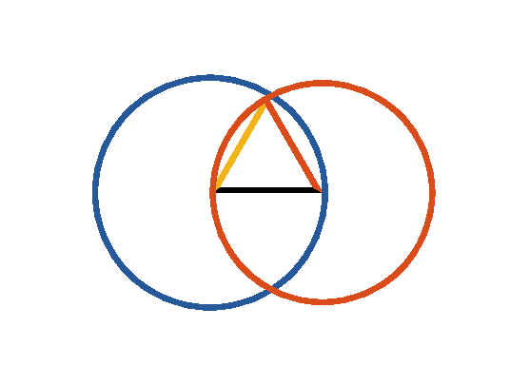

Book I. Prop. I. Prob. Statement
On a given finite straight line (
) to
describe an equilateral triangle.

Slide 2








Book I. Prop. I. Prob. Proof
Describe
and
(post. III);
draw
and
(post. I).
Then will
be equilateral.
For
(def. 15);
and
(def. 15);
(ax. I);
and therefore
is the equilateral triangle
required. Q. E. D.

