Slide 1
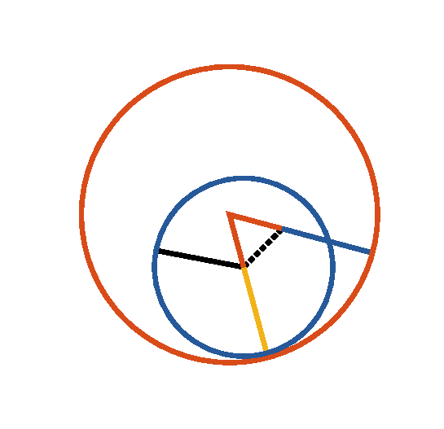

Book I. Prop. II. Prob. Statement
From a given point (
), to draw a
straight line equal to a given straight line (
).

Slide 2












Book I. Prop. II. Prob. Proof
Draw
(post. I), describe
(pr. I.1),
produce
(post. II),
describe
and
(post. III);
produce
(post. II),
then
is the line required.
For
(def. 15),
and
(const.),
(post. III),
but (def. 15)
;
drawn from the given point (
), is equal to
the given line
. Q. E. D.

