Slide 1
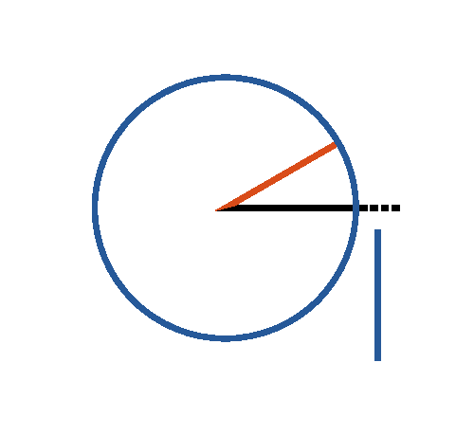


Book I. Prop. III. Prob. Statement
From the greater (
) of two given
straight lines, to cut off a part equal to the
less (
).

Slide 2






Book I. Prop. III. Prob. Proof
Draw
(pr. I.2);
describe
(post. III),
then
.
For
(def. 15),
and
(const.);
(ax. I). Q. E. D.

