Slide 1
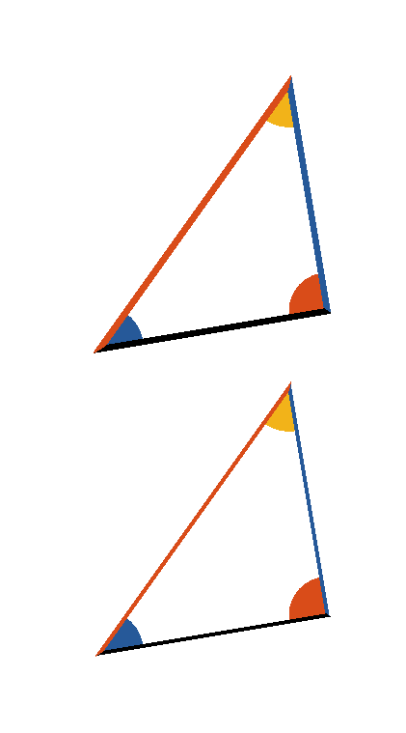









Book I. Prop. IV. Theor. Statement
If two triangles have two sides of the one
respectively equal to two sides of the
other, (
to
and
to
) and the angles (
and
)
contained by those equal sides also equal;
then their bases or their sides (
and
) are also equal: and the remaining
angles opposite to equal sides are
respectively equal (
and
):
and the triangles are equal in every respect.

Slide 2



Book I. Prop. IV. Theor. Proof
Let two triangles be conceived, to be so placed, that
the vertex of one of the equal angles (
or
)
shall fall upon that of the other, and
to
coincide with
, then will
coincide
with
if applied: consequently
will
coincide with
, or two straight lines will
enclose a space, which is impossible (ax. X),
therefore
,
and
, and as the triangles
and
coincide,
when applied, they are equal in every respect. Q. E.
D.

