Slide 1
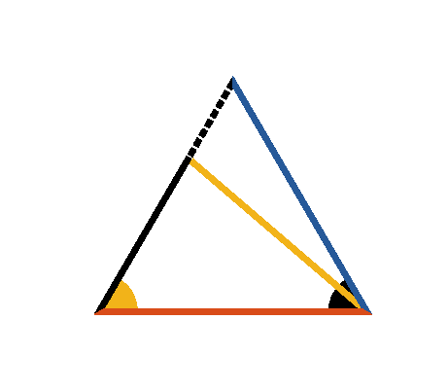





Book I. Prop. VI. Theor. Statement
In any triangle (
) if two angles (
and
) are equal, the sides (
and
) opposite to them are also equal.

Slide 2






Book I. Prop. VI. Theor. Proof
For if the sides be not equal, let one of them
be
greater than the other
, and from it cut off
(pr. I.3), draw
. in
and
,
(const.),
(hyp.)
and
common,
the triangles are equal (pr. I.4)
a part equal to the whole, which is absurd;
neither of the sides
or
is greater than the
other,
hence they are equal. Q. E. D.

