Slide 1
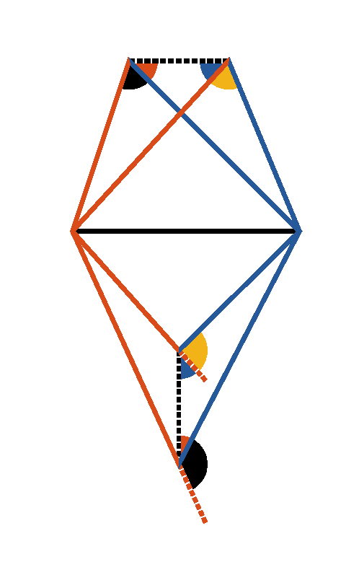



Book I. Prop. VII. Theor. Statement
On the same base (
), and on the
same side of it there cannot be two
triangles having their conterminous sides (
and
,
and
)
at both extremities of the base, equal to
each other.

Slide 2





Book I. Prop. VII. Theor. Proof
When two triangles stand on the same base, and on
the same side of it, the vertex of the one shall either
fall outside of the other triangle, or within it; or,
lastly, on one of its sides. If it be possible let the
two triangles be constructed so that
, then draw
and,
(pr. I.5)
and
therefore the two
triangles cannot have their conterminous sides
equal at both extremities of the base. Q. E. D.

