Slide 1
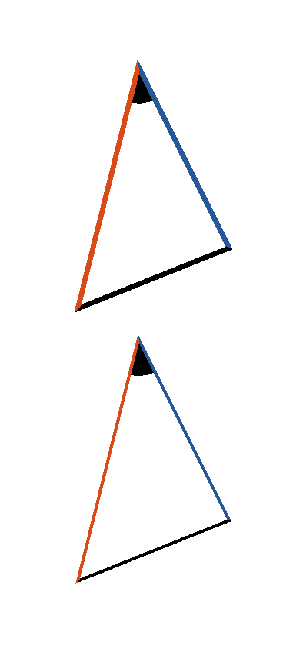



Book I. Prop. VIII. Theor. Statement
If two triangles have two sides of the one
respectively equal to two sides of the other
(
and
) and also their bases (
), equal; then the
angles (
and
) contained by
their equal sides are also equal.

Slide 2







Book I. Prop. VIII. Theor. Proof
If the equal bases
and
be
conceived to be placed one upon the other, so that
the triangles shall lie at the same side of them, and
that the equal sides
and
,
and
be conterminous, the vertex of the
one must fall on the vertex of the other; for to
suppose them not coincident would contradict the
last proposition. Therefore sides
and
, being coincident with
and
,
. Q. E. D.

