Slide 1
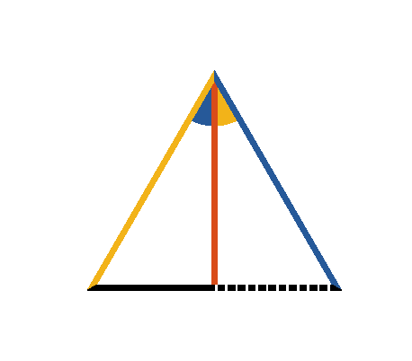

Book I. Prop. X. Prob. Statement
To bisect a given finite straight line (
).

Slide 2
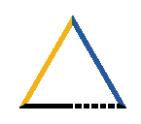




Book I. Prop. X. Prob. Proof
Construct
(pr. I.1),
draw
, making
(pr. I.9). Then
by (pr. I.4), for
(const.)
and
common to the two triangles.
Therefore the given line is bisected. Q. E. D.

