Slide 1
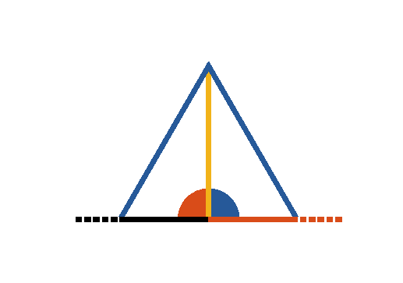

Book I. Prop. XI. Prob. Statement
From a given point ([middle]D), in a given
straight line (
), to draw a
perpendicular.

Slide 2







Book I. Prop. XI. Prob. Proof
Take any point ([middle]C) in the given line,
cut off
(pr. I.3),
construct
(pr. I.1),
draw
and it shall be perpendicular to the
given line.
For
(const.)
(const.)
and
common to the two triangles.
Therefore
(pr. I.8)
(def. 10). Q. E. D.

