Slide 1
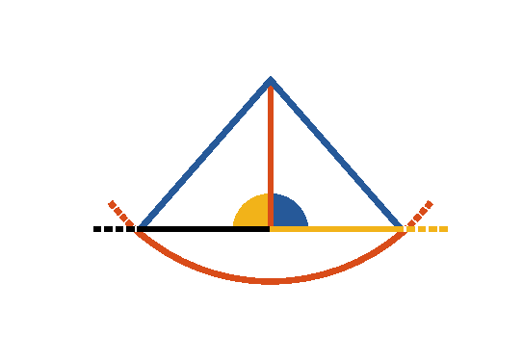

Book I. Prop. XII. Prob. Statement
To draw a straight line perpendicular to a
given indefinite straight line (
)
from a given point (A) without.

Slide 2









Book I. Prop. XII. Prob. Proof
With the given point A as centre, at one side of the line,
and any distance
capable of extending to the other
side, describe
.
Make
(pr. I.10),
draw
,
and
,
then
.
For (pr. I.8) since
(const.),
common to both,
and
(def. 15),
, and
(def. 10). Q. E. D.

