Slide 1
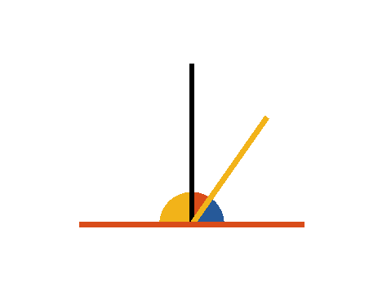


Book I. Prop. XIII. Theor. Statement
When a straight line (
) standing
upon another straight line (
) makes
angles with it; they are either two right
angles or together equal to two right
angles.

Slide 2







Book I. Prop. XIII. Theor. Proof
If
be to
then,
and
(def. 10),
but if
be not to
,
draw
(pr. I.11);
(const.),
(ax. II)
. Q. E. D.

