Slide 1
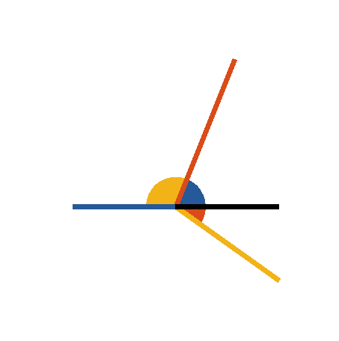





Book I. Prop. XIV. Theor. Statement
If two straight lines (
and
),
meeting a third straight line (
), at
the same point, and at opposite sides of it,
make with it adjacent angles (
and
)
equal to two right angles; these straight
lines lie in one continuous straight line.

Slide 2






Book I. Prop. XIV. Theor. Proof
For, if possible let
, and not
,
be the continuation of
,
then
but by the hypothesis
(ax. III); which is absurd (ax. IX).
is not the continuation of
, and
the like may be demonstrated of any other straight
line except
,
is the continuation
of
. Q. E. D.

