Slide 1
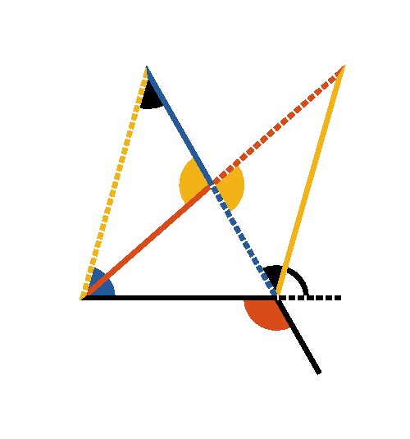




Book I. Prop. XVI. Theor. Statement
If a side of a triangle (
) is produced, the
external angle (
) is greater than
either of the internal remote angles (
or
).

Slide 2















Book I. Prop. XVI. Theor. Proof
Make
(pr. I.10);
draw
and produce it until
;
draw
.
In
and
;
,
and
(const.,
pr. I.15),
(pr. I.4),
.
In like manner it can be shown, that if
be produced,
and therefore
which is
is
. Q. E. D.

