Slide 1
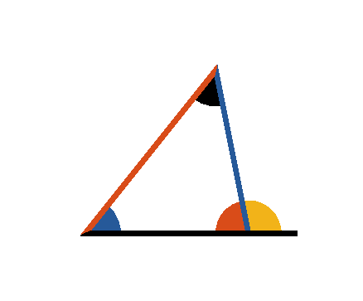

Book I. Prop. XVII. Theor. Statement
Any two angles of a triangle
are
together less than two right angles.

Slide 2




Book I. Prop. XVII. Theor. Proof
Produce
, then will
.
But
(pr. I.16)
, and in the same manner it may be
shown that any other two angles of the triangle
taken together are less than two right angles. Q. E.
D.

