Slide 1
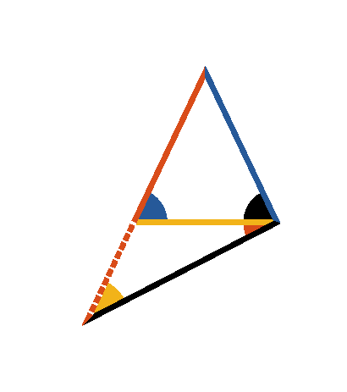




Book I. Prop. XVIII. Theor. Statement
In any triangle
if one side
be
greater than another
, the angle
opposite to the greater side is greater than
the angle opposite to the less. I.e.
.

Slide 2





Book I. Prop. XVIII. Theor. Proof
Make
(pr. I.3), draw
.
Then will
(pr. I.5);
but
(pr. I.16)
and much more
is
. Q. E. D.

