Slide 1
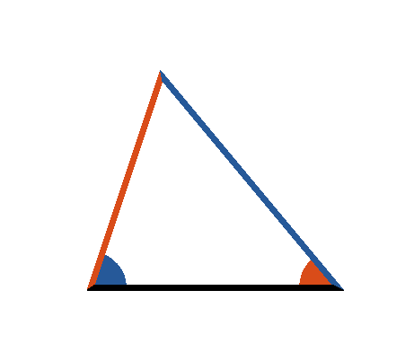





Book I. Prop. XIX. Theor. Statement
If in any triangle
one angle
be
greater than another
the side
which is opposite to the greater angle, is
greater than the side
opposite the
less.

Slide 2






Book I. Prop. XIX. Theor. Proof
If
be not greater than
then must
or
.
If
then
(pr. I.5);
which is contrary to the hypothesis.
is not less than
; for if it were,
(pr. I.18)
which is contrary to the hypothesis:
. Q. E. D.

