Slide 1
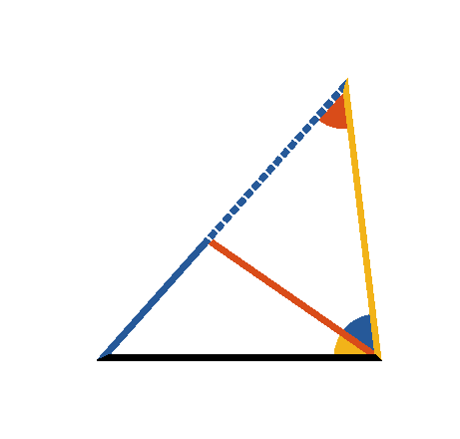




Book I. Prop. XX. Theor. Statement
Any two sides
and
of a
triangle
taken together are greater
than the third side (
).

Slide 2







Book I. Prop. XX. Theor. Proof
Produce
, and
make
(pr. I.3);
draw
.
Then
(const.),
(pr. I.5)
(ax. IX)
(pr. I.19)
and
. Q. E. D.

