Slide 1
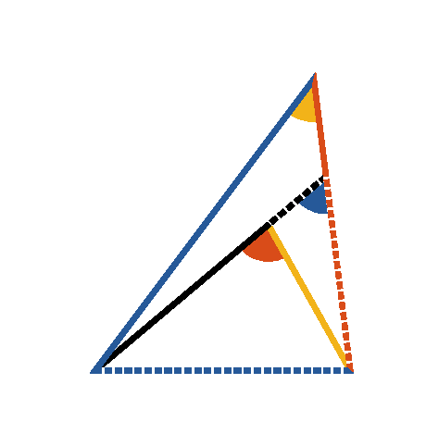


Book I. Prop. XXI. Theor. Statement
If from any point ([middle]D) within a
triangle
, straight lines be drawn to the
extremities of one side (
), these
lines must be together less than the other
two sides, but must contain a greater angle.

Slide 2









Book I. Prop. XXI. Theor. Proof
Produce
,
(pr. I.20),
add
to each,
(ax. IV)
in the same manner it may be shown that
,
,
which was to be proved.
Again
(pr. I.16),
and also
(pr. I.16),
. Q. E. D.

