Slide 1
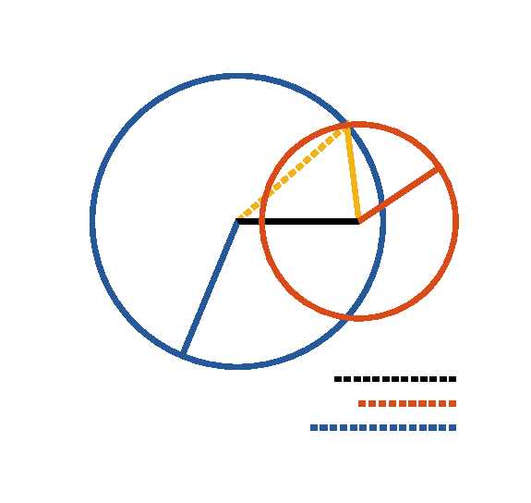

Book I. Prop. XXII. Prob. Statement
Given three right lines
the sum of
any two greater than the third, to
construct a triangle whose sides shall be
respectively equal to the given lines.

Slide 2








Book I. Prop. XXII. Prob. Proof
Assume
(pr. I.3).
With
and
as radii, describe
and
(post. III);
draw
and
,
then will
be the triangle required.
Q. E. D.

