Slide 1
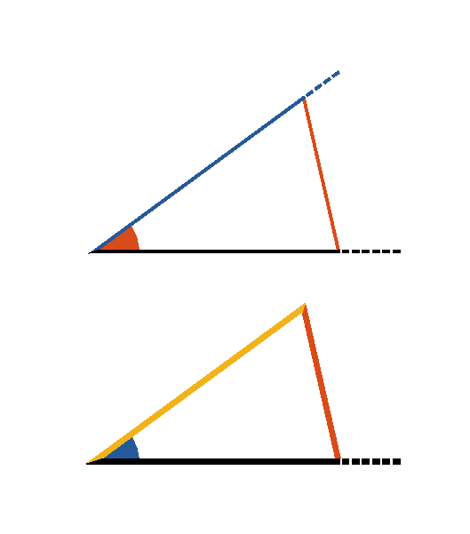


Book I. Prop. XXIII. Prob. Statement
At a given point (F) in a given straight line
(
), to make an angle equal to a
given rectilinear angle (
).

Slide 2






Book I. Prop. XXIII. Prob. Proof
Draw
between any two points in the legs
of the given angle.
Construct
(pr. I.22)
so that
,
and
.
Then
(pr. I.8). Q. E. D.

