Slide 1
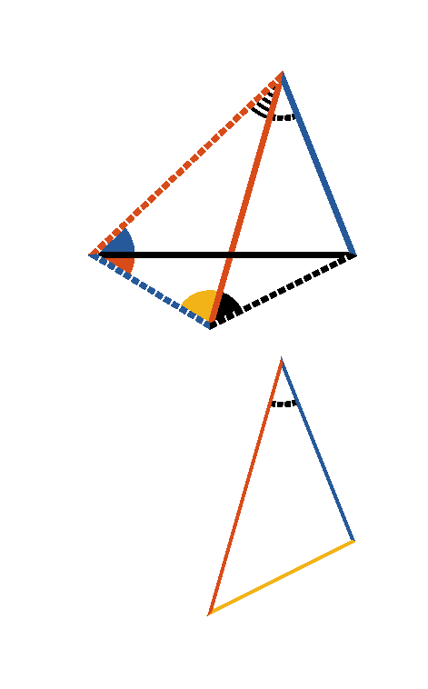








Book I. Prop. XXIV. Theor. Statement
If two triangles have two sides of the one
respectively equal to two sides of the other
(
to
and
to
), and if one of the angles (
)
contained by the equal sides be greater
than the other (
), the side (
)
which is opposite to the greater angle is
greater than the side (
) which is
opposite to the less angle.

Slide 2











Book I. Prop. XXIV. Theor. Proof
Make
(pr. I.23),
and
(pr. I.3),
draw
and
.
(ax. I, hyp., const.)
(pr. I.5)
but
,
and
,
(pr. I.19)
but
(pr. I.4)
. Q. E. D.

